Slide 1
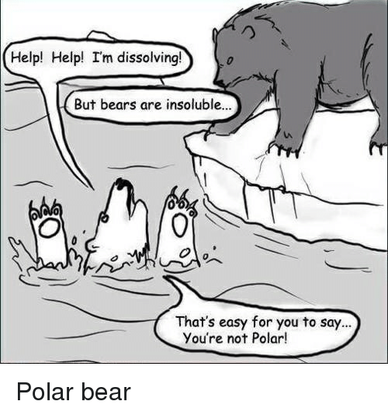
Exercise 4.104
Created by Lauren Taylor (’14)
Edited by Maxine Chan (‘16), Allee Vito (‘17), Doris Chen (‘18), Olivia Young (‘19), Sanna Vedrine (‘23), Austin Kwan (’24), Donovan Cho (‘25)

Slide 2
Design Goals
Separate E and X
Both streams may contain up to 10 wt% of the other component
Neither stream may contain water
Minimize the number of units
Minimize waste

Slide 3
Design Specifications
Component | Boiling Point (℃))
E | 100
X | 100
Water | 100
Oil | 320
N₂ | -196
input stream
x_{H20} = 0.95
x_{E} = 0.03
x_{X} = 0.02
Cannot separate by distillation!
Assumptions:
Water and oil are immiscible
Oil does not evaporate into N₂
Water evaporates into N₂ (1.4 wt% H₂O vapor in N₂ at 20 ℃)
Notes:
Doesn’t look like we are able to separate E and X using distillation

Slide 4
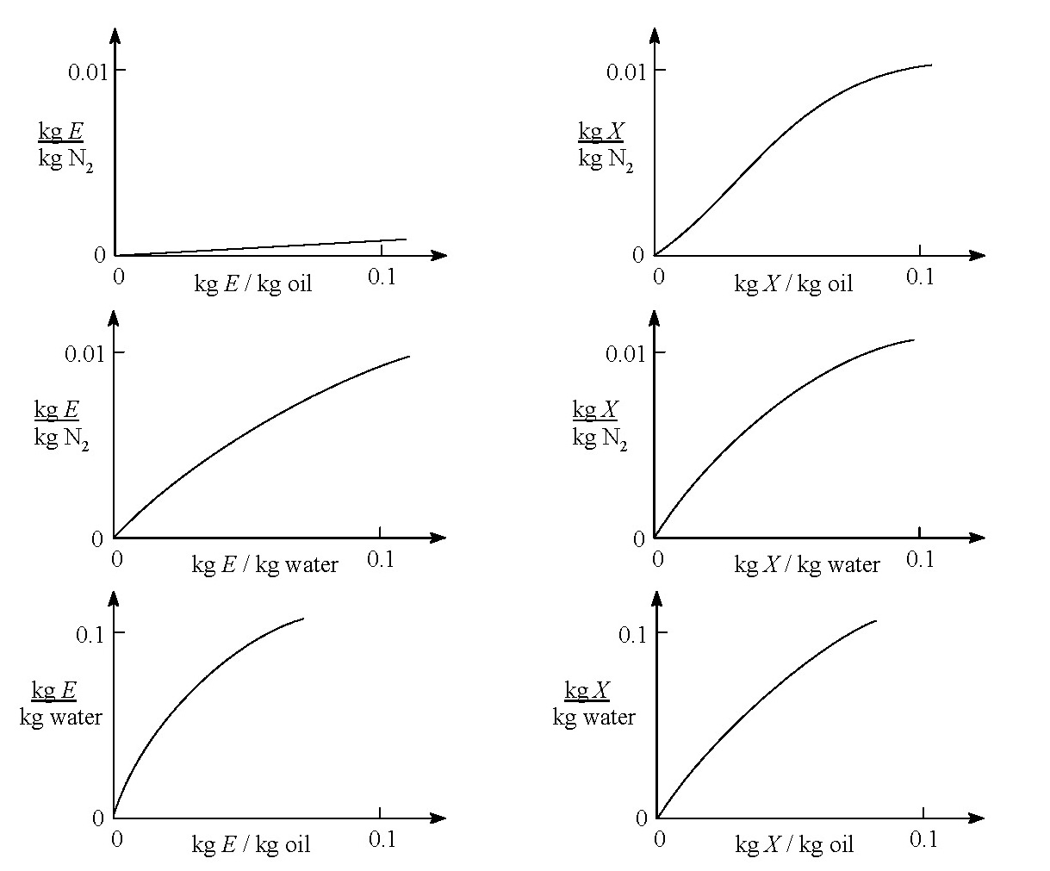
Which absorber should we use?
1. Oil + N₂
Preferentially extract X into N₂
Step 2
1.
2. Water + N₂
No clear preferential separation
2.
3. Water + Oil
No clear preferential separation
Step 1 (E and X from water to oil)
3.
* Input: Water, E, X
* Target Output: relatively pure E,X
Notes:
these graphs show the thermo data for various potential separations depending on what combination of solvents we use between n2, oil, and water
the 2 graphs on the first row describes the separation of e and if we were to use oil and n2. left shows E and right shows X. we see there is a significant difference in the slopes which indicate that there is a potential. we see that relatively no E ends up in N2. therefore there is potential to use n2 and oil to separate e and x from each other.
lowing at middle row – we see the slopes are very similar and there is therefore no clear potential for a meaningful separation
Want to look for graphs where the curves look significantly different. We see this with oil/N2.
Bubble N2 through oil to extract X
Currently have E and X in water…need to get into an oil solution to be able to separate

Slide 5
PLAN
E, X from water → oil
X from E and oil → N₂
Water 95 wt%
E 3 wt%
X 2 wt%
Water 100 wt%
Liquid-Liquid
Absorber
Oil 100 wt%
Oil 95 wt%
E 3 wt%
X 2 wt%
Notes:
Assume all E and X get transferred to oil. This isnt a super realistic assumption, but we will make it here

Slide 6
PLAN
E, X from water → oil
X from E and oil → N₂
Water 95 wt%
E 3 wt%
X 2 wt%
Water 100 wt%
Liquid-Liquid
Absorber
Oil 100 wt%
Oil 95 wt%
E 3 wt%
X 2 wt%
N₂ 98 wt%
E 0 wt%
X 2 wt%
Gas-Liquid Stripper
N₂ 100 wt%
Oil 97 wt%
E 3 wt%
X 0 wt%

Slide 7
PLAN
E, X from water → oil
X from E and oil → N₂
Water 95 wt%
E 3 wt%
X 2 wt%
Water 100 wt%
Liquid-Liquid
Absorber
Oil 100 wt%
Oil 95 wt%
E 3 wt%
X 2 wt%
N₂ 98 wt%
E 0 wt%
X 2 wt%
Gas-Liquid Stripper
N₂ 100 wt%
Oil 97 wt%
E 3 wt%
X 0 wt%

Slide 8
PLAN
E, X from water → oil
X from E and oil → N₂
Water 95 wt%
E 3 wt%
X 2 wt%
Water 100 wt%
N₂ 100 wt%
Liquid-Liquid
Absorber
Liquid-Gas Separator -50 °C
Oil 100 wt%
Oil 95 wt%
E 3 wt%
X 2 wt%
N₂ 98 wt%
E 0 wt%
X 2 wt%
Gas-Liquid Stripper
X 100 wt%
E 100 wt%
Liquid-Gas Separator 150 °C
N₂ 100 wt%
Oil 97 wt%
E 3 wt%
X 0 wt%
Oil 100 wt %

Slide 9
PLAN
E, X from water → oil
X from E and oil → N₂
Water 95 wt%
E 3 wt%
X 2 wt%
Water 100 wt%
N₂ 100 wt%
Liquid-Liquid
Absorber
Liquid-Gas Separator -50 °C
Oil 100 wt%
Oil 95 wt%
E 3 wt%
X 2 wt%
N₂ 98 wt%
E 0 wt%
X 2 wt%
Gas-Liquid Stripper
X 100 wt%
E 100 wt%
Liquid-Gas Separator 150 °C
N₂ 100 wt%
Oil 97 wt%
E 3 wt%
X 0 wt%
Don’t Be wasteful! ☹
Oil 100 wt %
Notes:
So this looks like a good design…but can we improve?

Slide 10
N₂ 100 wt%
Purge
Water 95 wt%
E 3 wt%
X 2 wt%
N₂ 100 wt%
Water 100 wt%
Liquid-Liquid
Absorber
Liquid-Gas Separator -50 °C
Oil 100 wt%
Oil 95 wt%
E 3 wt%
X 2 wt%
N₂ 98 wt%
E 0 wt%
X 2 wt%
Gas-Liquid Stripper
X 100 wt%
E 100 wt%
Liquid-Gas Separator 150 °C
N₂ 100 wt%
Oil 97 wt%
E 3 wt%
X 0 wt%
Oil 100 wt %
N₂ 100 wt%
(make up for purge)

Slide 11
Chemical Process
N₂ 100 wt%
Purge
Water 95 wt%
E 3 wt%
X 2 wt%
N₂ 100 wt%
Water 100 wt%
Liquid-Liquid
Absorber
Liquid-Gas Separator -50 °C
Oil 100 wt%
Oil 95 wt%
E 3 wt%
X 2 wt%
N₂ 98 wt%
E 0 wt%
X 2 wt%
Gas-Liquid Stripper
X 100 wt%
E 100 wt%
Liquid-Gas Separator 150 °C
N₂ 100 wt%
Oil 97 wt%
E 3 wt%
X 0 wt%
Oil 100 wt %
Oil 100 wt %
Purge
N₂ 100 wt%
(make up for purge)
Oil 100 wt%
(make up stream)

Slide 12
Key Takeaways
The oil/water and oil/N₂ extractions are not perfect
Minimize flow rates by recycling solvents when possible!

