Slide 1
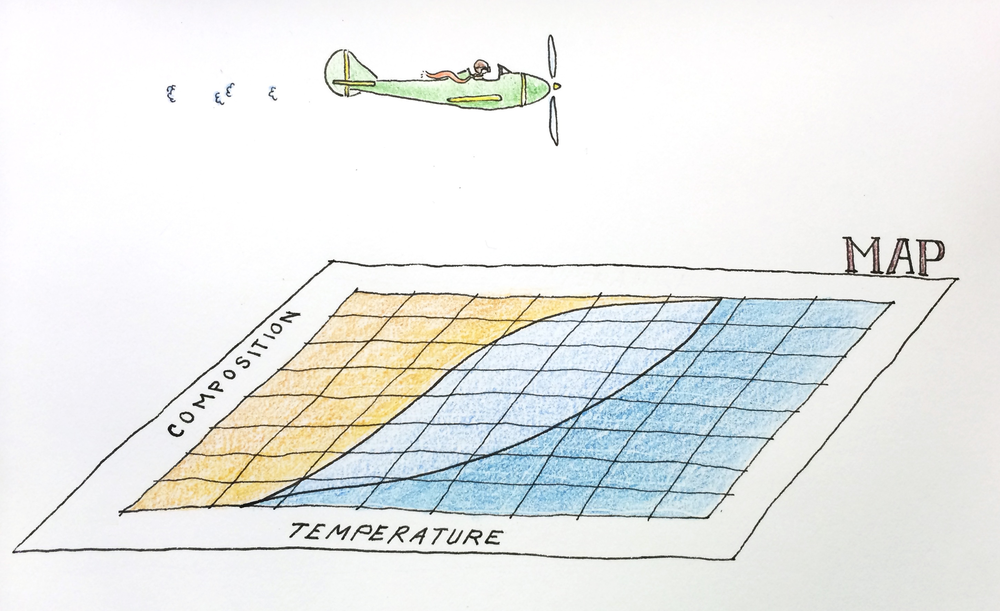
Exercise 4.35
Ada Chan (‘19)
Created by: Jiamin Zhang (’16) and Maxine Chan (’16)
Edited by: Jenny Bushnell (‘17), Andy Luke (‘18), Olivia Young (’19),
Ian Morrison (‘20), Andrew Simon (‘21) & Apoorva Agarwal (‘21), Max Serota (‘22), Maggie MacNeel (‘24), James Chen (‘26)

Slide 2
Our Process
What values are we looking for?
Vapor:
70. wt% NH₃
96 lb/min
Flow rate?
40. wt% NH₃
120°F
132 lb/min
3
Water
80°F
4
6
Composition?
NH₃ + H₂O
mixture
1
Flash
Drum
5
Mixer
Mixer
Temp?
Composition?
Temp?
NH₃ + H₂O
all liquid
7
Liquid:
38 lb/min
2
Composition?
Temp?
Composition?

Slide 3
Temperature in the flash drum?
A)
Vapor
Identify the stream(s)
  Which do I have information about?
Stream 3 is all vapor, in VLE
At 70 wt% NH₃ we are at 323°F
3
V + L
Liquid

Slide 4
Composition of Stream 2?
B)
Vapor
Identify the stream(s)
  Which do I have information about?
Draw tie lines
Stream 2 is all liquid, in VLE
At 323°F stream 2 is 18 wt% NH₃
2
3
V + L
Liquid

Slide 5


Composition of Stream 1?
C)
Vapor
96
38
Identify the stream(s)
  Which do I have information about?
Draw tie lines
Use the lever rule
1
2
3
52mm
Total flow = 134 lb/min
Fulcrum = (52mm) x (96/134)
=37mm from left
Stream 1 is 55 wt% NH₃
V + L
Liquid

Slide 6
Temperatures and Compositions?
D)
Vapor
350°F
300°F
250°F
200°F
V + L
Liquid

Slide 7
D)
Draw the tie lines
350°F
300°F
250°F
200°F
0.14
0.56

Slide 8

Temp of Stream 5?
E)
Vapor
NO! We can’t use a T(x,y) for this analysis!
3
Length of 3-4 is 47.7mm
Total Flow = 228 lb/min
Fulcrum = (47.7mm)x96/228
= 20.1mm from the left
V + L
4
The temperature of stream 5 is 210°F
Liquid

Slide 9
E)
Locate Streams 3 and 4
stream 3
350°F
300°F
250°F
200°F
stream 4

Slide 10
E)
Where is the fulcrum (stream 5)?
stream 3
(96+132)(L1) = (132)(L1+L2)
(228)(L1) = (132)(76mm)
L1 = 44mm
350°F
L1
300°F
250°F
Temperature for Stream 5 is 250°F.
200°F
L2
stream 5
stream 4

Slide 11
F)
Locate Streams 6 and 7
stream 3
What’s the minimum flow rate of stream 6?
350°F
L1
300°F
Use lever rule!
F5(L2) = F6(L1)
228(32mm) = F6(33mm)
F₆ = 221 lb/min
250°F
stream 7
200°F
L2
stream 5
Stream 6
stream 4

Slide 12
Key Takeaways:
Find your bearings on the diagrams first – label and color code!
Can’t use temperature-composition for mixing lines
  Temperature is not conserved!
Tie lines are always horizontal on T-(x,y), but not on H-(x,y)
We can use the T-(x,y) tie lines to draw tie lines on H-(x,y)

