Slide 1
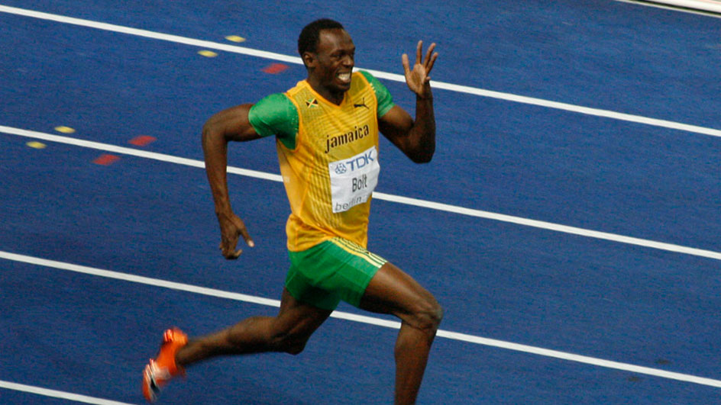
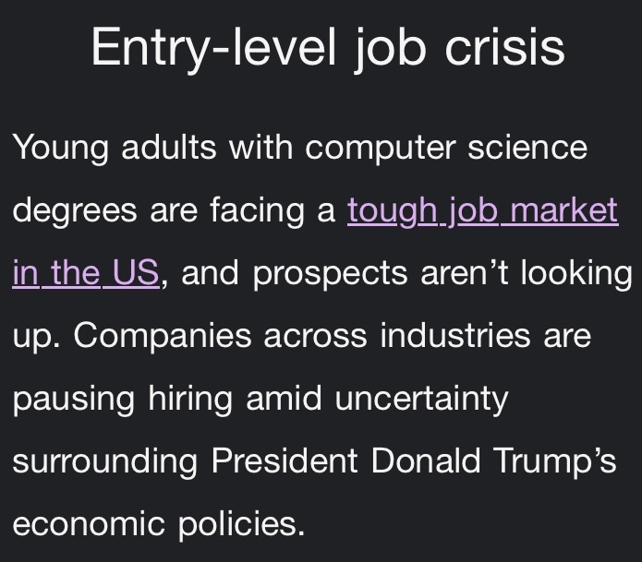
Exercise 4.39
Majoring in Chemical Engineering
Switching to Computer Science
Sophomores after taking ENGRD 2190 Prelim 2
Source: CNN
Created by: Kori Dunn (’09)
Edited by: Norman Su (’11), Jon Kienzle (‘12), McKenzie Huston (‘14), Ian Slauch (‘15), Matt Ferguson (‘16), Jenny Bushnell (‘17), Amy Penick (‘17), Joe Hassler (‘18), Jordan Fuller (’19), Kasim Khan (‘20), Emily Spiek (‘21), Kelsey Levine (’22), Ariel Struzyk (23’) Austin Vollweiler(24’), Dennis Wu (‘25), Amy Wu (‘26)

Slide 2
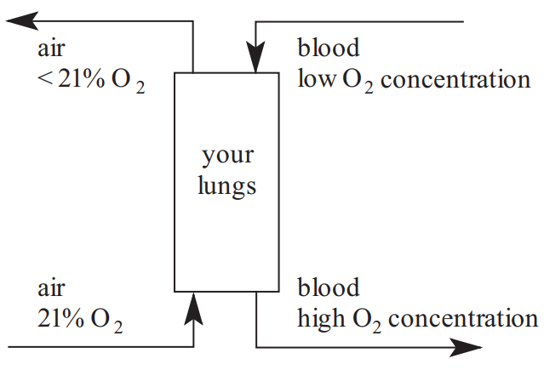
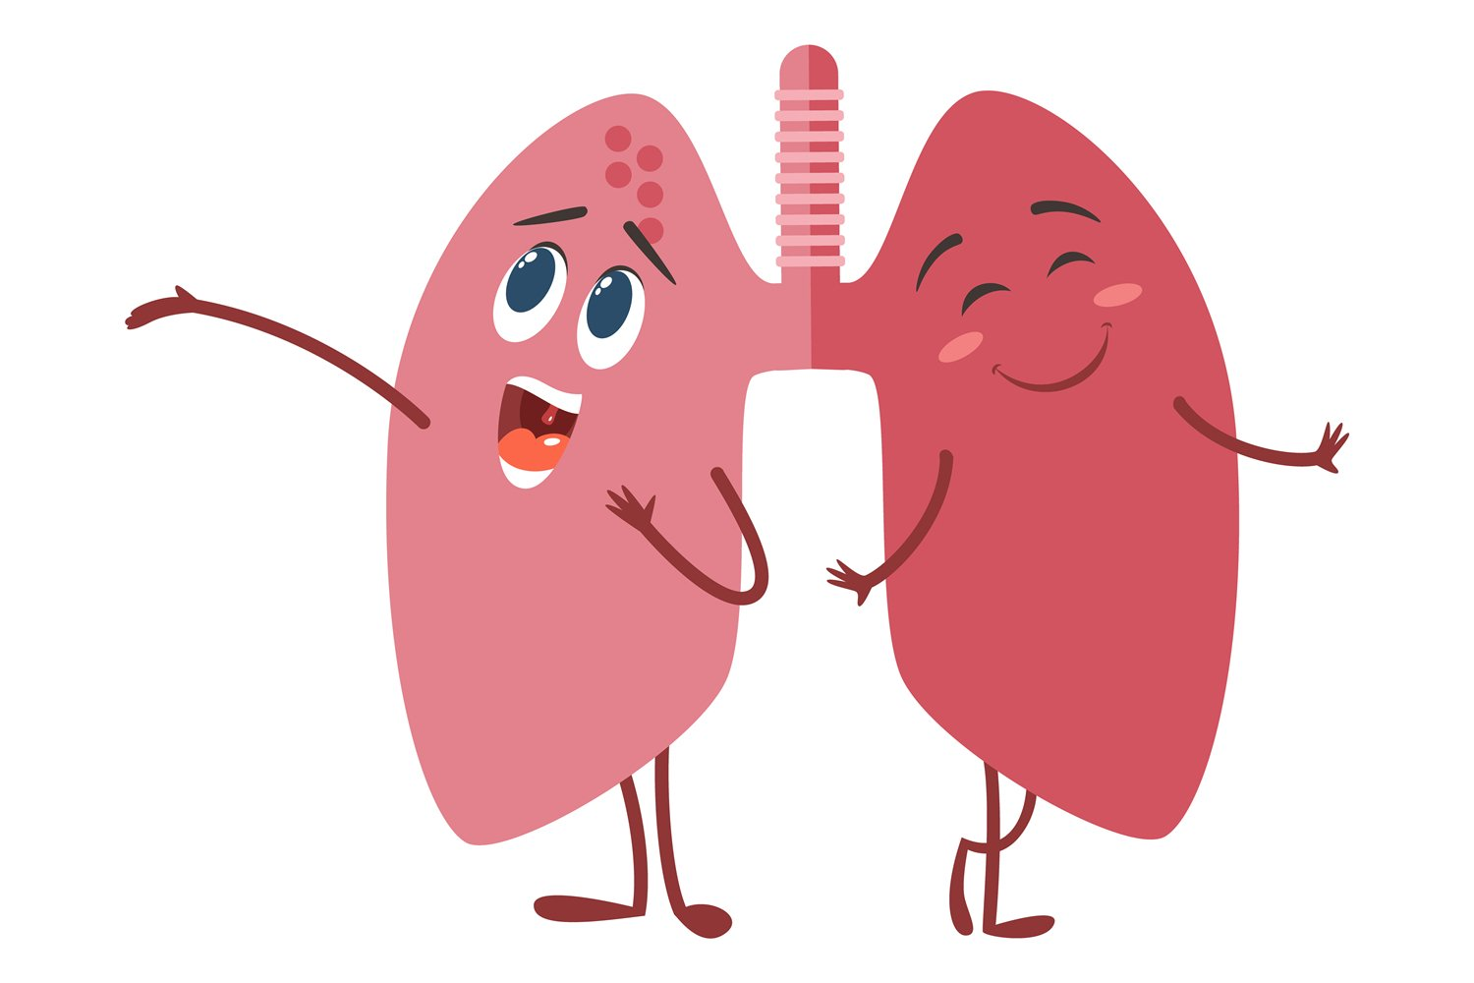

Slide 3
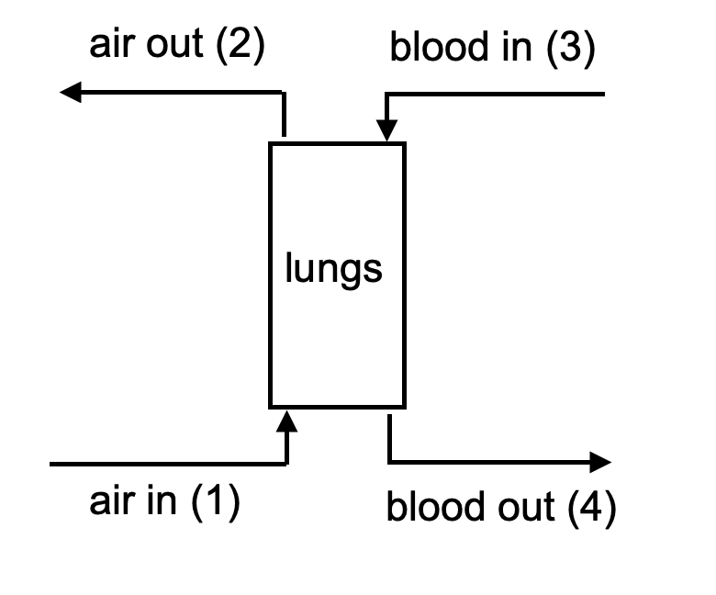
4.39 (A)
Air!
input streams
1. in
O2 leaving air
equilibrium line
output streams (at equilibrium)
2. out
Blood!
3. in
4. out
Let’s label the points!
Blood absorbing O2

Slide 4

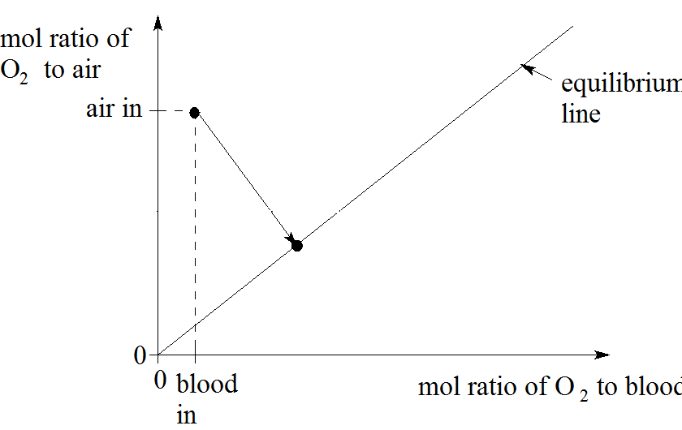
4.39 (B)
Original Slope =
Vapor flow doubles
2. Air out
New Slope=
Blood out

Slide 5

4.39 (C)
O₂ concentration in the air is lower
O₂ in blood must stay the same
Air in
New Slope ≈ Half Old Slope
75% of Original [O2]
Air out
New Slope=
So breathe twice as fast!
Blood in
Blood out

Slide 6


4.39 (D)
We lost half our blood!
Can only absorb half as much O2
Redefine: it takes twice the concentration of O2 in air to reach the same concentration O2 in undiluted blood

Slide 7
4.39 (D)
Equilibrium Line with Blood Loss
Air in
Air out
New Slope ≈ One fifth the original Slope
So breathe 5 times faster
Or??
Blood in
Blood out

Slide 8
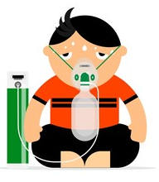
4.39 (D)
Air in
Is this point
fixed?
New Slope = Original Slope
Breathe normally with an oxygen mask
Blood in
Blood out

Slide 9
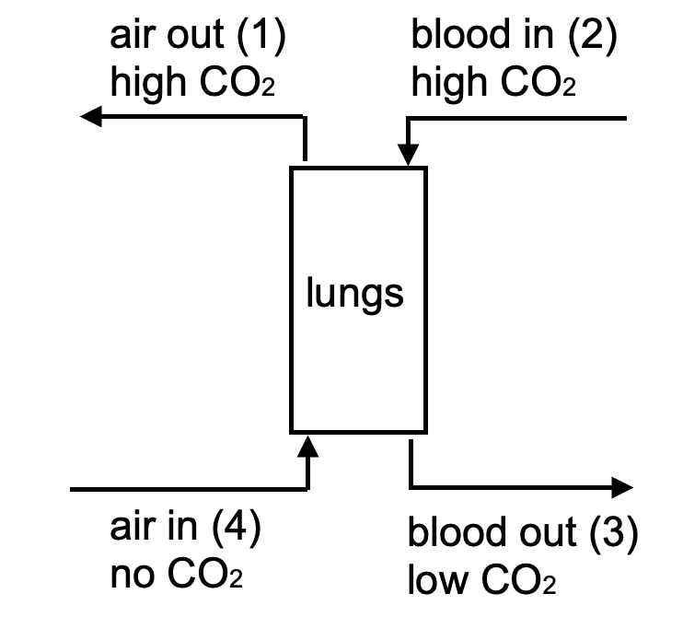
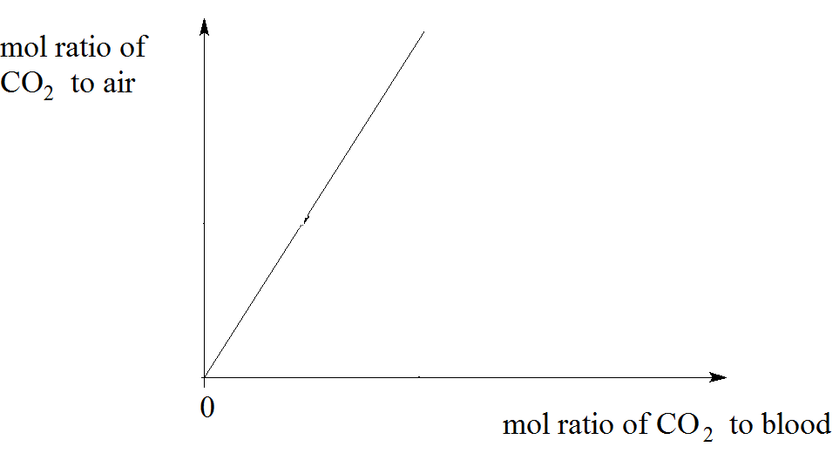
4.39 (E)
output streams
Air out
Same Slope as part (a)
Same lungs
Air in
Blood out
Blood in

Slide 10
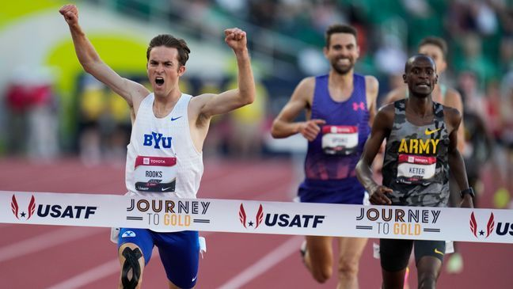


Takeaways
ChemE skills can be applied to a variety of systems
Graphical methods can help check our intuition
TAs trying to pass on knowledge before forgetting it all
My core: finishing cheme

