Slide 1
Calculation Session 10
Exercise 4.44
Created by: Angela Tang (‘18)
Edited by: Jordan Fuller (‘19), Spencer Hong (‘20), Tommy Bradford (‘21), Lucy Cadanau (‘22), Ailen Lao (’23), Maggie MacNeel (‘24), Ashlyn Dumaw (‘25), Angel Liang (‘26)

Slide 2
Goal:
Use graphical methods to analyze an absorber that extracts compound Q from air into oil
Info:
Inlet air and oil compositions, outlet air composition, and A Q/oil-Q/air solubility diagram
Where to start:
Locate your knowns
Consider the meaning of operating lines

Slide 3
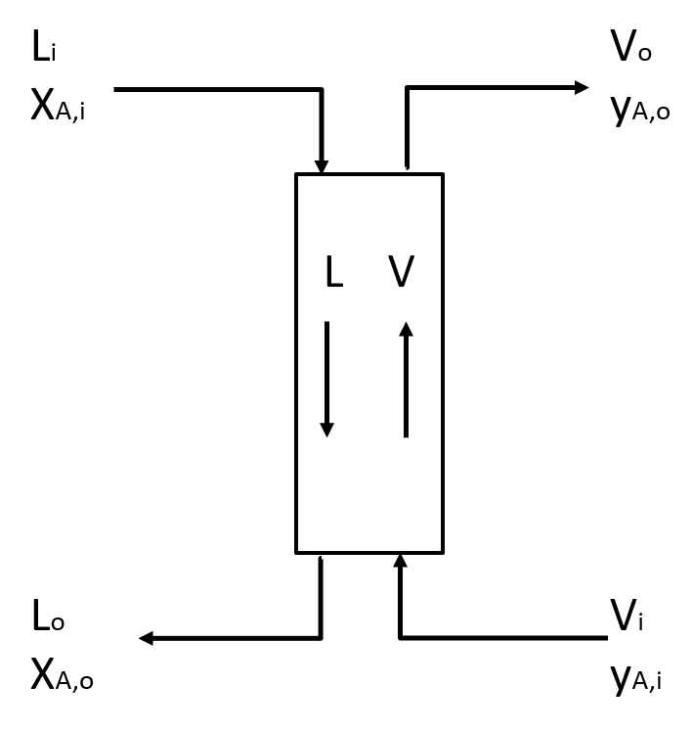
What do Absorbers Do?
Absorbers purify gases
Solute is absorbed from the gas into a liquid stream
  i.e. A contaminant in gas is absorbed into a liquid
  e.g. CO₂ absorbed from air into the solvent “MEA”
Important terms to know…
  V = vapor mass flow rate
  L = liquid mass flow rate
  i = into the column (influent)
  o = out of the column (effluent)

Slide 4
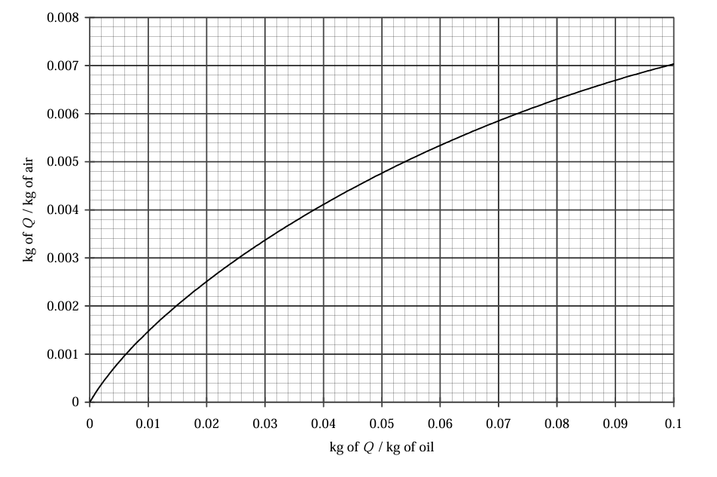
Graphical Analysis of Absorbers
Operating Line
  Connects the streams at the bottom of column to the streams at the top of the column
Equilibrium Line
  Indicates solubility equilibrium
Note
  Operating line for gas absorption lies above the equilibrium line
Y_{A}
X_{A}

Slide 5
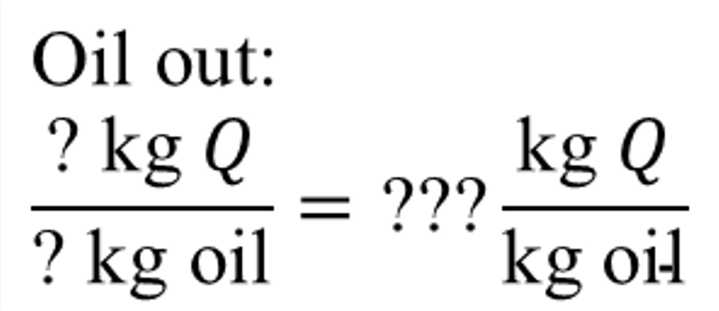
What We Know So Far
100. kg/min air
0.05 kg/min Q
Point on the operating line
oil
•
•
•
oil
Q
100. kg/min air
0.70 kg/min Q
Point on the operating line

Slide 6
What We Know So Far
0.0005
kg Q/kg air
Y_{A}
0 kg Q/kg oil
•
•
•
? kg Q/kg oil
0.007
kg Q/kg air
X_{A}

Slide 7
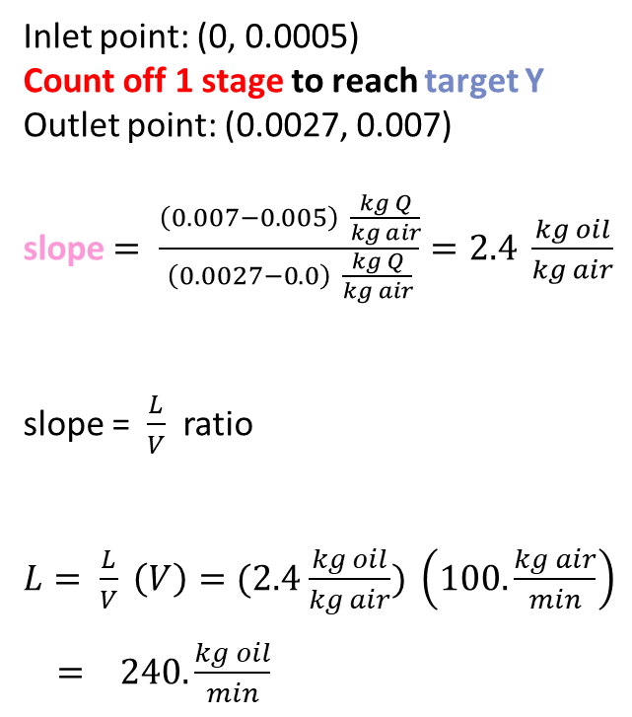
A) Oil Flow Rate with One Eq. Stage
Inlet point: (0, 0.0005)
Count off 1 stage to reach target Y
Outlet point: (0.0027, 0.007)
slope $= \frac{\left(0.007−0.005\right) \frac{kg Q}{kg air}}{\left(0.0027−0.0\right) \frac{kg Q}{kg air}}=2.4 \frac{kg oil}{kg air}$
slope = $\frac{L}{V}$ ratio
$L= \frac{L}{V} \left(V\right)=(2.4$ $\frac{kg oil}{kg air}) \left(100. \frac{kg air}{min}\right)$
$= 240. \frac{kg oil}{min}$
Y_{A}
1
X_{A}

Slide 8
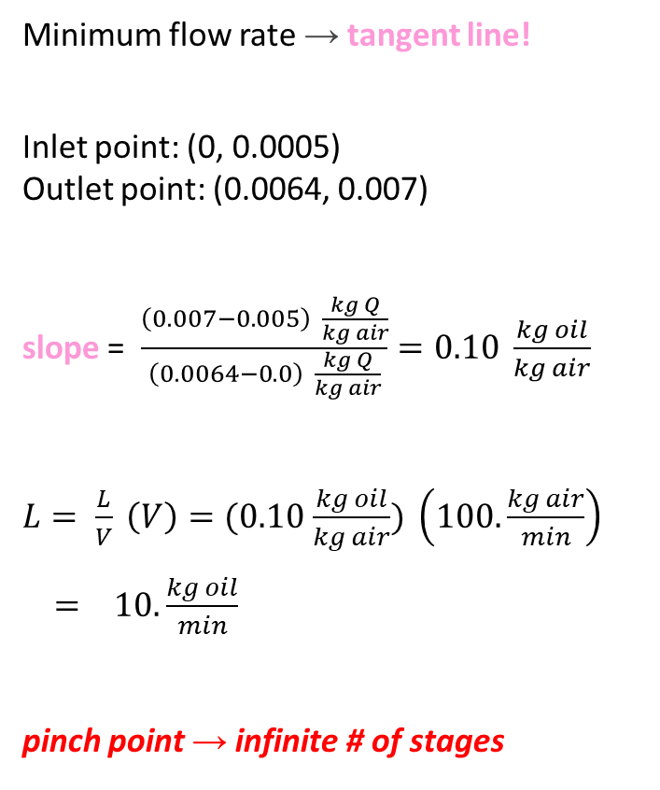
B) Minimum Oil Flow Rate
Minimum flow rate → tangent line!
Inlet point: (0, 0.0005)
Outlet point: (0.0064, 0.007)
slope = $\frac{\left(0.007−0.005\right) \frac{kg Q}{kg air}}{\left(0.0064−0.0\right) \frac{kg Q}{kg air}}=0.10 \frac{kg oil}{kg air}$
$L= \frac{L}{V} \left(V\right)=(0.10$ $\frac{kg oil}{kg air}) \left(100. \frac{kg air}{min}\right)$
$= 10. \frac{kg oil}{min}$
pinch point → infinite # of stages
Y_{A}
X_{A}

Slide 9
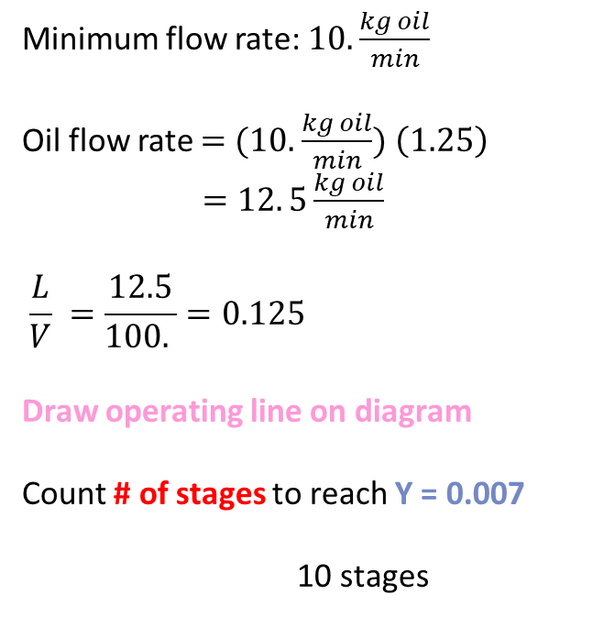
C) # of Stages with 25% Higher Than Min Flow Rate
Minimum flow rate: $10. \frac{kg oil}{min}$
Oil flow rate $=$ $(10.$ $\frac{kg oil}{min}) \left(1.25\right)$
$=12. 5\frac{kg oil}{min}$
$$\frac{L}{V} =\frac{12.5}{100. }=0.125$$
Draw operating line on diagram
Count # of stages to reach Y = 0.007
10 stages
Y_{A}
10
9
8
7
6
4
5
3
2
1
X_{A}

Slide 10
D) Flow Rate with 4 Eq. Stages
Iterative (guess and check) process
Draw operating line
Count # of stages
Too many stages → increase slope
Y_{A}
6
5
4
3
2
1
X_{A}

Slide 11
D) Flow Rate with 4 Eq. Stages
Iterative (guess and check) process
Draw operating line
Count # of stages
Too many stages → increase slope
Too few stages → decrease slope
Y_{A}
3
2
1
X_{A}

Slide 12
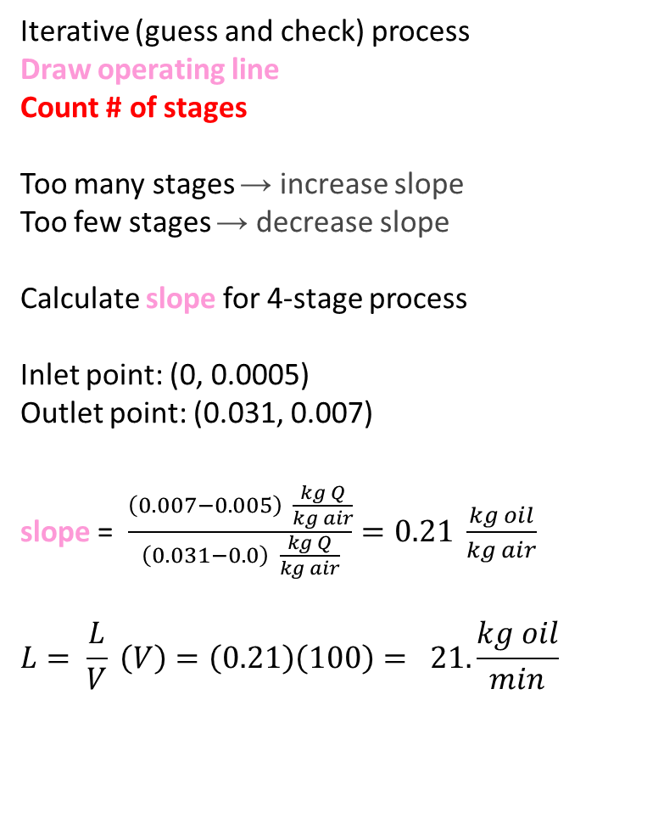
D) Flow Rate with 4 Eq. Stages
Iterative (guess and check) process
Draw operating line
Count # of stages
Too many stages → increase slope
Too few stages → decrease slope
Calculate slope for 4-stage process
Inlet point: (0, 0.0005)
Outlet point: (0.031, 0.007)
slope = $\frac{\left(0.007−0.005\right) \frac{kg Q}{kg air}}{\left(0.031−0.0\right) \frac{kg Q}{kg air}}=0.21 \frac{kg oil}{kg air}$
$$L= \frac{L}{V} \left(V\right)=\left(0.21\right)\left(100\right)= 21. \frac{kg oil}{min}$$
Y_{A}
4
3
2
1
X_{A}

Slide 13
Key Takeaways
Understand the meaning of your axes and operating line
Label your knowns first (inlets/outlets)
Count stages on the equilibrium line
Iterate with educated guesses
  What happens to stage count when you change the operating line?
This material will come back to you in Separations (junior spring)!

