Slide 1
Pre-Enroll Panel
Donny Cho
Lauren de Silva
Ashlyn Dumaw
Dennis Wu

Slide 2
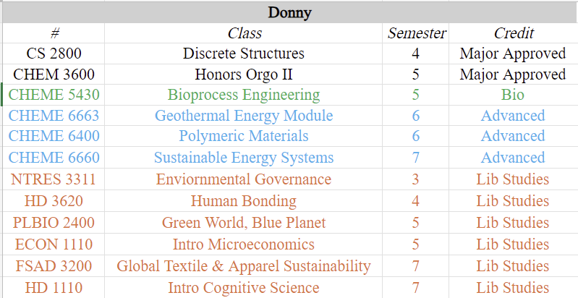
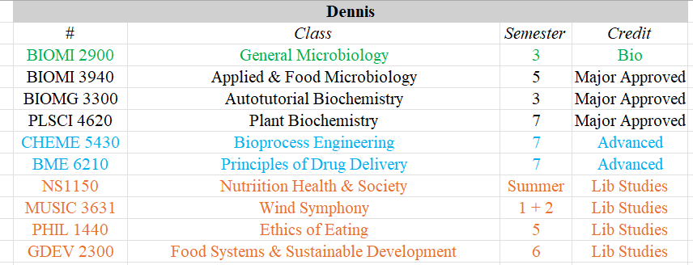
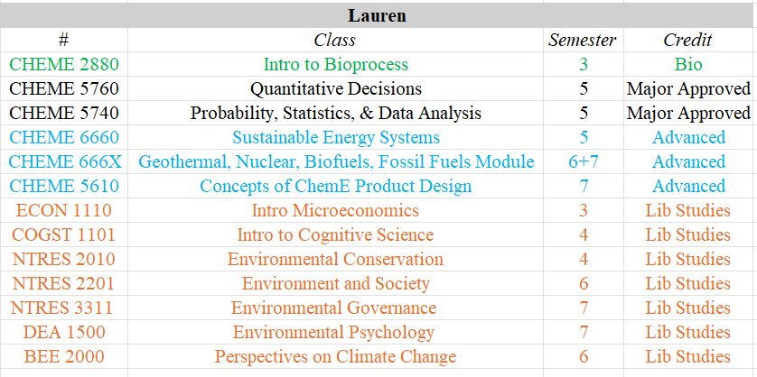
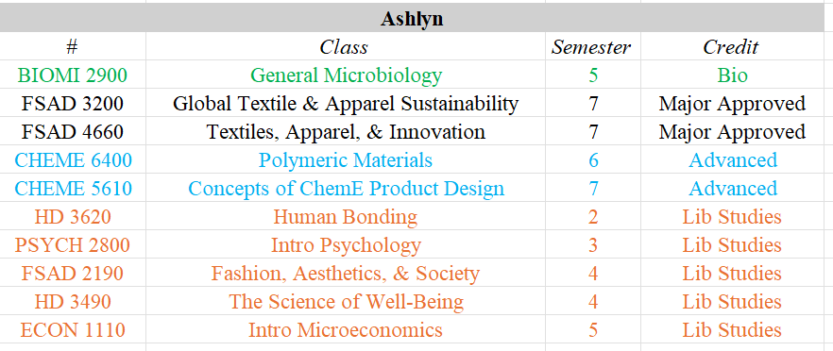
Classes we’ve taken

Slide 3
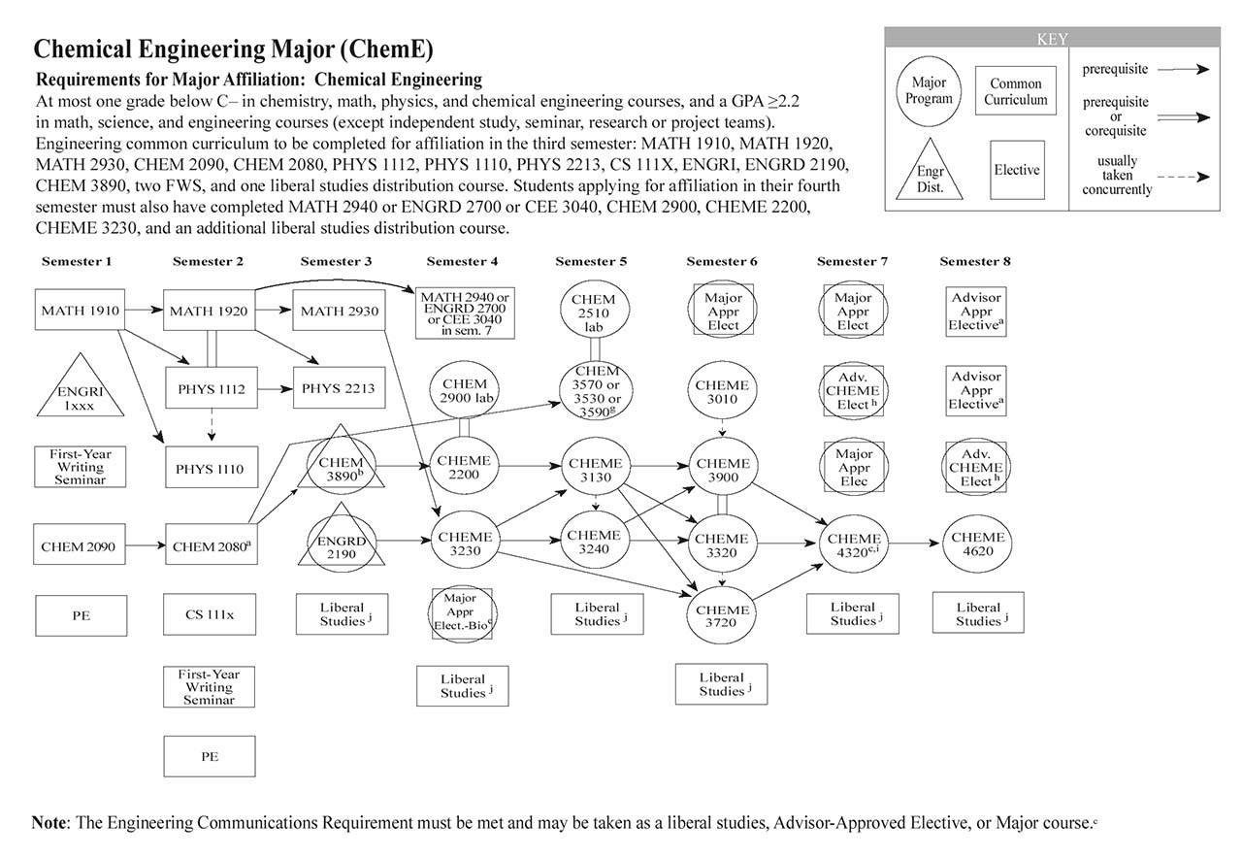

Slide 4
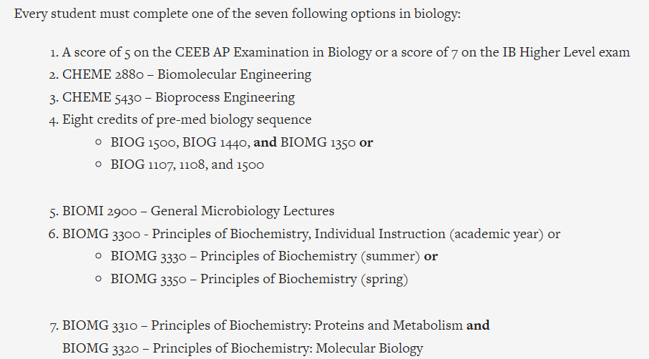
Typical Sophomore Spring Courseload
Linear Algebra for Engineers (MATH 2940)
OR Eng Probability and Statistics: Modeling and Data Science (ENGRD 2700)
OR Uncertainty Analysis in Engineering (CEE 3040) in sem 7
Introduction Physical Chemistry Laboratory (CHEM 2900)
Physical Chemistry II for Engineers (CHEME 2200)
Fluid Mechanics (CHEME 3230)
Liberal studies
Major-approved bio elective →

Slide 5
Choosing Your Bio Elective COMPARING
Biomolecular Engineering: Fundamentals and Applications (CHEME 2880)
Bioprocess Engineering (CHEME 5430)
General Microbiology Lectures (BIOMI 2900)
Principles of Biochemistry, Individualized Instruction (BIOMG 3300)

Slide 6
CHEME 2880
What’s covered in the course:
10% of course is pure bio. Only the foundational bio you need to understand the rest of the course.
Proteins, Lipids, DNA, Carbohydrates, Central Dogma
Bioreactors (reactor design)
Models for Gene regulatory circuits (controls)
Biomolecular interactions (equilibrium models, kinetics of binding)
Enzyme Kinetics (Michaelis Menten)
Last 10-15% of the course is all about how bioprocess is applied in industry (drug development, patenting, product commercialization)
Structure of class:
X1 short-ish MC quiz on basic bio knowledge
X10 in class 5 question MC quizzes about previous weeks content
X2 in class prelims
X1 final group presentation on some biotech development, topics are assigned
X1 final group project. Our year it was a single-page stock pitch for a new biotech startup
X2-3 Lab’s sessions throughout the semester + final lab report (~10 pages). 1st lab was for gene writing/sequencing, 2nd lab was growing a protein in a bioreactor, 3rd lab was separations and extracting your product
Opinions:
Overall an interesting and engaging class even though I am not really interested in bio
Good for people with no-prior bio knowledge (I went in only having freshman HS bio knowledge)
Focuses on breadth of topics, not depth.
Incorporated all core ChemE topics but in a Bio lens
Not terribly time-consuming. PSETs are not terrible if you go to Office hours. Paszek makes himself very available for help with PSETs. Exams were pretty fair

Slide 7
CHEME 5430
What’s covered in the course:
Biomolecular Considerations (DeLisa, more understanding/conceptual):
~10% of course is pure bio. Basic bio concepts taught semi-quickly in lecture + expectation is you supplement it with reading in textbook.
Drug Development process
Recombinant DNA + Protein Engineering (big focus)
Enzyme Kinetics
Genetic Flow
Cellular Considerations (Delisa/Woltornist, more mathematical modeling):
Cell Growth Kinetics
Bioreactor Design + Scale-Up
Industry Rep/Guest Lectures (Merck, GSK, Regeneron, Apertura, US FDA) Good for networking!!!
Downstream Considerations (Woltornist, shorter topic):
Structure of class:
X1 semester-long team project
x3.5 written reports/deliverables (+ optional report)
X5 problem sets (last was made optional for my semester)
X1 cumulative final exam
Opinions:
Interesting + semi-engaging class (I'm not a big bio person) BUT recommended class if into pharma industry!
Good overview of components of a pharma company.
Decent for people with no-prior bio knowledge, will require a bit of bio catch-up (only freshman HS bio knowledge).
Breadth + some depth of topics.
Not very time-consuming. PSETs are not bad if you start early.
Take class with people you work well with (?) b/c team project

Slide 8
BIOMI 2900
What’s covered in the course:
Microscopy techniques
Basic cell structure of prokaryotes (cell walls, motility, etc), their growth, and cell signaling (heat shock response, nutrient starvation, etc)
Gene expression (translation, transcription) and DNA repair and mutation
Molecular bio and biotechnology
Basic overview of metabolism: glycolysis, electron transport chain, photosynthesis, nitrogen and carbon cycles
Basic immunology, how vaccines work, and immunity
Infection mechanisms of pathogens (attachment, replication, etc) and food/water borne diseases
Virology: Genetic and cell structure of different virus types, and their 'growth' cycle
Structure of class:
X38 pre-lecture short canvas quiz homeworks, takes <10min and you get a couple retakes
X6 quizzes covering ~5 lectures each, 1 is dropped
X3 prelims (final focuses on last 1/3 of class, plus some very general questions about the first 2/3) (might be different in the future)
Opinions:
I liked the class because it covers a lot of different topics, and it wasn't stressful because it wasn't very in depth
Ex: For glycolysis you only need to know sugar is broken down and how many ATP are made, vs. BIOMG you need to know all the chemical structures, reactions and regulation
Cool because other bio electives don't really cover pathogenesis and viruses, interesting info if you want to work with vaccines/pharma
Readings are not necessary to do
Discussion section is not necessary (you can take the class for 3 credits without a discussion or 4 credits with a discussion)
If you have a good memory, this class is very easy, and you don't have to think about it until prelims
If you have zero interest in biology and want to get your elective over with, this is a good class to take to get a foundation without much effort
Most of the class is pre-med bio majors

Slide 9
BIOMG 3300
What’s covered in the course:
The course is split into 3 modules: Protein structure and function, Molecular biology (DNA/RNA), and Metabolism
The Proteins section covers the structure of amino acids, protein folding, enzyme regulation, enzymes kinetics, and membranes
The Molecular bio section covers gene expression (DNA/RNA), DNA repair, modification, sequencing techniques, recombinant DNA methods, and protein synthesis
The Metabolism section covers glycolysis, gluconeogenesis, electron transport chain, glycogen synthesis/degradation, and fatty acid synthesis/degradation (with chemical structures)
Structure of class:
X13 units that are self-taught through readings, videos, and going to the study center for help. Must pass each before your deadlines
X13 objectives for each unit with guiding questions and suggested readings
X13 written quizzes with ~1 week to prepare for each (>80% is a pass, your actual quiz grade doesn't matter so a pass is logged as 100% for the unit)
X13 multiple choice homeworks due before the day before their respective prelims (not weekly basis)
X12 oral quizzes where TAs walk through the objectives
X4 quiz retakes with 5% deductions after
X14 one-day deadline extensions
X3 non-cumulative prelims
Opinions:
I think this was my favorite class I've taken at Cornell (made me rethink the industry I want to work in)
Can be time consuming to learn, but is really rewarding, and help is always available through the TAs and the professor at the study center
The actual quizzes aren't too challenging as long as you do the objectives
You need really good time management skills, because no one will be reminding you to complete your quizzes unless you've already missed multiple deadlines
If you're interested in pure bio but unable to take other classes, this course offers both breadth and depth. It's a really good foundation of biology and pre-req for advanced bio classes
Doable even if you haven't taken bio classes (this was my first bio class since freshman year of HS, but I also took it alongside BIOMI 2900)

