Slide 1
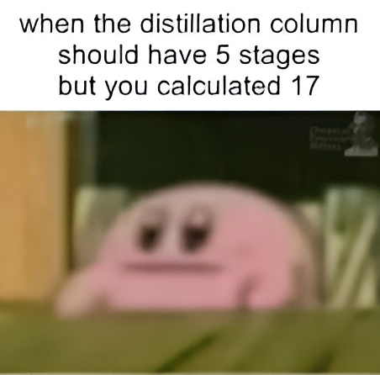
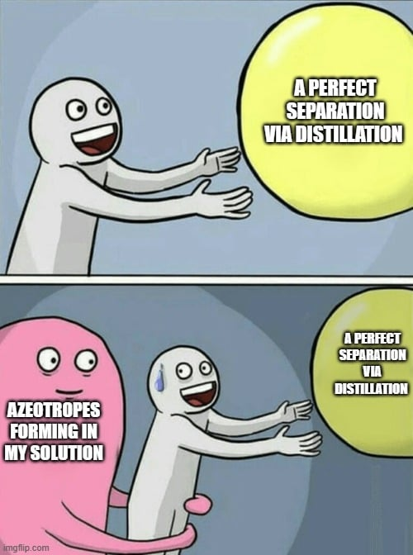
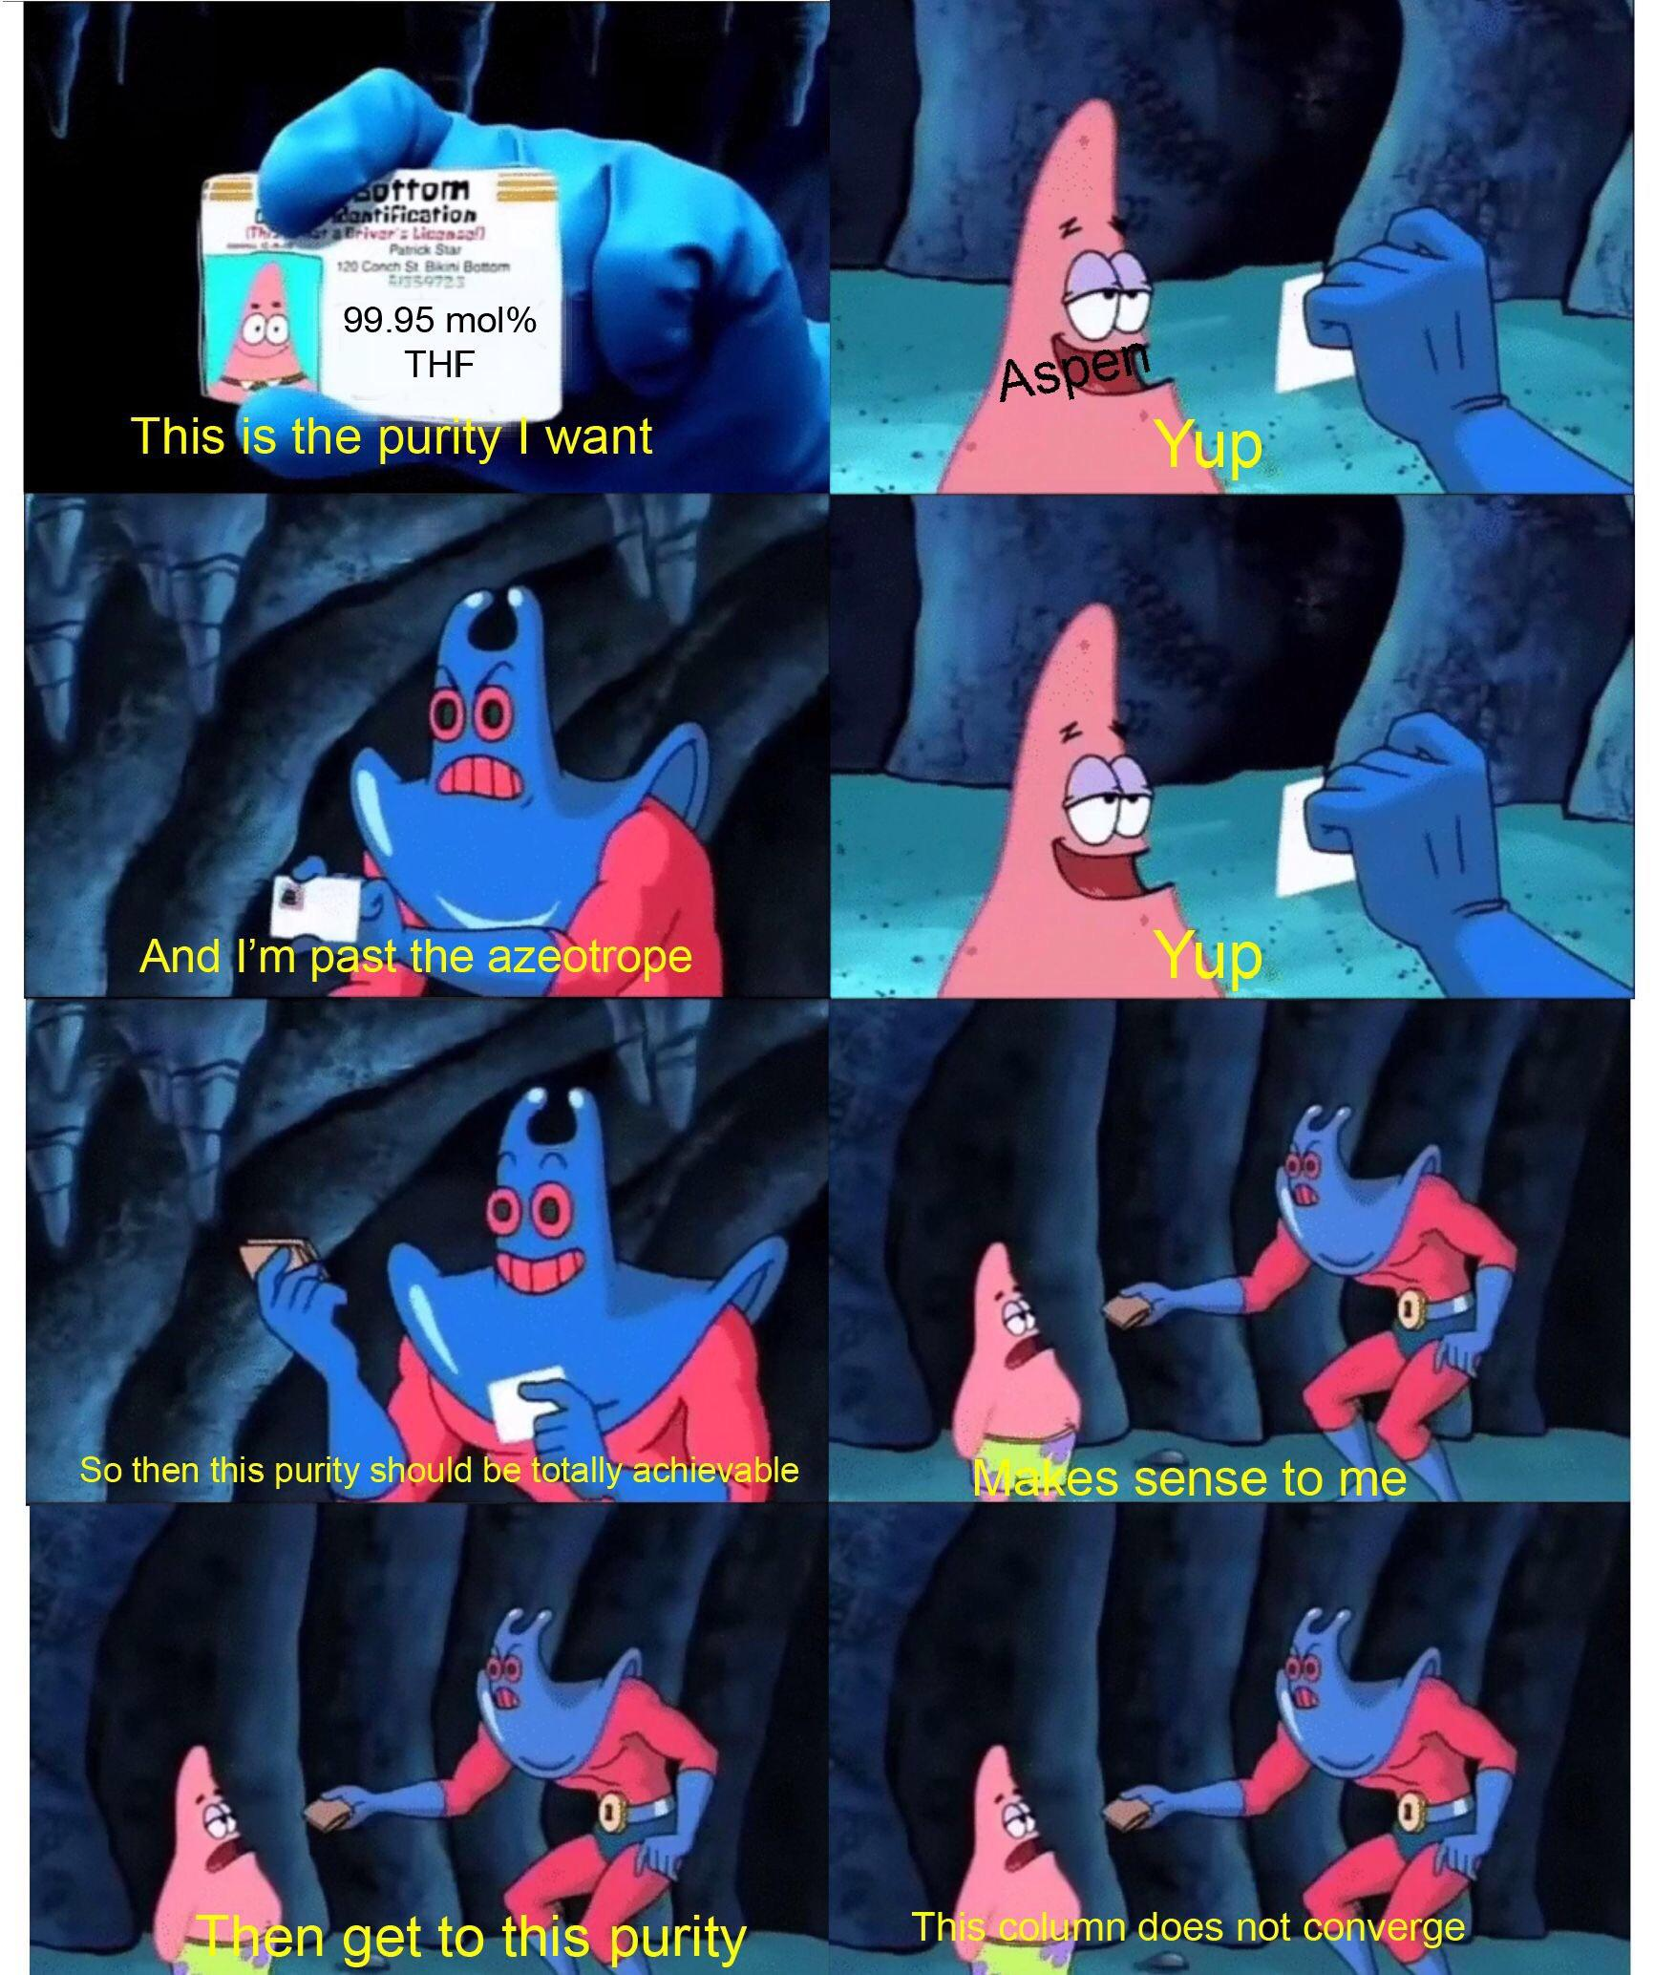
Exercise 4.107
Created by: Brian Weitzner (’09)
Modified by: Kelly Pollock (’10), Norman Su (’11), Maja Stojiljkovic (‘12),
Katie Reilly (‘12), David Sroczynski ('14), Tim Abbott (‘15),
McKenzie Hubert (‘16), Jenny Bushnell (‘17),
Joe Hassler (‘18), Francis Ledesma (‘19), Ellen Park (‘20),
Andrew Simon (‘21), Ailen Lao (‘23), Burke Combs (‘24), Donovan Cho (‘25), Amy Wu (‘26)

Slide 2
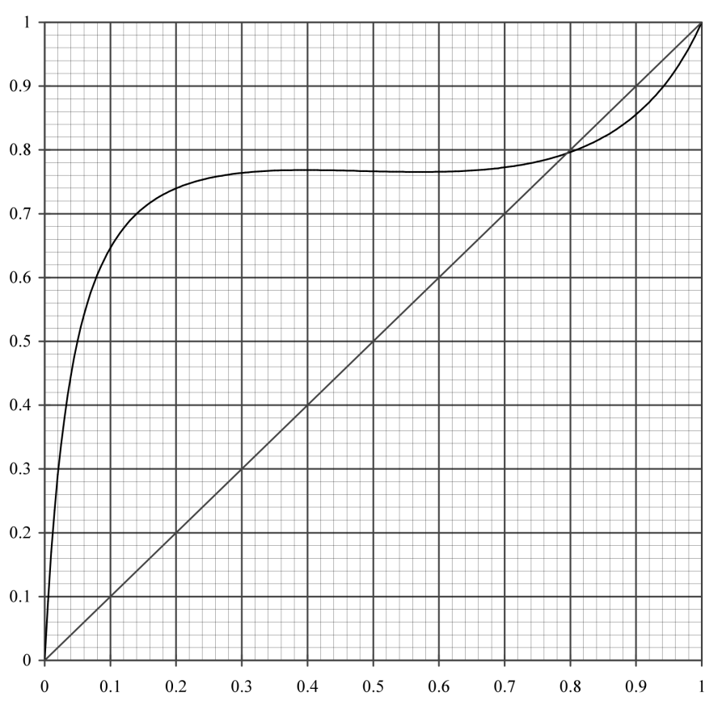
Gain familiarity with the diagram
Equilibrium line
Azeotrope
2
Distillate
Stage count
1
Rectifying line
y = x line
Stripping line
Bottoms
These will depend on reflux ratios—for this exercise, you can choose!

Slide 3

What are our design goals?
P = 0.2 atm
Separate a mixture of:
20 mol% acetonitrile
80 mol% water
Azeotrope
We want an acetonitrile-rich stream with ≥ 98 mol% acetonitrile
And a water-rich stream with
≤ 2 mol% acetonitrile
One big problem:
there’s an azeotrope and we can’t move past it!

Slide 4

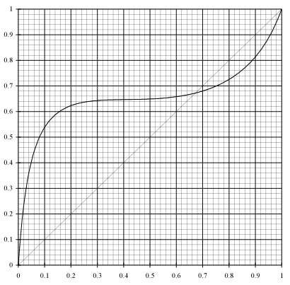
But wait…
If we change the pressure from 0.2 atm to 1 atm…
We want to get to here
P = 0.2 atm
P = 1.0 atm
We want to get to here
Azeotrope
Composition of the azeotrope
varies with system pressure!!
Azeotrope
Feed
Want to be here
in bottoms
Feed
0.675
Want to be here
in bottoms
0.8

Slide 5

The plan: use P to get around azeotrope
3
Move here at 0.2 atm and stop before azeotrope
2
P = 0.2 atm
P = 1.0 atm
Compress to 1 atm: azeotrope moves down
We are now past the azeotrope!
1
3 stages required
in Column A
Want to be here
in bottoms
Feed
0.77
Notes:
5

Slide 6


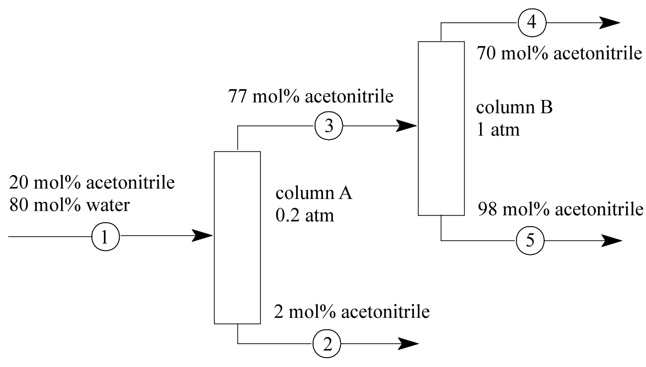
Our current setup
Now what?
Need 98% acetonitrile stream...
Let’s use another column!
1 atm
Don’t forget an expander!
Achieved 2% acetonitrile stream….

Slide 7
Feed to 2nd column
P = 0.2 atm
We want to be here
3
2
P = 1.0 atm
1
7

Slide 8
2nd column
P = 1.0 atm
1
2
3
4
6
5
6 stages required
in Column B

Slide 9
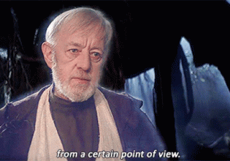
2nd column (from a different point of view)
y_{water}
6
5
Depends on reflux ratio…
4
3
2
1
0
1
x_{water}
There are many designs!
Notes:
If counting stages upside down is confusing, you can turn your map upside down to count, it’s exactly the same thing!

Slide 10


Our current setup
Add a recycle!
Is this the best design? How could we save money?
10

Slide 11
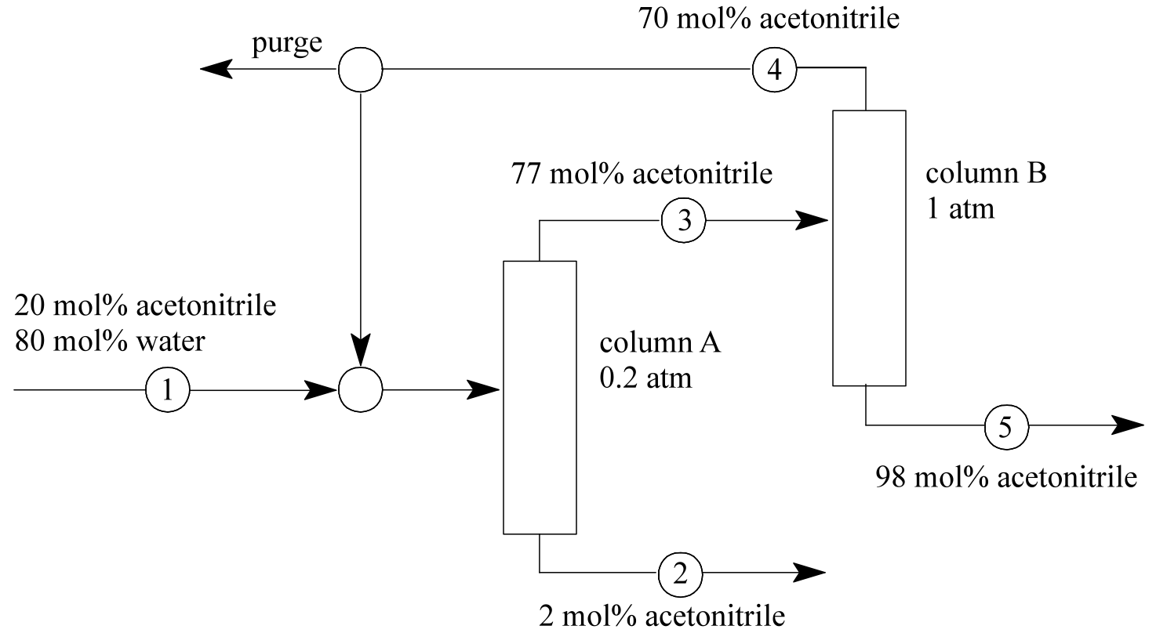
Adding a recycle
We could also recycle to…

Slide 12
Adding a recycle
A stage with similar composition!

Slide 13

4.107: Takeaways
Don’t be afraid to flip a graph to get a different ~perspective~
Change the pressure to get around an azeotrope
  Questions?

