Slide 1
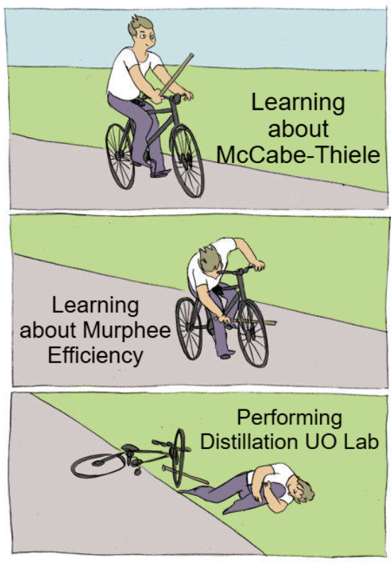
Calculation Session 11 Exercise 4.63
Created By: Zach Sherman (‘13)
Edited By: Lauren Taylor (‘14), Kathy Fein (‘15), Bari Grossman (‘15), Jiamin Zhang (‘16), Akash Vaidya (‘18), Jordan Fuller (‘19), Sabrina Chen (‘20), Drew Lazarow (‘21), Max Serota (’22), Leon Lee (‘23), Austin Kwan (‘24), Ashlyn Dumaw (‘25), and Kong Chen (‘26)

Slide 2
Review of the McCabe-Thiele Method
condenser
operating point
1
distillate
equilibrium point
rectifying section
x
y
y
2
x
y
x
feed
3
stripping section
4
bottoms
reboiler

Slide 3
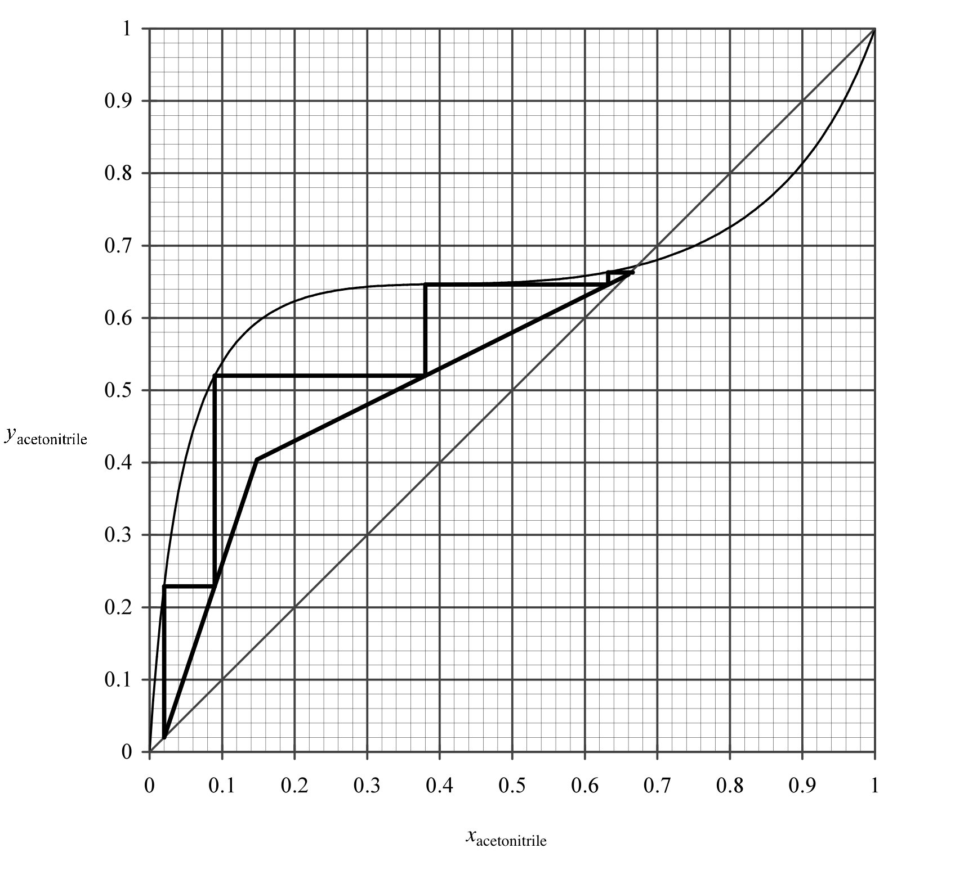
A) # of Equilibrium Stages
1
5 stages
4 stages
2
1
3
2
3
4
4
5

Slide 4
B) Mol % ACN in ACN-rich product
66%
C) Mol % ACN in water-rich product
2%
0.02
0.66

Slide 5
D) Mol % ACN in liquid and vapor streams leaving the feed stage
Locate the feed stage
Read x and y compositions
Liquid (x): 9 mol %
Vapor (y): 52 mol %
0.52
0.09

Slide 6
E) L/V ratio in rectifying section
Locate the rectifying section operating line
Slope = L/V ratio
(0.66, 0.66)
(0.15, 0.40)

Slide 7
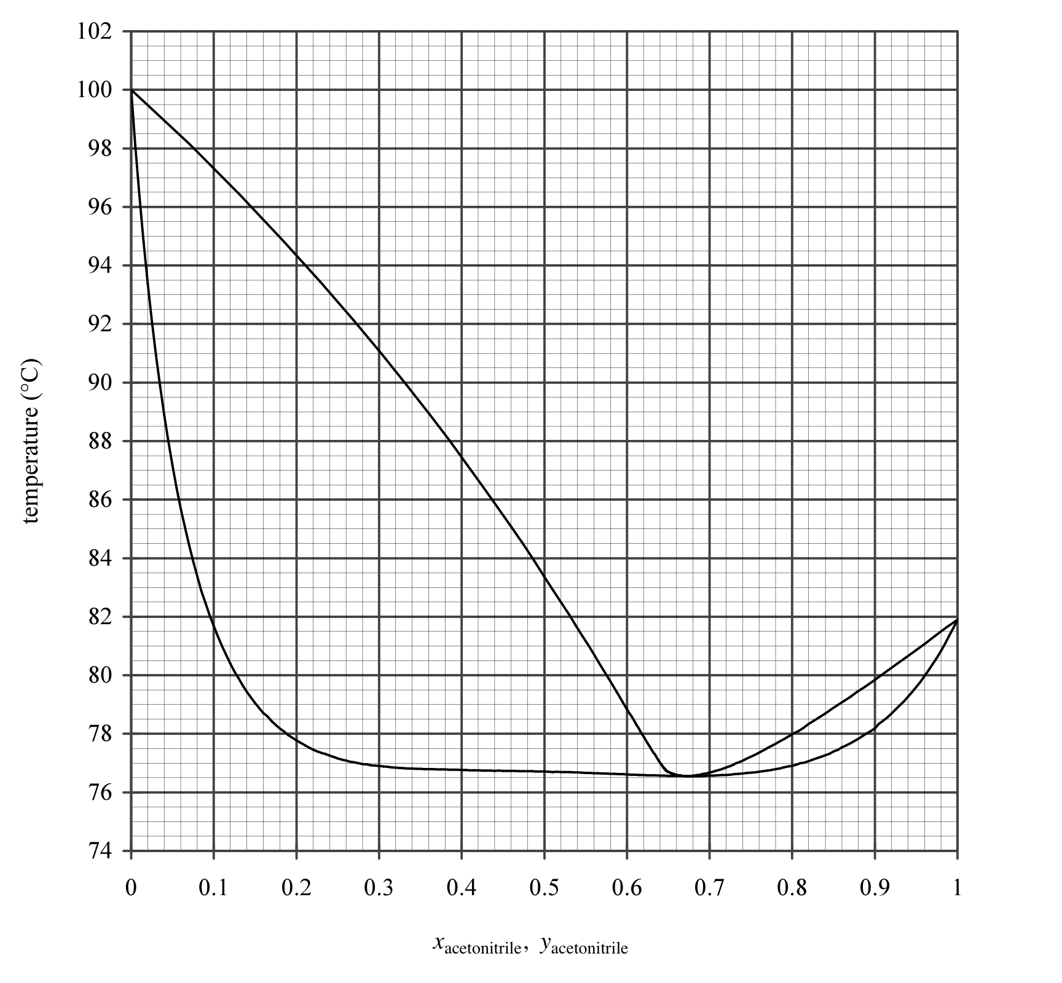
F) Label four regions of the T-x diagram
vapor
At an azeotrope:
Vapor composition =
Liquid composition
Boiling and condensing do not change composition, and further separation is impossible.
liq + vap
azeotrope
liquid

Slide 8
G) Determine the temp in the 20% ACN preheater
Feed stage:
y = 0.52
x = 0.09
82.5℃
H) Ratio of L/V leaving the preheater
82.5℃
Locate input (x = 0.20)
(0.52 - 0.2) V = (0.2 - 0.09) L

Slide 9
Key Takeaways
Always count stages on equilibrium line
Distillate is rich in more volatile component
Same composition as vapor stream leaving top stage
Bottoms is rich in less volatile component
Same composition as liquid stream leaving bottom stage
Feed stage connects stripping and rectifying operating lines
Slope of operating line is ratio of liquid to vapor flow rates

Slide 10


Merch Order Form
Mathworks Workshop

