Slide 1
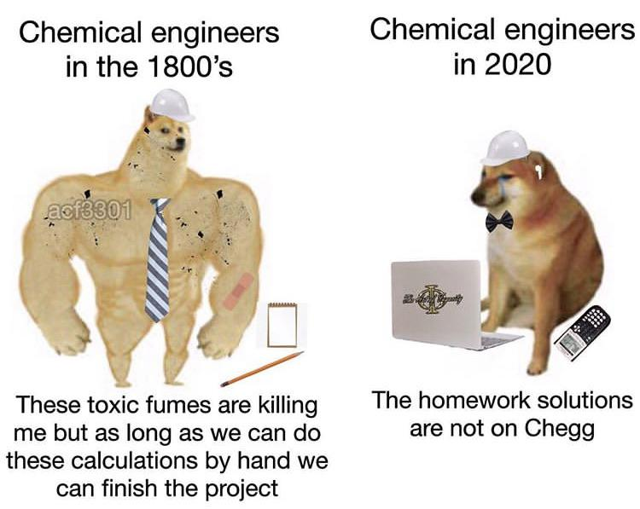
Exercise 4.42
By: Lauren Taylor (‘14)
Revised by: Kathy Fein (‘15), Max Serota (‘22), Sanna Vedrine (‘23) Austin Vollweiler (‘24), Donovan Cho (‘25)

Slide 2
Our Process
chemical process
liquid-liquid extractor
Notes:
our focus is on the LL absorber which takes x in cyclohexane and is absorbed into water

Slide 3
Our Operating Temperature Options
Which temperature should we use?
A
B
C
Too much
X in water
Too much X
in cyclohexane
T_{A} < T_{B} < T_{C}
Notes:
In our process, X transfers from cyclohexane to water, the operating line for the liquid-liquid absorber will lie below the equilibrium line.
Several approaches we can take to determine which temperature will maximize absorber capacity and minimize the absorber size

Slide 4
Approach 1: Constant wt ratio of X to Cyclohexane in
chemical process
liquid-liquid extractor
T_{A} , T_{B} , T_{C}
?
X/CH_{in}
Notes:
set in input ratio of X:cyclohexane and see which at which temperature we can absorb the most X into water based on the equilibrium relationship

Slide 5
Approach 1: Constant wt ratio of X to Cyclohexane in
0.087
0.05
0.032
0.05
T_{A} < T_{B} < T_{C}

Slide 6
Approach 1: Constant wt ratio of X to Cyclohexane in
0.087
A has the best results!
At T_{A} water can extract more X from cyclohexane
0.05
0.032
0.05
T_{A} < T_{B} < T_{C}
Notes:
Temperature TA is the better choice because the water will carry more X, and thus extract more X from the cyclohexane and/or have a lower flow rate of water in the liquid-liquid extractor.

Slide 7
Approach 2: Constant Operating Line
A
B
C
A has the best results!
At T_{A} more X is extracted from cyclohexane for the same operating conditions and number of stages
Notes:
Second approach is to set a constant operating line and use the different equilibrium lines to see how much X can be absorbed into water.
Clearly the equilibrium line at TA extracts more X from the cyclohexane than does the equilibrium
line at TC, given the same L/V operating conditions, which sets the capacity of the distillation column.
Two ways to interpret these results
for same number of stages, TA will allow water to absorb our more water
for the same amount of X absorbed into water, much fewer stages are needed at Ta

Slide 8
Approach 3: Constant Initial and Final wt ratios
chemical process
liquid-liquid extractor
T_{A} , T_{B} , T_{C}
X/CH_{out}
X/CH_{in}
X/H₂O_{in}
?
Notes:
3rd approach is to set the operating conditions (water and cyclohexane flowrates) therefore have a constant slope. as see how the amount of X in the water varies with temperature

Slide 9
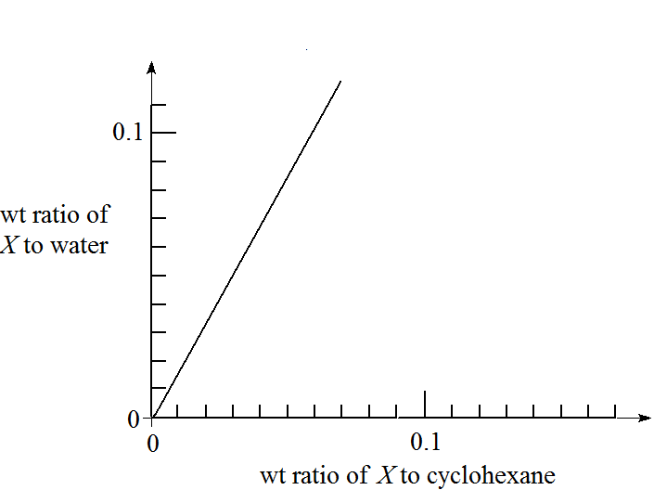
Approach 3: Constant Initial and Final wt ratios
0.107
X/H₂O_{in}
X/CH_{out}
X/CH_{in}
Notes:
A third approach is to vary the operating lines to extract the same amount of X into water at each temperature.
* to be clear – we are drawing the operating line in such a way that our process will have 4 stages and the same compositions in/out

Slide 10
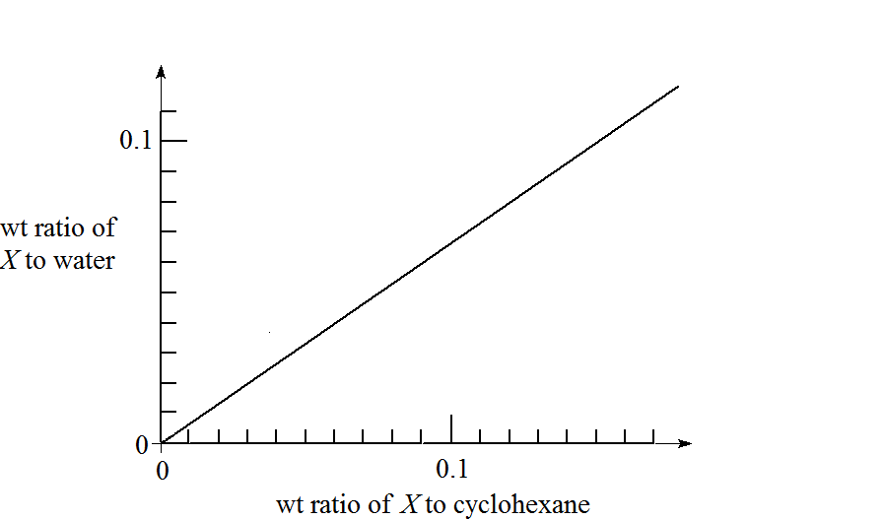
Approach 3: Constant Initial and Final wt ratios
0.042
X/H₂O_{in}
X/CH_{out}
X/CH_{in}

Slide 11
Which one uses less water?
Which one gets more X into water?
0.107
0.042
X/H₂O_{in}
X/H₂O_{in}
X/CH_{out}
X/CH_{in}
X/CH_{out}
X/CH_{in}
A
C

Slide 12
Which one uses less water?
Which one gets more X into water?
A has the best results!
At T_{A} the operating line is steeper, meaning for a given cyclohexane flow rate, the flow rate of water is smaller, and more X is extracted into the water
0.107
X/H₂O_{in}
X/CH_{out}
X/CH_{in}
A
Notes:
Compare to the slope of the operating line at TA needed to achieve the same inlet and outlet composi- tions. The operating line at TA as a greater slope, so for a given cyclohexane flow rate L, a much smaller flow rate of water, V is needed. Thus the liquid-liquid absorber and the distillation column will be much smaller, with the same amount of X extracted.

Slide 13
Takeaways
 | What are we holding constant? | What are we varying or assessing?
Approach 1 | Weight ratio of X to cyclohexane in | Amount of X extracted at each temperature (absorber capacity)
Approach 2 | Operating line slope | Amount of X extracted at each temperature (absorber capacity and stages)
Approach 3 | Amount of X:cyclohexane in, out and X:water in | Operating line slope (absorber size) Amount of X extracted at each temperature (absorbed ca
Notes:
The exercise asks us to determine which is the best operating temperature
maximizing the absorber capacity
minimizing the absorber size
Several approaches:
-
ompare the capacity of water to absorb X from cyclohexane with an arbitrary wt ratio of X in cyclohexane, such as 0.05 shown by the dotted line below.
Another approach is to compare the effectiveness of operating at different temperatures by drawing operating lines and stepping off the stages.
A third approach is to vary the operating lines to extract the same amount of X at each temperature.
A third approach is to vary the operating lines to extract the same amount of X at each temperature.

Slide 14
Takeaways
There are multiple ways to approach a problem
Use methods that make sense to you
Check with a different method if unsure
Breakdown a problem into smaller steps

