Slide 1
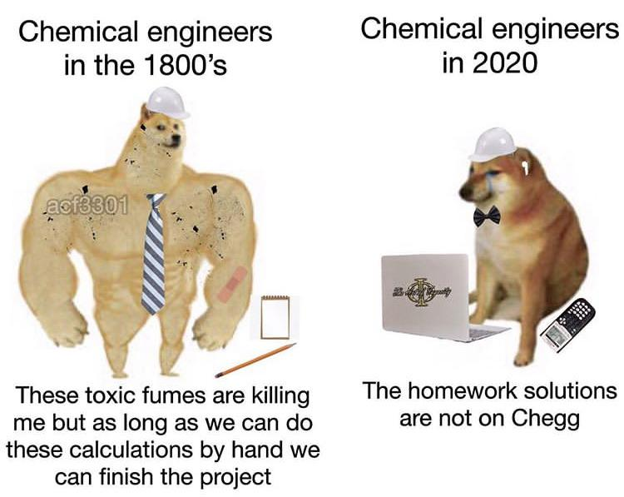
Exercise 4.42
By: Lauren Taylor (‘14)
Revised by: Kathy Fein (‘15), Max Serota (‘22), Sanna Vedrine (‘23) Austin Vollweiler (‘24), Donovan Cho (‘25), Liam Gillespie (‘26)

Slide 2
Our Process
chemical process
liquid-liquid extractor
Notes:
our focus is on the LL absorber which takes x in cyclohexane and is absorbed into water

Slide 3
Our Operating Temperature Options
Which temperature should we use?
A
B
C
Too much
X in water
Too much X
in cyclohexane
Our Water Stream
0.01
T_{A} < T_{B} < T_{C}
Notes:
In our process, X transfers from cyclohexane to water, the operating line for the liquid-liquid absorber will lie below the equilibrium line.
Several approaches we can take to determine which temperature will maximize absorber capacity and minimize the absorber size

Slide 4
Approach 1: Constant wt ratio of X to Cyclohexane in
chemical process
liquid-liquid extractor
T_{A} , T_{B} , T_{C}
?
X/CH_{in}
Notes:
set in input ratio of X:cyclohexane and see which at which temperature we can absorb the most X into water based on the equilibrium relationship

Slide 5
Approach 1: Constant wt ratio of X to Cyclohexane in
0.087
0.05
0.032
0.05
T_{A} < T_{B} < T_{C}

Slide 6
Approach 1: Constant wt ratio of X to Cyclohexane in
0.087
A has the best results!
At T_{A} water can extract more X from cyclohexane
0.05
0.032
0.05
T_{A} < T_{B} < T_{C}
Notes:
Temperature TA is the better choice because the water will carry more X, and thus extract more X from the cyclohexane and/or have a lower flow rate of water in the liquid-liquid extractor.

Slide 7
Approach 2: Constant Operating Line
A
B
C
A has the best results!
At T_{A} more X is extracted from cyclohexane for the same operating conditions and number of stages
Notes:
Second approach is to set a constant operating line and use the different equilibrium lines to see how much X can be absorbed into water.
Clearly the equilibrium line at TA extracts more X from the cyclohexane than does the equilibrium
line at TC, given the same L/V operating conditions, which sets the capacity of the distillation column.
Two ways to interpret these results
for same number of stages, TA will allow water to absorb more X
for the same amount of X absorbed into water, much fewer stages are needed at Ta

Slide 8
Approach 3: Constant Initial and Final wt ratios
chemical process
liquid-liquid extractor
T_{A} , T_{B} , T_{C}
X/CH_{out}
X/CH_{in}
X/H₂O_{in}
?
Notes:
3rd approach is to set the operating conditions (water and cyclohexane flowrates) therefore have a constant slope. as see how the amount of X in the water varies with temperature

Slide 9
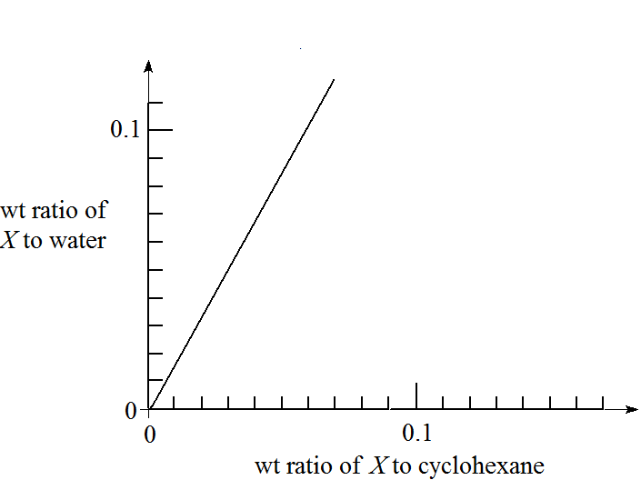
Approach 3: Constant Initial and Final wt ratios
0.107
X/H₂O_{in}
X/CH_{out}
X/CH_{in}
Notes:
A third approach is to vary the operating lines to extract the same amount of X into water at each temperature.
* to be clear – we are drawing the operating line in such a way that our process will have 4 stages and the same compositions in/out

Slide 10
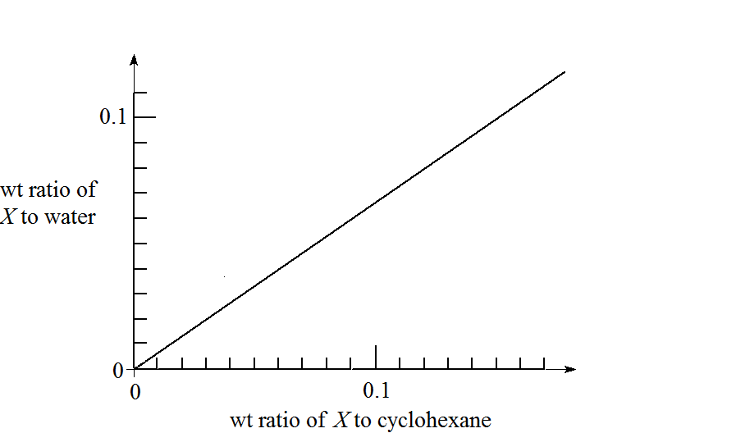
Approach 3: Constant Initial and Final wt ratios
0.042
X/H₂O_{in}
X/CH_{out}
X/CH_{in}

Slide 11
Which one uses less water?
Which one gets more X into water?
0.107
0.042
X/H₂O_{in}
X/H₂O_{in}
X/CH_{out}
X/CH_{in}
X/CH_{out}
X/CH_{in}
A
C

Slide 12
Which one uses less water?
Which one gets more X into water?
A has the best results!
At T_{A} the operating line is steeper, meaning for a given cyclohexane flow rate, the flow rate of water is smaller, and more X is extracted into the water
0.107
X/H₂O_{in}
X/CH_{out}
X/CH_{in}
A
Notes:
Compare to the slope of the operating line at TA needed to achieve the same inlet and outlet composi- tions. The operating line at TA as a greater slope, so for a given cyclohexane flow rate L, a much smaller flow rate of water, V is needed. Thus the liquid-liquid absorber and the distillation column will be much smaller, with the same amount of X extracted.

Slide 13
Takeaways
 | What are we holding constant? | What are we varying or assessing?
Approach 1 | Weight ratio of X to cyclohexane in | Amount of X extracted at each temperature (absorber capacity)
Approach 2 | Operating line slope | Amount of X extracted at each temperature (absorber capacity and stages)
Approach 3 | Amount of X:cyclohexane in, out and X:water in | Operating line slope (absorber size) Amount of X extracted at each temperature (absorbed ca
Notes:
The exercise asks us to determine which is the best operating temperature
maximizing the absorber capacity
minimizing the absorber size
Several approaches:
-
ompare the capacity of water to absorb X from cyclohexane with an arbitrary wt ratio of X in cyclohexane, such as 0.05 shown by the dotted line below.
Another approach is to compare the effectiveness of operating at different temperatures by drawing operating lines and stepping off the stages.
A third approach is to vary the operating lines to extract the same amount of X at each temperature.
A third approach is to vary the operating lines to extract the same amount of X at each temperature.

Slide 14
Takeaways
There are multiple ways to approach a problem
Use methods that make sense to you
Check with a different method if unsure
Breakdown a problem into smaller steps

