Slide 1
Calculation Session 12
Exercise 4.72
Created by: Gina Johnson (‘14)
Edited by: Katrina Curtiss (’15), McKenzie Hubert (’16), Amy Penick (’17), Natalie Goh (’17), Doris Chen (’18), Olivia Young (’19), Emily Spiek (’21), Ailen Lao (’23), Austin Kwan (’24), and Ashlyn Dumaw (‘25)

Slide 2
Goal:
Describe the design and operation of a distillation column using graphical analysis
PFD for a process that converts E to M
McCabe-Thiele diagram for the distillation column
x-y and temp-comp diagram for the mixture
Info:
Where to start:
Understand the given process
Utilize different diagrams for different purposes!

Slide 3
Process Converting E to M

Slide 4
A) # of Stages & Feed Stage Location
12
Always use the equilibrium line to count stages!
11 stages
Slope of the operating line changes at the feed stage
Stage 5
11
10
9
8
7
6
5
4
3
2
1

Slide 5
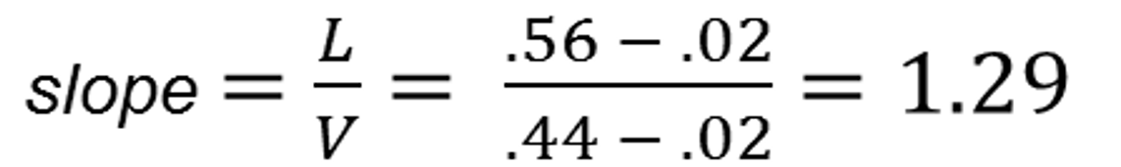
B) L/V in the Stripping Section
Locate the stripping section
Find specific endpoints
(0.02, 0.02)
(0.44, 0.56)
Calculate slope
(0.44, 0.56)
(0.02, 0.02)

Slide 6
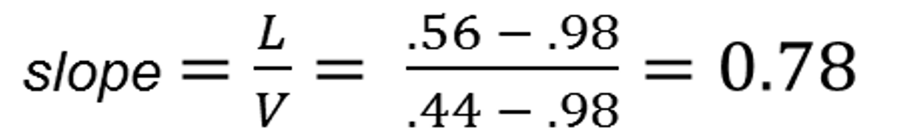
B) L/V in the Rectifying Section
(0.98, 0.98)
Locate the rectifying section
Find specific endpoints
(0.44, 0.56)
(0.98, 0.98)
Calculate slope
(0.44, 0.56)

Slide 7
B) Temperature in the Cooler
Composition of cooler?
Feed stage at equilibrium
x = 0.37
y = 0.60
Temperature…
Temp-comp diagram!
A
B
C

Slide 8
B) Temperature in the Cooler
Composition of cooler?
Feed stage at equilibrium
x = 0.37
y = 0.60
Temperature…
Temp-comp diagram!
79°C
79°C

Slide 9
C) Flow Rate of the Product Stream
rate in = rate out
1 mol of E → 1 mol of M
52 mol/min

Slide 10
D) Flow Rate of Vapor to the Condenser

Slide 11
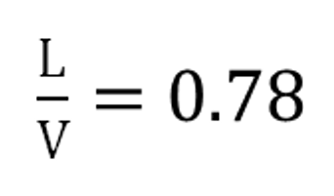
D) Flow Rate of Vapor to the Condenser
Mass balance
V = L + 52
Relationship between L and V?
(from Part B: rectifying section)
V = 0.78V + 52
V = 240 mol/min
V
L
52 mol/min

Slide 12
E) Distillation Operation with 40% Feed
Reactor output: 40%
(feed to distillation column)
Feed stage is within constraints!
Will this operating temperature
still work?
5
0.20 ≤ x_{M} ≤ 0.40
0.40 ≤ y_{M} ≤ 0.62

Slide 13
E) Distillation Operation with 40% Feed
Reactor output: 40%
(feed to distillation column)
Feed stage is within constraints!
Will this operating temperature
still work?
No change in operation!
79°C

Slide 14
F) Distillation Operation with 30% Feed
Reactor output: 30%
(feed to distillation column)
Feed stage is not within constraints
5

Slide 15
F) Distillation Operation with 30% Feed
Reactor output: 30%
(feed to distillation column)
Feed stage is not within constraints
Operating temperature no longer works
79°C

Slide 16
F) Distillation Operation with 30% Feed
Constraints:
Feed enters at stage 5
Feed is 30% M
Feed is liquid and vapor
x_{M} = 0.3 could be a fulcrum
Bottoms is 2% M
Distillate is 98% M
Must have 11 stages
Technique:
Guess & Check

Slide 17
F) Distillation Operation with 30% Feed
5
11
Locate feed constraint region
Locate targets for bottoms/distillate
Draw operating lines, intersecting near feed constraint region
Count off stages
Total stages: 11
Calculate L/V ratios for stripping and rectifying sections
Locate feed stage, find composition
Feed stage: stage 5
L/V Ratios:
Stripping: 1.52
Rectifying: 0.82
5
Feed M Composition:
x = 0.26
y = 0.47

Slide 18
F) Distillation Operation with 30% Feed
Locate equilibrium from feed
on temp-comp diagram
Locate 30% feed
Find operating temperature
81°C
81°C
L/V Ratios:
Stripping: 1.52
Rectifying: 0.82

Slide 19
F) Minimum M Reactor Output
11
10
L/V = 1
Total reflux operation!
Operating line = x-y line
Count backwards to feed stage 5
Locate equilibrium concentration
9
8
7
L/V = 1
6
Feed:
x = 0.07
y = 0.18
5

Slide 20
F) Minimum M Reactor Output
Locate equilibrium concentrations on temp-comp diagram
Operating temperature: 85°C
Fulcrum at the minimum of the lever
(limiting condition)
7 mol% M
85°C
Feed composition: 7 mol% M
(x = 0.07, y = 0.18)

Slide 21
Key Takeaways
Count stages on the equilibrium line
Find liquid/vapor flow rates from the slope of the stripping and rectifying lines (L/V ratio)
Don’t neglect mass balances!
Use temperature-composition diagrams to evaluate changes in feed composition
Guess & check is another method of analysis

