Slide 1
Calculation Session 12
Exercise 4.72
Created by: Gina Johnson (‘14)
Edited by: Katrina Curtiss (’15), McKenzie Hubert (’16), Amy Penick (’17), Natalie Goh (’17), Doris Chen (’18), Olivia Young (’19), Emily Spiek (’21), Ailen Lao (’23), Austin Kwan (’24), Ashlyn Dumaw (‘25), and Amy Wu (‘26)

Slide 2
Process Converting E to M

Slide 3



A) # of Stages & Feed Stage Location
12
Always use the equilibrium line to count stages!
11 stages
Slope of the operating line changes at the feed stage
Stage 5
11
10
9
8
7
6
5
4
3
2
1

Slide 4
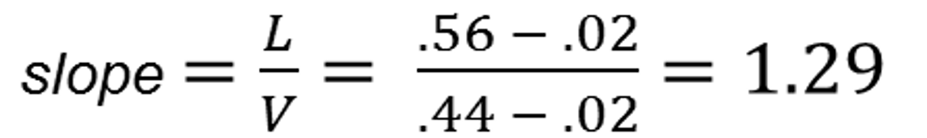
B) L/V in the Stripping Section
Locate the stripping section
Find specific endpoints
(0.02, 0.02)
(0.44, 0.56)
Calculate slope
(0.44, 0.56)
(0.02, 0.02)

Slide 5
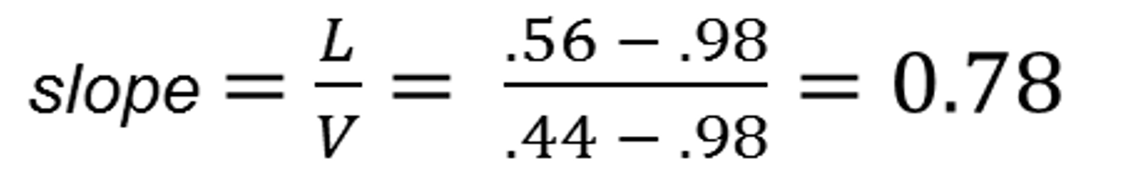
B) L/V in the Rectifying Section
(0.98, 0.98)
Locate the rectifying section
Find specific endpoints
(0.44, 0.56)
(0.98, 0.98)
Calculate slope
(0.44, 0.56)

Slide 6
B) Temperature in the Cooler
Composition of cooler?
Feed stage at equilibrium
x = 0.37
y = 0.60
Temperature…
Temp-comp diagram!

Slide 7
B) Temperature in the Cooler
Composition of cooler?
Feed stage at equilibrium
x = 0.37
y = 0.60
Temperature…
Temp-comp diagram!
79°C
79°C

Slide 8
C) Flow Rate of the Product Stream
rate in = rate out
1 mol of E → 1 mol of M
52 mol/min

Slide 9
D) Flow Rate of Vapor to the Condenser

Slide 10
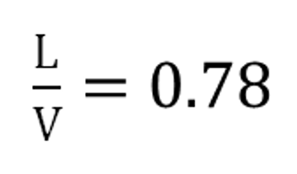
D) Flow Rate of Vapor to the Condenser
Mass balance
V = L + 52
Relationship between L and V?
(from Part B: rectifying section)
V = 0.78V + 52
V = 240 mol/min
V
L
52 mol/min

Slide 11
E) Distillation Operation with 40% Feed
Reactor output: 40%
(feed to distillation column)
Feed stage is within constraints!
Will this operating temperature
still work?
5
0.20 ≤ x_{M} ≤ 0.40
0.40 ≤ y_{M} ≤ 0.62

Slide 12
E) Distillation Operation with 40% Feed
Reactor output: 40%
(feed to distillation column)
Feed stage is within constraints!
Will this operating temperature
still work?
No change in operation!
79°C

Slide 13
F) Distillation Operation with 30% Feed
Reactor output: 30%
(feed to distillation column)
Feed stage is not within constraints
5

Slide 14
F) Distillation Operation with 30% Feed
Reactor output: 30%
(feed to distillation column)
Feed stage is not within constraints
Operating temperature no longer works
79°C

Slide 15
F) Distillation Operation with 30% Feed
Constraints:
Feed enters at stage 5
Feed is 30% M
Feed is liquid and vapor
Bottoms is 2% M
Distillate is 98% M
Must have 11 stages
Technique:
Guess & Check

Slide 16
F) Distillation Operation with 30% Feed
5
11
Locate feed constraint region
Locate targets for bottoms/distillate
Draw operating lines, intersecting near feed constraint region
Count off stages
Total stages: 11
Calculate L/V ratios for stripping and rectifying sections
Locate feed stage, find composition
Feed stage: stage 5
L/V Ratios:
Stripping: 1.52
Rectifying: 0.82
5
Feed M Composition:
x = 0.26
y = 0.47

Slide 17
F) Distillation Operation with 30% Feed
Locate equilibrium from feed
on temp-comp diagram
Locate 30% feed
Find operating temperature
81°C
81°C
L/V Ratios:
Stripping: 1.52
Rectifying: 0.82

Slide 18
G) Minimum M Reactor Output
11
10
L/V = 1
Total reflux operation!
Operating line = x-y line
Count backwards to feed stage 5
Locate equilibrium concentration
9
8
7
L/V = 1
6
Feed:
x = 0.07
y = 0.18
5

Slide 19
G) Minimum M Reactor Output
Locate equilibrium concentrations on temp-comp diagram
Operating temperature: 85°C
Take the smaller M composition
(asks for minimum M reactor output)
7 mol% M
85°C
Feed composition: 7 mol% M
(x = 0.07, y = 0.18)

Slide 20
Key Takeaways
Count stages on the equilibrium line
Find liquid/vapor flow rates from the slope of the stripping and rectifying lines (L/V ratio)
Don’t neglect mass balances!
Use temperature-composition diagrams to evaluate changes in feed composition
Guess & check is another method of analysis

