Slide 1
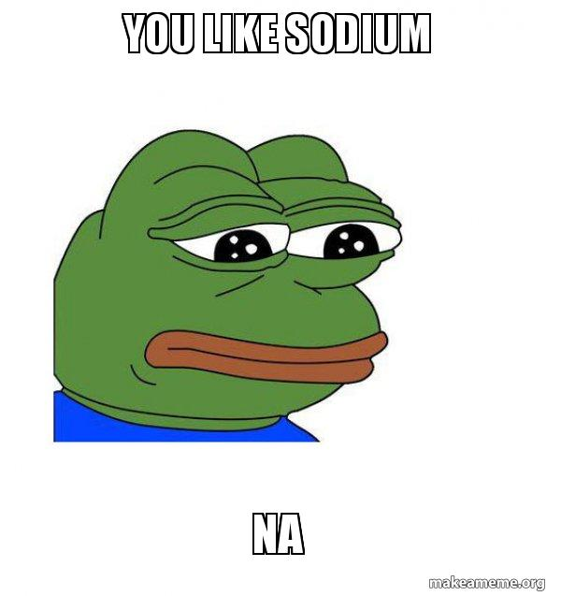
Exercise 4.93
Created by Dennis Wu & Lauren de Silva ('25)

Slide 2
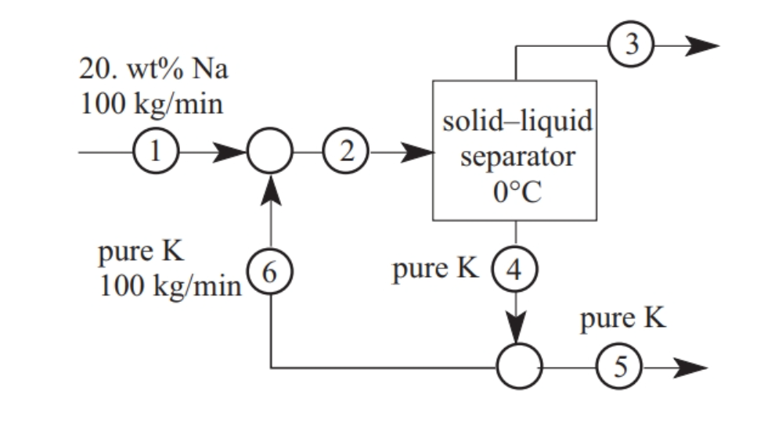
Given Information
Building some intuition...
Mixing line
Tie lines

Slide 3
(A) What is the composition of stream 3?
Given information:
  Stream 3 comes out of a solid-liquid separator at 0C
  Stream 3 is the liquid effluent
  Stream 4 is pure K
Hmmmm... okay let's just draw a tie line and find stream 3! EZPZ

Slide 4
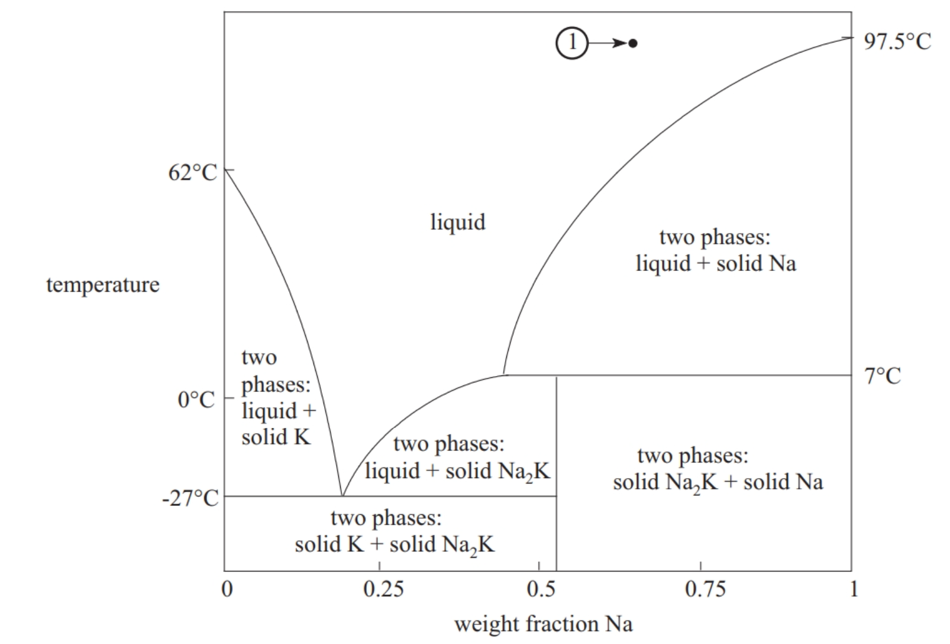
(A) Let's draw our tie line
Tie lines will end on the two phase boundary
4
3

Slide 5
(A) Let's do a check
What do we know?
Stream 2 enters the solid-liquid separator
Steam 2 comes from mixing streams 1 and 6
Stream 1: 100 kg/min 20% Na + 80% K
Stream 6: 100 kg/min 100% K
Stream 2: 200 kg/min 10% Na 90% K

Slide 6
(A) Let's place stream 2
4
3
2

Slide 7


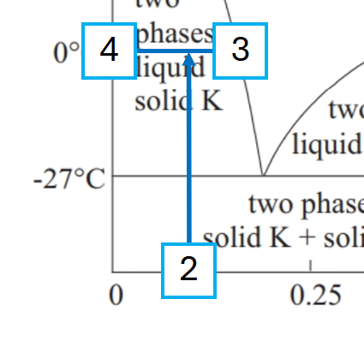

(B) Erm... professor this process isn't viable!
What do we know?
F2 = 200 kg/min
Stream 2 is 10% Na
Let's use the lever rule!
F4 = F2 × (.165 - .1) / (.165)
F4 = (200) × (.394)
F4 = 78.8 kg/min
wait a sec....
.165

Slide 8

(B) Does this match our provided PFD?
What's this thing say over here?
78.8 kg/min
The mass balance around the splitter is NOT valid, thus this process is NOT viable

Slide 9

(C) What if we change the temp?
Stream 2 is a mixture between stream 1 and 6
Decreasing temperature increases flow rate of stream 4, but it will never reach 20% which we need to get 100kg/min of stream 6
4
3
6
1
2
0.1
0.2

Slide 10
(C) What if we change the temp?
Let’s try increasing F4 by lowering the separator temperature…
4
3
2

Slide 11
(C) What if we change the temp?
Well, we can’t get F4 > 100 kg/min.
Can we change F6?
4
3
0.07
2
F4 = 200 kg/min (0.07/0.17)
0.17
F4 = 82 kg/min

Slide 12
(C) What if we change the temp?
Decreasing F6 concentrates F2…
3
4
2
Notes:
Changing the flow rate of stream 6 will not change the conclusion. Any tie line drawn across the two-phase region will be shorter than a line from pure K to stream 1 (20 wt% Na). The flow rate of stream 4 will always be less than the flow rate of stream 6. The process cannot be made to work.

Slide 13
(C) What if we change the temp?
Increasing F6 dilutes F2…
3
4
2
Notes:
Changing the flow rate of stream 6 will not change the conclusion. Any tie line drawn across the two-phase region will be shorter than a line from pure K to stream 1 (20 wt% Na). The flow rate of stream 4 will always be less than the flow rate of stream 6. The process cannot be made to work.

Slide 14

(C) What if we change the temp?
But either way, x_{Na,3} < 0.20.
We take a stream of 20 wt% Na and turn it into two streams with x_{Na} < 0.2.
Conclusion?? This process cannot be made to work!
3
4
2
Notes:
Changing the flow rate of stream 6 will not change the conclusion. Any tie line drawn across the two-phase region will be shorter than a line from pure K to stream 1 (20 wt% Na). The flow rate of stream 4 will always be less than the flow rate of stream 6. The process cannot be made to work.

Slide 15
(C) What if we change the flow rate of stream 6?
Stream 2 is a mixture between stream 1 and 6
Any tie line drawn across the two phase region will be shorter than the mixing line between stream 1 and 6
4
2
3
6
1
stream 4 will always be smaller than stream 6
0.1
0.2

Slide 16

(C) What if we change the flow rate of stream 6?
Stream 2 is a mixture between stream 1 and 6
stream 4 will always be smaller than stream 6 because your ratios will never be the same
4
2
3
6
2
1

Slide 17
Takeaways
Tie lines vs. Mixing lines
  Tie lines represent phases in equilibrium
  Mixing lines represent mixtures between two different streams
Legal vs. Illegal separations
Not all processes are possible, build intuition about physical meaning of separations

