Slide 1
Calculation Session 13
Exercise 4.61a
Created by: Ashlyn Dumaw (‘25)

Slide 2
Goal:
Determine if provided graphical models
are meaningful or meaningless
Info:
Graphical models for a binary mixture with
a multi-stage, counter-current separator
Where to start:
Recall the typical features of a graphical model

Slide 3
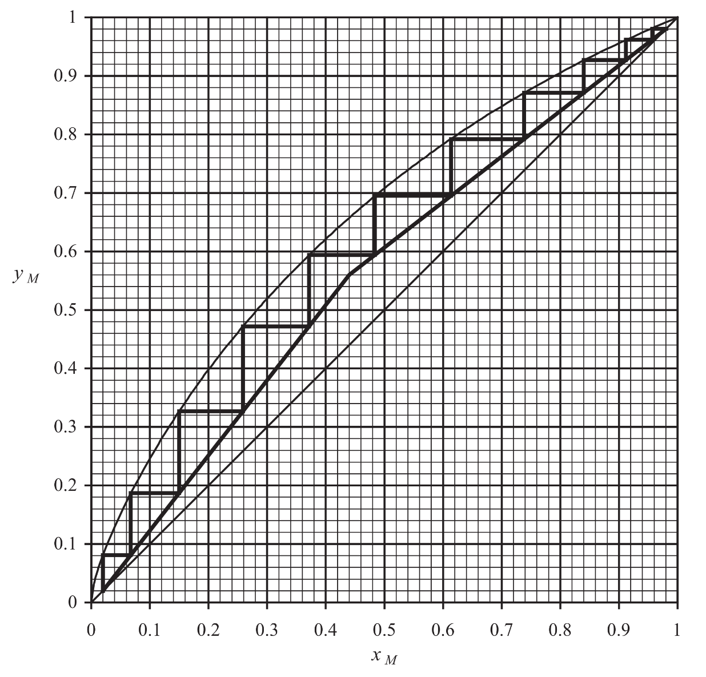
A Typical Graphical Model
equilibrium line
x-y line
operating lines
stripping section
rectifying section
count stages using the equilibrium line

Slide 4
A) Meaningful or Meaningless?
Key features:
Rectifying and stripping lines start on the x-y line
Steps begin on the rectifying
x-y point and terminate on the stripping x-y point

Slide 5
B) Meaningful or Meaningless?
Key features:
Pressure on the y-axis
Operating lines have no meaning!
Must be used on diagrams with compositions of distinct phases.

Slide 6
C) Meaningful or Meaningless?
Key features:
Steep stripping operating line
High reflux ratio

Slide 7
D) Meaningful or Meaningless?
Key features:
Slopes of operating lines are irrelevant
Single-step… single-stage
Flash drum!

Slide 8
E) Meaningful or Meaningless?
Key features:
Operating lines do not terminate on the x-y line
Partial reboiler/condenser!
…operating line should not terminate on equilibrium line
Slopes invalid
Stripping < 1 → L < V
Rectifying > 1

Slide 9
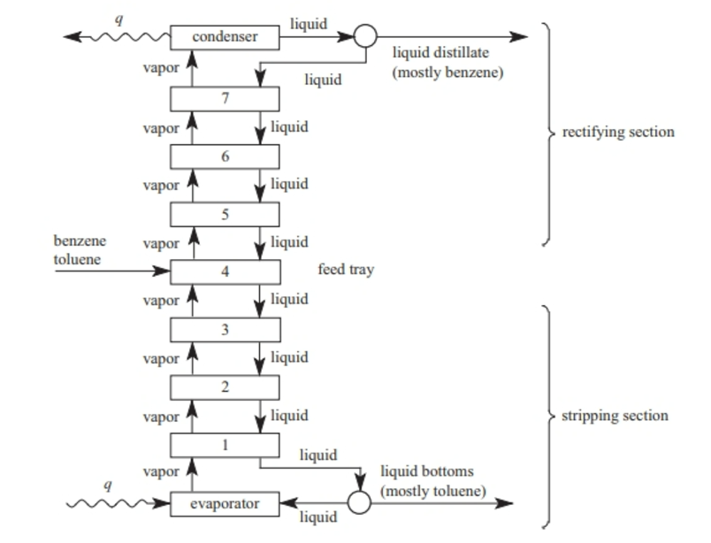
E) Meaningful or Meaningless?
Stripping section slope
Liquid stream split
Vapor < Liquid → L/V > 1
Rectifying → L/V < 1
Slopes invalid!

Slide 10
F) Meaningful or Meaningless?
Key features:
Stripping slope < 1
Rectifying slope > 1
Invalid slopes!

Slide 11
G) Meaningful or Meaningless?
Key features:
Funky equilibrium curve. Invalid.
Azeotrope!

Slide 12
H) Meaningful or Meaningless?
Key features:
Steps from operating line to x-y line
Should step from operating line to equilibrium line

Slide 13
I) Meaningful or Meaningless?
Key features:
Operating lines cross the x-y line
Partial reboiler/condenser?
Steps must terminate on equilibrium line, since they are eq stages!
Operating lines cannot start with vapor with pure B (x-axis) or liquid with pure A (right border)

Slide 14
J) Meaningful or Meaningless?
Key features:
Steps do not end on the x-y line
Multistage flash drum without reboiler at bottom, without condenser at top
(See Exercise 4.71)

Slide 15
Key Takeaways
Conduct McCabe-Thiele analyses on x-y diagrams
Pay close attention to operating lines
  Stripping slope > 1, rectifying slope < 1
  Should not terminate on the equilibrium line
  Should not cross the x=y line
Step from the operating line to the equilibrium line
The presence (or absence) of reboilers/condensers can affect your analysis
  Partial reboiler/condenser
  No reboiler/condenser

