Slide 1


Exercise 5.13
Created by: Leon Lee (’23)
Edited by: Maggie MacNeel (‘24), Dennis Wu (‘25), Angel Liang (‘26)

Slide 2
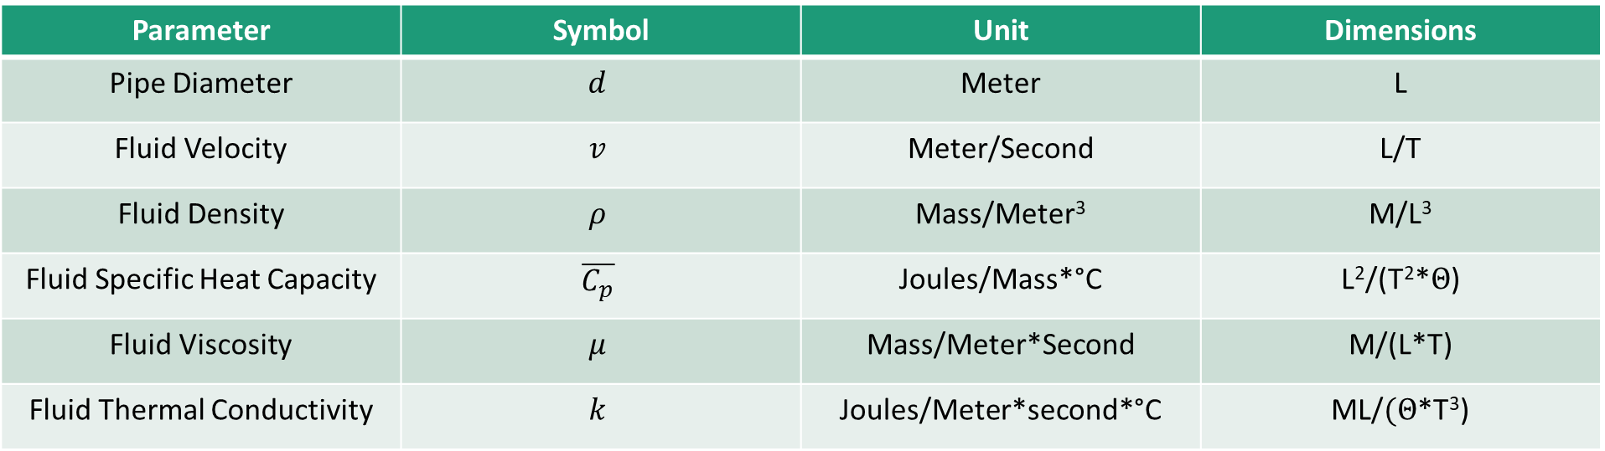
Given Parameters
Parameter | Symbol | Unit | Dimensions
Pipe Diameter | $$d$$ | Meter | L
Fluid Velocity | $$v$$ | Meter/Second | L/T
Fluid Density | $$ρ$$ | Mass/Meter³ | M/L³
Fluid Specific Heat Capacity | $$\overline{C_{p}}$$ | Joules/Mass*°C | L²/(T²*$Θ$)
Fluid Viscosity | $$μ$$ | Mass/Meter*Second | M/(L*T)
Fluid Thermal Conductivity | $$k$$ | Joules/Meter*second*°C | ML/$(Θ$*T³)

Slide 3
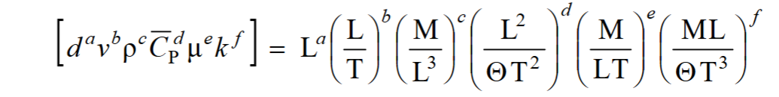
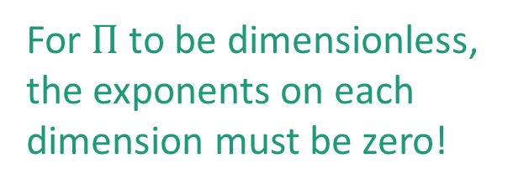
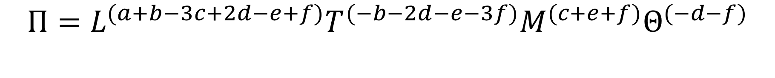
Formal Method
$$Π{=d}^{a}v^{b}ρ^{c} \overline{C_{p}^{d}}∗μ^{e}∗k^{f}$$
$$Π=L^{(a+b−3c+2d−e+f)}T^{(−b−2d−e−3f)}M^{(c+e+f)}Θ^{(−d−f)}$$
For $Π$ to be dimensionless, the exponents on each dimension must be zero!
Length: $a+b−3c+2d−e+f=0$
Time: $−b−2d−e−3f=0$
Mass: $c+e+f=0$
Temperature: $−d−f=0$
6 parameters – 4 equation = 2 $Π$ groups

Slide 4

Choosing our Core Variables
All Dimensions of the system must be represented by the core variables.
The core variables must not form a dimensionless group.
We choose $μ$ and $k$ as our core variables.
Let us choose the exponents of $μ$ and $k$ to be e and f respectively.

Slide 5
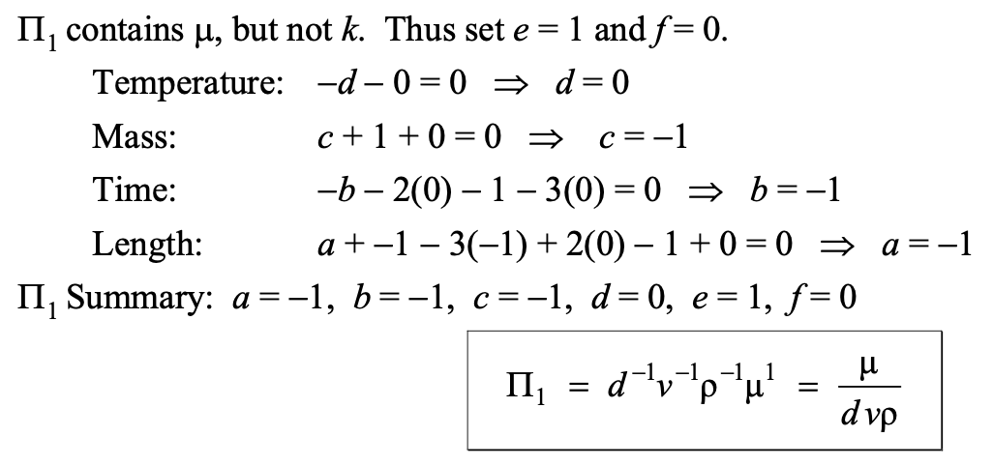
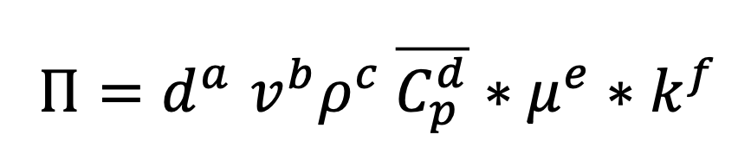
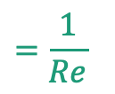
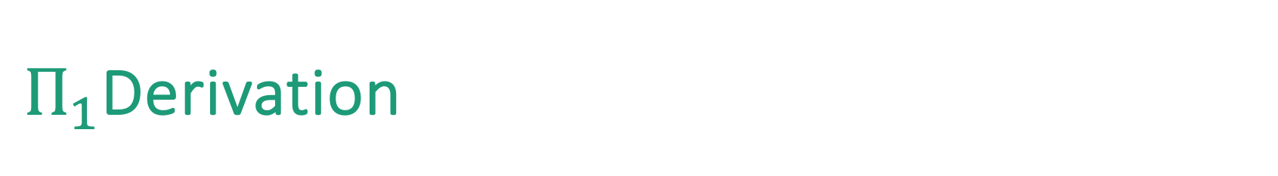

$Π_{1}$Derivation
Let’s set e = 1 and f = 0 for the first $Π$ group. Solving the constrained equations from the previous slide:
$$=\frac{1}{Re}$$
Let’s check our answer!
$$\frac{1}{Re}=\frac{μ}{dvρ}=\frac{\left(\frac{M}{LT}\right)}{L \left(\frac{L}{T}\right)\left(\frac{M}{L^{3}}\right)}=\frac{\frac{M}{LT}}{\frac{M}{LT}}=Dimensionless$$
✓

Slide 6
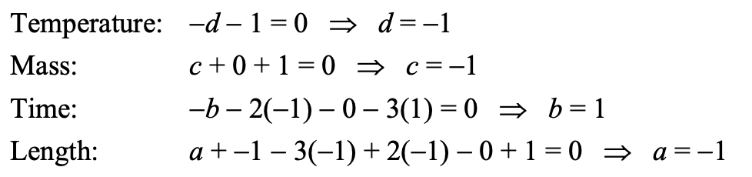

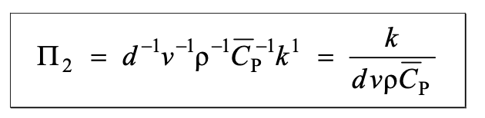
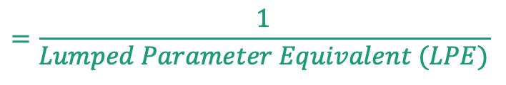
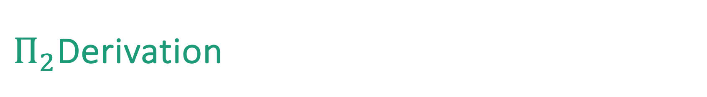

$Π_{2}$Derivation
Let’s set e = 0 and f = 1 for the second $Π$ group. Solving the constrained equations from the previous slide:
$$=\frac{1}{Lumped Parameter Equivalent (LPE)}$$
Let’s check our answer!
$$\frac{k}{dvρ\overline{C_{p}}}=\frac{\frac{ML}{ΘT^{3}}}{L(\frac{L}{T})(\frac{M}{L^{3}})(\frac{L^{2}}{ΘT^{2}})}=\frac{\frac{ML}{θT^{3}}}{\frac{ML}{θT^{3}}}=Dimensionless$$
✓

Slide 7





Another method for math lovers…
Let’s look back at our original system of equations:
Length: $a+b−3c+2d−e+f=0$
$$\begin{matrix}a & b & c & d & e & f\end{matrix}$$
Time: $−b−2d−e−3f=0$
$$\left[\begin{matrix}1 & 0 & 0 & 0 & 1 & 1 \\ 0 & 1 & 0 & 0 & 1 & 1 \\ 0 & 0 & 1 & 0 & 1 & 1 \\ 0 & 0 & 0 & 1 & 0 & 1\end{matrix}\right]$$
Mass: $c+e+f=0$
RREF
Temperature: $−d−f=0$
What can we get from this?
Rank of matrix: 4
Number of linearly independent vectors: 4
  a, b, c, d
Columns: 6
Number of linearly dependent vectors: $6−4=2$
  e, f representing core variables
$$\left[\begin{matrix}1 & 1 & −3 & 2 & −1 & 1 \\ 0 & −1 & 0 & −2 & −1 & −3 \\ 1 & 0 & 0 & 0 & 1 & 1 \\ 0 & 0 & 0 & −1 & 0 & 1\end{matrix}\right]$$

Slide 8
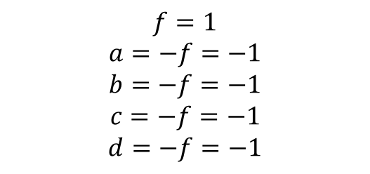

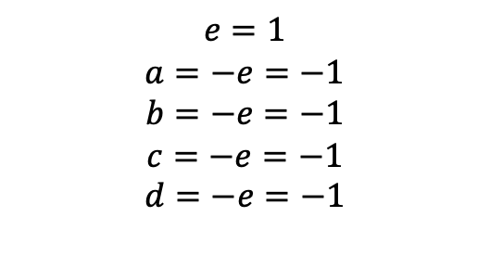




Calculating $Π_{1}$and $Π_{2}$
$$\begin{matrix}a & b & c & d & e & f\end{matrix}$$
$$\begin{matrix}a & b & c & d & e & f\end{matrix}$$
$$\left[\begin{matrix}1 & 0 & 0 & 0 & 1 & 1 \\ 0 & 1 & 0 & 0 & 1 & 1 \\ 0 & 0 & 1 & 0 & 1 & 1 \\ 0 & 0 & 0 & 1 & 0 & 1\end{matrix}\right]$$
$$\left[\begin{matrix}1 & 0 & 0 & 0 & 1 & 1 \\ 0 & 1 & 0 & 0 & 1 & 1 \\ 0 & 0 & 1 & 0 & 1 & 1 \\ 0 & 0 & 0 & 1 & 0 & 1\end{matrix}\right]$$
$$e=1$$
$$a=−e=−1$$
$$b=−e=−1$$
$$c=−e=−1$$
$$d=−e=−1$$
$$f=1$$
$$a=−f=−1$$
$$b=−f=−1$$
$$c=−f=−1$$
$$d=−f=−1$$

Slide 9
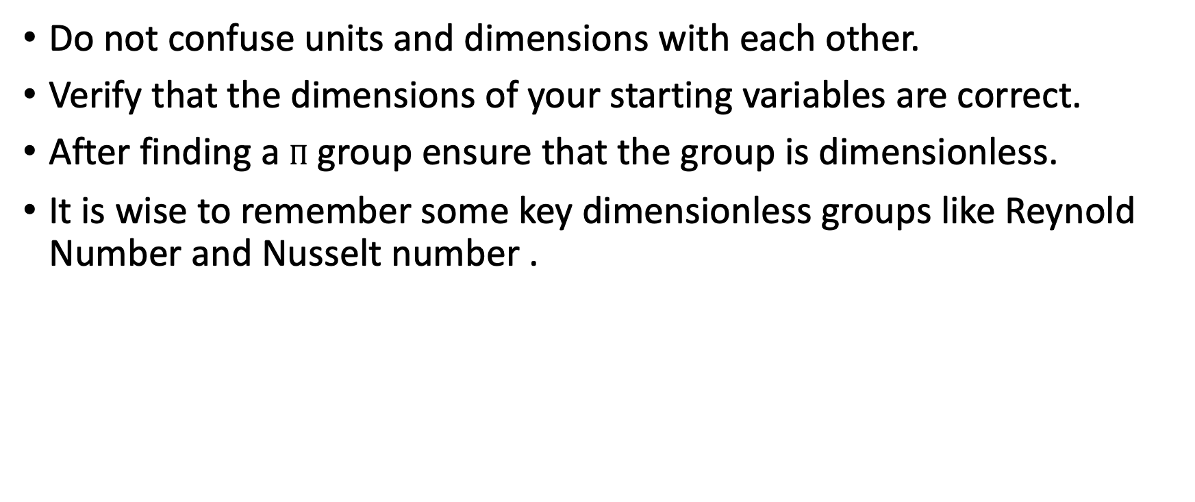
Key Takeaways
Do not confuse units and dimensions with each other.
Verify that the dimensions of your starting variables are correct.
After finding a $Π$ group ensure that the group is dimensionless.
It is wise to remember some key dimensionless groups like Reynold Number and Nusselt number .

