Slide 1
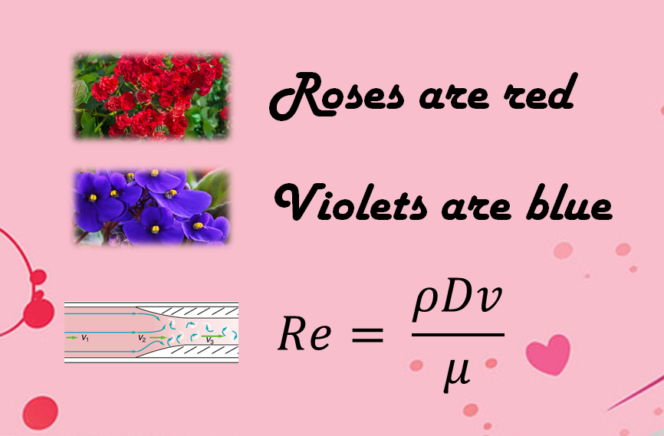
Exercise 5.22
Created by: McKenzie Huston (‘14)
Edited by: Bari Grossman (‘15), Maxine Chan (‘16),Robert Lee (‘17), Ameer Basrai (’18),Sydney Brannan (‘19),Sabrina Chen (‘20),Apoorva Agarwal (‘21),Sarah Huang (‘22),Ariel Struzyk (‘23), Burke Combs (‘24),Lauren de Silva (‘25)

Slide 2


This is your first real introduction to dimensionless numbers….
Don’t worry…you’ll apply them more next semester!

Slide 3
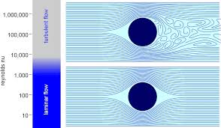
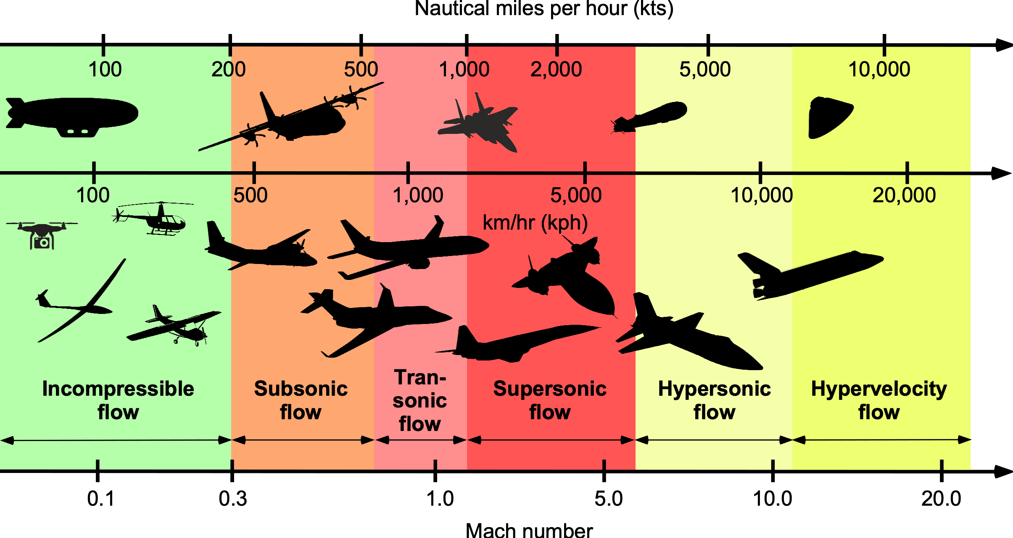
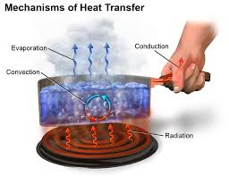
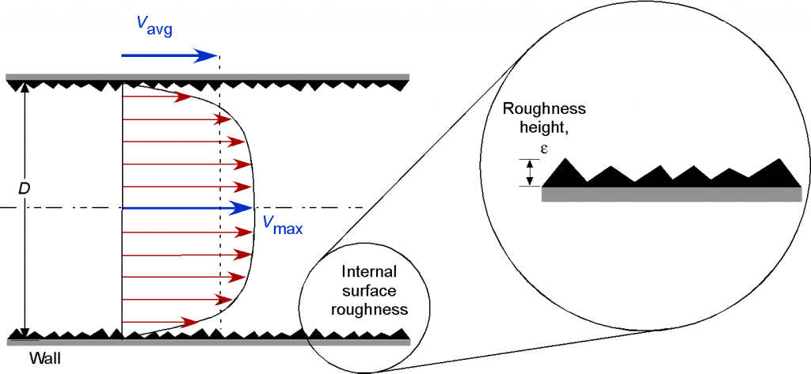

Slide 4
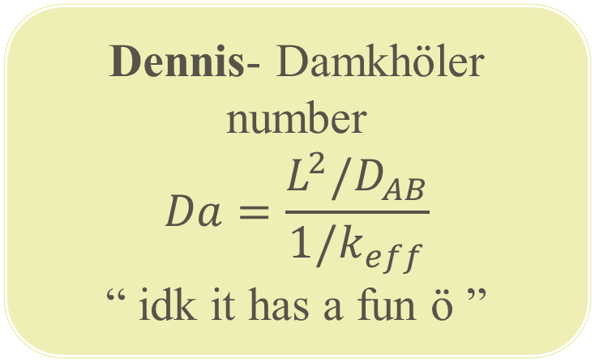
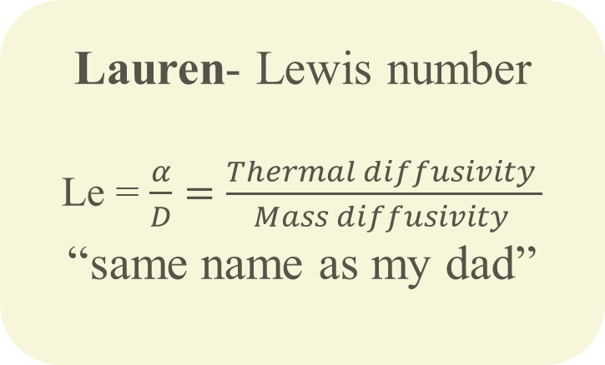
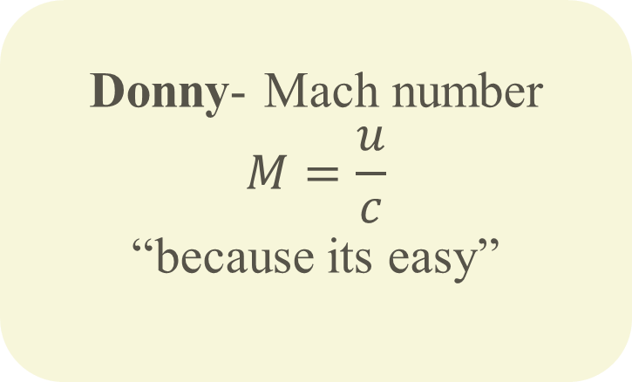
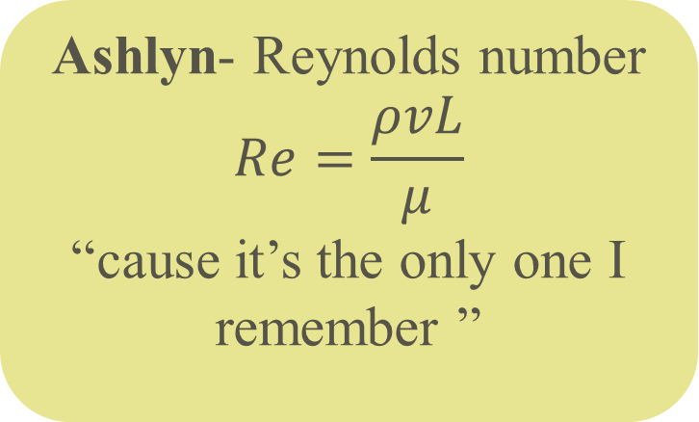
Your TA’s Favorite Dimensionless Groups
Donny- Mach number
$$M=\frac{u}{c}$$
“because its easy”
Ashlyn- Reynolds number
$$Re=\frac{ρvL}{μ}$$
“cause it’s the only one I remember ”
Dennis- Damkhӧler number
$$Da=\frac{L^{2}/D_{AB}}{1/k_{eff}}$$
“ idk it has a fun ӧ ”
Lauren- Lewis number
Le = $\frac{α}{D}=\frac{Thermal diffusivity }{Mass diffusivity }$
“same name as my dad”

Slide 5

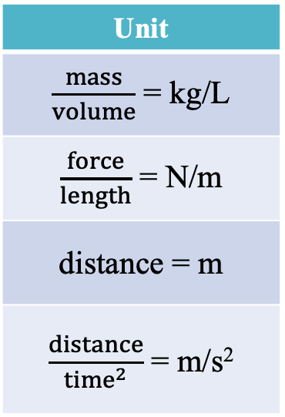
(A): Derive the Bond Number, Bo
Base Dimension | Abbreviation
Length | L
Mass | M
Time | T
Temperature | Θ
Amount | N
We need these dimensions!
Parameter | Symbol
Density difference | Δρ
Surface tension | γ
Characteristic size | d
Gravitational acceleration | g
Unit
$\frac{mass}{volume}$ = kg/L
$\frac{force}{length}$ = N/m
distance = m
$\frac{distance}{{time}^{2}}$ = m/s²
Dimensions
M/L³
L
L/T²

Slide 6
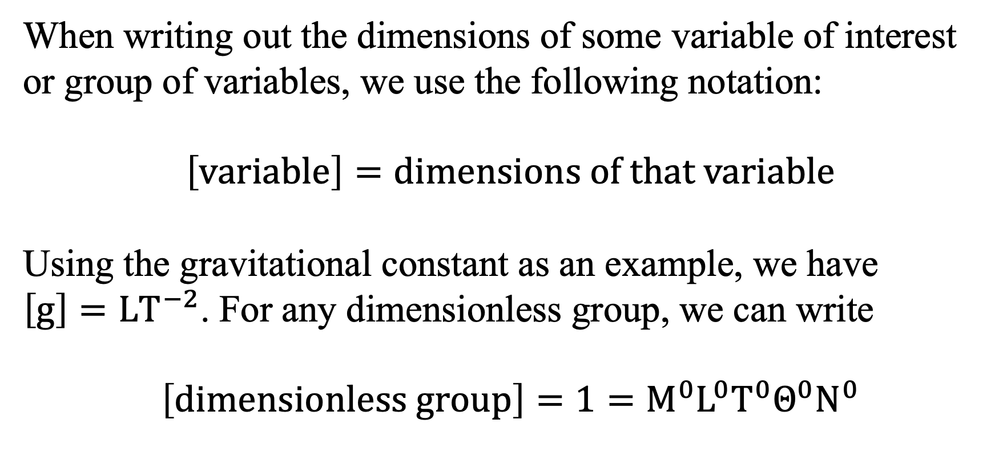
Aside: Important Notations
When writing out the dimensions of some variable of interest or group of variables, we use the following notation:
$$\left[variable\right]=dimensions of that variable$$
Using the gravitational constant as an example, we have
$\left[g\right]=LT^{−2}$. For any dimensionless group, we can write
$$\left[dimensionless group\right]=1=M^{0}L^{0}T^{0}Θ^{0}N^{0}$$

Slide 7
Deriving dimensions of surface tension
Base Dimension | Abbreviation
Length | L
Mass | M
Time | T
Temperature | Θ
Amount | N

Slide 8
Base Dimension | Abbreviation
Length | L
Mass | M
Time | T
Temperature | Θ
Amount | N
Let’s solve using the formal method!
Parameter | Symbol
Density difference | Δρ
Surface tension | γ
Characteristic size | d
Gravitational acceleration | g
Unit
$\frac{mass}{volume}$ = kg/L
$\frac{force}{length}$ = N/m
distance = m
$\frac{distance}{{time}^{2}}$ = m/s²
Dimensions
M/L³
M/T²
L
L/T²

Slide 9
Formal Method
Mass: a + b = 0
Length: –3a + c + d = 0
Time: –2b – 2d = 0
We know:
4 parameters – 3 equations = 1 Π group
Exponent of g is 1, so d = 1

Slide 10

Solve equations:
a = 1
b = –1
c = 2
d = 1
Check the dimensions of Bo:

Slide 11
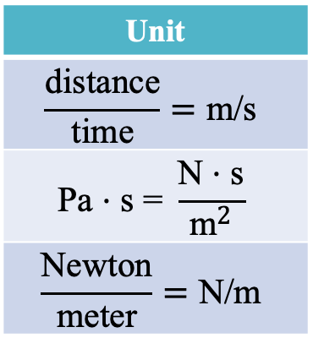
(B): Derive the Capillary Number, Ca
Parameter | Symbol
Fluid velocity | ν
Fluid viscosity | μ
Surface tension | γ
Unit
$$\frac{\text{distance}}{\text{time}}=\text{m}\text{/}\text{s}$$
$$\text{Pa}\text{ ⋅ }\text{s}\text{ = }\frac{\text{N}\text{ ⋅ }\text{s}}{{\text{m}}^{2}}$$
$$\frac{\text{Newton}}{\text{meter}}=\text{N}\text{/}\text{m}$$
Dimensions
L/T
M/LT
M/T²
Base Dimension | Abbreviation
Length | L
Mass | M
Time | T
Temperature | Θ
Amount | N

Slide 12
Informal Method
We know that the exponent of ν is 1.
The only other term with L is μ term. For L to cancel, b must equal 1, so
Combining the two known terms, we have
Therefore, c = -1

Slide 13
Formal and informal methods give the same answer!
Formal Method
Mass: b + c = 0
Length: a – b = 0
Time: –a – b – 2c = 0
Solve:
a = 1
b = 1
c = –1
3 parameters – 2 equations = 1 Π group
3 parameters – 3 equations = 0 Π groups
But wait, these equations are not independent!
–(a – b) – 2(b + c) = –a – b – 2c

Slide 14
Let’s check our answer…

Slide 15
Solution Method Summary
There are two valid methods to solve for dimensionless groups:
Formal method: write out expressions for dimensions, then solve algebraically
Informal method: use what you know and relationships between variables to deduce exponents

Slide 16
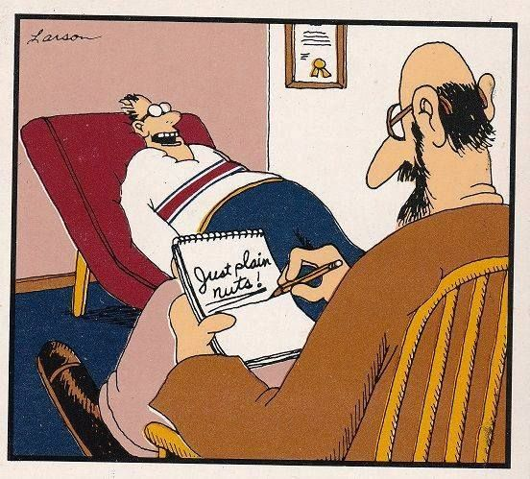

5.22: Key Takeaways
Units and dimensions are the same thing!
Don’t confuse units and dimensions!
Verify you use the correct dimensions!
Carefully work the algebra!
Check your final answer to ensure it is dimensionless.
$$\left[\text{meter}\right]≠\text{M}\text{!}$$

