Slide 1
Calculation Session 14
Exercise 5.33
Created by: Ashlyn Dumaw (‘25)

Slide 2
Goal:
Find the mass of a model meteor in a
dynamically-similar system
Info:
Three dimensionless groups that describe the event
Parameter info about the meteor and model
Where to start:
Organize your givens
Choose a suitable dimensionless group

Slide 3
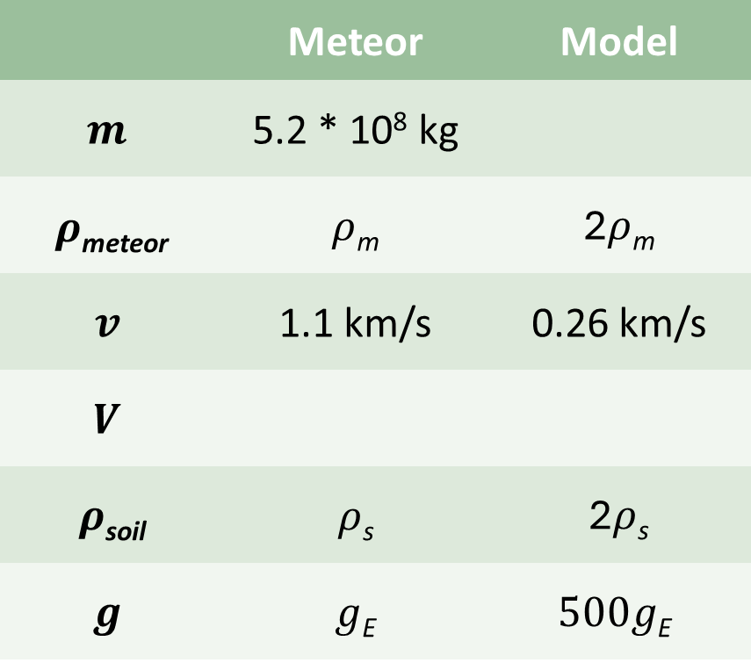
Provided Information
 | Meteor | Model
$$m$$ | 5.2 * 10⁸ kg
$ρ$_{meteor} | $ρ$_{m} | 2$ρ$_{m}
$$v$$ | 1.1 km/s | 0.26 km/s
$$V$$
$ρ$_{soil} | $ρ$_{s} | 2$ρ$_{s}
$$g$$ | $g$_{E} | $$500g\text{E}$$
How do we choose which
dimensionless group to use?

Slide 4
Determining m_{model}
 | Meteor | Model
$$m$$ | 5.2 * 10⁸ kg
$ρ$_{meteor} | $ρ$_{m} | 2$ρ$_{m}
$$v$$ | 1.1 km/s | 0.26 km/s
$$V$$
$ρ$_{soil} | $ρ$_{s} | 2$ρ$_{s}
$$g$$ | $g$_{E} | $$500g\text{E}$$

Slide 5
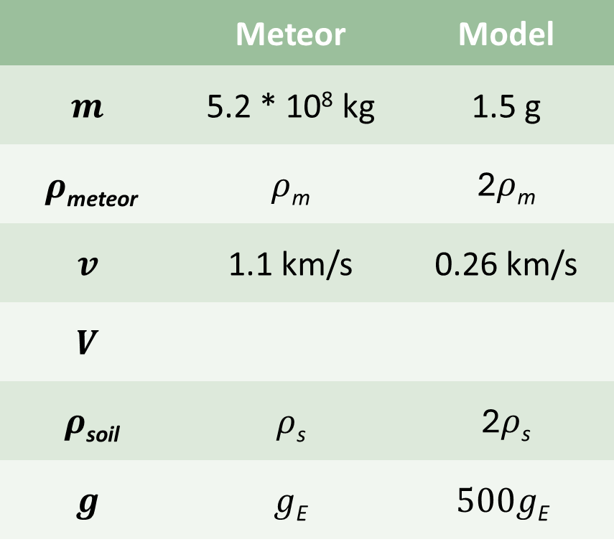


Scaling V
 | Meteor | Model
$$m$$ | 5.2 * 10⁸ kg | 1.5 g
$ρ$_{meteor} | $ρ$_{m} | 2$ρ$_{m}
$$v$$ | 1.1 km/s | 0.26 km/s
$$V$$
$ρ$_{soil} | $ρ$_{s} | 2$ρ$_{s}
$$g$$ | $g$_{E} | $$500g\text{E}$$
$\text{6.9}\text{ ∗ 10}\text{11} V$_{model}
$V$_{model}
model

Slide 6
Key Takeaways
Use dimensionless groups to relate dynamically similar systems
  Application: modeling large systems on a small-scale
  Calculate design parameters for a model based on the larger-scale system
  Equate different groups to calculate for different parameters
Use multiple dimensionless groups to fill in missing information

