Slide 1
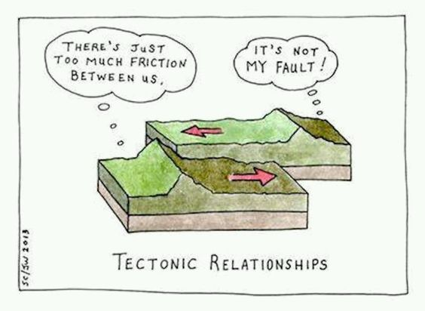
Exercise 5.34
Created by: Colin Buss ’11
Edited by:
Chida Balaji & Andrew Broenen ’13,
David Sroczynski ’14,
Kathy Fein ’15,
McKenzie Hubert ’16,
Allee Vito ’17, Andy Luke ’18,
Olivia Young ’19,
Ian Morrison ’20,
Tommy Bradford ’21,
Kelsey Levine ’22,
Ariel Struzyk ’23,
Burke Combs ‘24
Dennis Wu '24

Slide 2
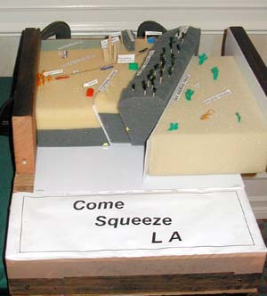
Alternative Plate Tectonics Model – Styrofoam?!?
Notes:
A foam model which can be squeezed together to simulate movement along the San Andreas fault, and the uplift of the San Gabriel Mountains.

Slide 3
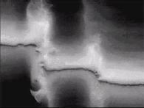
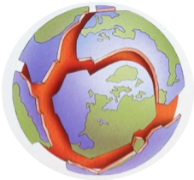
Wax Plate Tectonics Model
Uses a solid wax crust over melted wax to model the Earth’s crust over the mantle
It is used to study Earth’s plate tectonics
It can be used to predict the development of geological structures on a short time scale

Slide 4
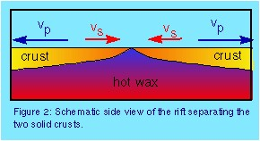
Wax Plate Tectonics Model

Slide 5
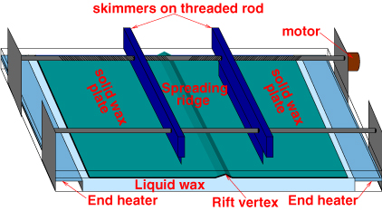
Wax Plate Tectonics Model
Notes:
Tank is filled with wax
Heated from below and cooled from above by air flow
The skimmers are embedded in the wax and attached to the threaded rod, which is driven by the motor
Make the rift by cutting straight through the wax perpendicular to the spreading motion (which is to the top/bottom)
Plate thickness is imaged by lighting from below and using a video camera (thicker = darker)

Slide 6
Part (A): How many dimensionless groups?
First, list the dimensions of each parameter:
Parameter | Symbol | Earth | Wax Model | Dimensions
Crust Thickness (m) | h | 4.0*10⁴ |  | L
Velocity of moving plate (m/s) | v | 1.0*10⁻⁹ |  | L/T
Crust density (kg/m3) | ρ | 3300 | 790 | M/L³
Thermal conductivity (J/(m*s*C) | k | 2.5 | 0.087 | ML/T³Θ
Heat capacity (J/kg*C) | C_{p} | 1360 | 2260 | L²/T²Θ
Heat melting (J/kg) | ΔH_{melt} | 3.67*10⁵ | 2.2*10⁵ | L²/T²
Difference between melting point and surface temperature (C) | T_{m}-T_{s} | 1200 |  | Θ
1
2
3
4
Remember:
J = N*m
N = kg*m/s2
5
6
7
7 parameters
– 4 dimensions (M, L, T, Θ)
= 3 dimensionless groups
Notes:
Theta is temp

Slide 7
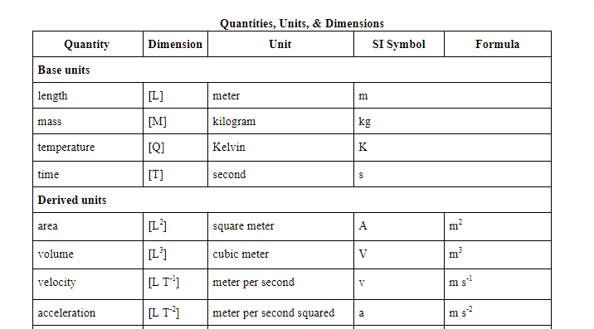
Aside
For future work – find or make a dimensional reference!
Notes:
Theta is temp

Slide 8
Part (B): Derive dimensionless groups
Parameter | Symbol | Earth | Wax Model | Dimensions
Crust Thickness (m) | h | 4.0*10⁴ |  | L
Velocity of moving plate (m/s) | v | 1.0*10⁻⁹ |  | L/T
Crust density (kg/m3) | ρ | 3300 | 790 | M/L³
Thermal conductivity (J/(m*s*C) | k | 2.5 | 0.087 | ML/T³Θ
Heat capacity (J/kg*C) | C_{p} | 1360 | 2260 | L²/T²Θ
Heat melting (J/kg) | ΔH_{melt} | 3.67*10⁵ | 2.2*10⁵ | L²/T²
Difference between melting point and surface temperature (C) | T_{m}-T_{s} | 1200 |  | Θ
Core variables are given in the problem statement
Notes:
Theta is temp

Slide 9
Part (B): Derive dimensionless groups
Write the general formula for a Π group in this system:
Substitute dimensions:
Combine exponents:
Write a system of equations:
0 = c+d
0 = -b-3d-2e-2f
0 = -d-e+g
0 = a+b-3c+d+2e+2f
Mass
Time
Temperature
Length

Slide 10
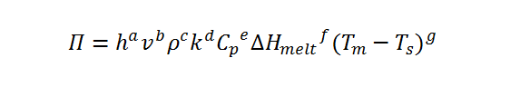
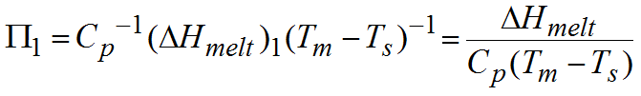
Part (B): Derive dimensionless groups
For group 1, use ∆H_{melt} as core variable (set exponent, f = 1)
set exponents for k and v equal to 0 (b = 0, d = 0)
Mass
c + 0 = 0
c = 0
Time
-0 – 3(0) – 2e – 2(1) = 0
e = -1
Temperature
-0 – (-1) + g = 0
g = -1
Length
a + 0 – 3(0) + 0 + 2(-1) = 0
a = 0

Slide 11
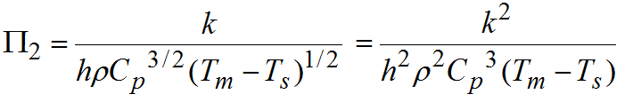
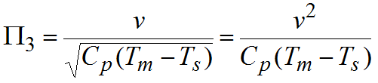
Part (B): Derive dimensionless groups
Similarly, we can find the dimensionless groups for v and k:
Square Π to eliminate the square root

Slide 12
Our variables and dimensions
Parameter | Symbol | Earth | Wax Model | Dimensions
Crust Thickness (m) | h | 4.0*10⁴ |  | L
Velocity of moving plate (m/s) | v | 1.0*10⁻⁹ |  | L/T
Crust density (kg/m3) | ρ | 3300 | 790 | M/L³
Thermal conductivity (J/(m*s*C) | k | 2.5 | 0.087 | ML/T³Θ
Heat capacity (J/kg*C) | C_{p} | 1360 | 2260 | L²/T²Θ
Heat melting (J/kg) | ΔH_{melt} | 3.67*10⁵ | 2.2*10⁵ | L²/T²
Difference between melting point and surface temperature (C) | T_{m}-T_{s} | 1200 |  | Θ
Notes:
Got rid of fractional exponents for easier calculations later

Slide 13
Skipping Parts (A) and (B)…
Notes:
Got rid of fractional exponents for easier calculations later

Slide 14
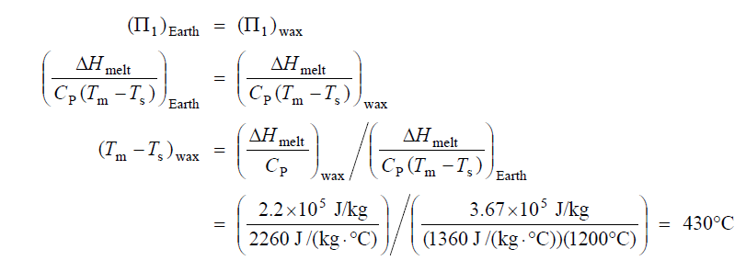
Part (C): Is the wax model dynamically similar?
How can we find T_{m}-T_{s} so the systems are dynamically similar?
Need to use Π₁

Slide 15
Part (C): Compare Temperature Difference, T_{m} - T_{s}
Given: Typical difference for wax model ~ 50˚C
Nope! 50˚C << 430˚C
Whoops…
Strike one!

Slide 16
Part (C): Compare Other Variables
Use Π₂ to determine wax crust thickness
Use Π₃ to determine plate velocity
h_{wax} = 4.5 km
v_{wax} = 7.7*10⁻¹⁰ m/s
= 7.7*10⁻⁷ mm/s
That’s 1/10 the thickness of Earth’s mantle!
Typical model = few cm… Strike two!
That’s slower than the actual plate velocity!
Typical model = 1 mm/s… Strike three!

Slide 17
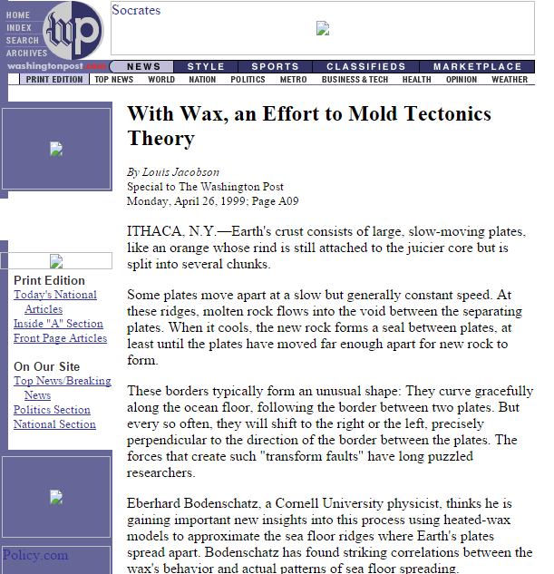
Three strikes, you’re out!
Wax model is not dynamically similar to Earth’s plate tectonics
Part (C)
Let’s think about this again…
Are all of the dimensionless groups important?

Slide 18






Part (C): Physical meaning of groups

Slide 19
Part (C): Relative importance of each parameter
The heat transferred through the crust and the kinetic energy of the plates are negligible compared to the energy required to heat the plates
Π_{1,Earth} = 0.2
Π_{2,Earth} = 1*10⁻²⁸
Π_{3,Earth} = 6*10⁻²⁵
Only Π₁ is significant compared to Π₂ and Π₃
Maybe it’s not necessary to match Π₂ and Π₃ for dynamic similarity

Slide 20
Part (C): Comparing Π₁
Π_{1,Model} = 2
Π_{1,Earth} = 0.2
They’re relatively close!
Still, it may be best to adjust the model.

Slide 21
5.34: Takeaways
Dimensional analysis is a powerful tool for considering many phenomena.
Dimensionless groups can reflect trends or relationships in nature.
Stay organized when performing dimensional analysis work
There are multiple ways to approach dimensional analysis (e.g., setting Π groups equal to each other or evaluating them separately)

Slide 22

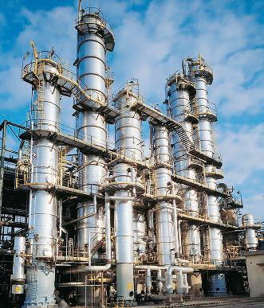

1 Prof. Duncan
1 Distill Bill
2 Dennis Wu
2 Good Luck, Babe!
3 Lauren de Silva
3 PFD.
4 Ashlyn Dumaw
4 ChemE, so confusing
5 Donovan Cho
5 Liquid + Vapor
That's a wrap!

