Slide 1
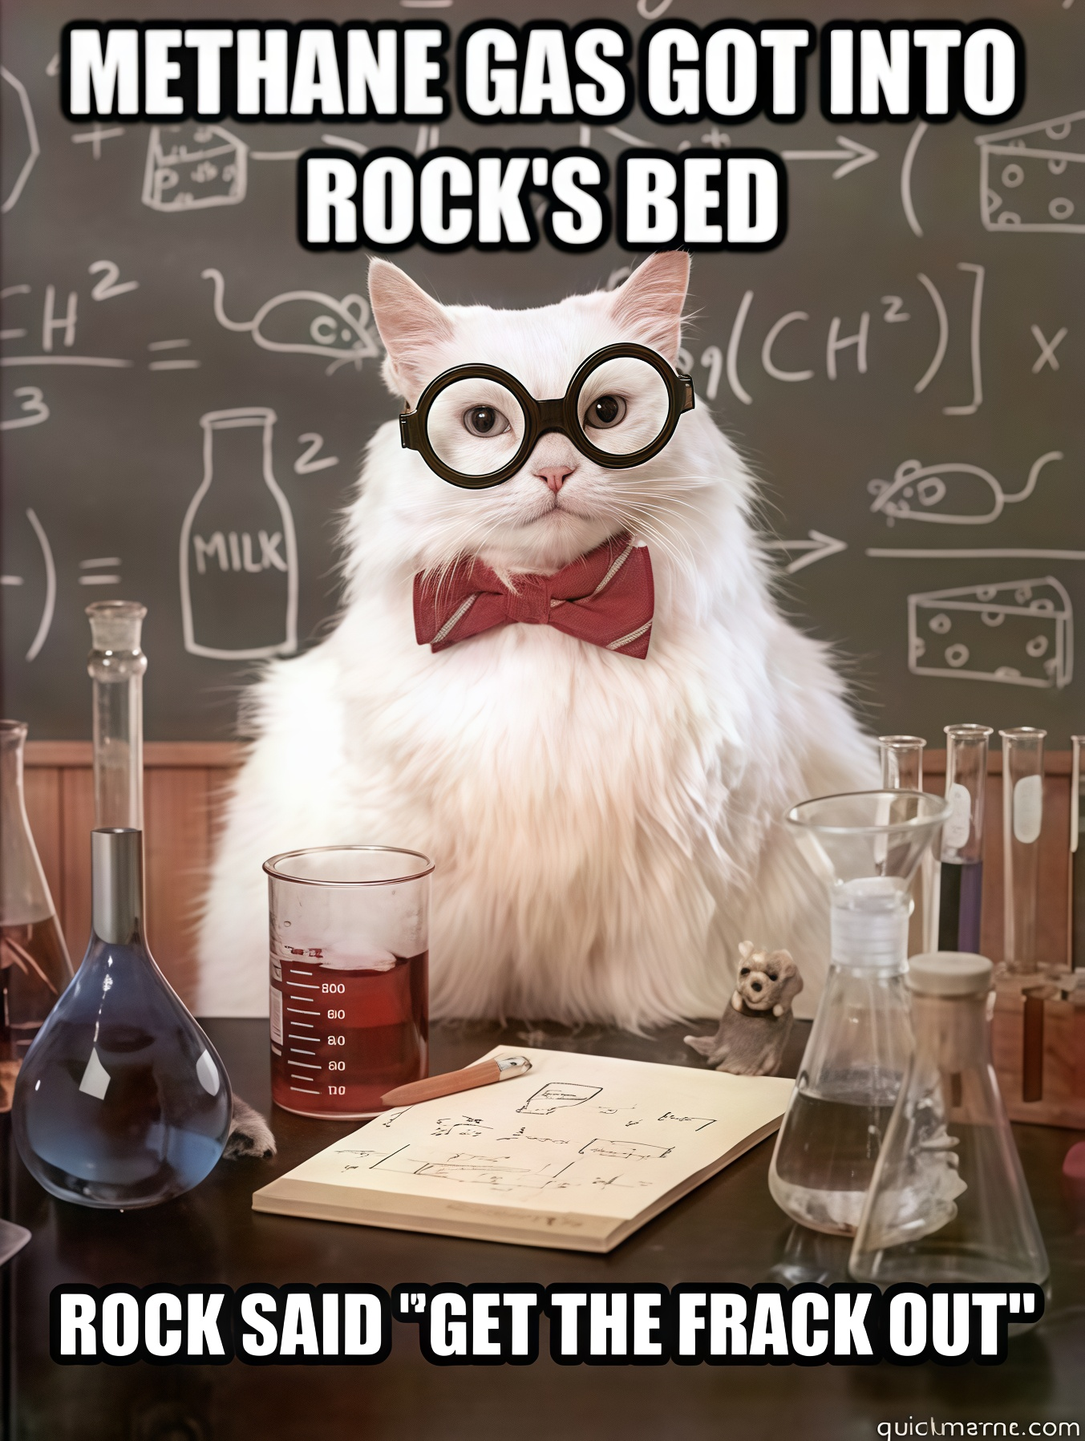
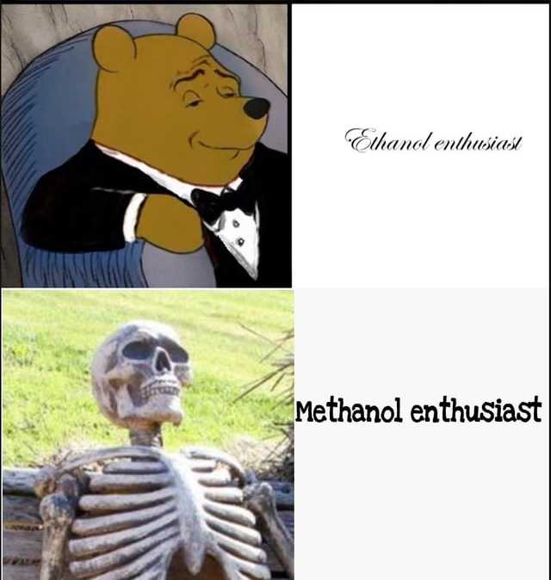
Calculation Session 1
Exercise 2.22
Created by Yuan Li (‘12)
Revised by Katie Reilly (’12), Andrew Broenen (‘13), Lauren Taylor (‘14), Carl Schultz (‘15), Maxine Chan (‘16)/Jesse Garcia (’16), Robert Lee (‘17), Ameer Basrai (‘18), Francis Ledesma (‘19), Michelle Quien (‘20)/Ian Morrison (‘20), Ann Metzloff (‘21), Sarah Huang (’22), Sanna Vedrine (‘23), Austin Kwan (‘24), Dennis Wu (‘25), Amy Wu (‘26)
Notes:
hope you have had enough time work on this exercise – I will now start going over part a.

Slide 2


Exercise Overview
Design a process to efficiently transport natural gas
  Produce methanol from methane and water
Fracking
Utility Company
Notes:
methanol is an easily transportable liquid
methanol → energy form is easier to transport and a better fuel source than methane (more attractive and valuable

Slide 3
What are we given?
Design Goals
Produce methanol from methane and water
Minimize number of units at 300 atm
Design Rules
Only use given chemistry!
Assume no reactions go to completion (80-90%)
Assume ideal separations:
  Solid-liquid
  Solid-gas
Show compressors/expanders

Slide 4
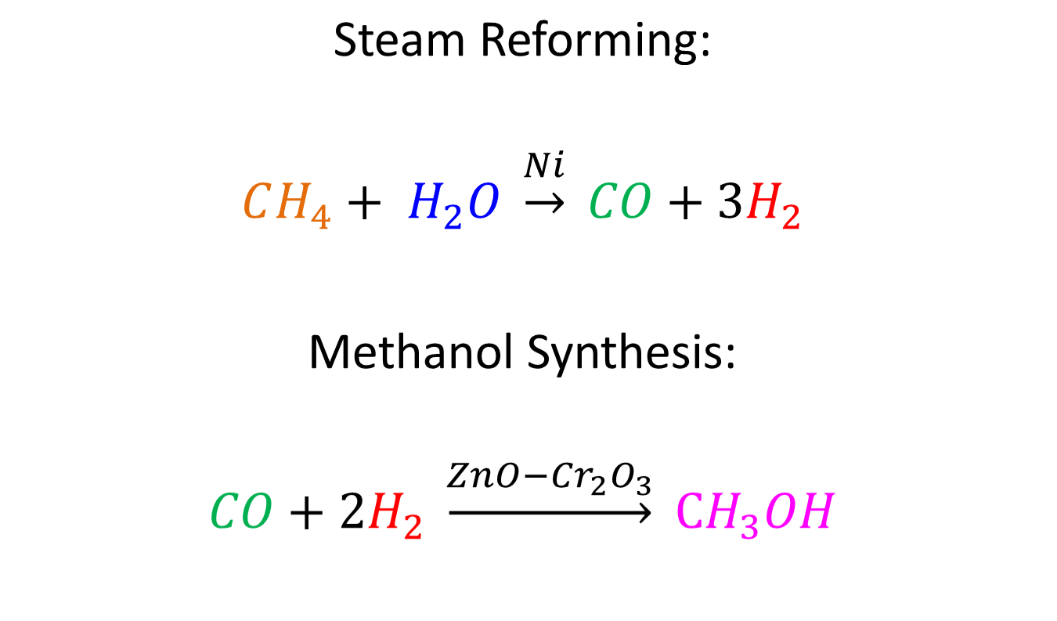
Our Reactions
(A)
900 ᵒC
300 ᵒC
300 atm
Notes:
You can use colors to track where each compound goes.

Slide 5




(A)
H2O
Does this satisfy the
design goals and rules?
Design Goal
Produce methanol from methane and water
Minimize number of units at 300 atm
Design Rules
Only use given chemistry!
Assume no reactions go to completion (80-90%)
Assume ideal separations:
  Solid-liquid
  Solid-gas
Show compressors/expanders
CH4
H2O
CH4
Steam-Methane Reformer
900 ᵒC
CO
H2
Methanol Synthesis Reactor
300 ᵒC, 300 atm
CH3OH
Notes:
What can be done? Add unreacted reagents

Slide 6

(A)
H2O
Does this satisfy the
design goals and rules now?
CH4
H2O
CH4
Almost… we can still improve the process.
Steam-Methane Reformer
900 ᵒC
H2O
CH4
CO
H2
H2O
CH4
CO
H2 CH3OH
H2O
CH4
CO
H2
Methanol Synthesis Reactor
300 ᵒC, 300 atm
1 atm
300 atm
For example, we waste valuable
reactor space on unused reagents
(H2O, CH4) the 2nd reactor.
What should we do to fix this?
Add a separator!
Notes:
considering that none of the reactions go to completion, how many components will be in the exit stream – hold
What can be done? Add a separator. The compressor and reactor become smaller, which is much cheaper.

Slide 7

(A)
H2O
1 atm
300 atm
CH4
H2O
CH4
CO
H2
CO
H2
Steam-Methane Reformer
900 ᵒC
Can have a smaller reactor now!
Methanol Synthesis Reactor
300 ᵒC, 300 atm
CO
H2
CH4
H2O
CH3OH
CO
H2
Is this separation possible? If so, what temperature?
Separator
CH4
H2O
Notes:
Don’t need unreacted reagents, separate them!
Can this separation be achieved? Let’s look at the boiling points of these compounds.

Slide 8

Physical Properties
(A)
Compound | Melting Point (ºC) | Boiling Point (ºC)
CH₄ | -182 | -164
H₂O | 0 | 100
CO | -205 | -191
H₂ | -259 | -253
CH₃OH | -94 | 65
Is there another way to visualize this information?

Slide 9

Physical Properties
(A)
CO
H₂
CH₄
H₂O
CO
H₂
Separator
CH₄
H₂O
H₂
-300ºC
-200ºC
-100ºC
0ºC
100ºC
CO
-300ºC
-200ºC
-100ºC
0ºC
100ºC
CH₄
-300ºC
-200ºC
-100ºC
0ºC
100ºC
H₂O
-300ºC
-200ºC
-100ºC
0ºC
100ºC
SOLID
LIQUID
VAPOR
-170 ᵒC
Notes:
I think that a color-coded chart like this is useful to visualize the physical properties. Here. green = solid, blue = liquid, red = gas. It’s now easy to see that at ~ -170 oC, the CO and H2 will be gases, and can be separated from the liquid CH4 and solid H2O.

Slide 10
(A)
H2O
CH4
H2O
CH4
CO
H2
CO
H2
Steam-Methane Reformer
900 ᵒC
Methanol Synthesis Reactor
300 ᵒC, 300 atm
CO
H2
CH4
H2O
CH3OH
CO
H2
CH3OH
CO
H2
(S & L)-G Separator
-170 ᵒC
CH4
H2O
Have we reached our design goal?
Not quite…Pure methanol is our desired product! We need a separator!
Notes:
CH4 is liquid, H2O is solid. CO and H2 are gases. Also don’t need these unreacted reagents!

Slide 11
(A)
H2O
CH4
H2O
CH4
CO
H2
CO
H2
Steam-Methane Reformer
900 ᵒC
Methanol Synthesis Reactor
300 ᵒC, 300 atm
CO
H2
CH4
H2O
CH3OH
CO
H2
CO
H2
(S & L)-G Separator
-170 ᵒC
Separator
CH4
H2O
CH3OH
Notes:
Don’t forget about compressors and expanders! We want to minimize the number of units at high pressure. Let’s prevent the separator from operating at 300 atm.

Slide 12
Physical Properties
(A)
CO
H₂
CH₃OH
CO
H₂
Separator
CH₃OH
H₂
-300ºC
-200ºC
-100ºC
0ºC
100ºC
CO
-300ºC
-200ºC
-100ºC
0ºC
100ºC
CH₃OH
-300ºC
-200ºC
-100ºC
0ºC
100ºC
-150 ᵒC
20 ᵒC
Question: Should we separate at -150 ºC or 20 ºC?
20 ºC (room temperature)
Cooling to -150 ºC requires unnecessary energy to achieve the same separation
SOLID
LIQUID
VAPOR
Notes:
The separation can be easily achieved because the boiling points are vastly different.
Should we put it at -150 degrees? NO! Takes too much energy and thus cost, put it at room temperature (in the problem statement).

Slide 13
(A)
H2O
CH4
H2O
CH4
CO
H2
CO
H2
Steam-Methane Reformer
900 ᵒC
Methanol Synthesis Reactor
300 ᵒC, 300 atm
CO
H2
CH4
H2O
CH3OH
CO
H2
CO
H2
(S & L)-G Separator
L-G Separator
20 ᵒC, 300 atm
-170 ᵒC
CH4
H2O
CH3OH
Does this process satisfy the design goal?
No, need to minimize units at 300atm
Does this process satisfy the design rules?
No, need compressor & expander
Notes:
Don’t forget about compressors and expanders! We want to minimize the number of units at high pressure. Let’s prevent the separator from operating at 300 atm.

Slide 14

(A)
H2O
CO
H2
300 atm
CH4
H2O
CH4
CO
H2
1 atm
Steam-Methane Reformer
900 ᵒC
Methanol Synthesis Reactor
300 ᵒC, 300 atm
CO
H2
CH4
H2O
CH3OH
CO
H2
CO
H2
CH3OH
CO
H2
300 atm
(S & L)-G Separator
L-G Separator
20 ᵒC
-170 ᵒC
1 atm
Recycle
starting material and intermediates
CH4
H2O
CH3OH
Does this process satisfy the design goals and rules?
Yes, but we can still improve the process!
Notes:
Not a bad setup. Can this be improved?
Recycle the CO and H2.

Slide 15
(A)
H2O
CO
H2
1 atm
CO
H2
300 atm
CH4
H2O
CH4
Steam-Methane Reformer
900 ᵒC
Methanol Synthesis Reactor
300 ᵒC, 300 atm
CO
H2
CO
H2
CH4
H2O
CH3OH
CO
H2
CO
H2
CH3OH
CO
H2
300 atm
(S & L)-G Separator
L-G Separator
20 ᵒC
-170 ᵒC
1 atm
CH4
H2O
CH3OH
What do all recycles need?
All recycles need purges!
Notes:
What do all recycles need? Purges.

Slide 16
(A)
H2O
CO
H2
1 atm
CO
H2
300 atm
CH4
H2O
CH4
CO
H2
Steam-Methane Reformer
900 ᵒC
Purge
Methanol Synthesis Reactor
300 ᵒC, 300 atm
CO
H2
CH4
H2O
CO
H2
CH4
H2O
CH3OH
CO
H2
CO
H2
CH3OH
CO
H2
300 atm
(S & L)-G Separator
L-G Separator
20 ᵒC
-170 ᵒC
1 atm
Purge
CH4
H2O
CH3OH
Let’s check the overall reaction!
Notes:
Always check the mass balance!

Slide 17
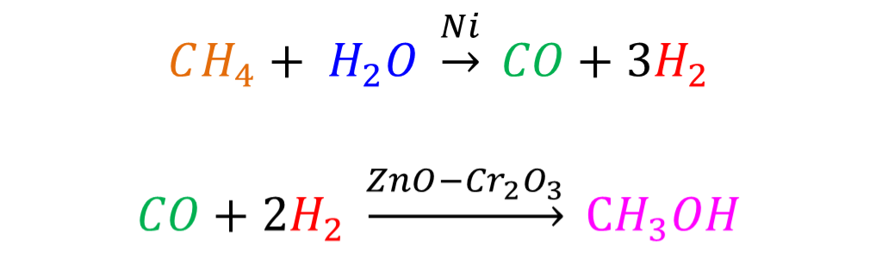
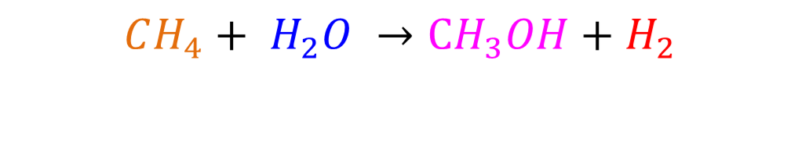
Overall Reaction
(A)
What we want!
Extra
MUST Agree with Overall Process...
Notes:
To see the overall reaction we add the two reactions and cancel substances that appear on both the left and right sides
The overall reaction MUST agree with the overall process! And from that we see that CH4 and H2O must enter our process, and CH3OH and H2 must leave the process. Is that what we have?

Slide 18

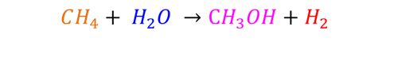
(A)
No H₂ stream leaves the process!
H2O
CO
H2
1 atm
CO
H2
300 atm
CH4
H2O
CH4
CO
H2
Steam-Methane Reformer
900 ᵒC
Purge
Methanol Synthesis Reactor
300 ᵒC, 300 atm
CO
H2
CH4
H2O
CO
H2
CH4
H2O
CH3OH
CO
H2
CO
H2
CH3OH
CO
H2
300 atm
(S & L)-G Separator
L-G Separator
20 ᵒC
-170 ᵒC
1 atm
Purge
CH4
H2O
CH3OH
Notes:
No!
This design has an error: the overall process does not agree with the overall reaction.

Slide 19

Problem: H₂ will accumulate in the process → need an outlet
(A)
Does the purge after the CH₃OH separator solve the problem?
No! Because the purge also removes CO, it does not solve the problem of excess H₂.
What could we do?
Add a separator to remove pure H₂, which we can sell!
Notes:
For the purge to solve the problem, the H₂/CO ratio in the recycle (and in the CH₃OH synthesis reactor) would need to be large. This would increase the volume of the high-pressure reactor, which would be expensive.

Slide 20
(A)
H2O
CO
H2
1 atm
CO
H2
300 atm
CH4
H2O
CH4
CO
H2
Steam-Methane Reformer
900 ᵒC
Purge
Methanol Synthesis Reactor
300 ᵒC, 300 atm
CO
H2
CH4
H2O
CO
H2
CH4
H2O
CH3OH
CO
H2
CO
H2
CH3OH
CO
H2
300 atm
(S & L)-G Separator
L-G Separator
20 ᵒC
-170 ᵒC
1 atm
Purge
CH4
H2O
CH3OH
What temperature and location for the separator?
Notes:
Always check the mass balance!

Slide 21
Physical Properties
(A)
CO
H2
H2
Separator
CO
H₂
-300ºC
-200ºC
-100ºC
0ºC
100ºC
CO
-300ºC
-200ºC
-100ºC
0ºC
100ºC
-195 ºC
SOLID
LIQUID
VAPOR
Notes:
Condensing CO requires a temperature below -191 oC. Let’s choose -195 oC. This is best done immediately after the first separator, which operates at -170 oC.

Slide 22
(A)
H2O
CO
H2
1 atm
CO
H2
300 atm
CH4
H2O
CH4
CO
H2
Steam-Methane Reformer
900 ᵒC
Purge
Methanol Synthesis Reactor
300 ᵒC, 300 atm
CO
H2
CH4
H2O
CO
H2
CH4
H2O
CH3OH
CO
H2
CO
H2
CH3OH
CO
H2
300 atm
(S & L)-G Separator
L-G Separator
20 ᵒC
-170 ᵒC
1 atm
Purge
CH4
H2O
After 1st separator
CH3OH
What temperature and location for the separator?
- 195 ºC
Notes:
Always check the mass balance!

Slide 23
(A)
H2
H2
What ratio for splitter?
L-G Separator
-195 ᵒC
H2
H2O
CO
CO
H2
1 atm
CO
H2
300 atm
CH4
H2O
CH4
CO
H2
Steam-Methane Reformer
900 ᵒC
Purge
Methanol Synthesis Reactor
300 ᵒC, 300 atm
CO
H2
CH4
H2O
CO
H2
CH4
H2O
CH3OH
CO
H2
CO
H2
CH3OH
CO
H2
300 atm
(S & L)-G Separator
L-G Separator
20 ᵒC
-170 ᵒC
1 atm
Purge
CH4
H2O
CH3OH
Notes:
This setup accounts for the extra H2 produced.
Last thing to consider: what ratio should we split it at?

Slide 24
Overall Reaction
(A)
For every 1 mol of reactants of the first reaction, 3 mols of hydrogen are produced
For every 1 mol of product produced by the second reaction, 2 mols of hydrogen are consumed
Therefore, 1 mol of hydrogen goes unused, while 2 mols are needed for reaction
Notes:
Read the text^

Slide 25

(A)
H2
H2
L-G Separator
-195 ᵒC
Splitter 1:2
H2
H2O
CO
CO
H2
1 atm
CO
H2
300 atm
CH4
H2O
CH4
CO
H2
Steam-Methane Reformer
900 ᵒC
Purge
Methanol Synthesis Reactor
300 ᵒC, 300 atm
CO
H2
CH4
H2O
CH3OH
CO
H2
CO
H2
CH4
H2O
CO
H2
CH3OH
CO
H2
300 atm
(S & L)-G Separator
L-G Separator
20 ᵒC
-170 ᵒC
1 atm
Purge
CH4
H2O
CH3OH
Notes:
And so we should split it 1:2 – removing one third of the stream and directing two thirds back into the process!

Slide 26
Process Overview
(A)
Goal: synthesize (and isolate) pure methanol
Since reactions don’t go to completion we used separators, recycles (and purges) to improve process
Make incremental modifications
  Have you satisfied the design goals and rules?
    Minimizing # of units at 300 atm
  Checking overall reactions
  Recycle with purges!

Slide 27


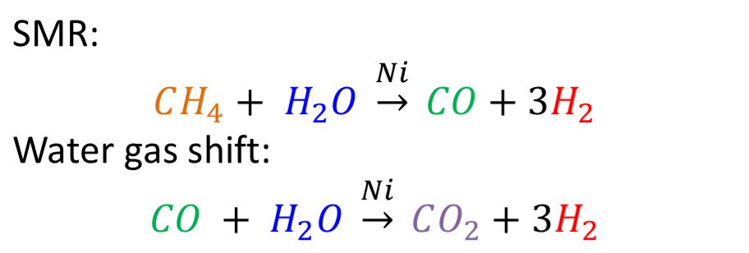
Oh no!... Side Reactions
(B)
Steam-Methane Reformer
900 C
H2O (excess)
CH4
CO₂
CO
H2
H2O
CH4
Notes:
In part B we take side reactions into account. We try to avoid the disproportionation CO+CO reaction, so instead we use the water gas shift.
This reaction introduces CO2 as a product in the first reactor.

Slide 28
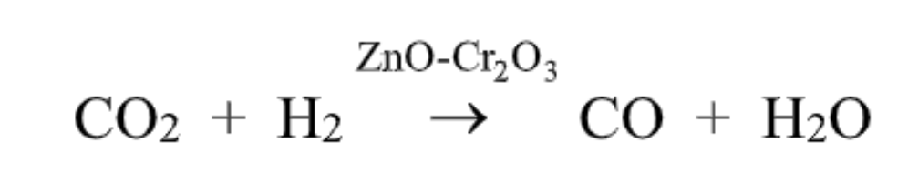
What else do we know?
(B)
Water gas shift creates CO₂ side product
  CO₂ can be converted to CO in the methanol synthesis reactor if H₂O is not present
  Reconversion is not complete

Slide 29
(B)
H2
H2
L-G Separator
-195 ᵒC
Splitter 1:2
H2
H2O
H2O (excess)
CO
CH4
CO
H2
1 atm
CO
H2
300 atm
CH4
CO
H2
Steam-Methane Reformer
900 ᵒC
CO
H2
CO
H2
CH4
H2O
Purge
Methanol Synthesis Reactor
300 ᵒC, 300 atm
(S & L)-G Separator
-170 ᵒC
CH4
H2O
CO
H2
CO₂
CH3OH
CO
H2
CH3OH
CO
H2
CO₂
L-G Separator
20 ᵒC
1 atm
300 atm
S-G Separator
CH3OH
What temperature?
Notes:
To avoid disproportionation, put the water in excess, and add co2 as a product.
Looking at boiling points, we know CO2 will come out the bottom with methane and water because co2 has a higher boiling point than methane.
Thinking about our principle of recycling unused reactant, should we separate the methane or the water out with the co2? (water)

Slide 30
Physical Properties
(B)
CH₄
-300ºC
-200ºC
-100ºC
0ºC
100ºC
H₂O
-300ºC
-200ºC
-100ºC
0ºC
100ºC
CO₂
-300ºC
-200ºC
-100ºC
0ºC
100ºC
-85 ᵒC
SOLID
LIQUID
VAPOR
Notes:
CO2 is between methane and water, but we don’t need methane at all for the second reactor, while we do need water for the second reactor.
Pick a temperature between methane and co2

Slide 31
(B)
H2
H2
L-G Separator
-195 ᵒC
Splitter 1:2
H2
H2O
H2O (excess)
CO
CH4
CO
H2
1 atm
CO
H2
300 atm
CH4
CO
H2
Steam-Methane Reformer
900 ᵒC
CO
H2
CO
H2
CH4
H2O
Purge
Methanol Synthesis Reactor
300 ᵒC, 300 atm
CH4
(S & L)-G Separator
-170 ᵒC
CH4
H2O
CO
H2
CO₂
CH3OH
CO
H2
CH3OH
CO
H2
CO₂
Purge
CH4
L-G Separator
20 ᵒC
1 atm
300 atm
S-G Separator
CH3OH
-85 ᵒC
CO₂
H2O
Where should CO₂ and H₂O go?
Notes:
So now we’re sending the co2 and water to the L-G separator, since sending it anywhere else would be efficient and take up space at such high pressures
Where does CO2 and water go at this temperature?

Slide 32
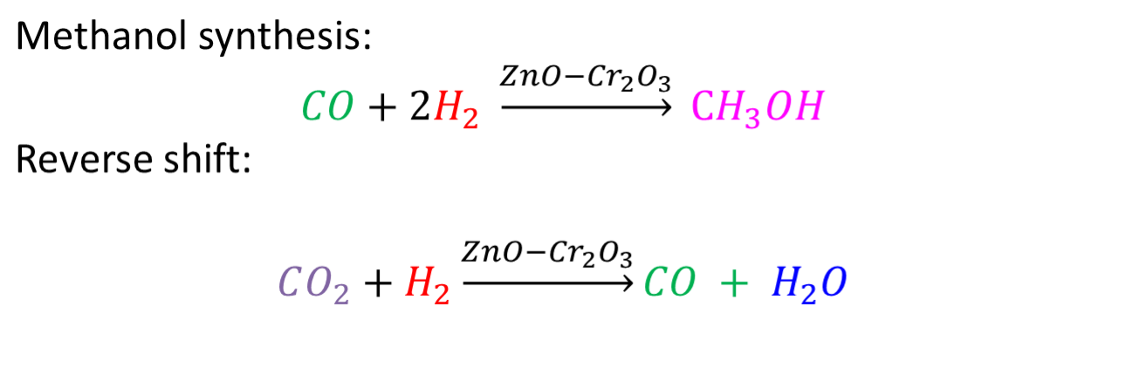
Side Reactions
(B)
Methanol Synthesis Reactor 300 C
300 atm
CO₂
CO
H2
CO₂
CO
H2
H2O
CH3OH
Notes:
To get CO back from CO2, we use the reverse shift reaction. This requires no water in the reactor at the beginning.
Write the new products into the outlets of the reactors and trace them through the process (e.g. separators). What needs to be fixed?

Slide 33
(B)
H2
H2
L-G Separator
-195 ᵒC
Splitter 1:2
H2
H2O
H2O (excess)
CO
CH4
CO
H2
1 atm
CO
H2
300 atm
CH4
CO
H2
Steam-Methane Reformer
900 ᵒC
CO
H2
CO
H2
CH4
H2O
Purge
Methanol Synthesis Reactor
300 ᵒC, 300 atm
CH4
(S & L)-G Separator
-170 ᵒC
CH4
H2O
CO
H2
CO₂
CH3OH
CO
H2
CH3OH
CO
H2
CO₂
Purge
CH4
L-G Separator
20 ᵒC
1 atm
300 atm
S-G Separator
CH3OH
-85 ᵒC
CO₂
H2O
Where do the CO₂ and H₂O go?
Notes:
So now we’re sending the co2 and water to the L-G separator, since sending it anywhere else would be inefficient and take up space at such high pressures
Where does CO2 and water go at this temperature?

Slide 34
Physical Properties
(B)
H₂
-300ºC
-200ºC
-100ºC
0ºC
100ºC
CO
-300ºC
-200ºC
-100ºC
0ºC
100ºC
CH₃OH
-300ºC
-200ºC
-100ºC
0ºC
100ºC
H₂O
-300ºC
-200ºC
-100ºC
0ºC
100ºC
CO₂
SOLID
LIQUID
VAPOR
-300ºC
-200ºC
-100ºC
0ºC
100ºC
20 ᵒC
Notes:
The separation can be easily achieved because the boiling points are vastly different.
Should we put it at -150 degrees? NO! Takes too much energy and thus cost, put it at room temperature (in the problem statement).

Slide 35
(B)
H2
H2
L-G Separator
-195 ᵒC
Splitter 1:2
H2
H2O
H2O (excess)
CO
CO₂
CO₂
CH4
CO
H2
1 atm
CO
H2
300 atm
CH4
CO
H2
CO₂
Steam-Methane Reformer
900 ᵒC
CO
H2
CO
H2
CH4
H2O
Purge
Methanol Synthesis Reactor
300 ᵒC, 300 atm
CH4
(S & L)-G Separator
CO₂
CO₂
H2O
-170 ᵒC
CO₂
CH4
H2O
CO
H2
H2O
CO₂
CH3OH
CO
H2
CH3OH
CO
H2
CO₂
Purge
CH4
L-G Separator
20 ᵒC
1 atm
300 atm
H2O
S-G Separator
-85 ᵒC
CO₂
H2O
CH3OH
Need to isolate methanol!
Notes:
Add your new components to the reaction streams, and now we can pay attention to the next side reaction

Slide 36
(B)
H2
H2
L-G Separator
-195 ᵒC
Splitter 1:2
H2
H2O
H2O (excess)
CO
CO₂
CO₂
CH4
CO
H2
1 atm
CO
H2
300 atm
CH4
CO
H2
CO₂
Steam-Methane Reformer
900 ᵒC
CO
H2
CO
H2
CH4
H2O
Purge
Methanol Synthesis Reactor
300 ᵒC, 300 atm
CH4
(S & L)-G Separator
CO₂
CO₂
H2O
-170 ᵒC
CO₂
CH4
H2O
CO
H2
H2O
CO₂
CH3OH
CO
H2
CH3OH
CO
H2
CO₂
Purge
CH4
L-G Separator
20 ᵒC
1 atm
300 atm
H2O
S-G Separator
-85 ᵒC
CO₂
H2O
CH3OH
L-G Separator
Notes:
Now we have our new products, with carbon dioxide and water, which we trace through the streams
We know that water comes out with methanol, so all the water from this reactor will come out the separator
Finally, we should separate the water from the methanol to get our pure desired product: what temperature?

Slide 37
Physical Properties
(B)
CH₃OH
-300ºC
-200ºC
-100ºC
0ºC
100ºC
H₂O
-300ºC
-200ºC
-100ºC
0ºC
100ºC
80 ᵒC
SOLID
LIQUID
VAPOR
Notes:
The separation can be easily achieved because the boiling points are vastly different.
Should we put it at -150 degrees? NO! Takes too much energy and thus cost, put it at room temperature (in the problem statement).

Slide 38
(B)
H2
H2
H2O
L-G Separator
-195 ᵒC
Splitter 1:2
H2
H2O
H2O (excess)
CO
CO₂
CO₂
CH4
CO
H2
1 atm
CO
H2
300 atm
CH4
CH4
CO
H2
CO₂
Steam-Methane Reformer
900 ᵒC
CO
H2
CO
H2
CH4
H2O
Purge
Methanol Synthesis Reactor
300 ᵒC, 300 atm
H2O
CH4
(S & L)-G Separator
CO₂
H2O
-170 ᵒC
CO₂
CO₂
CH4
H2O
CO
H2
H2O
CO₂
CH3OH
CO
H2
CH3OH
CO
H2
CO₂
Purge
CH4
L-G Separator
20 ᵒC
1 atm
300 atm
H2O
S-G Separator
-85 ᵒC
CO₂
H2O
CH3OH
CH3OH
L-G Separator
80 ᵒC
Purge
H2O
H2O
Notes:
Should we just throw away this water? NO
Recycle!

Slide 39
Process Overview
(B)
Utilize new reactions to prevent unfavorable side reaction
Isolate pure methanol
Recycle unused reactants
Check overall reaction

Slide 40
Summary
Key Takeaways
  Overall reaction needs to be represented in overall process
  Minimize size of costly units via separations
  Place separators strategically for optimal energy efficiency
  Minimize inlet flow and waste by using recycles
  Every recycle needs a purge!
Problem Solving Strategies
  Start with overall reaction, think about how overall process should go
  Underline/color code important information
  Check overall reaction at the end

