Slide 1
Calculation Session 1 Exercise 2.9
Created by: Angela Tang (‘18)
Edited by: Olivia Young (‘19), Ellen Park (’20), Andrew Simon (’21), Kelsey Levine (‘22), Lucy Cadanau (‘22), Ariel Struzyk (‘23), Burke Combs (‘24), and Ashlyn Dumaw (‘25)

Slide 2
Goal:
Combine the three reactions to get the overall reaction
Info:
Three individual reactions and the overall reaction
Where to start:
Match species in the overall reaction to the individual reactions

Slide 3
A) Combining Reactions
C + 2S → CS₂
CS₂ + 3Cl₂ → S₂Cl₂ + CCl₄
CS₂ + 2S₂Cl₂ → 6S + CCl₄
C + 2Cl₂ → CCl₄

Slide 4
A) Combining Reactions
C + 2S → CS₂
CS₂ + 3Cl₂ → S₂Cl₂ + CCl₄
CS₂ + 2S₂Cl₂ → 6S + CCl₄
C + 2Cl₂ → CCl₄

Slide 5
A) Combining Reactions
1x
C + 2S → CS₂
$\frac{2}{3}$x
CS₂ + 3Cl₂ → S₂Cl₂ + CCl₄
$\frac{1}{3}$x
CS₂ + 2S₂Cl₂ → 6S + CCl₄
C + 2Cl₂ → CCl₄

Slide 6
A) Combining Reactions
C + 2S → CS₂
$\frac{2}{3}$CS₂ + 2Cl₂ → $\frac{2}{3}$S₂Cl₂ + $\frac{2}{3}$CCl₄
$\frac{1}{3}$CS₂ + $\frac{2}{3}$S₂Cl₂ → 2S + $\frac{1}{3}$CCl₄
C + 2Cl₂ → CCl₄

Slide 7
Goal:
B) Correct errors in the process flow diagram
Info:
A provided process flow diagram (PFD)
Compound melting and boiling points
Where to start:
Check the overall reaction
Check individual reactions/separators
Check the logic of the diagram

Slide 8
Error 1
Error 2
Error 3
Error 4
Error 5
Notes:
Error 1 = No Chlorine Entering System
Error 2 = No CS2 to Carbon tetrachloride synthesis reactor II
Error 3 = No purge on Reactor 1 CS2 and Cl2 recycle loop
Error 4 = Wrong temperature on Liq-Gas separator @ 155C
Error 5 = Solid-gas separator @ 150 C incorrectly labeled
For future TAs, the error buttons were created using action buttons. These buttons can be found under Insert>Shapes>Action Buttons. The slide they link to can be edited by right-clicking on the button and then selecting edit link. The same can be done to select edit text to change the name on the button.

Slide 9
3C + 6Cl₂ → 3CCl₄
Cl₂
Return

Slide 10
CS₂
Return
CS₂ + 2S₂Cl₂ → 6S + CCl₄

Slide 11
purge
Return

Slide 12
Do our separators check out?
Return
Cl₂
CS₂
CCl₄
S₂Cl₂
S
C
-101
-35
T=60ºC
-111
46
-23
77
-80
136
113
Notes:
Phase lines!

Slide 13
Return
T=155ºC
Cl₂
CS₂
CCl₄
S₂Cl₂
S
C
-101
-35
T=105ºC
T=105ºC
-111
S₂Cl₂ and CCl₄ are both gases. Cannot separate!
46
-23
77
-80
136
113

Slide 14
Cl₂
CS₂
CCl₄
S₂Cl₂
S
C
-101
-35
T=150ºC
-111
46
-23
77
-80
136
113
Return
Liquid-gas separator

Slide 15
CS₂
purge
Cl₂
CS₂
liquid-gas separator 105°C
liquid-gas separator 150°C
Notes:
Buffer slide for clicking mistakes

Slide 16
Key Takeaways – What Did We Learn?
Overall process agrees with overall reaction (Error #1)
Check the overall process by tracing the path (Error #2)
Every recycle needs a purge to remove impurities (Error #3)
Use visuals to double check physical states and temperatures (Error #4 & Error #5)

Slide 17
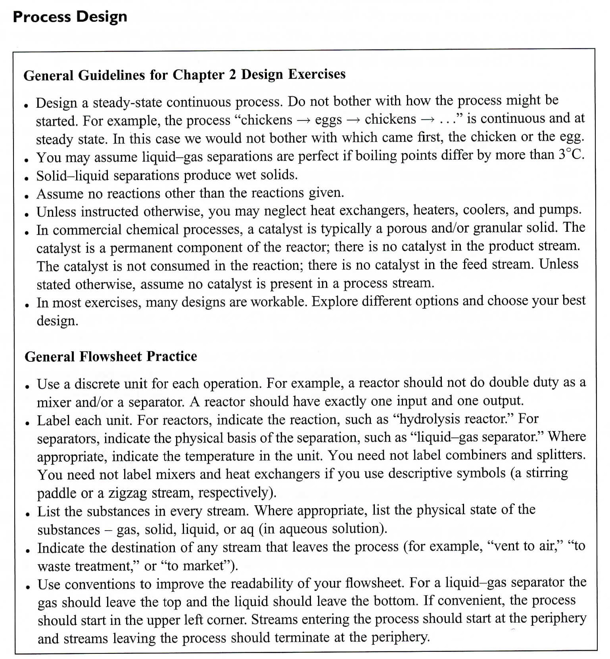
(page 57)

