Slide 1
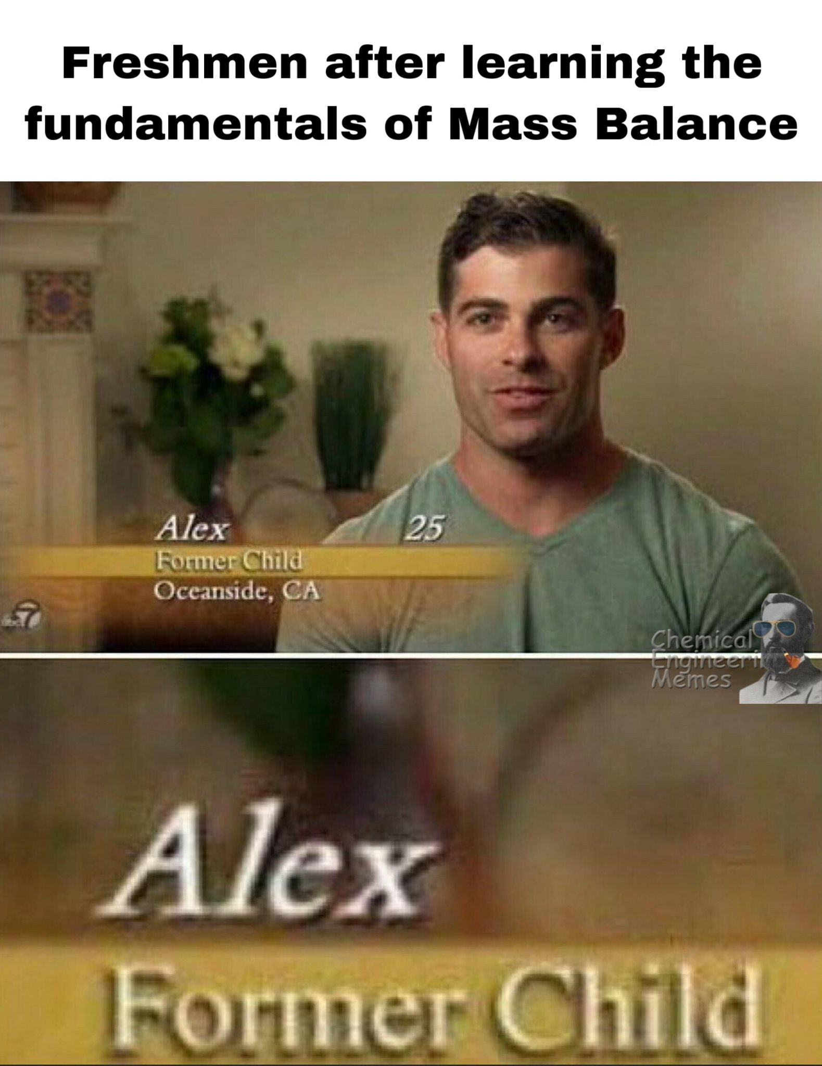
Exercise 2.32
Sophomore
Created by:
Norman Su ‘11
Revised by:
Yuan Li ’12
Katie Reilly ’12
Andrew Broenen ’13
David Sroczynski ’14
Tim Abbott ’15
Jesse Garcia ’16
Allee Vito ’17
Ameer Basrai ’18
Jordan Fuller ’19
Sabrina Chen ’20
Emily Spiek ’21
Max Serota ’22
Ailen Lao ’23
Austin Vollweiler ’24
Donovan Cho ‘25
Ashlyn Dumaw ‘25
Notes:
1

Slide 2
What are our knowns?
What streams are given?
1 mol/min A mixed with 2 mol/min B
50% C mixed with 50% D – unlimited
What are the reaction rules?
Reactants are fully consumed if in stoichiometric ratios
A (1 mol)
B (2 mol)
C (1 mol)
D (1 mol)

Slide 3
What reactions are possible?
B + H → P
A + C → H
B + C → R
B + D → Q
Key product
Needed reactant
Side reaction
Side reaction
Notes:
So, want to separate A and B

Slide 4
What are our goals?
Maximize revenue
Minimize # of units
Minimize size of units
lower value reactant
to higher value product
Strategy: Whenever possible, convert

Slide 5
Compound | Role | Market Value
A | Reactant | 1
B | Reactant | 13
C | Reactant | 2
D | Reactant | 15
H | Intermediate | 2
P | Product | 100
Q | By-Product | 6
R | By-Product | 0
lower value reactant
to higher value product
Strategy: Whenever possible, convert

Slide 6
Do we want to convert all reactants to products?
Compound | Role | Market Value
A | Reactant | 1
B | Reactant | 13
C | Reactant | 2
D | Reactant | 15
H | Intermediate | 2
P | Product | 100
Q | By-Product | 6
R | By-Product | 0
B + C → R
-15 $/mol
NO! Q and R are worth less than their reactants!

Slide 7
Do we want to convert all reactants to products?
Compound | Role | Market Value
A | Reactant | 1
B | Reactant | 13
C | Reactant | 2
D | Reactant | 15
H | Intermediate | 2
P | Product | 100
Q | By-Product | 6
R | By-Product | 0
B + D → Q
-22 $/mol
NO! Q and R are worth less than their reactants!

Slide 8
Separations
A
B
C
D
H
P
Q
R
-100ºC
0ºC
100ºC
200ºC
Solid
Liquid
Gas
Notes:
What jumps out at you that we should take note of? (the things that are circled)

Slide 9
How to approach?
Reactions
B + H → P
A + C → H
B + C → R
B + D → Q
Given reactant mixtures: A+B and C+D
Start with two input streams
Remember: we can’t separate C & D
Focus on maximizing most profitable reaction
B + H → P
Need to produce an intermediate, H
A + C → H
P & Q cannot be separated. Formation of Q loses money.
Don’t let B & D react
Formation of R loses money
Don’t let B & C react
Minimize losses, unwanted by-products, reactions, & units
Notes:
For the bolded points, ask how we can stop formation of Q and formation of R

Slide 10
Reactions
B + H → P
A + C → H
B + C → R
B + D → Q
C (1 mol)
D (1 mol)
A (1 mol)
B (2 mol)
C (1 mol)
D (1 mol)
A (1 mol)
B (2 mol)
Does this look good?
No! We have B mixed with C & D!
If B reacts with C & D, we lose money!
What if we separate A & B from the get-go? Can we?

Slide 11
Separations
A
B
C
D
H
P
Q
R
-100ºC
0ºC
100ºC
200ºC
Solid
Liquid
Gas
Notes:
Want B+H➔P, so need to get B and H
Should be able to separate A and B to prevent a B/C or D reaction
We can separate A and B right away and move A to react with C/D
Seps: A/B, D/H, B/P

Slide 12
Reactions
B + H → P
A + C → H
B + C → R
B + D → Q
C (1 mol)
D (1 mol)
A (1 mol)
B (2 mol)
C (1 mol)
D (1 mol)
A (1 mol)
B (2 mol)
We have B mixed with C & D!
If B reacts with C & D, we lose money!
What if we separate A & B from the get-go? Can we?
YES!

Slide 13
Reactions
B + H → P
A + C → H
B + C → R
B + D → Q
C (1 mol)
D (1 mol)
A (1 mol)
C (1 mol)
D (1 mol)
H (1 mol)
D (1 mol)
Reactor 1, 300º C
A + C → H
A (1 mol, g)
A (1 mol)
B (2 mol)
L-G
Separator
75ºC
Next step?
Combine H/D with B?
Don’t want Q – minimize losses!
B (2 mol, l)
What if we separate H & D? Can we?

Slide 14
Separations
A
B
C
D
H
P
Q
R
-100ºC
0ºC
100ºC
200ºC
Solid
Liquid
Gas
Notes:
Want B+H➔P, so need to get B and H
Should be able to separate A and B to prevent a B/C or D reaction
We can separate A and B right away and move A to react with C/D
Seps: A/B, D/H, B/P

Slide 15
Reactions
B + H → P
A + C → H
B + C → R
B + D → Q
C (1 mol)
D (1 mol)
A (1 mol)
C (1 mol)
D (1 mol)
H (1 mol)
D (1 mol)
Reactor 1, 300º C
A + C → H
A (1 mol, g)
A (1 mol)
B (2 mol)
L-G
Separator
75ºC
Next step?
Combine H/D with B?
B (2 mol, l)
Don’t want Q – minimize losses!
What if we separate H & D? Can we?
YES!

Slide 16
Reactions
B + H → P
A + C → H
B + C → R
B + D → Q
D (1 mol, g)
C (1 mol)
D (1 mol)
A (1 mol)
C (1 mol)
D (1 mol)
H (1 mol)
D (1 mol)
Reactor 1, 300º C
A + C → H
L-G
Separator
80ºC
A (1 mol, g)
H (1 mol, l)
A (1 mol)
B (2 mol)
L-G
Separator
75ºC
H (1 mol)
B (2 mol, l)
H (1 mol)
B (2 mol)
P (1 mol)
B (1 mol)
Reactor 2, 300º C
B + H → P
Can we Separate P & B?
Notes:
So this looked good, but can we do better? Definitely!
We have room to take out an extra separator. Does anyone see where?

Slide 17
Separations
A
B
C
D
H
P
Q
R
-100ºC
0ºC
100ºC
200ºC
Solid
Liquid
Gas
Notes:
Want B+H➔P, so need to get B and H
Should be able to separate A and B to prevent a B/C or D reaction
We can separate A and B right away and move A to react with C/D
Seps: A/B, D/H, B/P

Slide 18
Reactions
B + H → P
A + C → H
B + C → R
B + D → Q
D (1 mol, g)
$15/min
C (1 mol)
D (1 mol)
A (1 mol)
C (1 mol)
D (1 mol)
H (1 mol)
D (1 mol)
Reactor 1, 300º C
A + C → H
L-G
Separator
80ºC
A (1 mol, g)
H (1 mol, l)
A (1 mol)
B (2 mol)
L-G
Separator
75ºC
H (1 mol)
B (2 mol, l)
H (1 mol)
B (2 mol)
P (1 mol)
B (1 mol)
Reactor 2, 300º C
B + H → P
Can we Separate P & B?
YES!
Notes:
So this looked good, but can we do better? Definitely!
We have room to take out an extra separator. Does anyone see where?

Slide 19
Reactions
B + H → P
A + C → H
B + C → R
B + D → Q
D (1 mol, g)
$15/min
C (1 mol)
D (1 mol)
A (1 mol)
C (1 mol)
D (1 mol)
H (1 mol)
D (1 mol)
Reactor 1, 300º C
A + C → H
L-G
Separator
80ºC
A (1 mol, g)
H (1 mol, l)
A (1 mol)
B (2 mol)
L-G
Separator
75ºC
H (1 mol)
B (1 mol, g)
$13/min
B (2 mol, l)
H (1 mol)
B (2 mol)
P (1 mol)
B (1 mol)
Reactor 2, 300º C
B + H → P
L-G
Separator
100ºC
P (1 mol, l)
$100/min
Notes:
So this looked good, but can we do better? Definitely!
We have room to take out an extra separator. Does anyone see where?

Slide 20
Overall reaction?
B + H → P
A + C → H
B + C → R
B + D → Q
Unwanted side reactions!
A + B + C → P

Slide 21
Reactions
B + H → P
A + C → H
B + C → R
B + D → Q
D (1 mol, g)
$15/min
C (1 mol)
D (1 mol)
A (1 mol)
C (1 mol)
D (1 mol)
H (1 mol)
D (1 mol)
Reactor 1, 300º C
A + C → H
L-G
Separator
80ºC
A (1 mol, g)
H (1 mol, l)
A (1 mol)
B (2 mol)
L-G
Separator
75ºC
H (1 mol)
B (1 mol, g)
$13/min
B (2 mol, l)
H (1 mol)
B (2 mol)
P (1 mol)
B (1 mol)
Reactor 2, 300º C
B + H → P
Can we do better?
L-G
Separator
100ºC
P (1 mol, l)
$100/min
Overall Reaction
A + B + C → P
Total revenue = $128/min
Notes:
So this looked good, but can we make more $? Definitely!
We have room to take out an extra separator. Does anyone see where?

Slide 22
Reactions
B + H → P
A + C → H
B + C → R
B + D → Q
D (1 mol, g)
$15/min
C (1 mol)
D (1 mol)
A (1 mol)
C (1 mol)
D (1 mol)
H (1 mol)
D (1 mol)
Reactor 1, 300º C
A + C → H
L-G
Separator
80ºC
A (1 mol, g)
H (1 mol, l)
A (1 mol)
B (2 mol)
L-G
Separator
75ºC
H (1 mol)
B (1 mol, g)
$13/min
B (2 mol, l)
H (1 mol)
B (2 mol)
H (1 mol)
B (1 mol)
P (1 mol)
B (1 mol)
P (1 mol)
$100/min
Reactor 2, 300º C
B + H → P
B (1 mol)
$13/min
B (1 mol)
L-G
Separator
100ºC
Same revenue, but 1 less unit + 1 smaller unit!!
P (1 mol, l)
$100/min
Overall Reaction
A + B + C → P
Total revenue = $128/min
Notes:
So this looked good, but can we do better? Yes!
We have room to take out an extra separator. Does anyone see where?

Slide 23
Key Takeaways
Ultimate goal is to maximize profit
Minimize # and size of units by adjusting where streams enter/leave the process and the order of reactions and separations
Strategy: Whenever possible, convert lower value reactants to higher value products.
Sometimes, keeping your reactants is the better option

