Slide 1
Calculation Session 2
Exercise 2.34
Created By:
Alana Szkodny (‘14)
Tim Abbott (‘15)
Alex Settle (‘16)
Jenny Bushnell (‘17)
Akash Vaidya (‘18)
Joe Hassler (‘18)
Sydney Brannan (‘19)
Gavin Batsimm (‘21) + Apoorva Agarwal (‘21)
Kelsey Levine (‘22)
Leon Lee (‘23)
Burke Combs (‘24)
Lauren de Silva + Dennis Wu (‘25)
Lara Capellino (‘26)
Notes:
1

Slide 2
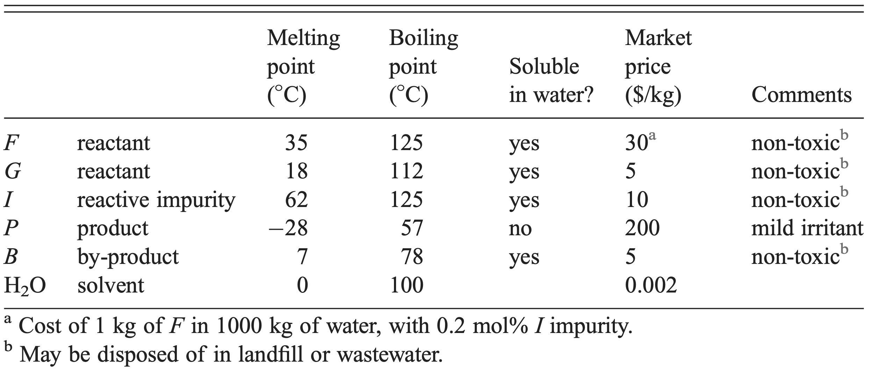

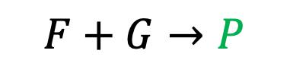
We are given:
Reactions
Feed Stream
Physical Parameter Data
$$F+G→P$$
1000 mol/min H20
  1 mol/min F
  2 mol/min I
Desired, 90% conversion
F and G in the product stream!
$$I+G→B$$
(2) Pure G (unlimited flow rate)
Undesired, 100% conversion
Only B in the product stream!
“What happens along the way”
“Where I start”
“How I reach my targets”
Notes:
We’re also given a bunch of other information in the problem statement.
[click] First, we’re given the all-important chemical reactions and [click]their % conversions. What do these % conversions mean? It tells us what percentage of the compounds are converted to products.
In the scope of this problem, the 90% conversion implies that [click] F and G will be in the product stream from the reactor, but I won’t! This means that we’re going to have leftover reactant that needs to be purified.
We’re also given [click] flow rates for the two input streams (pay close attention to the unlimited flow rate for G), and [click] the physical parameter data.
Note the fact that B, our only by-product, is worth 40x less than P,
need 3 mols of G to consume all reactant

Slide 3
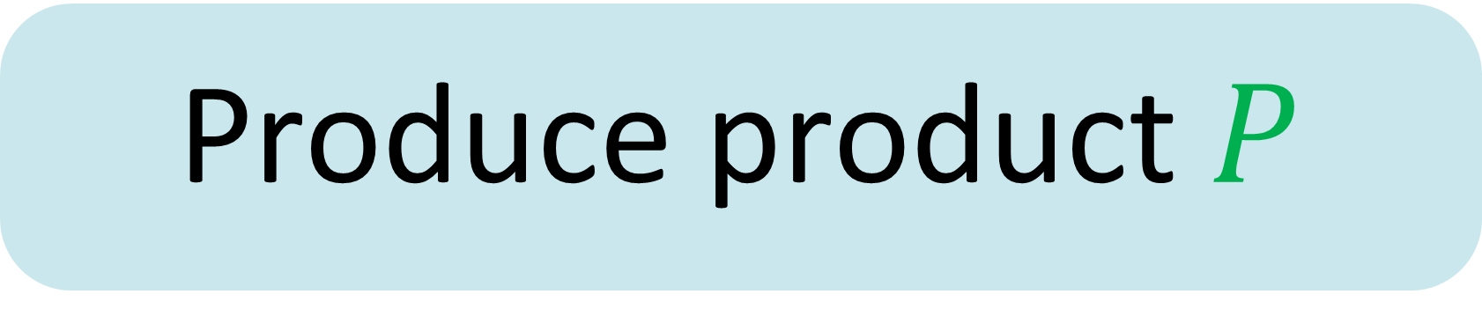
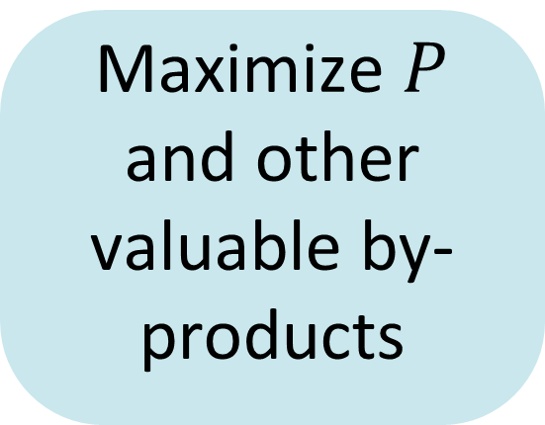
Goals for Our Design
Produce product $P$
Decreasing Importance
Minimize the number (and size) of units
Maximize $P$ and other valuable by-products
Employ easy separations
Decreasing Importance

Slide 4
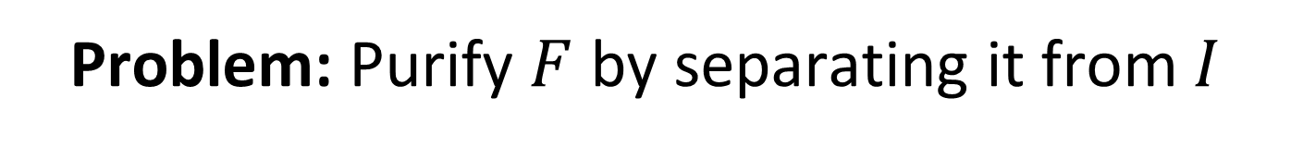
Let’s start at the beginning
Initial strategy…
Remove I and H₂O from the feed stream. This way we can easily make P from F+G and reduce the size of our units!
F 1 mol/min
I 2 mol/min
H₂O
Problem: Purify $F$ by separating it from $I$
Notes:
Speaker 1 Proposes that the problem statement is to purify F by separating it from I

Slide 5
Solution Methods: Separation tools we’ve seen
1. Phase: Gas- Liquid Separation
2. Phase: Solid- Liquid Separation
3. Chemistry: Exploit Different Reactivities
Notes:
Pause and ask students which tools they can recall.
See Lecture 3!

Slide 6
Solution Methods: Purifying F
To separate I from F, could we use:
    1. Liquid/gas separation?
Nope.
F
°C
-40 -20 0 20 40 60 80 100 120 140
I
°C
-40 -20 0 20 40 60 80 100 120 140
Notes:
6

Slide 7
Solution Methods: Separations
To separate I from F, could we use:
    1. Liquid/gas separation?
    2. Solid/liquid separation?
Maybe!
F
°C
-40 -20 0 20 40 60 80 100 120 140
I
°C
-40 -20 0 20 40 60 80 100 120 140
Notes:
7

Slide 8
Solution Methods: Separations
To separate I from F, could we use:
    1. Liquid/gas separation?
    2. Solid/liquid separation?
F (aq)
H₂O
Could we remove the water beforehand?
F
I
H₂O
solid/liquid separator
50˚C
I (s)
Notes:
8

Slide 9
Solution Methods: Separations
To separate I from F, could we use:
    1. Liquid/gas separation?
    2. Solid/liquid separation?
Let’s separate water using a L/G separator!
F
°C
-40 -20 0 20 40 60 80 100 120 140
I
°C
-40 -20 0 20 40 60 80 100 120 140
Notes:
9

Slide 10
Solution Methods: Separations
To separate I from F, could we use:
    1. Liquid/gas separation?
    2. Solid/liquid separation?
Would this work?
Steam
F (liq)
F 1 mol/min
I 2 mol/min
H₂O
liquid/gas separator
110˚C
solid/liquid separator
50˚C
F (liq) 1 mol/min
I (liq) 2 mol/min
I (s)
F (liq)
Notes:
10

Slide 11

Demonstration Time!
Can you think of an example from daily life? Anything similar to what you might encounter in industry?
TAs Amy and Kong do…

Slide 12


Slide 13
Solution Methods: Separations
To separate I from F, could we use:
    1. Liquid/gas separation?
    2. Solid/liquid separation?
Steam
F (liq)
<< 1 mol/min
This won’t work either! With a high solid-to-liquid ratio, most of F (liq) will be absorbed in I (s) ☹
F 1 mol/min
I 2 mol/min
H₂O
liquid/gas separator
110˚C
solid/liquid separator
50˚C
F (liq) 1 mol/min
I (liq) 2 mol/min
I (s)
F (liq)
~ 2 mol/min
~ 1 mol/min
Notes:
13

Slide 14

pause
maybe there’s another way to think about this
Notes:
Since the easy phase separations lead us to a dead end, maybe lets try thinking about this exercise differently.

Slide 15

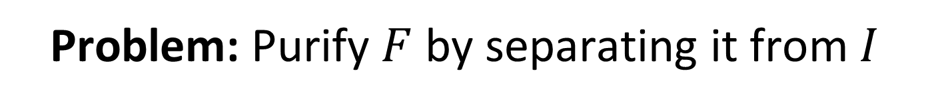

Let’s go back to the beginning
Main goal: Produce product $P$
Do we need to remove$I$?
No!
Problem: Purify $F$ by separating it from $I$
Redefined Problem: Produce product $P$

Slide 16
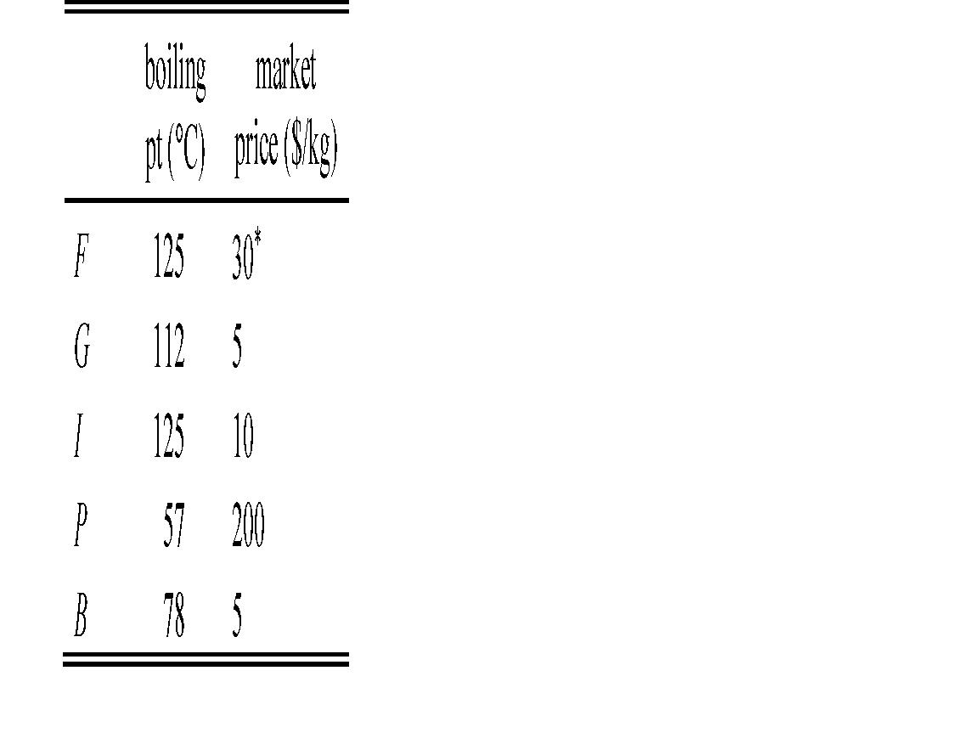

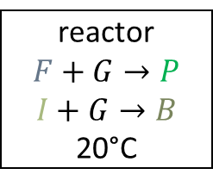

Trying again, just trying to produce P
Option #1
$$I+G→B$$
100% conversion
$$F+G→P$$
90% conversion
G (excess)
F (aq)
G (aq)
P (aq)
B (aq)
H₂O
F (aq)
I (aq)
G (aq)
H₂O
F (aq)
I (aq)
H₂O
reactor
$$F+G→P$$
$$I+G→B$$
20°C

Slide 17
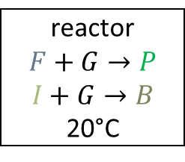
Trying again, just trying to produce P
Option #2
steam
G (excess)
F (aq)
I (aq)
H₂O
liquid/gas separator
110˚C
F
I
FG
I
reactor
$$F+G→P$$
$$I+G→B$$
20°C
F
G
B
P
Even though Option 2 has 1 extra unit, all subsequent units will be smaller in 2 than 1 and therefore cheaper!
Notes:
But dennis, doesn’t your option has 2 units but mine only has 1

Slide 18


Produce P
Option #2
Can we make it better?
G (excess)
steam
F
G
B
P
P (g)
F (aq)
I (aq)
H₂O
liquid/gas separator
110˚C
F
I
reactor
$$F+G→P$$
$$I+G→B$$
20°C
liquid/gas separator
65˚C
F
G
I
B
Add a liquid-gas separator to produce pure P
F
G
B
F
G
B
purge
P (liq)
to market
Option 2A

Slide 19
F (aq)
I (aq)
H₂O
Produce P
Option #2a
Can we make it better?
G (excess)
H₂O
steam
F
G
B
P
P (g)
H₂O
F (aq)
I (aq)
liquid/gas separator
110˚C
F
I
reactor
$$F+G→P$$
$$I+G→B$$
20°C
liquid/gas separator
65˚C
F
G
I
Add a heat exchanger to recycle heat and save energy
B
F
G
B
F
G
B
purge
P (liq)
to market
Option 2A

Slide 20
Produce P
Option #2b
H₂O
F (aq)
I (aq)
Can we make it better?
G (excess)
H₂O
F
G
B
P
P (g)
steam
L/G Sep. 110˚C
Reactor
F + G → P
I + G → B
20˚C
L/G Sep.
65˚C
H₂O
F (aq)
I (aq)
F, ˚C
F
G
I
-40 -20 0 20 40 60 80 100 120 140
G, ˚C
B
F
I
-40 -20 0 20 40 60 80 100 120 140
B, ˚C
F
G
B (g)
B (g)
-40 -20 0 20 40 60 80 100 120 140
L/G Sep. 85˚C
L/G Sep. ??˚C
F
G
B
Add an additional separator to get product B!
purge
F (liq)
G (liq)
P (liq)
to market
Notes:
2B

Slide 21
Produce P
Option #2c
Can we make it better?
H₂O
F (aq)
I (aq)
G (excess)
??
H₂O
steam
P (g)
F
G
I
L/G Sep.
110 °C
Reactor
F + G → P
I + G → B
20 °C
F
G
B
P
F
G
B
P
L/G Sep.
65 °C
H₂O
F (aq)
I (aq)
Add an additional reactor to produce more P?
F (liq)
G (liq)
B (liq)
F (liq)
I (liq)
P (g)
B (g)
F
G
P
F
G
P
F
G
L/G Sep.
65 °C
Reactor
F + G → P
20 °C
B
L/G Sep.
85 °C
F
G
B
F (l)
G (l)
F
G
F
G
purge
P (liq) to market
P (liq) to market
Notes:
Right off the bat, we have two ways to move forward. We can either just mix excess G with the input stream and react away, or we can remove the water and then react the compounds.
[click] Which option is better? Well, let’s take a look at both of them to find out!
[click] keeping our design principles in mind, let’s go with option 1 and reduce the number of units we have.
21

Slide 22
Comparing Our Three Designs
Design | 2A | 2B | 2C
# reactors | 1 | 1 | 2
# heat exchangers | 2 | 3 | 4
# separators | 2 | 3 | 4
Total # process units | 5 | 7 | 10

Slide 23
Which Option is Better?
Option 2C has extra units and is not economically viable
Option 2A has 2 fewer units than 2B
However, 2B has far smaller unit sizes than 2A
  Later, after covering mass balances in depth, we can solve for exact separator and reactor sizes!
An economic analysis is needed to reach the final conclusion, but we’d estimate Option 2B is better!

Slide 24
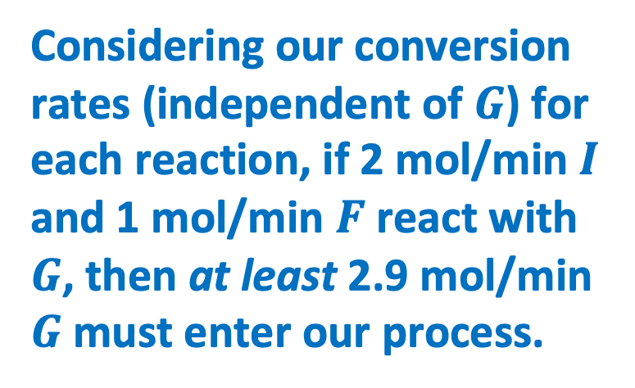
(All flow rates in mol/min)
Flow Rates for Option 2B
H₂O (1000)
F (aq) [1]
I (aq) [2]
H₂O (1000)
G (excess)
F
G
B
P
P (g)
steam
L/G Sep. 110˚C
Reactor
F + G → P
I + G → B
20˚C
L/G Sep.
65˚C
H₂O (1000)
F (aq) [1]
I (aq) [2]
F
G
I
B
Considering our conversion rates (independent of $G$) for each reaction, if 2 mol/min $I$ and 1 mol/min $F$ react with $G$, then at least 2.9 mol/min $G$ must enter our process.
F (1)
I (2)
F
G
B
B (g)
B (g) [2]
L/G Sep. 85˚C
L/G Sep. ??˚C
F
G
B
purge
F (liq)
G (liq)
P (liq) [1]
to market

Slide 25
Takeaways from 2.34
By-products may be unavoidable
Reduce unit operation size when applicable
The first design you make may not be (and often isn’t) the best; it may take multiple attempts to find the most optimal
There are A LOT of factors to consider when optimizing a process
Don’t forget to add a purge to a recycle loop!

