Slide 1
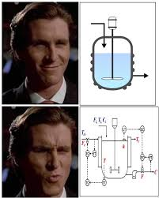
Exercise 2.35
Original created by Allie Pinterpe ('13), Remastered and reworked by Angela Tang (‘18), Finessed and fine tuned by Francis Ledesma (‘19), Appraised and altered by Michelle Quien (‘20), Scrutinized and streamlined by Drew Lazarow (‘21), Revised and renovated by Sarah Huang and Lucy Cadanau (‘22), Edited and embellished by Ailen Lao and Sanna Vedrine (’23), Trimmed and tidied by Austin Vollweiler (‘24), Chat GPT’d by Dennis Wu (‘25), Cooked and clarified by James Chen (‘26)

Slide 2
Design Goals
Maximize the total value of the product(s)
Minimize the number of units
Minimize the size of each unit

Slide 3
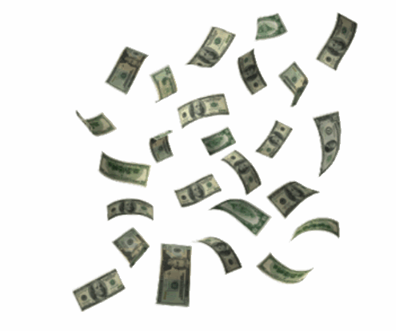
Design Goals

Slide 4
Reactions
P
A
B
X
Q
both reactions result in an in equimolar mixture of components
A
P
Q
B
X
A, P, or Q
B or X
reactor
Notes:
A reacts reversibly to form P and Q
B reacts reversibly to form X
Since we’re given that A, P, and Q have the same molecular weight and so do B and X, mole balances can be treated as mass balances.
The problem also tells us what happens going into and out of a reactor
If A, P, or Q go in, equalmolar amounts of A, P, and Q come out
Likewise, if B or X go in, equalmolar amounts of B and X come out

Slide 5

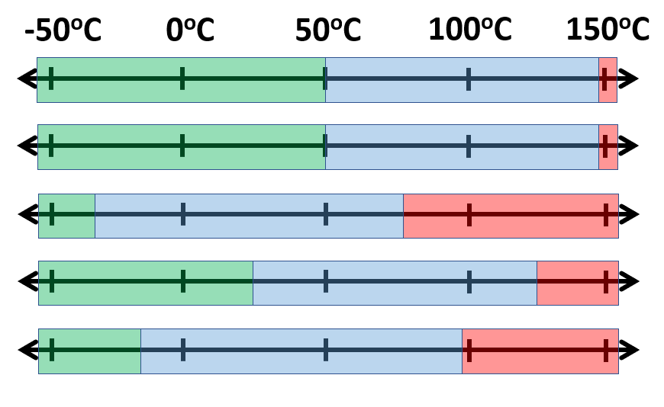
Properties
P
A
B
X
Q
 | Melting pt (˚C) | Boiling pt (˚C) | Price ($/mol)
A | 51 | 147 | 1
B | 51 | 147 | 20
P | -36 | 77 | 100
Q | 24 | 123 | 30
X | -12 | 95 | 3
Notes:
Now let’s turn to the physical properties
We can draw temperature lines to see where the phase changes are.
The first thing to notice is that A and B are inseparable by phase. This complexity will be addressed
Focusing on the first reactions with A, we see that all products are separable. That’s good. But our main design goal is to maximize value, so early we want to focus on producing as much P as possible
Looking at the prices of all given chemicals, P clearly makes the most money, so why not just make P?
We can only get A as a mixture of A and B, and looking at their melting and boiling points, we can’t separate them physically, so we do need to consider chemical reactions of B

Slide 6
Properties
P
A
B
X
Q
 | Melting pt (˚C) | Boiling pt (˚C) | Price ($/mol)
A | 51 | 147 | 1
B | 51 | 147 | 20
P | -36 | 77 | 100
Q | 24 | 123 | 30
X | -12 | 95 | 3
Notes:
Likewise if we focus on the reaction between B and X, we see that they’re separable, but we want to focus on producing as much B as possible
So looking at everything together, we know P and B are the products we want to focus on making and A and B cannot be separated.

Slide 7
Properties
P
A
B
X
Q
 | Melting pt (˚C) | Boiling pt (˚C) | Price ($/mol)
A | 51 | 147 | 1
B | 51 | 147 | 20
P | -36 | 77 | 100
Q | 24 | 123 | 30
X | -12 | 95 | 3
Notes:
Likewise if we focus on the reaction between B and X, we see that they’re separable, but we want to focus on producing as much B as possible
So looking at everything together, we know P and B are the products we want to focus on making and A and B cannot be separated.

Slide 8
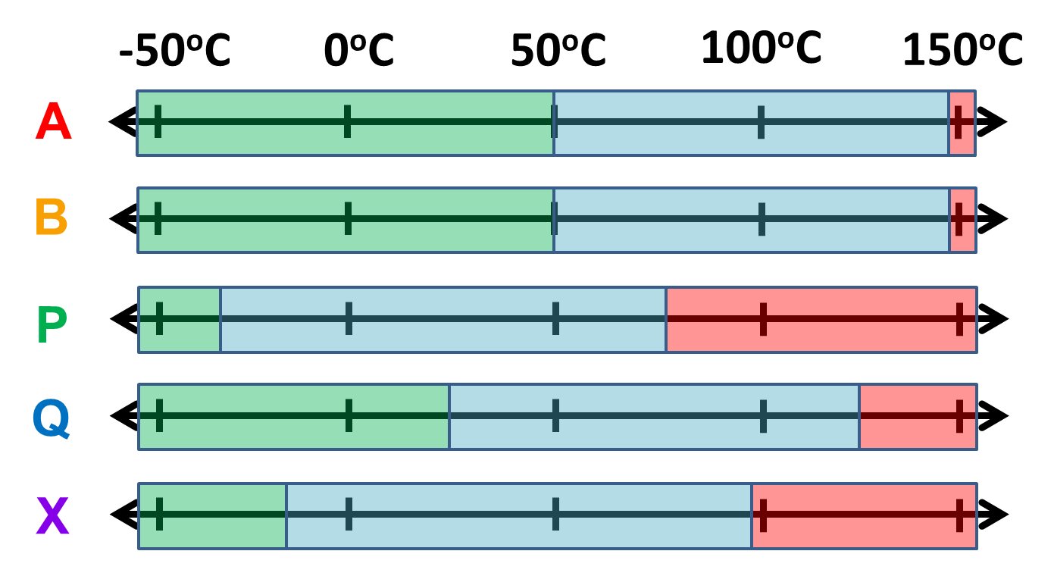
Design Draft 1: single pass
A | (30)
B | (5)
P | (30)
Q | (30)
X | (5)
P | (30)
X | (5)
A | (90)
B | (10)
Reactor
117 ºC
A→A+P+Q
B→B+X
Liquid – Gas Separator
110 ºC
A | (30)
B | (5)
Q | (30)
95C: separate P and A,B,Q,X
110C: separate P,X and A,B,Q
Minimize the size of units!
Notes:
We feed our starting materials into a reactor, take the stream that comes out and separate out P, X, and Q.
From the values of the streams coming out of our process, we can calculate the value of our products to be $3915/min
But we need to keep in mind that one of our design goals is to minimize the size of the units. SO WHAT COULD WE DO

Slide 9
Design Draft 1: single pass
P | (30)
A | (30)
B | (5)
P | (30)
Q | (30)
X | (5)
P | (30)
X | (5)
Liquid – Gas Separator
85 ºC
A | (90)
B | (10)
Reactor
117 ºC
A→A+P+Q
B→B+X
Liquid – Gas Separator
X | (5)
110 ºC
A | (30)
B | (5)
Q | (30)
Q | (30)
Liquid – Gas Separator
135 ºC
A | (30)
B | (5)
Notes:
We feed our starting materials into a reactor, take the stream that comes out and separate out P, X, and Q.
From the values of the streams coming out of our process, we can calculate the value of our products to be $3915/min
But we need to keep in mind that one of our design goals is to minimize the size of the units. SO WHAT COULD WE DO

Slide 10
Design Draft 1: single pass
P | (30)
A | (30)
B | (5)
P | (30)
Q | (30)
X | (5)
P | (30)
X | (5)
Liquid – Gas Separator
85 ºC
A | (90)
B | (10)
Reactor
117 ºC
A→A+P+Q
B→B+X
Liquid – Gas Separator
X | (5)
110 ºC
A | (30)
B | (5)
Q | (30)
Q | (30)
Liquid – Gas Separator
135 ºC
Product | Flow Rate (mol/min) | Price ($/mol) | Value ($/min)
P | 30 | 100 | 3000
X | 5 | 3 | 15
Q | 30 | 30 | 900
A + B | 35 | 0 | 0
A | (30)
B | (5)
Are we really maximizing the total value of the products in this process?
Not quite! By adding recycles we can push up the production of P (= more $$$)
$3915/min total
Notes:
We feed our starting materials into a reactor, take the stream that comes out and separate out P, X, and Q.
From the values of the streams coming out of our process, we can calculate the value of our products to be $3915/min
But we need to keep in mind that one of our design goals is to minimize the size of the units. SO WHAT COULD WE DO

Slide 11
How to Improve?
P | (30)
A | (30)
B | (5)
P | (30)
Q | (30)
X | (5)
P | (30)
X | (5)
Liquid – Gas Separator
85 ºC
A | (90)
B | (10)
A | (90)
B | (10)
Reactor
117 ºC
A→A+P+Q
B→B+X
Liquid – Gas Separator
110ºC
X | (5)
[100]
A | (30)
B | (5)
Q | (30)
Q | (30)
Liquid – Gas Separator
135 ºC
A
B
purge
A | (30)
B | (5)
How much money are we making now?
What are the flow rates in the process?

Slide 12
Iterate to Find Flow Rates at Steady State
P
 | (43)
 | (40)
 | (45)
P | (30)
 | (44)
P
X
 | (40)
 | (7.5)
 | (45)
 | (10)
P | (30)
X | (5)
 | (43)
 | (9)
A | (43)
B | (9)
P | (43)
Q | (43)
X | (9)
 | (44)
 | (9)
A | (30)
B | (5)
P | (30)
Q | (30)
X | (5)
A | (40)
B | (7.5)
P | (40)
Q | (40)
X | (7.5)
A | (44)
B | (9)
P | (44)
Q | (44)
X | (9)
A | (45)
B | (10)
P | (45)
Q | (45)
X | (10)
Liquid – Gas Separator
85 ºC
[35]
[47.5]
[52]
[53]
[55]
A | (90)
B | (10)
A | (130)
B | (17)
A | (134)
B | (20)
A | (120)
B | (15)
A | (90)
B | (10)
A | (135)
B | (20)
A | (133)
B | (19)
Reactor
117 ºC
A→A+P+Q
B→B+X
X
 | (9)
 | (10)
X | (5)
 | (7.5)
Liquid – Gas Separator
110 ºC
 | (9)
[100]
[100]
[100]
[135]
[147]
[150]
[155]
[155]
[135]
[135]
[147]
[152]
[154]
Q
Q | (30)
 | (44)
 | (40)
 | (43)
A
B
Q
 | (45)
 | (44)
 | (9)
 | (44)
A | (30)
B | (5)
Q | (30)
 | (45)
 | (10)
 | (45)
 | (43)
 | (9)
 | (43)
A | (44)
B | (9)
 | (40)
 | (7.5)
 | (40)
A | (43)
B | (9)
A | (45)
B | (10)
A | (40)
B | (7.5)
A | (30)
B | (5)
[87.5]
[97]
[100]
[95]
[65]
[35]
Liquid – Gas Separator
135 ºC
[47.5]
[52]
[53]
[55]
A
B
 | (45)
 | (10)
A | (30)
B | (5)
 | (43)
 | (9)
 | (44)
 | (9)
 | (40)
 | (7.5)
purge
[35]
[47.5]
[52]
[53]
[55]
Done!

Slide 13

Iterating is tedious…

Slide 14
Instead of Iterating…Work Outside In
 | (45)
P
 | (45)
 | (10)
A → A + P + Q
A_{in} + P_{in} + Q_{in} = A_{out} + P_{out} + Q_{out}
P_{out} = Q_{out}
P_{out} = Q_{out} = A_{in} / 2 = 45
A
B
P
Q
X
P
X
 | (45)
 | (10)
 | (45)
 | (45)
 | (10)
Liquid – Gas Separator
85 ºC
mass balance
[55]
A | (90)
B | (10)
 | (135)
 | (20)
A
B
Reactor
117 ºC
A→A+P+Q
B→B+X
 | (10)
equimolar
Liquid – Gas Separator
110 ºC
X
[155]
[155]
solving
A
B
Q
 | (45)
 | (10)
 | (45)
 | (10)
 | (45)
A
B
B → B + X
B_{in} + X_{in} = B_{out} + X_{out}
B_{in} = X_{out}
X_{out} = 10
 | (45)
[100]
Q
[55]
mass balance
Liquid – Gas Separator
135 ºC
A
B
 | (45)
 | (10)
purge
equimolar
[55]
solving

Slide 15
Instead of Iterating…Work Outside In
 | (45)
P
 | (45)
 | (10)
A
B
P
Q
X
P
X
 | (45)
 | (10)
 | (45)
 | (45)
 | (10)
Liquid – Gas Separator
85 ºC
[55]
A | (90)
B | (10)
 | (135)
 | (20)
A
B
Reactor
117 ºC
A→A+P+Q
B→B+X
 | (10)
Liquid – Gas Separator
110 ºC
X
[100]
[155]
[155]
A
B
Q
 | (45)
 | (10)
 | (45)
 | (10)
 | (45)
A
B
 | (45)
[100]
Q
[55]
Liquid – Gas Separator
135 ºC
A
B
 | (45)
 | (10)
purge
[55]
Same result as iterating!
All reaction products leave the system

Slide 16
Now to evaluate our design
P
P | (45)
P
X
A
B
P
Q
X
P | (45)
X | (10)
A | (45)
B | (10)
P | (45)
Q | (45)
X | (10)
Liquid – Gas Separator
85 ºC
[55]
A | (90)
B | (10)
A
B
A | (135)
B | (20)
Reactor
117 ºC
A→A+P+Q
B→B+X
X
Liquid – Gas Separator
110 ºC
X | (10)
[100]
[155]
[155]
Q
A
B
Q
Q | (45)
A
B
A | (45)
B | (10)
Q | (45)
A | (45)
B | (10)
[100]
[55]
Liquid – Gas Separator
135 ºC
A
B
A | (45)
B | (10)
purge
[55]
Product | Flow Rate (mol/min) | Price ($/mol) | Value ($/min)
P | 45 | 100 | 4500
X | 10 | 3 | 30
Q | 45 | 30 | 1350
Are we really maximizing the total value of the products in this process?
Total: $5880/min
Notes:
Now we’re making more money than before. Look good?

Slide 17
Let’s go back to see if we’ve met the design goals
Maximize the total value of the product(s)
 | Melting pt (˚C) | Boiling pt (˚C) | Price ($/mol)
A | 51 | 147 | 1
B | 51 | 147 | 20
P | -36 | 77 | 100
Q | 24 | 123 | 30
X | -12 | 95 | 3
Focus on producing the most profitable products:
P & B
How do we do this?
Notes:
Does our current process satisfy the design goals? Let’s check
Our most important design goal for this exercise is to maximize the value of the products.
Did we do this?

Slide 18
Design Goals

Slide 19
Focus on making P & B
P | (45)
P
A
B
P
Q
X
A | (45)
B | (10)
P | (45)
Q | (45)
X | (10)
P | (45)
X | (10)
P
X
Liquid – Gas Separator
135 ºC
[55]
A | (135)
B | (20)
A | (90)
B | (10)
A
B
Reactor
117 ºC
A→A+P+Q
B→B+X
Liquid – Gas Separator
85 ºC
X | (10)
[100]
[155]
[155]
X
Q
A
B
Q
Q | (45)
A | (50)
B | (10)
Q | (50)
[100]
A | (50)
B | (10)
Liquid – Gas Separator
110 ºC
A
B
[60]
A | (50)
B | (10)
purge
[60]
Recycling Q will help us produce more P!
Notes:
Recycle Q back into the process to produce more P

Slide 20
Focus on making P & B
P
P | (90)
A
B
P
Q
X
A | (90)
B | (10)
P | (90)
Q | (90)
X | (10)
P | (90)
X | (10)
P
X
Liquid – Gas Separator
135 ºC
A | (180)
B | (20)
Q | (90)
[100]
A | (90)
B | (10)
A
B
Reactor
117 ºC
A→A+P+Q
B→B+X
Liquid – Gas Separator
85 ºC
X | (10)
X
[100]
[290]
[290]
A | (90)
B | (10)
Q | (90)
A | (90)
B | (10)
Q | (90)
[190]
A
B
Q
[190]
purge
Are we really maximizing the total value of the products in this process?
While we are now maximizing the value of P produced….
…we can still make more money by converting X to B
Notes:
Do mass balances the outside in way

Slide 21

Focus on making P & B
✓
✓
P | (90)
A | (90)
B | (10)
P | (90)
Q | (90)
X | (10)
P | (90)
X | (10)
Liquid – Gas Separator
135 ºC
A | (180)
B | (20)
Q | (90)
[100]
A | (90)
B | (10)
Reactor
117 ºC
A→A+P+Q
B→B+X
Liquid – Gas Separator
110 ºC
[100]
[290]
[290]
X | (10)
[190]
A | (90)
B | (10)
Q | (90)
A | (90)
B | (10)
Q | (90)
[190]
purge
purge
X | (10)
X
X | (10)
X
B | (10)
X | (10)
B
X
Liquid – Gas Separator
117 ºC
Reactor
117 ºC
X→B+X
X | (20)
X
B | (10)
B
Product | Flow Rate (mol/min) | Price ($/mol) | Value ($/min)
P | 90 | 100 | 9000
B | 10 | 20 | 200
Total: $9200/min
Notes:
Recycle X back to make B

Slide 22

Chemical Process Recap
Made a design that worked to isolate and maximize P and B
Recycled unused reactants to increase product yield
Utilized a second reactor to convert a less favorable product to a more favorable one

Slide 23
Our Process Recap (Takeaways)
Check & prioritize your design goals
  May need to change design multiple times to make sure your top goal is accomplished!
Recycle Loops
  Remember to purge
  Use to increase output of certain products
  Calculate flow rates by
    Iterating until numbers converge
    System mass balance, working outside in
One input and one output stream per reactor

Slide 24
Calculation Session 3
Exercise 2.35 – process design with informal, approximate flow rates.
Assess your process:
Does your process agree with an overall mass balance?
Given A_{in} = 90 ⇒ (A + P + Q)_{out} = ?
Given B_{in} = 10 ⇒ (B + X)_{out} = ?
Does your process achieve the maximum P output?
Exercises 3.4, 3.10, and 3.24 – formal mass balances.
1. Draw system borders.
2. Describe system and state assumptions
or write rate in = rate out
Homework questions? Ask!

