Slide 1
Exercise 3.24
Created by Jiamin Zhang ’16 and Maxine Chan ’16 Revised by Amy Penick ’17, Anderson Luke ‘18, Joe Hassler ’18, Max Serota ’22, Sanna Vedrine ‘23, Ailen Lao ’23, Austin Kwan ’24, Lauren de Silva ‘25
Notes:
Extraction of oil from soybeans

Slide 2
Soybeans:
37 wt% Oil
45 wt% Protein
18 wt% Fiber
2.3 kg/min
Hexane
Oil
Hexane
3
1
5
Oil
Oil
Extractor
Oil
Recovery
6
Hexane
7.4 kg/min
2
Protein
Fiber
3.0 wt% Hexane
4
Nomenclature:
F_{T,n} = Total flow rate of stream n
x_{P,n}= mass fraction of Protein in stream n
Notes:
Calculate the flow rate and composition of stream 2
Use O,P,F to represent oil, protein, and fiber, respectively

Slide 3
37 wt% O
45 wt% P
18 wt% F
2.3 kg/min
H
O
H
3
1
5
O
Oil
Extractor
Oil
Recovery
6
H
7.4 kg/min
2
P
F
3.0 wt% H
4
Part (A)
What is F_{T,2} and its composition?
Notes:
In Part A, we need the flow rate and composition of stream 2.
Where should we draw the system borders?
Draw border around oil extractor, or whole system. Either one works.

Slide 4
1. Let’s define our system
37 wt% O
45 wt% P
18 wt% F
2.3 kg/min
H
O
H
3
1
5
O
Oil
Extractor
Oil
Recovery
6
H
7.4 kg/min
2
P
F
3.0 wt% H
4
Total in = Total Out
Pin = Pout
Fin = Fout
Notes:
Protein and fiber only come into the system and exit in one stream: could be easy to work with.
Overall mass balance? [pause]
Total In = Total Out
No
Species balance on Protein and Fiber

Slide 5
Assume protein is conserved
Assume fiber is conserved.
Protein in= Protein out
F_{P,1} + F_{P,5} = F_{P,2} + F_{P,6}
F_{P,1} = x_{P,1}F_{T,1} = 0.45(2.3 kg/min)
= 1.035 kg/min
F_{P,2} = 1.035 kg/min
Fiber in = Fiber out
F_{F,1} + F_{F,5} = F_{F,2} + F_{F,6}
F_{F,1} = x_{F,1}F_{T,1} = 0.18(2.3 kg/min)
= 0.414 kg/min
F_{F,2} = 0.414 kg/min
37 wt% O
45 wt% P
18 wt% F
2.3 kg/min
3
Note:
There is NO protein or fiber in input stream 5 or output stream 6.
x_{P,5} , x_{P,6} = 0
x_{F,5} , x_{F,6} = 0
1
5
6
1.035 kg/min P
0.414 kg/min F
3.0 wt% H
2
P
F
3.0 wt% H
4

Slide 6
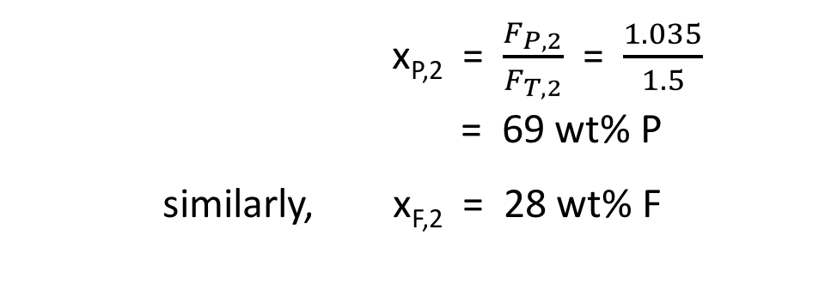
37 wt% O
45 wt% P
18 wt% F
2.3 kg/min
1
3
5
6
1.035 kg/min P
0.414 kg/min F
3.0 wt% H
2
4
F_{T,2} = F_{P,2} + F_{F,2} + F_{H,2}
F_{H,2} = 0.030 F_{T,2}
F_{T,2} = (1.035 + 0.414) kg/min + 0.030 F_{T,2}
(1 - 0.030) F_{T,2} = (1.035 + 0.414) kg/min
F_{T,2} = 1.5 kg/min
Composition?

Slide 7
Parts (B) & (C)
F_{T,6} ? F_{T,5} ?
37 wt% O
45 wt% P
18 wt% F
2.3 kg/min
H
O
H
3
1
5
O
Oil
Extractor
Oil
Recovery
6
H
7.4 kg/min
2
69 wt% P
28 wt% F
3.0 wt% H
1.5 kg/min
4
Notes:
Hexane and Oil only come into the system and exit in one stream: could be easy to work with.
System borders?? [PAUSE]

Slide 8
B.
Conservation of Oil
F_{O,in} = F_{O,out}
F_{O,1} = F_{O,6}
F_{T,6} = F_{O,6}
F_{T,6} = x_{O,1}F_{T,1}
F_{T,6} = 0.37*2.3 kg/min
F_{T,6} = 0.85 kg/min
Note:
There is NO oil in input stream 5 or output stream 2.
x_{O,5} , x_{O,2} = 0
37 wt% O
45 wt% P
18 wt% F
2.3 kg/min
H
1
3
5
O
6
1.035 kg/min P
0.414 kg/min F
3.0 wt% H
2
4
Notes:
NOTE: One more sig fig can be achieved by using the unrounded values of the flow rates. The more accurate result is 0.045 kg/min, which can be calculated using the total mass or with a mass balance on hexane.

Slide 9
C.
Conservation of Hexane
F_{H,in} = F_{H,out}
F_{H,5} = F_{H,2}
F_{T,5} = F_{H,5}
F_{T,5} = 0.03F_{T,2}
F_{T,5} = 0.03*1.5 kg/min
F_{T,5} = 0.05 kg/min
Note:
There is NO Hexane in input stream 1 or output stream 6.
x_{H,1} , x_{H,6} = 0
37 wt% O
45 wt% P
18 wt% F
2.3 kg/min
H
1
3
5
O
6
1.035 kg/min P
0.414 kg/min F
3.0 wt% H
1.5 kg/min
2
4
Notes:
NOTE: One more sig fig can be achieved by using the unrounded values of the flow rates. The more accurate result is 0.045 kg/min, which can be calculated using the total mass or with a mass balance on hexane.

Slide 10
2.3 kg/min
0.05 kg/min
1
3
5
0.85 kg/min
6
1.5 kg/min
2
4
Check our Answer!
Conservation of mass
F_{T,in} = F_{T,out}
F_{T,1} + F_{T,5} = F_{T,2} + F_{T,6}
2.3 + 0.05 = 1.5 + 0.85
2.35 kg/min = 2.35 kg/min
Notes:
NOTE: One more sig fig can be achieved by using the unrounded values of the flow rates. The more accurate result is 0.045 kg/min, which can be calculated using the total mass or with a mass balance on hexane.

Slide 11
Takeaways
Steady State + No Reaction Rate in = Rate out
No Accumulation
Draw system borders (that simplify your analysis)
Include UNITS (always)
Check your work with an alternative method
Notes:
Conservation of mass
No need to worry about recycle loop, draw system boundary to include both units

