Slide 1
Calculation Session 3 Exercise 3.4
Created by: Spencer Hong (‘20)
Edited by: Sarah Huang (‘22), Leon Lee (‘23), Maggie MacNeel (‘24), & Ashlyn Dumaw (‘25)

Slide 2
Goal:
Calculate stream flow rates using formal mass balances
Info:
Flow rates of some of the streams
Where to start:
Define your variables
Consider system borders

Slide 3
Nomenclature
F_{W,2}
Flow rate
**If you choose your own notation, please define your variables clearly!
Species (e.g. water)
Stream #
x_{W,2}
Mass fraction (or mole fraction) of water in stream 2

Slide 4
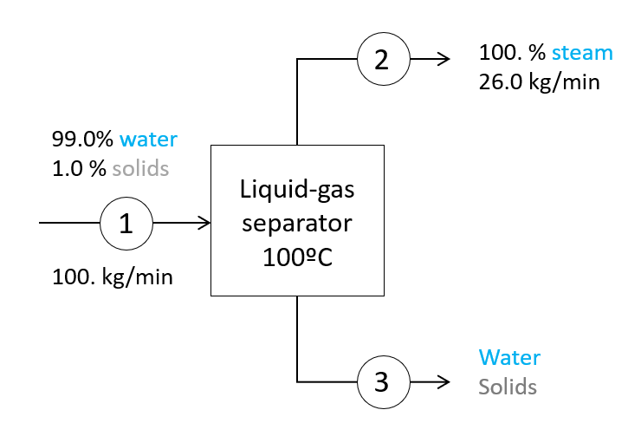
Rate water in = Rate water out
F_{W, 3} = F_{W, 1}
F_{W, 3} = (0.99) * 100. kg/min = 99 kg/min
Rate solids in = Rate solids out
F_{S, 3} = F_{S, 1}
Assumptions
Assume steady state.
Assume no reaction.
F_{S, 3} = (0.01) * 100. = 1 kg/min
Notes:
Draw boundaries around system
Assumptions!

Slide 5
26
Rate water in = Rate water out
F_{W, 1} = F_{W, 2} + F_{W, 3}
99
F_{W, 2} = F_{T, 2} = 26 kg/min
F_{W, 1} = F_{T, 1} * x_{W,} ₁
= (100.)(0.99) = 99 kg/min
73
F_{W, 3} = F_{W, 1} - F_{W, 2} = 99 – 26 = 73 kg/min
Assumptions
Assume steady state.
Assume no reaction.
Notes:
Draw boundaries around system
Assumptions!

Slide 6
26
Rate solids in = Rate solids out
F_{S, 1} = F_{S, 2} + F_{S, 3}
99
1
F_{S, 2} = no solid! = 0 kg/min
F_{S, 1} = F_{T, 1} * x_{S, 1}
= (100.)(0.01) = 1 kg/min
73
1
F_{S, 3} = F_{S, 1} - F_{S, 2}
= 1 – 0 = 1 kg/min
Assumptions
Assume steady state.
Assume no reaction.
Notes:
Draw boundaries around system
Assumptions!

Slide 7
Flow rate and composition of stream 3
26
F_{T, 3} = F_{W, 3} + F_{S, 3}
F_{T, 3} = 73 + 1 = 74 kg/min
99
1
Mole/mass fractions must sum to 1!
x_{W, 3} + x_{S, 3} = 1
x_{S, 3} = 1 - x_{W, 3}
= 1 - (73/74) = 0.01351
73
1
0.014
x_{W, 3} = 1 - 0.014 = 0.986
Assumptions
Assume steady state.
Assume no reaction.
Total flow rate: 74 kg/min
Composition: 98.6 wt% water, 1.4 wt % solids
Notes:
Draw boundaries around system
Assumptions!

Slide 8
2
Assumptions
Assume steady state.
Assume no reaction.
100.0 % steam
26.0 kg/min
99.0% water
1.0 % solids
liquid-gas separator
Liquid-gas separator 100ºC
100.0 % steam
23.0 kg/min
1
4
100. kg/min
Liquid-gas separator 100ºC
100.0 % steam
17.0 kg/min
3
6
100.0 % steam
13.0 kg/min
Liquid-gas separator 100ºC
5
8
Liquid-gas separator 100ºC
Overall System Boundary
7
9
Water
Solids

Slide 9
100.0 % steam
26.0 kg/min
liquid-gas separator
2
Assumptions
Assume steady state.
Assume no reaction.
99.0% water
1.0 % solids
4
100.0 % steam
23.0 kg/min
6
100.0 % steam
17.0 kg/min
1
100. kg/min
8
100.0 % steam
13.0 kg/min
9
Water
Solids
Rate in = Rate out
F_{T,1} = F_{T,2} + F_{T,4}+ F_{T,6} + F_{T,8} + F_{T,9}
Mole/mass fractions must sum to 1!
F_{T,9} = F_{T,1} - F_{T,2} - F_{T,4} - F_{T,6} - F_{T,8}
= 100 - 26 - 23 - 17 – 13 = 21.0 kg/min
X_{W,9} + X_{S,9} = 1
X_{S,9} = 1 - (20/21) = 0.05
X_{W,9} = 1 - 0.05 = 0.95
Rate solids in = Rate solids out
F_{S,1} = F_{S,2} + F_{S,4}+ F_{S,6} + F_{S,8} + F_{S,9}
Total flow rate: 21.0 kg/min
Composition: 95. wt% water, 5. wt % solids
F_{S,1} = 0 + 0 + 0 + 0 + F_{S,9}
F_{S,9} = F_{S,1} = 1. kg/min

Slide 10
Key Takeaways
Drawing Boundaries
Encompass entire units
Overall: Streams coming in from outside system or leaving system must cross system boundaries
Formal Mass Balances
List Assumptions
Mass in = Mass out
Write out equations in terms of variables
Plug in values and solve
Mass Balance Equations
Overall mass balance (F₁ = F₂ + F₃)
Species balances (x_{W,1}F₁ = x_{W,2}F₂ + x_{W,3}F₃)
Stream totals (x_{W,1} + x_{S,1} = 1)

