Slide 1
Calculation Session 4
Exercise 2.34 revisited – process analysis with informal mass balances.
Calculate approximate flow rates in mol/min.
Exercise 3.116 – process design with approximate flow rates.
Assess your process:
Does your process agree with an overall mass balance?
Given A_{in} = 90 ⇒ (A + P + Q)_{out} = ?
Given B_{in} = 10 ⇒ (B + Z)_{out} = ?
What is the theoretical maximum pure P output?
What is the actual maximum pure P output?
Exercise 3.114 – process analysis.
Homework questions? Ask!

Slide 2
Calculation Session 4
Exercise 2.34 (Revisited)
Created by: Chida Balaji ’13
Revised by: Andrew Broenen ’13, Alanda Szkodny ’14, Kathy Fein ’15, Jesse Garcia ’16, Jenny Bushnell ’17, Joe Hassler ’18, Francis Ledesma ’19, Michelle Quien ’20, Gavin Batsimm ’21, Kelsey Levine ’22, Leon Lee ’23, Burke Combs ’24, and Ashlyn Dumaw ‘25

Slide 3
Goal:
Calculate flow rates and reactor/separator capacities using informal mass balances and determine the better design
Info:
Two proposed design solutions
Inlet flow rates for the components
Where to start:
Trace through provided flow rates
Use mass balances to solve the rest

Slide 4
Process A
What are the main differences?
Which would you guess is a better process?
Process B
Reactions:
F + G → P (90% conversion)
I + G → B (100% conversion)
Notes:
1a. Produces P and B
1 mol P, 2 mol B
Smaller units!
~4x smaller, in fact
1 b. One less separator!
Produces P!
0.99 mol P
B discarded in purge
Bigger units

Slide 5
Process A
Overall Mass Balance
(1.0)
(2.0)
(2.0)
(1.0)
(2.0)

Slide 6
Process A: Overall Mass Balance
Reactions:
F + G → P (90% conversion)
I + G → B (100% conversion)
G (3.0)
H₂O (1000)
F (1.0)
I (2.0)
B
(2.0)
I does not leave the process
All I must be converted to B
P
(1.0)
90% of the F is converted
So 0.9 P leaves the process
H₂O
No F leaves the process
All F is converted to P

Slide 7
Process A
(1.0)
(1.0)
(2.0)
(2.0)
(1.0)
(2.0)
(1.0)
(1.0)
(2.0)
(2.0)
(2.0)
(2.0)
(2.0)

Slide 8
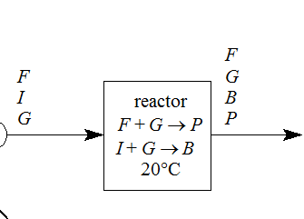
Process A: Reactor Mass Balance
Reactions:
F + G → P (90% conversion)
I + G → B (100% conversion)
(0.11)
(1.11)
(0.11)
(2.0)
(2.0)
P_{out} = 0.9*F_{in}
1.0 = 0.9*F_{in}
F_{in} = 1.11
(3.11)
(1.0)
Notes:
Correct! No F leaves process, but it does leave the reactor (0.11 mol/min)

Slide 9
Process A
(0.11)
(1.0)
(1.1)
(0.11)
(2.0)
(2.0)
(1.0)
(3.1)
(1.0)
(2.0)
(1.0)
(1.0)
(2.0)
(0.11)
(0.11)
(2.0)
(0.11)
(2.0)
(0.11)
(0.11)
Moles are not conserved… Mass is!
(0.11)
(2.0)
(2.0)
(0.11)
(0.11)

Slide 10
Process B
(2.0)
(1.0)
(2.0)
(1.0)
(2.0)

Slide 11
Process B: Overall Mass Balance
Reactions:
F + G → P (90% conversion)
I + G → B (100% conversion)
G (3.0)
B
F
G
(2.0)
(0.010)
H₂O (1000)
F (1.0)
I (2.0)
(0.010)
I does not leave the process.
B_{out} = 2.0 mol/min
P
(0.99)
P_{out} = F_{in} – F_{out}
P_{out} = 1 – 0.01
P_{out} = 0.99 mol/min
H₂O

Slide 12
Process B
P_{out}=0.9*F_{in}
0.99=0.9*F_{in}
F_{in}= 1.11
(1.11)
(0.11)
(0.99)
(2.0)
(0.11)
(1.0)
(3.11)
(22)
(2.0)
(20)
(0.99)
(1.0)
(2.0)
(0.10)
(0.10)
(0.11)
(20)
(0.11)
(x)
(22)
(0.99)
(2.0)

Slide 13
Effect of Recycle
Notes:
Shows we can get higher and higher conversion of P (highest point is 0.99999). However, B in the recycle grows extremely quickly. We use this to approximate reactor sizes

Slide 14
Process A
Unit | Capacity (mol/min)
Reactor | 6.2
Separator at 60 | 3.2
Separator at 80 | 2.2
6.2 mol/min
Capacity
3.2 mol/min
Capacity
(1 mol/min)
(2 mol/min)
2.2 mol/min
Capacity
Process B
(23 mol/min)
Capacity
(26 mol/min)
Capacity
Unit | Capacity (mol/min)
Reactor | 26
Separator at 60 | 23
(2.0 mol/min)
(0.99 mol/min)
Notes:
1a. Produces P and B
1 mol P, 2 mol B
Smaller units!
~4x smaller, in fact
1 b. One less separator!
Produces P!
0.99 mol P
B discarded in purge
Bigger units

Slide 15

And the winner is…
Process A!
(with the caveat that economic analysis is still necessary!)
Notes:
1a. Produces P and B
1 mol P, 2 mol B
Smaller units!
~4x smaller, in fact
1 b. One less separator!
Produces P!
0.99 mol P
B discarded in purge
Bigger units

Slide 16
Key Takeaways
How to judge a design
  Flow rates of products to market
  Reactor/separator capacities
  Economic analysis (when available)
Calculating flow rates
  Trace provided flow rates through the process
  Review overall mass balances and reaction chemistry to determine
  inner flow rates
  Use the splitter-composition rule when applicable

Slide 17
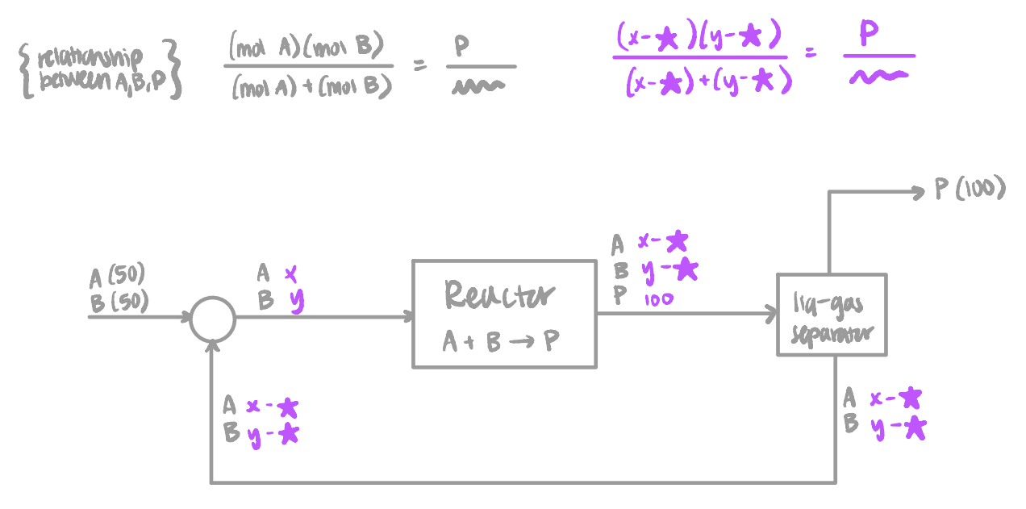
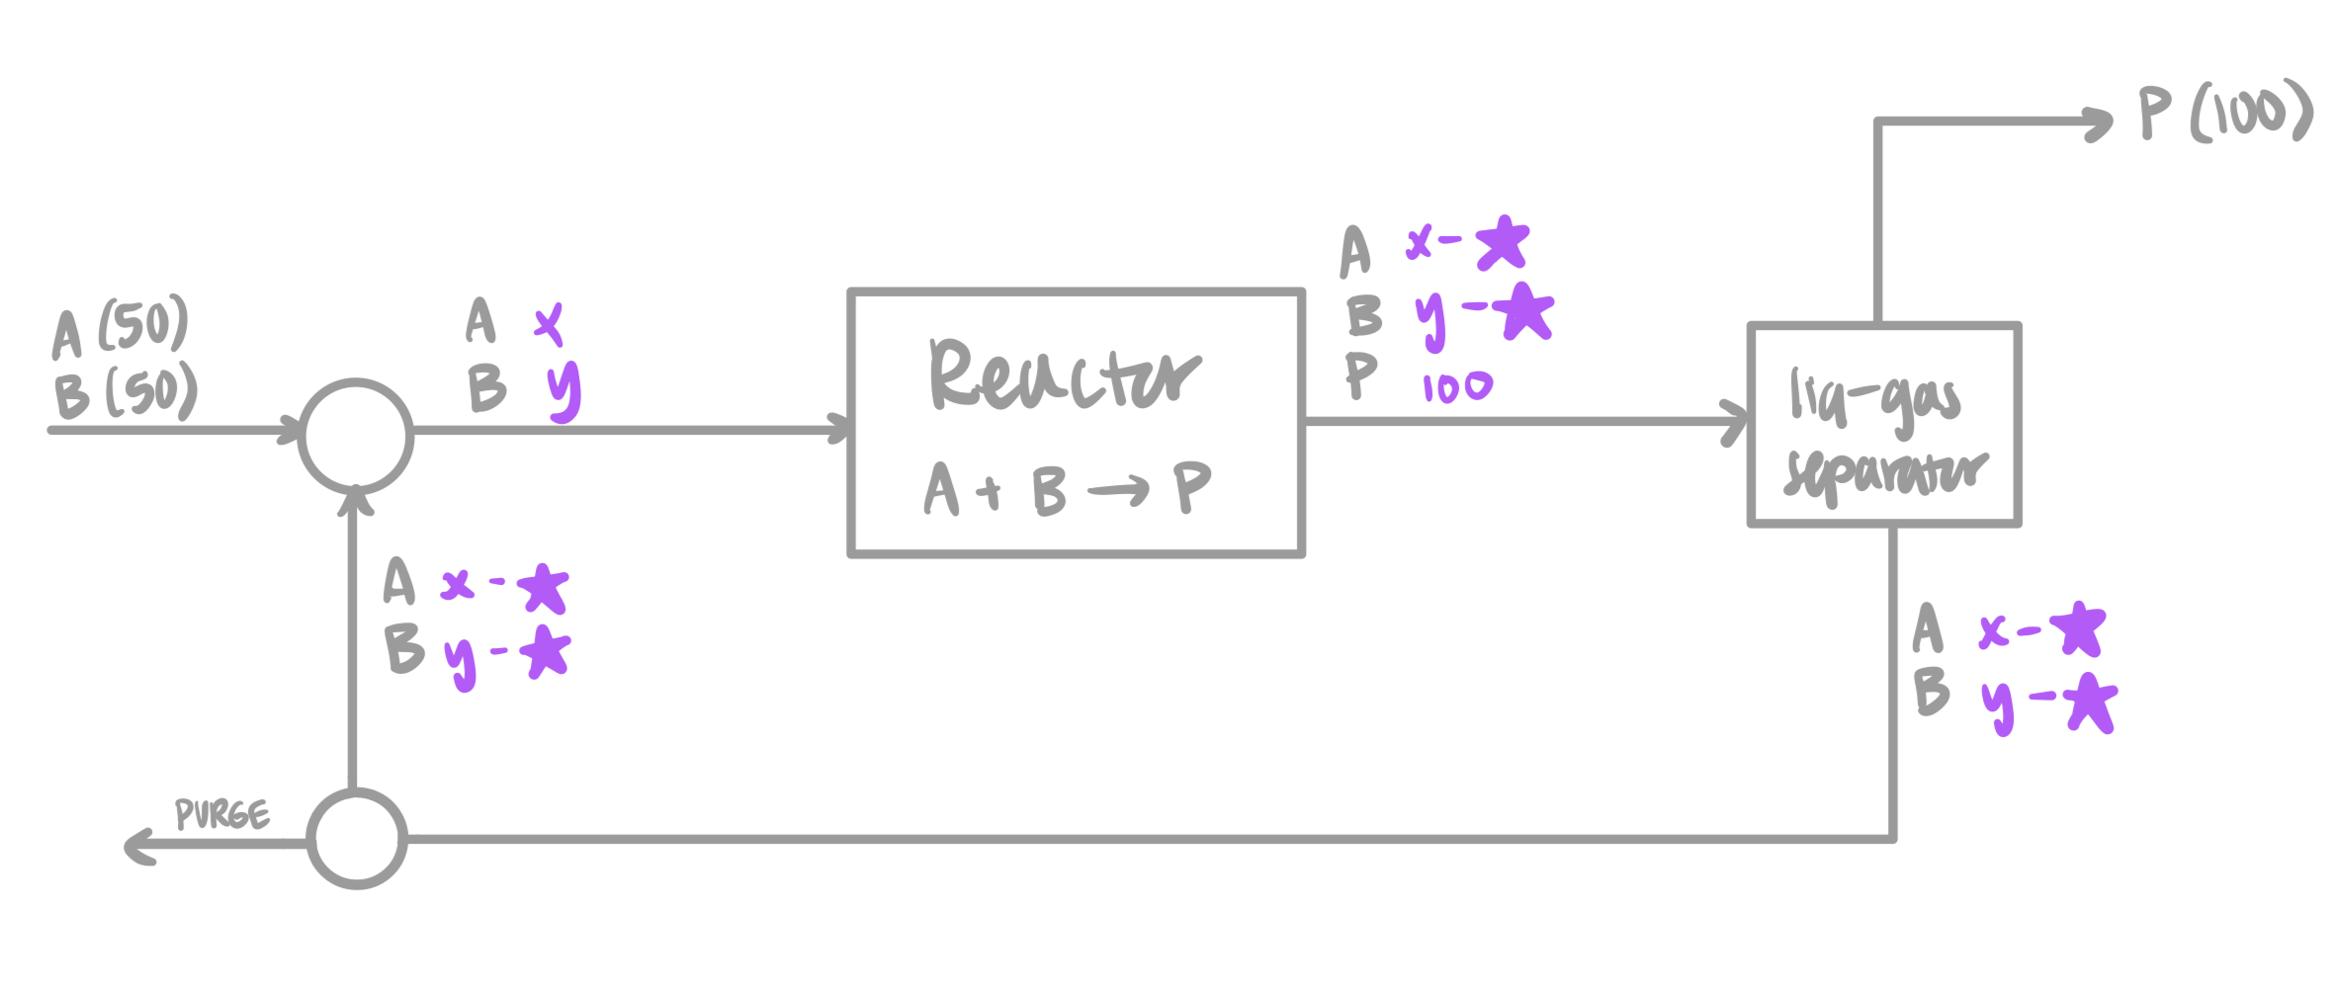
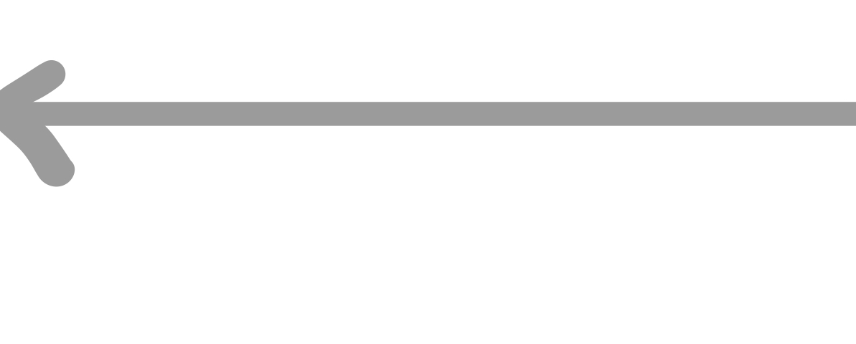
Setting Recycle Loop Variables
Notes:
Be smart about where you set your variables. This approach sets the variable as what’s entering the reactor,

Slide 18
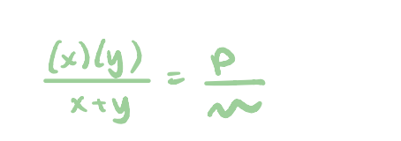
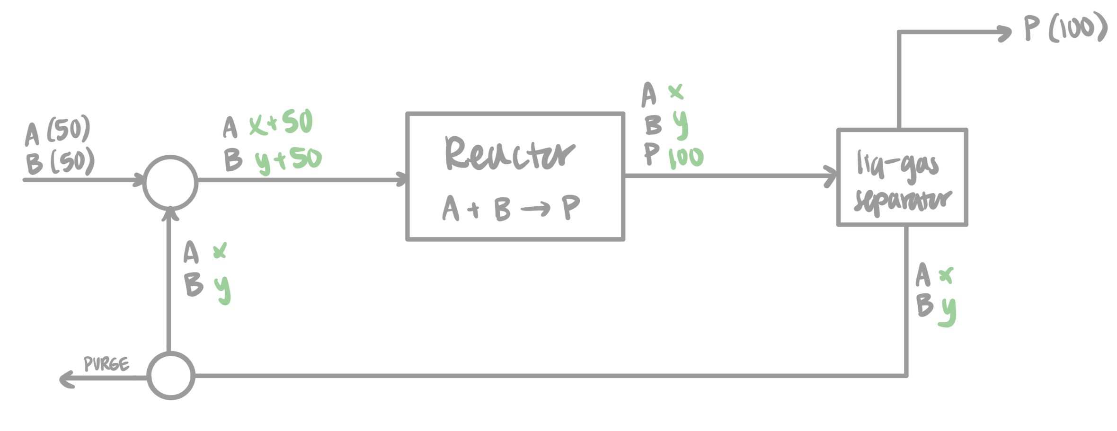
Setting Recycle Loop Variables

Slide 19
Setting Recycle Loop Variables
Set the reactor effluent as your variables to make the math easier!

Slide 20
Calculation Session 4
Exercise 2.34 revisited – process analysis with informal mass balances.
Calculate approximate flow rates in mol/min.
Exercise 3.116 – process design with approximate flow rates.
Assess your process:
Does your process agree with an overall mass balance?
Given A_{in} = 90 ⇒ (A + P + Q)_{out} = ?
Given B_{in} = 10 ⇒ (B + Z)_{out} = ?
What is the theoretical maximum pure P output?
What is the actual maximum pure P output?
Exercise 3.114 – process analysis.
Homework questions? Ask!

