Slide 1
Exercise 3.114
Created by Angela Tang (‘18)
Revised by: Sydney Brannan (‘19), Sabrina Chen (‘20), Apoorva Agarwal (‘21), Lucy Cadanau (‘22), Ariel Struzyk (‘23), Austin Kwan (‘24), Donovan Cho (’25)
Liam Gillespie (’26)

Slide 2
What we’re given
Chemical reactions and conversions
A + B → 2H 60% H + C → 2P 100%
A + B → 2K 30% B + C → 2X 90% (avoid!)
K + C → 2Q 100%
P & Q are inseparable
Process given is viable – molar flow rates are correct
Notes:
The exercise tells us some stuff about chemical reactions and conversions and that the process is viable – so we don’t need to worry about checking the molar flow rates.
We’re asked to find improvements to reduce costs or increase revenue
It also gives us a couple of things we could potentially do
Let’s translate them into questions you might be asking when we’re going through the PFD

Slide 3
Method
Determine Objective (what makes a process better?)
Assess Original Design
Make Incremental Changes (Step By Step)
Objective: INCREASE Profitability = Revenue – Cost
Increase Revenue and/or Decrease Cost

Slide 4
What can we change?
Improvements to reduce costs or increase revenue:
Eliminate a unit
Decrease unit size
Decrease reactants purchased
Do I need to separate species?
Do I need to react species?
Can I separate out more species earlier?
Can I combine streams after the unit?
Are we getting maximum profit from our reactants?
Do I add a recycle?
Notes:
The exercise tells us some stuff about chemical reactions and conversions and that the process is viable – so we don’t need to worry about checking the molar flow rates.
We’re asked to find improvements to reduce costs or increase revenue
It also gives us a couple of things we could potentially do
Let’s translate them into questions you might be asking when we’re going through the PFD

Slide 5
Original Process
 | Flow rate (mol/min) | Price ($/mol) | Value ($/min)
Reactant costs
A | 9 | 3 | 27
B | 9 | 5 | 45
C | 18 | 19 | 342
total = $414/min
Product revenues
P | 24 | 100 | 2400
Q | 12 | 17 | 204
total = $2604/min
Net = $2604 - $414 = $2190/min
Notes:
Looking at the overall process, we can figure out the cost of the reactants going in, the amount of money we can sell the products for, which gives us a net value for our process

Slide 6
Ask for suggestions
Maximize revenue?
Notes:
So any suggestions?
A+B – click their combiner [slide 7]
Move C input – click splitter of C(18) -> C(12) and C(6) [slide 9]
Reactor 3 – click reaction in reactor 3 [slide 11]
Circle on bottom = end (13)

Slide 7

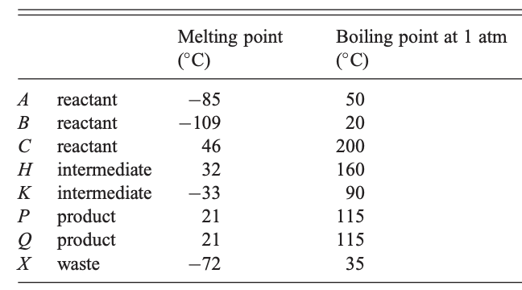
AB First
A (1)
B (1)
liquid-gas separator
70°C
K (6)
Notes:
A+B, separating them out right before combining them, just sep out together to recycle, and put K directly from second sep into reactor 3
Move C input – click splitter of C(18) -> C(12) and C(6) [slide 6]
Reactor 3 – click reaction in reactor 3 [slide 8]

Slide 8
AB First, C second
C (12)
H (12)
Notes:
We add C here and it isn’t needed until right before reactor 2 – so we can add it after only H is separated out
Reactor 3 – click reaction in reactor 3 [slide 7]

Slide 9
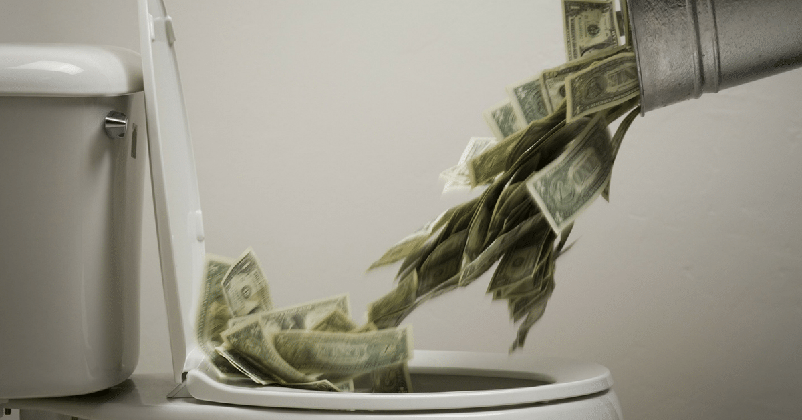
AB and C, reactor 3 third
Improved: $2346/min
reactor 3
K + C → 2Q
Reactants: C (6) ⇒ $114/min
K (6) ⇒ $246/min
Products: Q (12) ⇒ $204/min
We’re losing $156/min!
 | Flow rate (mol/min) | Price ($/mol) | Value ($/min)
Reactant costs
A | 9 | 3 | 27
B | 9 | 5 | 45
C | 18 | 19 | 342
total = $414/min
Product revenues
P | 24 | 100 | 2400
Q | 12 | 17 | 204
total = $2604/min
Net = $2604 - $414 = $2190/min
 | Flow rate (mol/min) | Price ($/mol) | Value ($/min)
Reactant costs
A | 9 | 3 | 27
B | 9 | 5 | 45
C | 12 | 19 | 228
total = $300/min
Product revenues
P | 24 | 100 | 2400
K | 6 | 41 | 246
total = $2646/min
Net = $2646 - $300 = $2346/min
Notes:
If we look back at the values of the chemicals, the reactants of reactor 3 are more valuable than the products, so we’re actually losing money! We can just get rid of it and the extra input of C.
By the reduction of C and selling of K, we can increase our process’s value
Overall, we made that $156/min more, have one less reactor, one less separator, and a smaller separator
Any other suggestions? -- click in bottom right area to slide 17

Slide 10
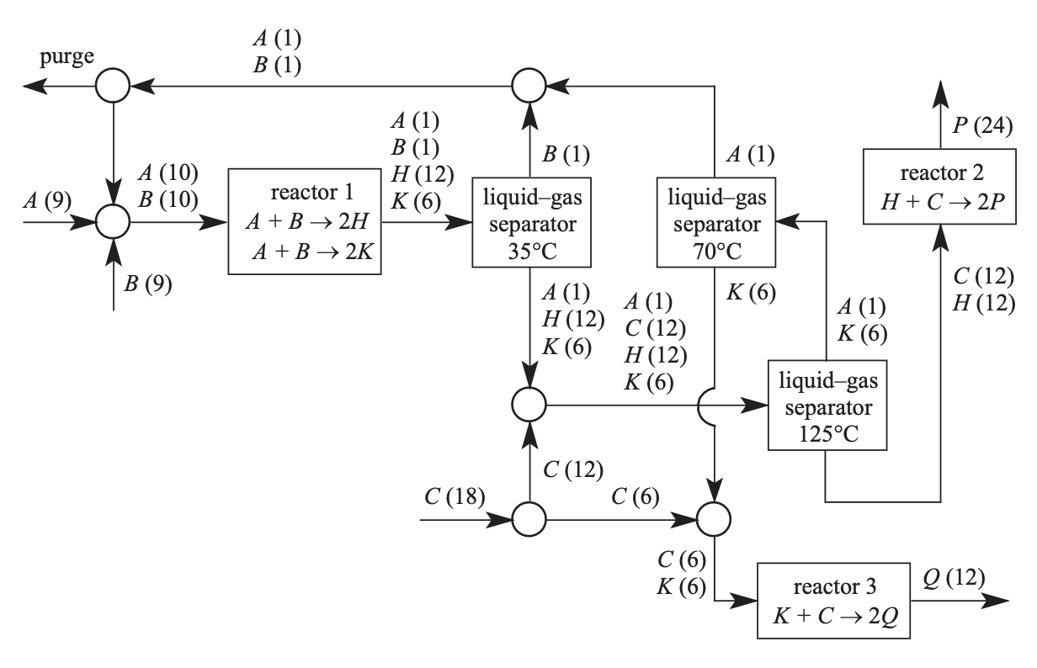
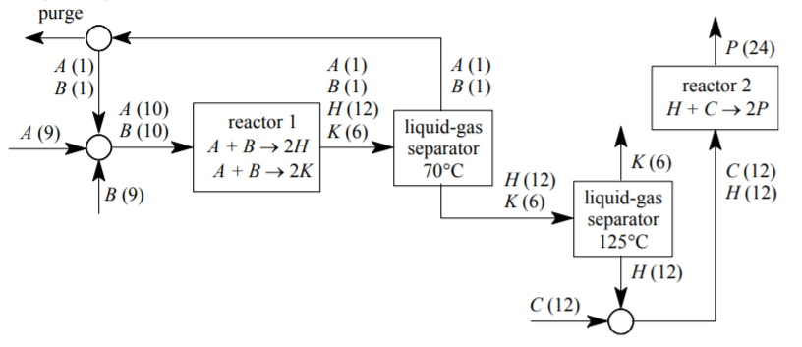
Improved Design
Only 2 reactors and 2 separators
Smaller Separator 2
Greater profit – leveraging prices of each component

Slide 11
Analysis Recap
Eliminate a unit
Decrease flow rate through unit
Decrease reactant flow rate
Most profitable products (or reactants!)
Do I need to separate species?
Do I need to react species?
Can I separate out more stuff earlier?
Can I combine streams after the unit?
Maximize cost per reactant
Do I add a recycle?
Questions?
Notes:
Recap of questions you can ask (so it can be left projected on board)
Recap of things we manipulated and how they affected stuff
Profitable products -> overall reaction -> eliminate reactor and some reactant input
When to separate -> eliminate separator, decrease in flow rates

