Slide 1

Design Exercise 3.116
Design Exercise
??
Created by Lauren Taylor ‘14
Edited by Katrina Curtiss ’15, McKenzie Hubert ’16, Aron Coraor ’17, Ameer Basrai ’18, Francis Ledesma ’19. Michelle Quien ’20, Andrew Simon ’21, Kelsey Levine ’22, Ailen Lao and Sanna Vedrine ’23, Maggie MacNeel ’24, Lauren de Silva and Dennis Wu ‘25
Notes:
sanna

Slide 2
Design Goals
1. Maximize $$$$ from selling pure products
2. Minimize the number of units
3. Minimize the size of each unit
Notes:
sanna

Slide 3
Design Considerations
A (1)
P (1)
A (2)
Reactor
Type 1
37 °C
A_{out} = ½ A_{in}
P_{out} = P_{in} + ½ A_{in}
Notes:
ailen
Type 1 Reactor
Converts ½ of A to P

Slide 4
Design Considerations
P (4)
Q (1)
A (5)
Reactor
Type 2
85 °C
P_{out} = 4 Q_{out}
P_{out} = P_{in} + 4/5 A_{in}
Q_{out} = Q_{in} + 1/5 A_{in}
Notes:
ailen
Type 2 Reactor
Converts 100% of A to P and Q in a ratio of 4:1 (P:Q)

Slide 5
Design Considerations
A (9)
B (2)
Reactor
Type 3
49 °C
A (8)
P (6)
Z (2)
P (7)
Z (4)
P_{out} = P_{in} + 1/9 A_{in}
Z_{out} = Z_{in} + B_{in}
Notes:
ailen
Type 3 Reactor
Converts 1/9 A to P
Converts 100% B to Z

Slide 6
Design Considerations
 | M.W. | Melting Pt, °C | Boiling Pt, °C | Price ($/mol) | Notes
A | 120 | -3 | 122 | 100 | Must not be heated above 250 °C
B | 133 | -3 | 122 | 35
P | 120 | -3 | 122 | 1000
Q | 120 | 18 | 147 | 20 | Suspected carcinogen
Z | 133 | -28 | 95 | 10 | Non-toxic
Get pure P by completely reacting A and B
Notes:
ailen

Slide 7
Design Considerations
Only use 1 of each reactor type
All reactions are irreversible
Start with 100 mol/hr of 90% A and 10% B
HINT: It is possible to produce P in 100% purity, with less than 1% of A converted to Q
  This means we can obtain < 0.9 mol Q
Notes:
ailen

Slide 8
Outline Initial Game Plan
Reactor
Benefit
A (1)
P (1)
Produces only P, but low conversion rate
A (2)
Reactor
Type 1
37 °C
Q (1)
P (4)
A (5)
Reactor
Type 2
85 °C
Separates A from P by producing Q
A (9)
B (2)
Reactor
Type 3
49 °C
A (8)
Separates B from P by producing Z
P (6)
Z (2)
P (7)
Z (4)
Notes:
sanna

Slide 9
Initial Game Plan
Use Type 3 to create Z from B
Use Type 2 to remove A and produce P&Q
Separate Q and P to sell
Z (10)
A (80)
P (10)
Z (10)
A (90)
B (10)
Reactor
Type 3
49 °C
Liquid-Gas Separator
110 °C
Since we want to minimize unit sizes,
let’s get rid of B first
P (74)
A (80)
P (10)
Q (16)
P (74)
Reactor
Type 2
85 °C
Liquid-Gas Separator
135 °C
Revenue: $74,420/hour
Q (16)
Notes:
sanna

Slide 10
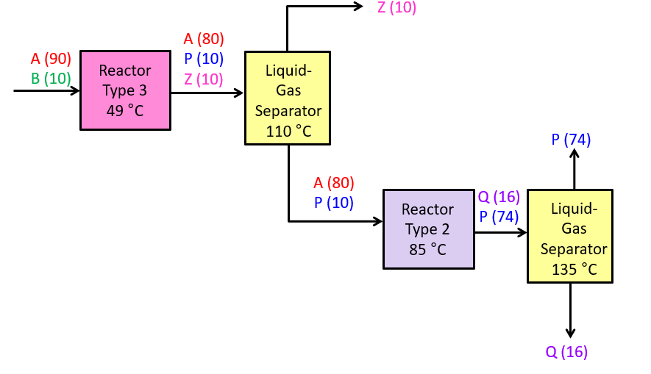
Post-Design Analysis
What I like
What needs improvement
How to improve
1. Removed B early and reduced the size of later units
Produce a lot of Q
2. Can produce more P
Problem: Produce less Q
Solution: React less A
2. Produced pure P by using reactor 2

Slide 11
Post-Design Analysis
Initial designs are seldom perfect…
Design Goals:
Maximize revenue
Minimize # units
Minimize size of units
Need to increase the yield of P!
Notes:
sanna + ailen

Slide 12

Outline Initial Game Plan
Reactor
Benefit
A (1)
P (1)
Produces only P, but low conversion rate
A (2)
Reactor
Type 1
37 °C
Q (1)
P (4)
A (5)
Reactor
Type 2
85 °C
Separates A from P by producing Q
A (9)
B (2)
Reactor
Type 3
49 °C
A (8)
Separates B from P by producing Z
P (6)
Z (2)
P (7)
Z (4)
Notes:
sanna

Slide 13
Where should we put the Type 1 reactor?
To minimize how much Q is made,
let’s use a Type 1 reactor to remove some A before reactor 2
Z (10)
A (80)
P (10)
Z (10)
A (90)
B (10)
Liquid-Gas Separator
110 °C
Reactor
Type 3
49 °C
P (74)
A (80)
P (10)
Q (16)
P (74)
A (80)
P (10)
A (40)
P (50)
Reactor
Type 2
85 °C
Reactor
Type 1
85 °C
Liquid-Gas Separator
135 °C
P (82)
Q (16)
Q (8)
P (82)
Liquid-Gas Separator
135 °C
Reactor
Type 2
85 °C
We still haven’t maximized the amount of P or our profit!
Revenue: $82,260/hour
<1% A converted into Q, which is 0.9 mol
Q (8)
Notes:
ailen

Slide 14
How do we convert more A?
2 Major Options:
    Add another reactor
    Add a recycle
Prompt prohibits any more reactors, so let’s design a recycle
Notes:
ailen

Slide 15

Z (10)
A (80)
P (10)
Z (10)
A (90)
B (10)
What about impurities?
Reactor
Type 3
49 °C
Liquid-Gas Separator
110 °C
Informal System Mass Balances!
A (80)
P (10)
A
P
purge
A
P
A
P
Reactor
Type 1
85 °C
P
Q
P
Liquid-Gas Separator
135 °C
Reactor
Type 2
85 °C
A
P
Q
Notes:
ailen
since flow rates are 1 sig fig
we know we have 90 mol A , therefore p + q = a in
smallest amount of Q = 1

Slide 16
P
A (90)
(1)
Q
B (10)
Z (10)
Design hint tells us our target Q_{out} ≈ 1 mol/hour
A_{in}= A_{out} + P_{out}+ Q_{out}
90 = 0 + P_{out} + 1
P_{out} ≈ 89 mol/hour

Slide 17
Z (10)
A (80)
P (10)
Z (10)
A (90)
B (10)
Reactor
Type 3
49 °C
Liquid-Gas Separator
110 °C
A (80)
P (10)
A
P
purge
A
P
A
P
Reactor
Type 1
85 °C
P
(89)
(1)
(89)
Q
P
Liquid-Gas Separator
135 °C
Reactor
Type 2
85 °C
A
P
Q
(1)
Notes:
ailen
since flow rates are 1 sig fig
we know we have 90 mol A , therefore p + q = a in
smallest amount of Q = 1

Slide 18
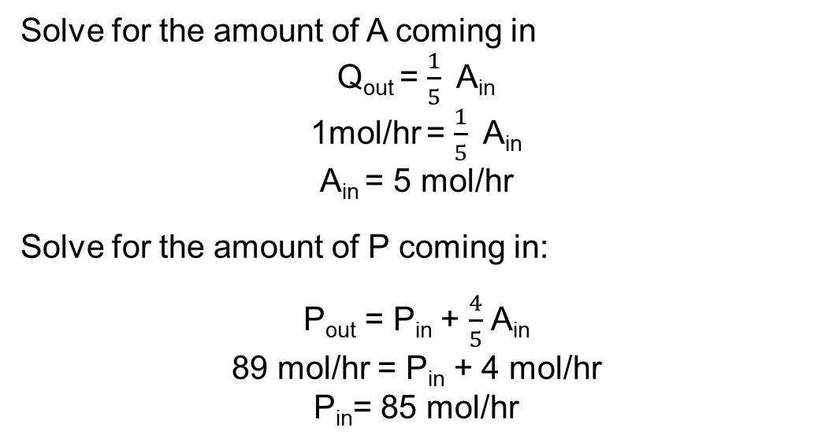
A
(5)
Q (1)
Reaction:
A → P + Q
100% conversion
4P:1Q
P
(85)
P (89)
Solve for the amount of A coming in
Q_{out} = $\frac{1}{5}$ A_{in}
1mol/hr = $\frac{1}{5}$ A_{in}
A_{in} = 5 mol/hr
Solve for the amount of P coming in:
P_{out} = P_{in} + $\frac{4}{5}$ A_{in}
89 mol/hr = P_{in} + 4 mol/hr
P_{in}= 85 mol/hr

Slide 19
Z (10)
A (80)
P (10)
Z (10)
A (90)
B (10)
Reactor
Type 3
49 °C
Liquid-Gas Separator
110 °C
A (80)
P (10)
A
P
purge
A
P
A
P
Reactor
Type 1
85 °C
P
(89)
(1)
(89)
Q
P
Liquid-Gas Separator
135 °C
A
P
Reactor
Type 2
85 °C
(5)
(85)
Q
(1)
Notes:
ailen
since flow rates are 1 sig fig
we know we have 90 mol A , therefore p + q = a in
smallest amount of Q = 1

Slide 20
Z (10)
A (80)
P (10)
Z (10)
A (90)
B (10)
Reactor
Type 3
49 °C
Liquid-Gas Separator
110 °C
A (80)
P (10)
A
P
purge
A
P
(150)
A
P
Reactor
Type 1
85 °C
(75)
P
(89)
Q
P
Liquid-Gas Separator
135 °C
(1)
(89)
(5)
Reactor
Type 2
85 °C
A
P
(85)
Reactor 1 converts ½ of A to P,
75*2 = 150 mole/hr
Q
(1)
Notes:
sanna

Slide 21
Z (10)
A (80)
P (10)
Z (10)
A (90)
B (10)
Reactor
Type 3
49 °C
Liquid-Gas Separator
110 °C
A (80)
P (10)
A
P
purge
A
P
A
P
Reactor
Type 1
85 °C
P
(89)
Q
P
Liquid-Gas Separator
135 °C
(1)
(89)
(5)
Reactor
Type 2
85 °C
A
P
(85)
Q
(1)
Notes:
sanna

Slide 22
A (80)
P (10)
Reaction:
A → P
50% conversion
A (5)
P (85)
Lets find how much A is consumed in our process:
A_{consumed} = A_{in} – A_{out}
A_{consumed}= 80 mol/hr – 5 mol/hr
A_{consumed} = 75mol/hr
Thus, we must start with 2x75=150 mol/hr A
(150)
A
P
A
P
Reactor
Type 1
85 °C
(75)
A (75)
50% of A is consumed…

Slide 23
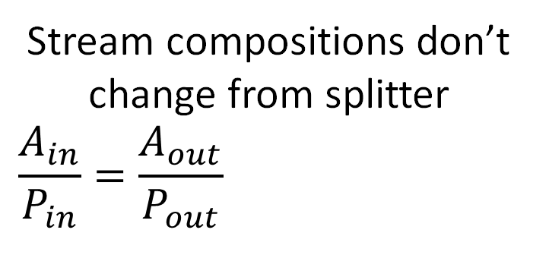
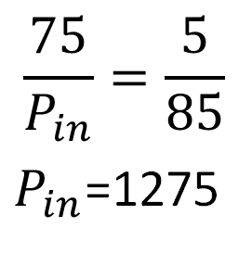
Z (10)
A (80)
P (10)
Z (10)
Stream compositions don’t change from splitter
$$\frac{A_{in}}{P_{in}}=\frac{A_{out}}{P_{out}}$$
A (90)
B (10)
Reactor
Type 3
49 °C
Liquid-Gas Separator
110 °C
$$\frac{75}{P_{in}}=\frac{5}{85}$$
$P_{in}$=1275
A (80)
P (10)
A
P
purge
A
P
(150)
A
P
c
(75)
Reactor
Type 1
85 °C
(1275)
P
(89)
Q
P
Liquid-Gas Separator
135 °C
(1)
(89)
(5)
Reactor
Type 2
85 °C
A
P
(85)
Q
(1)
Notes:
sanna

Slide 24
Z (10)
A₁ = A₂ + A₃
A₃ = 75 – 5 = 70
A (80)
P (10)
Z (10)
A (90)
B (10)
Reactor
Type 3
49 °C
Liquid-Gas Separator
110 °C
P₁ = P₂ + P₃
P₃ = 1275 – 85 = 1190
A (80)
P (10)
(70)
A
P
(1190)
3
purge
A
P
(150)
A
P
Reactor
Type 1
85 °C
(75)
(1200)
(1275)
P
(89)
1
Q
P
Liquid-Gas Separator
135 °C
(1)
(89)
(5)
2
Reactor
Type 2
85 °C
A
P
(85)
Q
(1)
Notes:
sanna

Slide 25
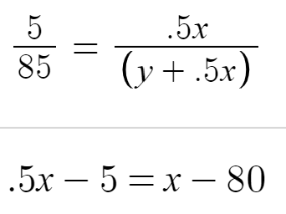
Z (10)
A (80)
P (10)
Z (10)
Alternatively….
Try a deductive method.
A (90)
B (10)
Reactor
Type 3
49 °C
Liquid-Gas Separator
110 °C
A (80)
P (10)
A
P
x-80 = (.5x-5)
y-10 = (y+.5x-85)
purge
(x)
(y)
A
P
(.5x)
(y+.5x)
A
P
Reactor
Type 1
85 °C
P
(89)
Q
P
Liquid-Gas Separator
135 °C
(1)
(89)
(5)
Reactor
Type 2
85 °C
A
P
(85)
Q
(1)
Notes:
ailen

Slide 26
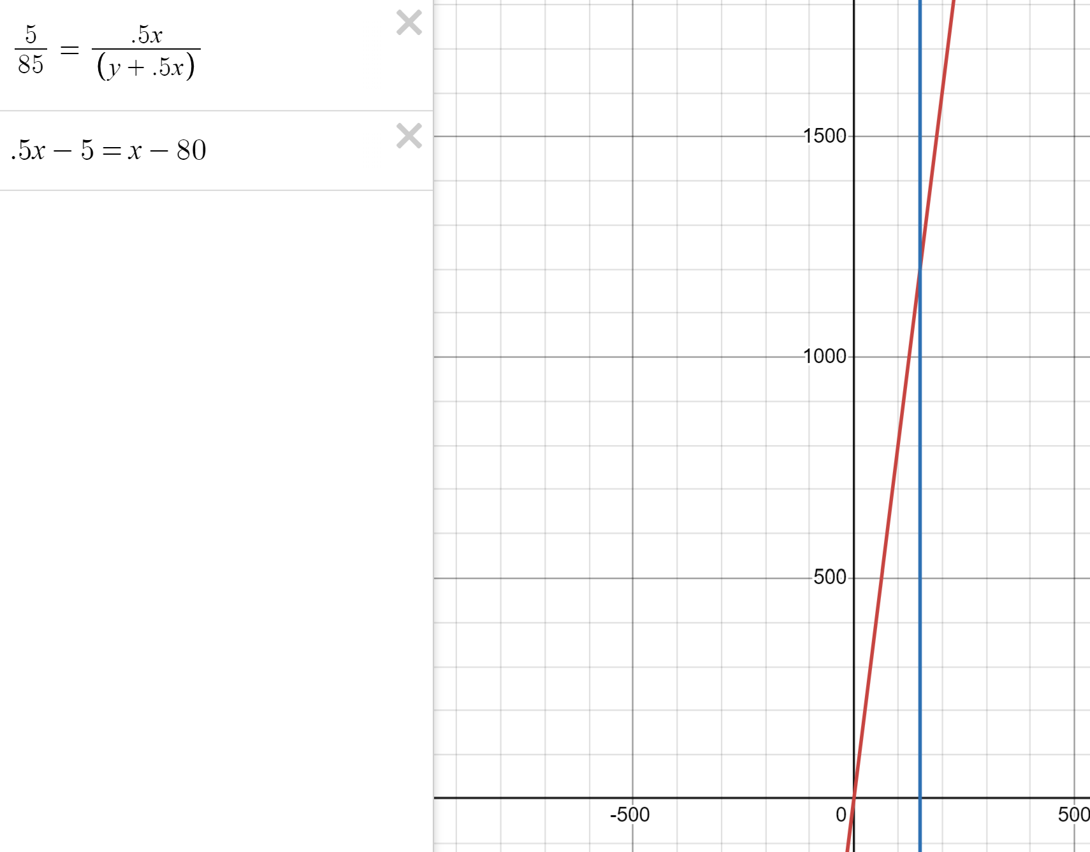
Y = 1200
X = 150

Slide 27
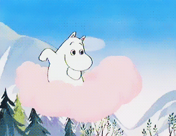
Z (10)
A (80)
P (10)
Z (10)
A (90)
B (10)
Reactor
Type 3
49 °C
Liquid-Gas Separator
110 °C
yay!
A (80)
P (10)
(70)
Revenue: $89,120/hour
A
P
(1190)
purge
A
P
(150)
A
P
Reactor
Type 1
85 °C
(75)
(1200)
(1275)
P
(89)
Q
P
Liquid-Gas Separator
135 °C
(1)
(89)
(5)
Reactor
Type 2
85 °C
A
P
(85)
Q
(1)
Notes:
ailen

Slide 28
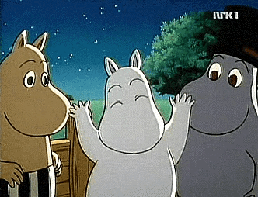
Post-Design Analysis
Design Goals:
Maximize revenue
Minimize # units
Minimize size of units
Future improvements
Produce even more P by reducing Q
Notes:
sanna + ailen

Slide 29
Z (10)
A (80)
P (10)
Z (10)
What if Q_{out}=0.5?
A (90)
B (10)
Reactor
Type 3
49 °C
Liquid-Gas Separator
110 °C
The recycle more than doubles!
A (80)
P (10)
(75)
A
P
(2622.5)
purge
A
P
(155)
A
P
Reactor
Type 1
85 °C
(77.5)
(2632.5)
(2710)
P
(89.5)
Q
P
Liquid-Gas Separator
135 °C
(.5)
(89.5)
(2.5)
Reactor
Type 2
85 °C
A
P
(87.5)
Q
(.5)
Notes:
sanna
By producing 0.5 more mol of P, we have to recycle 1000 more mols of P, which makes the reactor HUGE and not worth it!

Slide 30
Key Takeaways
Work backwards to find relative flow rates
  Determine reactor generation and consumption in the recycle loop
  Ratios and mass balances across splitters/combiners
  Inductive vs. Deductive methods
The more P we want to produce, the more that needs to be recycled!
Notes:
ailen

