Slide 1

Exercise 3.121
Mathematica
Created by Ian Slauch (‘15) & Tim Abbott (‘15)
Modified by Jiamin Zhang (’16), Robert Lee (‘17), Andy Luke (‘18), Olivia Young (‘19), Ian Morrison (‘20), Sarah Huang (‘22), Ariel Struzyk (‘23), Ailen Lao (‘23), Maggie MacNeel (‘24), Donovan Cho (‘25)

Slide 2
What do we know?
Reactions:
B + R ⟶ 2 Z
I + R ⟶ no rxn
A + R ⟷ 2 X
B is entirely consumed if R is in excess
INERT
(mol A) : (mol X) = 5:1 out of a reactor if R is in excess
Example:
11 A + 100 R ⟶ 10 A + 2 X + 99 R
Start with 100 mol of 55% A, 44% B, and 1% I
Goal: purify A

Slide 3
What else do we know?
Purity (mol% A) | $/mol of A
≥ 50% | 1
≥ 90% | 5
≥ 97% | 10
≥ 99% | 30
100% | 100
Compound | Melting pt (ºC) | Boiling pt (ºC)
A | -27 | 37
B | -27 | 37
I | -27 | 37
R | 65 | 244
X | 24 | 123
Z | 77 | 171
Pure A is much more valuable than impure A
We can’t separate A, B, or I by phase!
How can we purify A?

Slide 4
What are our goals?
Maximize revenue from selling [high purity] A
Minimize cost of R (what does this really mean?)
Minimize number of units
Minimize size of each unit
HINT: It is possible to produce some A with 100% purity.

Slide 5
What is the Plan?
Reactions:
B + R ⟶ 2 Z
I + R ⟶ no rxn
A + R ⟷ 2 X
What is a consequence of each reaction?
B is separated from A in the form of Z
I must leave the system somehow
A is converted to X, decreasing purity

Slide 6
What is the Plan?
What must we do to start our design?
React B with Z to separate from A
  Can separate Z from all components, but not B
Do not let I accumulate
  Keep track of mass balances!
Minimize amount of A converted to X
Notes:
Lets focus on producing some A first to prove that we can do it, and lets work from there

Slide 7
Design 1: Convert B to Z
A (50)
I (1)
R (151)
X (10)
Z (88)
A (55)
B (44)
I (1)
R (200)
A (50)
I (1)
A (55)
B (44)
I (1)
X (10)
Z (88)
Reactor
A + R ⟷ 2X
B + R ⟶ 2Z
Liquid-gas separator
80ºC
R (151)
X (10)
Z (88)
Liquid-gas separator
200ºC
R (200)
R (49)
R (151)
R (151)
purge
A is 98% pure. Our revenue is 50 mol/min * $10/mol = $500/min
How can we improve?
Notes:
Separate A by converting B → Z
Think about what comes out of our system → X comes out, and we know our reaction is reversible → can we use that to produce more A?

Slide 8
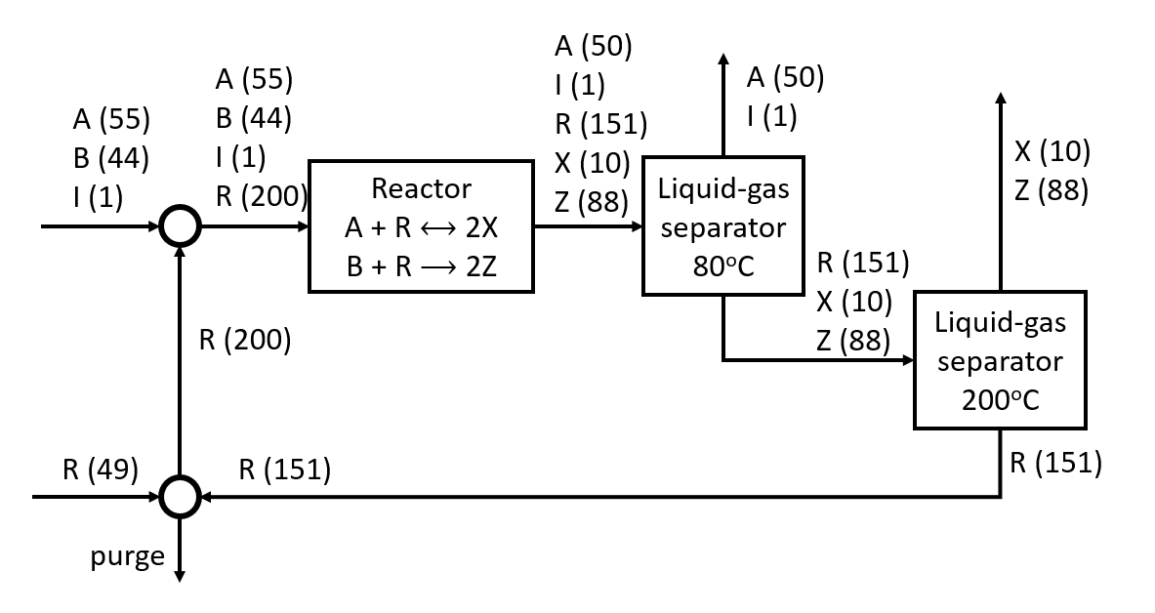
Improvement: Recycle X
X (11)
X (11)
Z (88)
A (55)
I (1)
Liquid-gas separator
145ºC
Z (88)
X (11)
Z (88)
A (55)
I (1)
R (156)
X (11)
Z (88)
A (55)
B (44)
I (1)
A (55)
B (44)
I (1)
R (200)
X (11)
Reactor
A + R ⟷ 2X
B + R ⟶ 2Z
Liquid-gas separator
80ºC
R (156)
X (11)
Z (88)
Liquid-gas separator
200ºC
R (44)
R (156)
R (156)
No A is produced! Still, we make extra 5 mol/min of A at $10/mol. Revenue is now $550/min
Pure A is much more valuable. Can we make 100% pure A?
Notes:
Recycling X improves the equilibrium of the A + R reaction.
BUT what if we took the X and turned it back to A?

Slide 9
Improvements???
Reactions:
B + R ⟶ 2 Z
I + R ⟶ no rxn
A + R ⟷ 2 X
What is a consequence of each reaction?
B is separated from A in the form of Z
I must leave the system somehow
A is converted to X, decreasing purity
providing opportunity to make pure A
X may be converted back to A
Notes:
A → X to get it away from I THEN X → A to get pure A
Let’s leverage the reversible reaction

Slide 10
Improvement: Convert X to A separately
A
I
R
X
Z
(55)
(1)
(151)
(10)
(88)
A
I
A
B
I
R
(50)
(1)
(55)
(44)
(1)
(200)
A
B
I
(55)
(44)
(1)
Reactor
A + R ⟷ 2X
B + R ⟶ 2Z
Liquid-gas separator
80ºC
(5)
A
R
X
Z
A
R
X
Z
(151)
(10)
(88)
(5)
(155)
(1)
(88)
R
X
Z
(151)
(11)
(88)
Liquid-gas separator
80ºC
Reactor
2X ⟷ A + R
(200)
R
X
(1)
X
Z
(1)
(88)
X
Z
(1)
(88)
Liquid-gas separator
145ºC
R
X
Z
(156)
(1)
(88)
R
(44)
Liquid-gas separator
200ºC
We have pure A!
Revenue is now $1000/min, $500 from each product stream
Z
(88)
R
(156)
Notes:
Add reactor with inputs
Separate our A and I out like before, produce 98% A stream
Feed X into another reactor to convert it back to A!
Separate A out to get pure A stream
Separate R out to recycle
Can we make this EVEN better? Can I get all pure A? → Let’s convert all A → X → A

Slide 11
How do we get even more pure A?
Recycle the A-I stream!
What is the problem?
We want to minimize the amount of A in the impure stream, while preventing the reactor from becoming too large
Purge with 1:1 ratio for A:I
Notes:
If feed A – I stream back to system, no way to I to exit our system!
We need to be careful and add a purge to remove our I

Slide 12
Design 4: Recycle A-I Stream
A
I
A (1)
I (1)
A
I
R
X
Z
A
I
A
B
I
A
B
I
R
Reactor
A + R ⟷ 2X
B + R ⟶ 2Z
Liquid-gas separator
80ºC
R
X
Z
R
X
Z
A (54)
R (1156)
X (11)
Z (88)
A
Liquid-gas separator
80ºC
Reactor
2X ⟷ A + R
X
R
X
Z
X
Z
R
X
Z
Liquid-gas separator
145ºC
purge
Liquid-gas separator
200ºC
R
R
Z
R
Notes:
Take old system → add purge to A – I stream (1:1) before recycling

Slide 13
How to Calculate Flow Rates?
(1)
(1)
A
I
A
I
A
I
A
I
R
X
Z
(88)
Choose to recycle 1:1 with I, then balance around reactions
A (55)
B (44)
I (1)
A
B
I
R
Reactor
A + R ⟷ 2X
B + R ⟶ 2Z
Liquid-gas separator
80ºC
(88)
R
X
Z
R
X
Z
A
R
X
Z
(88)
Liquid-gas separator
80ºC
(88)
A
(54)
Reactor
2X ⟷ A + R
X
(88)
R
X
Z
X
Z
(88)
R
X
Z
(88)
Liquid-gas separator
145ºC
purge
Liquid-gas separator
200ºC
R
(44)
R
(88)
Z
R

Slide 14
Looking at 2X ↔ A + R reactor
Recall 5:1 ratio of A:X
Flow rate of X into reactor:
X – 54*2 = 11
X = 119
A
I
A (1)
I (1)
A
I
A
I
R
X
Z
(88)
A (55)
B (44)
I (1)
A
B (44)
I
R
Reactor
A + R ⟷ 2X
B + R ⟶ 2Z
Liquid-gas separator
80ºC
(119)
(88)
R
X
Z
R
X
Z
(88)
(11)
(88)
(54)
A
R
X
Z
A (54)
Liquid-gas separator
80ºC
Reactor
2X ⟷ A + R
X
(88)
R
X
Z
X
Z
(88)
R
X
Z
(88)
Liquid-gas separator
145ºC
purge
Liquid-gas separator
200ºC
R
R
Z (88)
R
Notes:
Calculate X and R coming into reactor 2

Slide 15
5:1 ratio of A:X
A
I
A (1)
I (1)
A
I
A
I
R
X
Z
(540)
(88)
A (55)
B (44)
I (1)
A
B (44)
I
R
Reactor
A + R ⟷ 2X
B + R ⟶ 2Z
Liquid-gas separator
80ºC
(108)
(119)
(88)
R
X
Z
R
X
Z
(88)
(108)
(54)
(11)
(88)
A
R
X
Z
A (54)
Liquid-gas separator
80ºC
Reactor
2X ⟷ A + R
(11)
X
(11)
R
X
Z
(11)
X
Z
(88)
(88)
R
X
Z
(11)
Liquid-gas separator
145ºC
(88)
purge
Liquid-gas separator
200ºC
R
R
Z (88)
R

Slide 16
Splitter composition: A and I in 1:1 ratio
A
I
(539)
(539)
A (1)
I (1)
(540)
(540)
A
I
A
I
R
X
Z
(540)
(540)
(108)
(88)
A (55)
B (44)
I (1)
A
B
I
R
(594)
(44)
(540)
Reactor
A + R ⟷ 2X
B + R ⟶ 2Z
Liquid-gas separator
80ºC
(119)
(88)
R
X
Z
R
X
Z
(108)
(88)
(54)
(11)
(88)
A
R
X
Z
A (54)
Liquid-gas separator
80ºC
Reactor
2X ⟷ A + R
X (11)
R
X
Z
(11)
(88)
X
Z
(11)
(88)
R
X
Z
(11)
(88)
Liquid-gas separator
145ºC
purge
Liquid-gas separator
200ºC
R
R
Z (88)
R

Slide 17
Put R in excess, track R through process
A (539)
I (539)
A (539)
I (539)
A (1)
I (1)
A (1)
I (1)
A (540)
I (540)
A (540)
I (540)
(540)
(540)
(1102)
(108)
(88)
A
I
R
X
Z
A (55)
B (44)
I (1)
A
B
I
R
(594)
(44)
(540)
(1200)
Reactor
A + R ⟷ 2X
B + R ⟶ 2Z
Liquid-gas separator
80ºC
(1102)
(119)
(88)
R
X
Z
R
X
Z
(1102)
(108)
(88)
(54)
(1156)
(11)
(88)
A
R
X
Z
A (54)
Liquid-gas separator
80ºC
Reactor
2X ⟷ A + R
A (54)
X (11)
X (11)
R
X
Z
(1156)
(11)
(88)
X
Z
X
Z
(11)
(88)
(11)
(88)
R
X
Z
R
X
Z
(1156)
(11)
(88)
Liquid-gas separator
145ºC
purge
Liquid-gas separator
200ºC
MAX revenue! ~$5400
(44)
R
(1200)
R
Z (88)
Z (88)
R
(1156)
Notes:
R is twice of other reactants (A and B)

Slide 18
Final note
Fraction Purged | Mol/hr of A purged | Mol/hr through reactor
0.185% | 1.0 | 1380
0.1% | 0.55 | 1840
0.03% | 0.17 | 4180
0.01% | 0.055 | 10840
We could make a bit more A, but our reactor size goes to infinity. Process design is a balance!

Slide 19
Key Takeaways
Use differences in reactivity to separate ”inseparable” components
ALWAYS read the given information thoroughly and use the hints – producing pure A is possible by turning the X back to A.
Almost all the A can be recovered in a pure form by recycling the A and I, but purging can present challenges.
Excess usually means more than double the sum of other reactants in the input stream.
Think about what each reaction can do for you, how does it contribute to your overall goal?

Slide 20
Calculation Session 5
Exercise 3.121 – process design with approximate flow rates.
Hint: Some A must leave with I. How to minimize the
A lost in the I purge?
Exercise 3.64 – Consider drawing an equivalent unit
that comprises units with elementary energy changes.
Exercise 3.68 – Sketch the heat exchanger.
Professional Development, Part 3: creating a LinkedIn page.
Homework questions? Ask!

