Slide 1
Created by: Parry Grewal (‘10)
Modified by: Christine Catudal (‘11)
Yuan Li (‘12)
Samantha Tierney (‘13)
Alana Szkodny (‘14)
Kathy Fein (‘15)
Jesse Garcia (‘16)
Robert Lee (‘17)
Ameer Basrai (‘18)
Olivia Young (‘19)
Spencer Hong (‘20)
Emily Spiek (‘21)
Max Serota (‘22) / Lucy Cadanou (‘22)
Leon Lee (‘23)
Burke Combs (‘24)
Dennis Wu (‘25)
Exercise 3.64
**Heat Exchange Flow**
Yo, in the lab, where the numbers rise,
Chemical engineers, we’re the wise guys.
Heat exchangers work, let the energy mix,
Pipes and plates, yo, it’s all in the fix.
We calculate flows, plot it on the graph,
Turning up the heat, let the process laugh.
From chill to thrill, we shift the game,
Efficiency’s our goal, and we’re bringing the flame.
We got copper and steel, crafting with style,
Transforming the heat, making it worthwhile.
In the heartbeat of industry, we take our stance,
From the lab to the field, watch us advance!
So here’s to the engineers, we’re making it right,
In the world of heat exchange, we ignite the night.
With every exchange, we rise and we flow,
Chemical kings and queens, let the knowledge grow!
-ChatGPT

Slide 2
Getting Started
4,500 kJ/min
F_{T, 2} = ?
Evaporated
Heated
F_{T, 3} = ?

Slide 3

Rules for Energy Balances
We cannot calculate the absolute energy of a mass stream (do NOT state q₁ = 100 kJ/min). We must calculate the change (q₁ – q₀) instead.
We cannot measure energy (q).
We must measure a change in
temperature, phase, etc. and use
thermodynamics to calculate energy.

Slide 4
Two Solution Methods
Complete Energy Balance
Equivalent Units

Slide 5

Method 1: Balances on Entire Process
Energy Balance on Entire Process:
Rate of energy in = Rate of energy out
Mass Balance on Entire Process:
Flow rate of mass in = Flow rate of mass out
We need another equation…
Wait! I thought you said we couldn’t calculate absolute q’s!
Two equations, two unknowns!

Slide 6

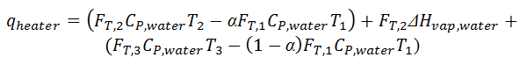
Method 1: Balances on Entire Process
Our energy balance appears to violate our rule that “we cannot calculate the energy of a mass stream”
But, with some rearrangement, we are calculating differences
Stream 2 Flow Rate = 1.3 kg/min
Stream 3 Flow Rate = 6.0 kg/min

Slide 7
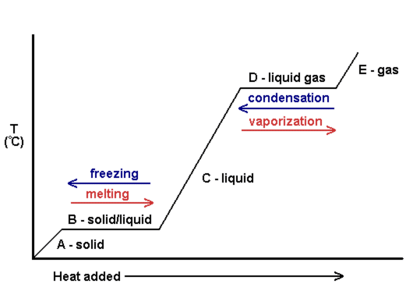
Method 2: Equivalent Units
Note:
- All water is heated to 100ºC
- Some water is then evaporated to steam, but still is at 100ºC
3
2
1

Slide 8
Method 2: How to show steps in diagram?
Elementary Energy Units!
What is an elementary energy unit?
1 mass stream in, 1 mass stream out; 1 energy change.
All mass passing through the units is heated or changes phase.

Slide 9
Method 2: Find q_{warmer}
q
heater
= 4500 kJ/min
q
warmer
water
water
q
evap
50.ºC
100.ºC
steam at 100.ºC
1
warmer
1a
1b
evaporator
2
7.3 kg/min
water at 100.ºC
equivalent boiler
3
Calculate q_{warmer}:

Slide 10
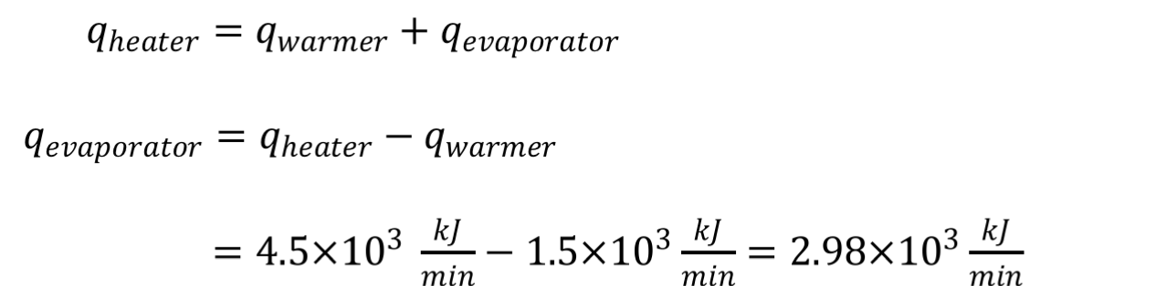
Method 2: Find q_{evap}
q
heater
= 4500 kJ/min
q
= 1520 kJ/min
q
warmer
evap
water
water
50.ºC
100.ºC
steam at 100.ºC
1
warmer
1a
1b
evaporator
2
7.3 kg/min
water at 100.ºC
equivalent boiler
3
Use an energy balance on the splitter:

Slide 11
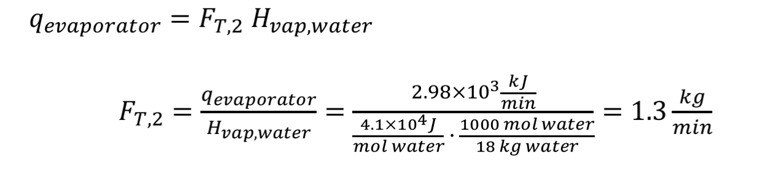
Method 2: Find F_{T,2}
q
heater
= 4500 kJ/min
q
= 1520 kJ/min
q
= 2980 kJ/min
warmer
evap
water
water
50.ºC
100.ºC
steam at 100.ºC
1
warmer
1a
1b
evaporator
2
7.3 kg/min
water at 100.ºC
equivalent boiler
3
How much steam can be produced by q_{evap}?

Slide 12
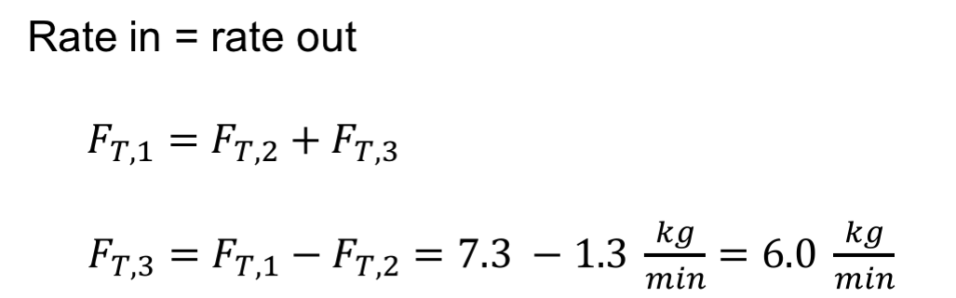
Method 2: Find F_{T,3}
q
heater
= 4500 kJ/min
q
= 1520 kJ/min
q
= 2980 kJ/min
warmer
evap
water
water
1.3 kg/min
50.ºC
100.ºC
steam at 100.ºC
1
warmer
1a
1b
evaporator
2
7.3 kg/min
water at 100.ºC
equivalent boiler
3
6.0 kg/min
We can use a mass balance on the entire process to get F_{T,3:}
Stream 2 Flow Rate = 1.3 kg/min
Stream 3 Flow Rate = 6.0 kg/min

Slide 13
Review: Method 1
2 unknowns
Need 2 equations
      Energy Balance
      Mass Balance
→ Solve

Slide 14
Review: Method 2
Simple mass units can be complex energy units – break it up
q
heater
= 4500 kJ/min
q
= 1520 kJ/min
q
= 2980 kJ/min
warmer
evap
water
water
50.°C
100.°C
steam at 100. °C, 1.3 kg/min
1
warmer
1a
1b
evaporator
2
7.3 kg/min
water at 100.°C, 6.0 kg/min
equivalent boiler
3
Steps
1. Calculate q_{warmer}
2. Use q_{warmer} to calculate q_{evap}
3. Determine how much water can be converted into steam (at 100.°C) by q_{evap} → F_{T,2}
4. Calculate F_{T,3} by mass balance

Slide 15
3.64: Key Takeaways
We can use multiple approaches to solve a problem while getting the same answer.
We can use the method of equivalent energy units to organize our calculations.

