Slide 1
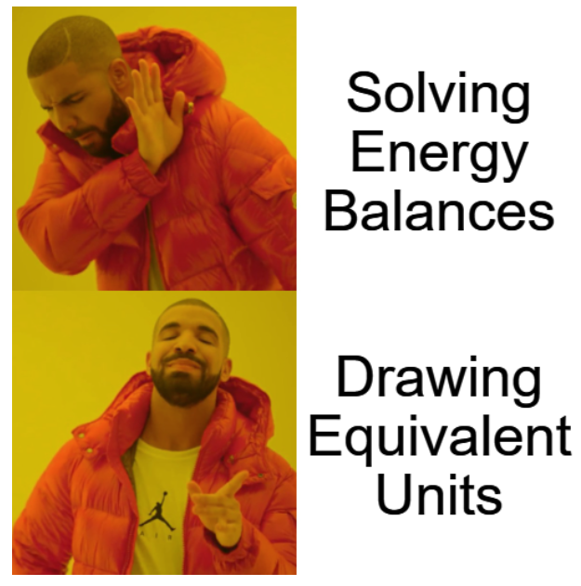
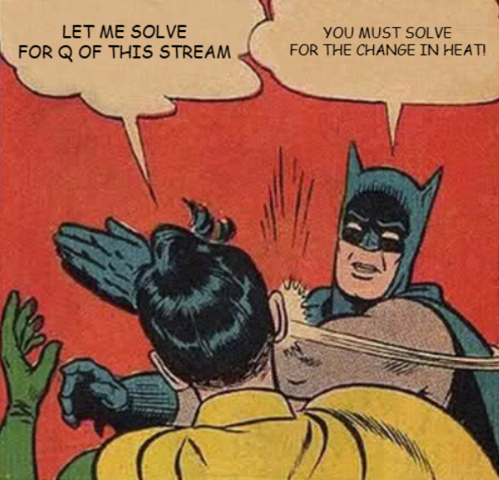
Calculation Session 5
Exercise 3.64
Created by: Parry Grewal (‘10)
Modified by: Christine Catudal (‘11)
Yuan Li (‘12)
Samantha Tierney (‘13)
Alana Szkodny (‘14)
Kathy Fein (‘15)
Jesse Garcia (‘16)
Robert Lee (‘17)
Ameer Basrai (‘18)
Olivia Young (‘19)
Spencer Hong (‘20)
Emily Spiek (‘21)
Max Serota (‘22) / Lucy Cadanou (‘22)
Leon Lee (‘23)
Burke Combs (‘24)
Dennis Wu (‘25)
Kong Chen (‘26)

Slide 2

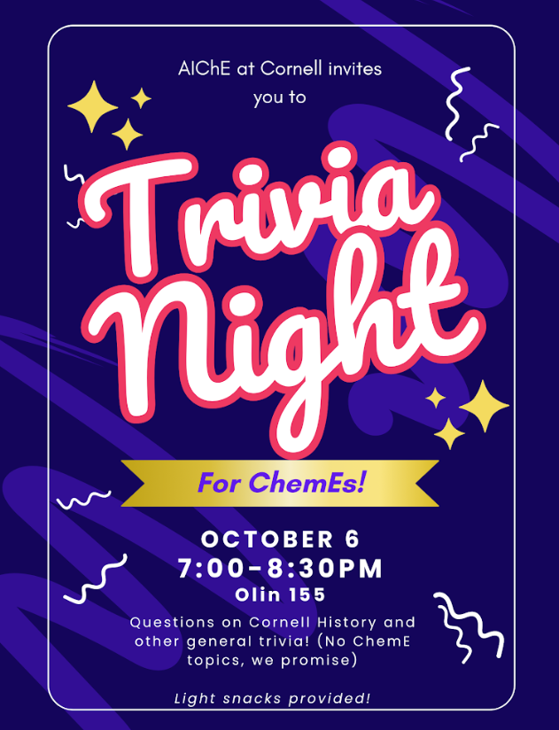

Slide 3
Getting Started
4,500 kJ/min
F_{T, 2} = ?
Evaporated
Heated
F_{T, 3} = ?

Slide 4

Rules for Energy Balances
We cannot calculate the absolute energy of a mass stream (do NOT state q₁ = 100 kJ/min). We must calculate the change (q₁ – q₀) instead.
We cannot measure energy (q). We must measure a change in temperature, phase, etc. and use thermodynamics to calculate energy.

Slide 5
Two Solution Methods
Complete Energy Balance
Equivalent Units

Slide 6

Method 1: Balances on Entire Process
Energy Balance on Entire Process:
Rate of energy in = Rate of energy out
Mass Balance on Entire Process:
Flow rate of mass in = Flow rate of mass out
We need another equation…
Wait! I thought you said we couldn’t calculate absolute q’s!
Two equations, two unknowns!

Slide 7

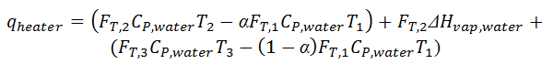
Method 1: Balances on Entire Process
Our energy balance appears to violate our rule that “we cannot calculate the energy of a mass stream”
But, with some rearrangement, we are calculating differences
Fraction of Steam 1 that evaporates
Stream 2 Flow Rate = 1.3 kg/min
Stream 3 Flow Rate = 6.0 kg/min

Slide 8
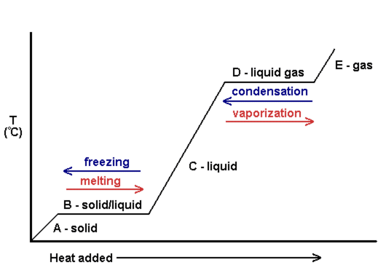
Method 2: Equivalent Units
Note:
- All water is heated to 100ºC
- Some water is then evaporated to steam, but still is at 100ºC
3
2
1

Slide 9
Method 2: How to show steps in diagram?
Elementary Energy Units!
What is an elementary energy unit?
1 mass stream in, 1 mass stream out; 1 energy change.
All mass passing through the units is heated or changes phase.

Slide 10
Method 2: Find q_{warmer}
q
heater
= 4500 kJ/min
q
warmer
water
water
q
evap
50.ºC
100.ºC
steam at 100.ºC
1
warmer
1a
1b
evaporator
2
7.3 kg/min
water at 100.ºC
equivalent boiler
3
Calculate q_{warmer}:

Slide 11
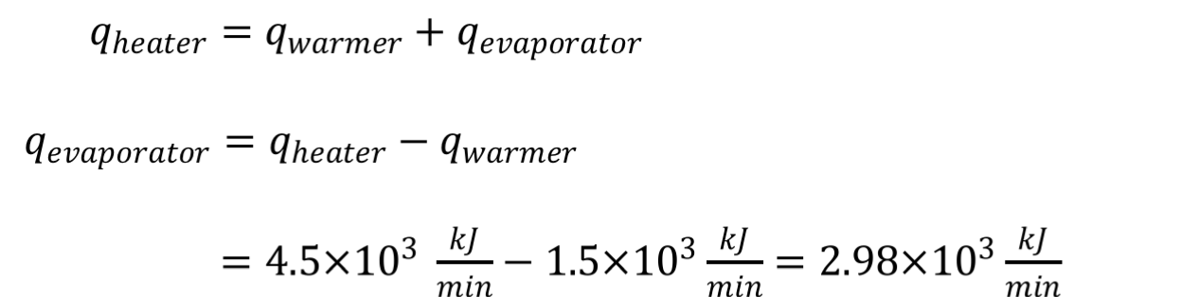
Method 2: Find q_{evap}
q
heater
= 4500 kJ/min
q
= 1520 kJ/min
q
warmer
evap
water
water
50.ºC
100.ºC
steam at 100.ºC
1
warmer
1a
1b
evaporator
2
7.3 kg/min
water at 100.ºC
equivalent boiler
3
Use an energy balance on the splitter:

Slide 12
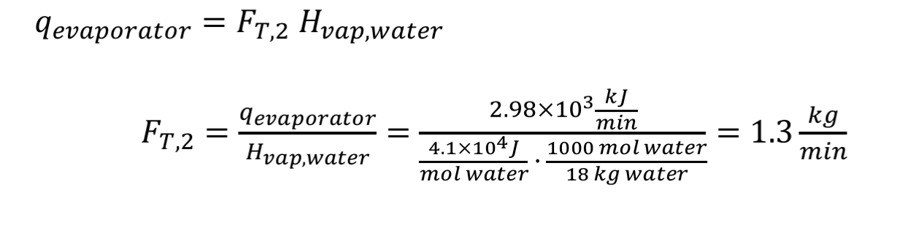
Method 2: Find F_{T,2}
q
heater
= 4500 kJ/min
q
= 1520 kJ/min
q
= 2980 kJ/min
warmer
evap
water
water
50.ºC
100.ºC
steam at 100.ºC
1
warmer
1a
1b
evaporator
2
7.3 kg/min
water at 100.ºC
equivalent boiler
3
How much steam can be produced by q_{evap}?

Slide 13
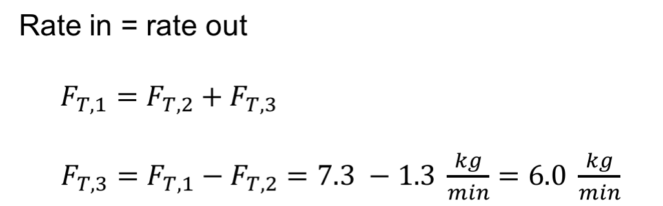
Method 2: Find F_{T,3}
q
heater
= 4500 kJ/min
q
= 1520 kJ/min
q
= 2980 kJ/min
warmer
evap
water
water
1.3 kg/min
50.ºC
100.ºC
steam at 100.ºC
1
warmer
1a
1b
evaporator
2
7.3 kg/min
water at 100.ºC
equivalent boiler
3
6.0 kg/min
We can use a mass balance on the entire process to get F_{T,3:}
Stream 2 Flow Rate = 1.3 kg/min
Stream 3 Flow Rate = 6.0 kg/min

Slide 14
Review: Method 1
2 unknowns
Need 2 equations
Energy Balance
Mass Balance
→ Solve

Slide 15
Review: Method 2
Simple mass units can be complex energy units – break it up
q
heater
= 4500 kJ/min
q
= 1520 kJ/min
q
= 2980 kJ/min
warmer
evap
water
water
50.°C
100.°C
steam at 100. °C, 1.3 kg/min
1
warmer
1a
1b
evaporator
2
7.3 kg/min
water at 100.°C, 6.0 kg/min
equivalent boiler
3
Steps
1. Calculate q_{warmer}
2. Use q_{warmer} to calculate q_{evap}
3. Determine how much water can be converted into steam (at 100.°C) by q_{evap} → F_{T,2}
4. Calculate F_{T,3} by mass balance

Slide 16
3.64: Key Takeaways
We can use multiple approaches to solve a problem while getting the same answer.
We can use the method of equivalent energy units to organize our calculations.

