Slide 1
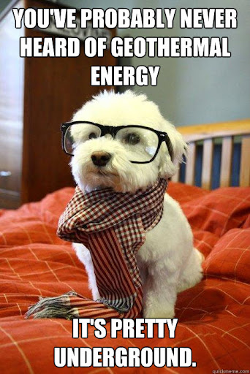
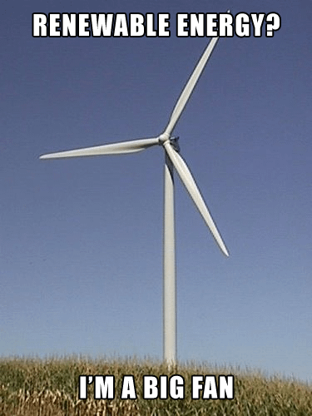
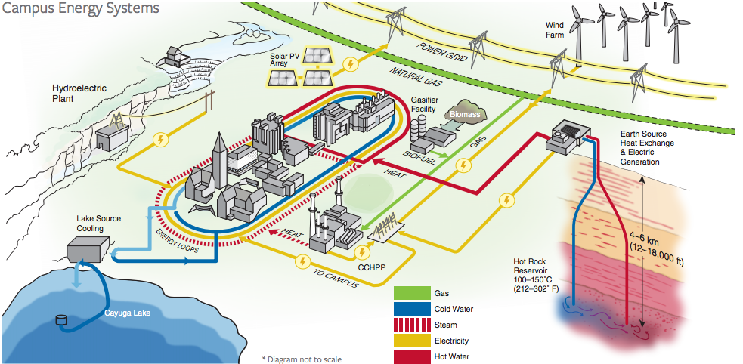
Exercise 3.68
Created by Sanna Vedrine ’23
Edited by Austin Vollweiler ’24
Lauren de Silva ’25
Amy Wu ‘26

Slide 2

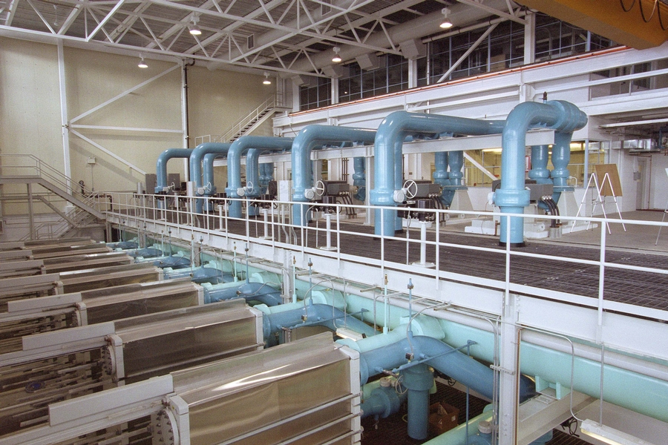
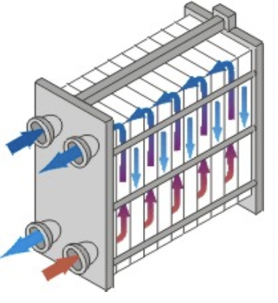
Saves over 20 million kWh per year versus previous cooling methods!
Enough to continuously supply to 2,500 homes in Tompkins County!
85% reduction in energy use for campus cooling

Slide 3
Part A
  Estimate flow rate of chilled water needed to cool 4·10⁴ m³/min air from 90 °F to 68 °F

Slide 4
1
Cooler
2
Air at 90 °F
4·10⁴ m³/min
Air at 68 °F
4·10⁴ m³/min
q_{air}
3
Heater
4
Water at 45 °F
Water at 60 °F
? gal/min
? gal/min

Slide 5
Let’s solve for q_{air}
Energy balance arround the cooler
1
Cooler
2
Air at 90 °F
4·10⁴ m³/min
Air at 68 °F
4·10⁴ m³/min
q_{air}
3
Heater
4
Water at 45 °F
Water at 60 °F
? gal/min
? gal/min

Slide 6
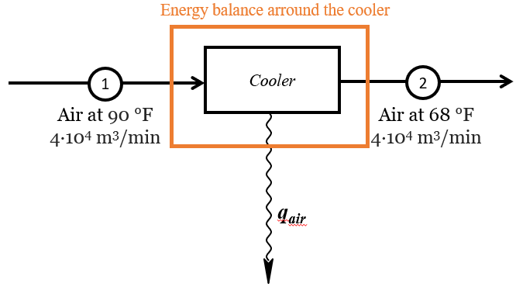
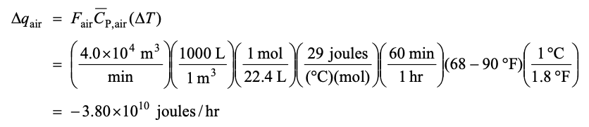

Let’s solve for q_{cool}
Rate of energy in = rate of energy out
(1) Conservation of energy
q₁ = q_{air} + q₂
q_{air} = q₁ - q₂
q_{air} = - (q₂ – q₁)
(2) Rate of energy transfer
q_{air} = - F_{T,1} C_{P,air} (T₂ – T₁)
(3) Solving for q_{cool}
q_{air =} -
q_{air =}

Slide 7
Now let's look at side that’s warming
1
Cooler
2
Air at 90 °F
4·10⁴ m³/min
Air at 68 °F
4·10⁴ m³/min
q_{air}
3
Heater
4
Water at 45 °F
Water at 60 °F
? gal/min
? gal/min
Energy balance arround the heater

Slide 8
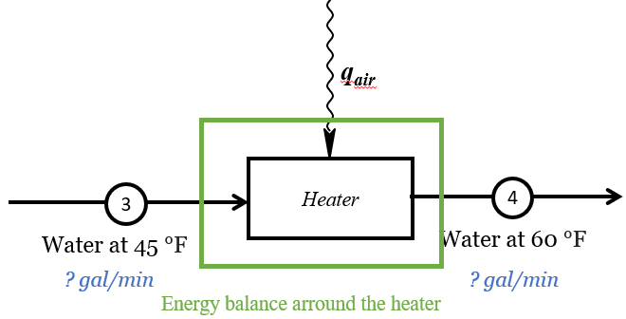
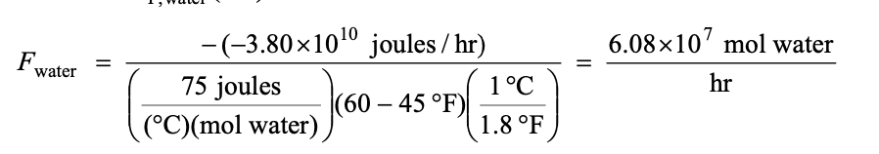
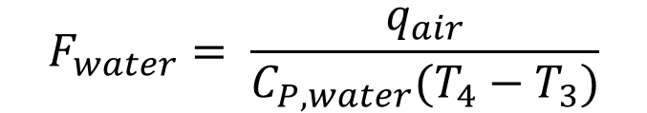
Rate of energy in = rate of energy out
(4) Conservation of energy
q₃ + q_{air} = q₄
q_{air} = q₄ – q₃
(5) Rate of energy transfer
q_{air} = F_{water} C_{P,water} (T₄ – T₃)
$$F_{water}= \frac{q_{air}}{C_{P,water}(T_{4}−T_{3})}$$
(
(6) Solving for F_{water}

Slide 9


(7) Converting Eq (6) to gal/min
Notes:
because the air loses energy when it cools

Slide 10
Part B
In addition to cooling the air from 90°F to 68°F, we will now also consider the condensation of water vapor at 68°F

Slide 11
Air at 68 °F, 90% Humidity
4·10⁴ m³/min
1
Cooler
1a
Condenser
68°F
2
Air at 90 °F, 90% Humidity
4·10⁴ m³/min
Air at 68 °F, 50% Humidity
4·10⁴ m³/min
q_{cool}
q_{condense}
q_{cool} = -Δq_{1a→1}
q_{condense} = -Δq_{2→1a}
q_{air}
3
Heater
4
Water at 45 °F
Water at 60 °F
? gal/min
? gal/min

Slide 12


Calculating Δq_{air}
q_{air} = q_{cool} + q_{condense}
Temperature change at constant phase
Phase change at constant temperature
q_{cool} = -Δq_{1a → 1}
q_{condense} = -Δq_{2→1a}
From Part A:
= – 3.80 x 10¹⁰ Joules/hour

Slide 13
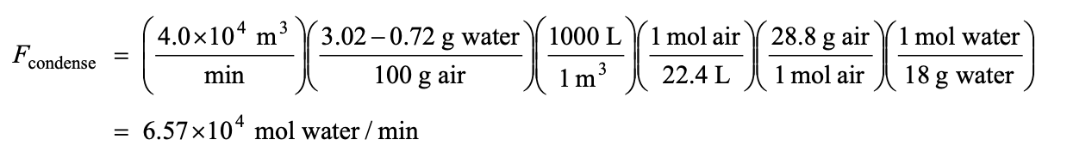
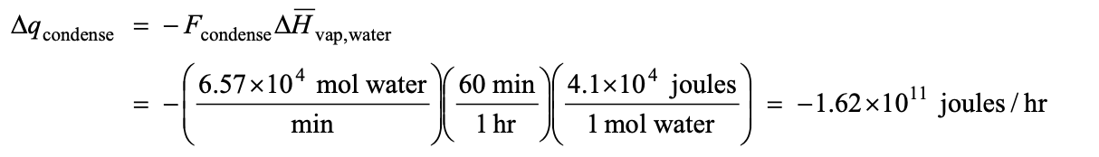
Calculating Δq_{air}
Calculate rate water is condensed from air (F_{condense})
Calculate rate energy released from vapor condensation (Δq_{condense})

Slide 14
Calculating Δ q_{air}
condensing is 4 times as energy intensive as cooling !
= – 1.62 x 10¹¹ Joules/hour
= – 3.80 x 10¹⁰ Joules/hour
q_{air} = (– 3.80 x 10¹⁰ – 1.62 x 10¹¹ ) Joules/hour
q_{air} = – 2.00 x 10¹¹ Joules/hour
Notes:
This is why these units are called ‘air conditioners’ and not ‘air coolers’. ‘Conditioning’ the air (reducing the humidity) is more important than just cooling the air, which would generally yield cool air with 100% humidity, which is not comfortable.

Slide 15
Air at 68 °F, 90% Humidity
4·10⁴ m³/min
1
Cooler
1a
Condenser
68°F
2
Air at 90 °F, 90% Humidity
4·10⁴ m³/min
Air at 68 °F, 50% Humidity
4·10⁴ m³/min
q_{cool}
q_{condense}
q_{air}
3
Heater
4
Water at 45 °F
Water at 60 °F
? gal/min
? gal/min

Slide 16
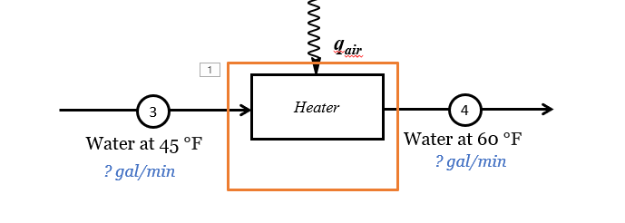
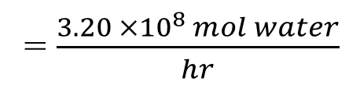
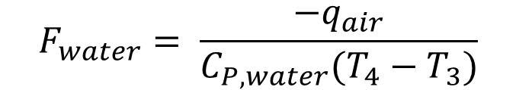
Rate of energy in = rate of energy out
(1) Conservation of energy
q₃ + (-q_{air}) = q₄
q₃ = q_{air} + q₄
q_{air} = q₃ – q₄
q_{air} = - (q₄ – q₃)
(2) Rate of energy transfer
q_{air} = - F_{water} C_{P,water} (T₄ – T₃)
$$F_{water}= \frac{−q_{air}}{C_{P,water}(T_{4}−T_{3})}$$
(3) Solving for q_{air}
-(– 2.00 x 10¹¹ Joules/hour)
(
= $\frac{3.20 ×{10}^{8 }mol water}{hr}$

Slide 17

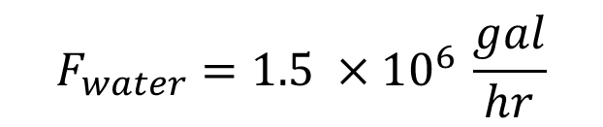
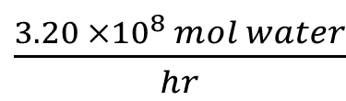
(7) Converting eq (6) to gal/min
$\frac{3.20 ×{10}^{8 }mol water}{hr}$
$$F_{water}=1.5 ×{10}^{6 }\frac{gal}{hr}$$
Notes:
because the air loses energy when it cools

Slide 18
Part C
Estimate the flow rate of water from Cayuga Lake needed to cool the circulating water from 60°F to 45°F

Slide 19
60 °F
45 °F
50 °F
40 °F
Notes:
1. draws water

Slide 20
1
Cooler
2
Water at 60 °F
1.53·10⁶ gal/min
Water at 45 °F
1.53·10⁶ gal/min
3
Heater
4
Lake water at 40 °F
Lake water at 50 °F
? gal/min
? gal/min

Slide 21
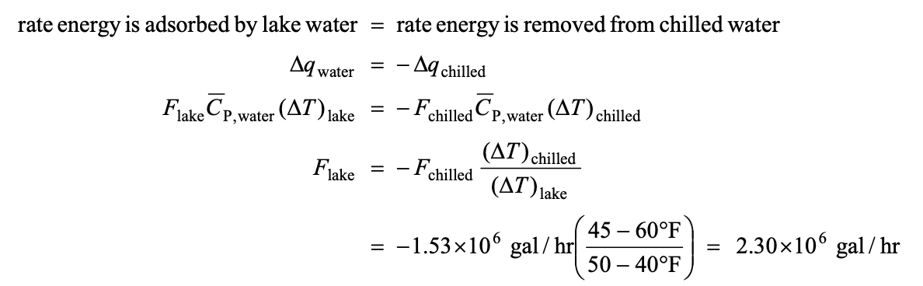

Calculating F_{lake water}

Slide 22

1
Cooler
2
Water at 60 °F
1.53·10⁶ gal/min
Water at 45 °F
1.53·10⁶ gal/min
3
Heater
4
Lake water at 40 °F
Lake water at 50 °F
2.3 x 10⁶ gal/min
2.3 x 10⁶ gal/min
? gal/min
? gal/min

Slide 23
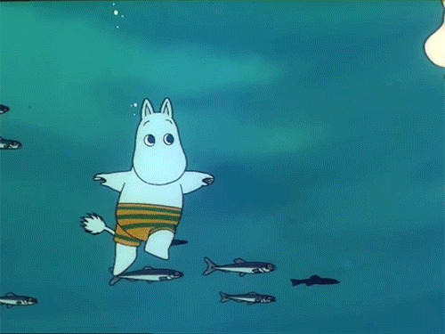
Takeaways
Heat exchangers can be broken down into smaller units!
  such as heaters, coolers, condensers…
Think about the direction in which heat is flowing
  Check signs!
  Δq < 0 for cooling
  Δq > 0 for heating
Pay attention to units!
Notes:
Break down complicated processes into simple units.
Check your signs/directionality!
Is heat entering or leaving the stream?
Coolers/Condensers → Heat is leaving
Warmers/Melters/Vaporizers → Heat is entering
Units!
kJ vs. J
kg vs. moles (heat capacities)

