Slide 1
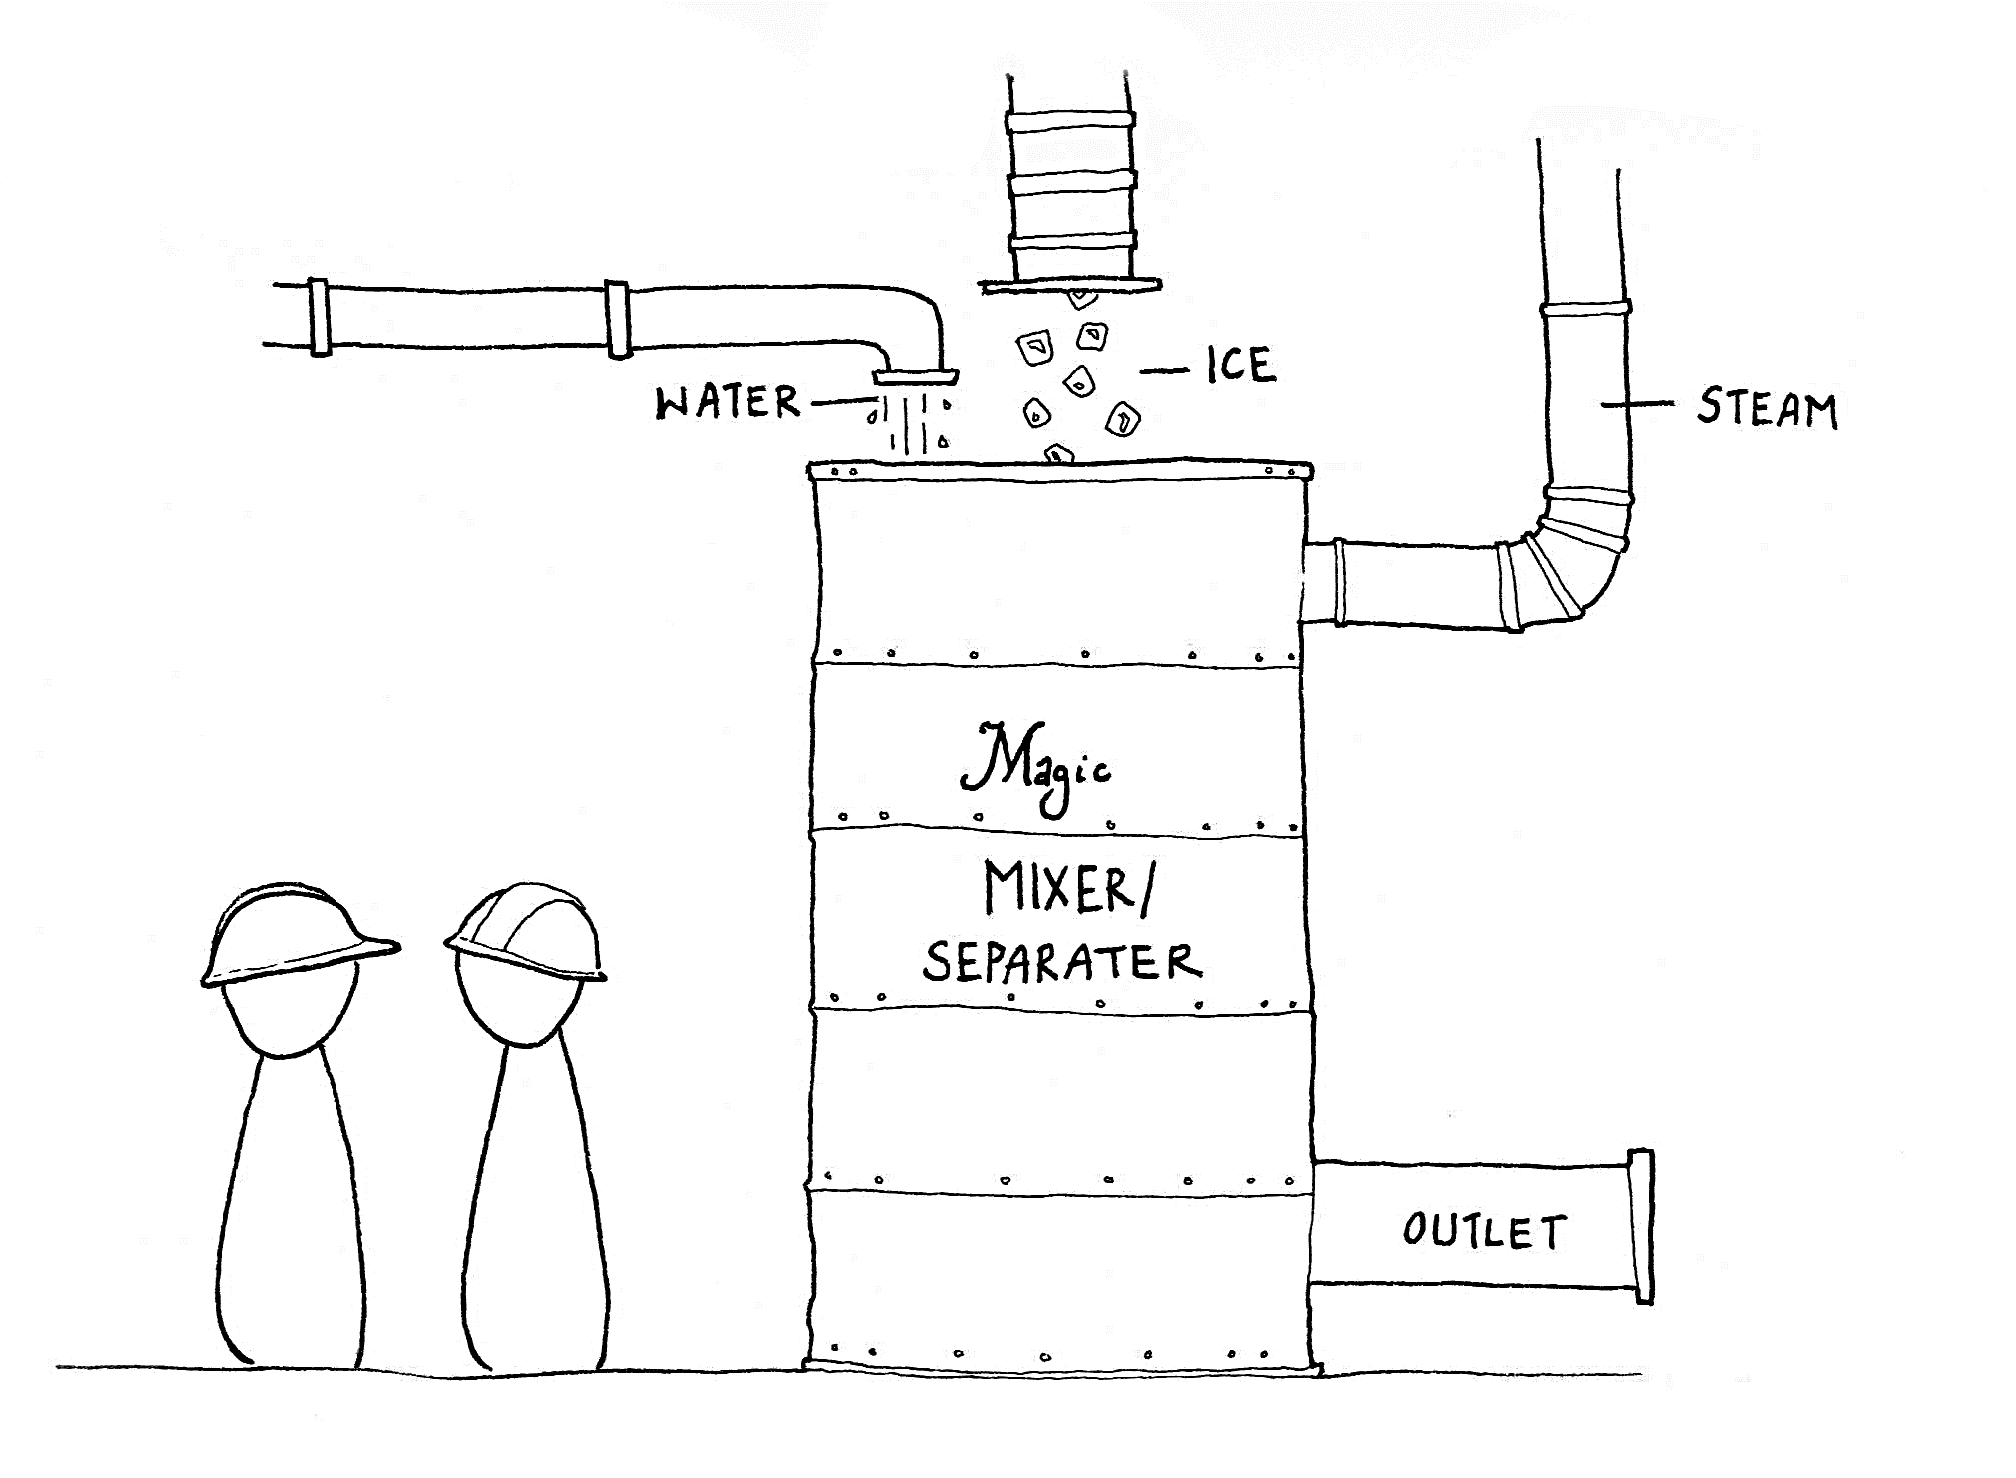
Exercise 3.66
Created by McKenzie Hubert ('16) & Maxine Chan ('16)
Revised by Jenny Bushnell (‘17), Angela Tang (‘18), Sydney Brannan (‘19), Michelle Quien (‘20), Ann Metzloff (‘21), Sarah Huang (‘22), Leon Lee (‘23), Austin Vollweiler (24’), Donovan Cho (‘25)

Slide 2
Overview
Find:
F_{T,4}
T₄
Composition
Water at 16°C
10. kg/min
1
Ice at -12°C
4.0 kg/min
2
Mixer
4
Steam at 215°C
6.0 kg/min
3

Slide 3
F_{T,4} – Mass Balance
Water at 16°C
10. kg/min
1
Rate in = Rate out
No chemical rxns
F_{T,1} + F_{T, 2} + F_{T, 3} = F_{T,4}
10. + 4.0 + 6.0 = F_{T,4}
F_{T,4} = 20. kg/min
Ice at -12°C
4.0 kg/min
2
4
Mixer
Steam at 215°C
6.0 kg/min
3

Slide 4
Temperature and Composition
Process with 3 inputs: water, ice, steam
What are possible combinations leaving?
  All steam
  Water + steam
  All water
  Water + ice
  All ice
Thermodynamic properties for H₂O
 | P = 1 atm | P = 0.005 atm
(joules °C₋₁ mol₋₁)* | 33. (solid) | 33. (solid)
 | 75. (liquid) | 75. (liquid)
 | 35. (vapor) | 33. (vapor)
boiling point (°C) | 100 | -2
melting point (°C) | 0 | -2
heat of vaporization (joules mol₋₁) | 4.1 × 10₄ | 4.5 × 10₄
heat of melting (joules mol₋₁) | 6.0 × 10₃ | 6.8 × 10₃
* varies with temperature. These values are valid to two significant figures in the range –50°C to 200°C.
Energy is conserved in the mixer!
Notes:
First going to assume that it’s only water coming out

Slide 5
Again, Our Process
Water at 16°C
10. kg/min
1
Ice at -12°C
4.0 kg/min
2
Mixer
Assume
Water at ?? °C
20. kg/min
Steam at 215°C
6.0 kg/min
3
4

Slide 6
No external heat input
equivalent mixer
q_{cooler}
Water at 16°C
10. kg/min
Water at 0°C
Cooler
1
1a
q_{warmer+melter}
Ice at -12°C
4.0 kg/min
Water at 0°C
Warmer
Melter
2
2a
q_{condendser+cooler}
3b
q_{total}
Steam at 215°C
6.0 kg/min
Water at 0°C
Water at ?? °C
20. kg/min
Cooler
Condenser
Cooler
Warmer
3
3a
4
Warm/cool each stream to 0C water, then warm up to final temperature
Notes:
Look at warmer+melter first

Slide 7
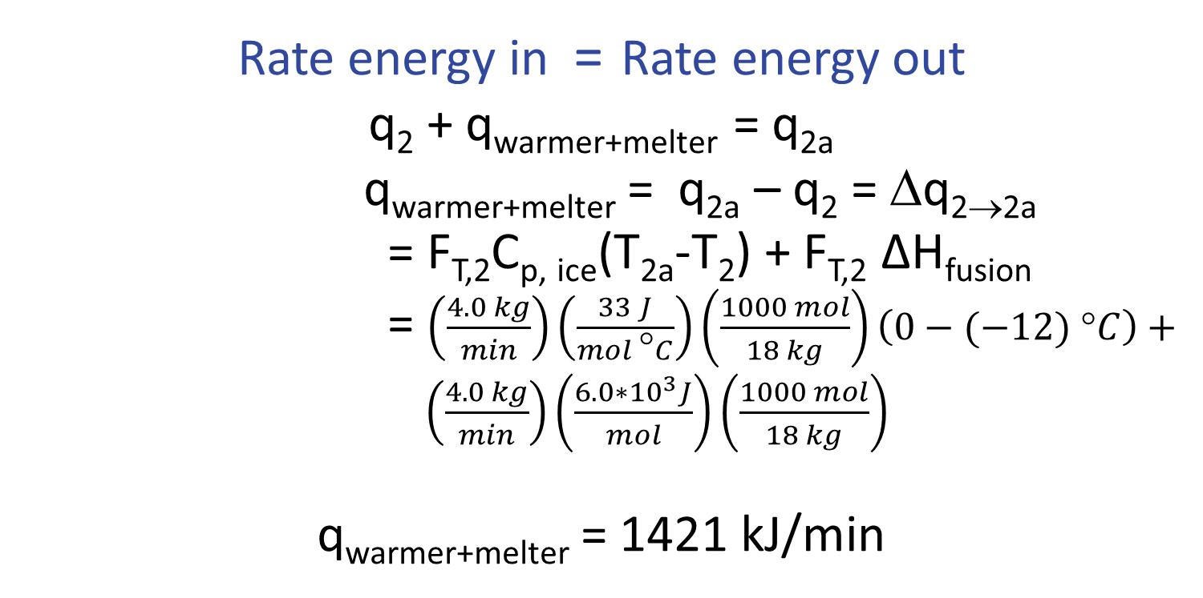
Warmer + Melter
q_{warmer+melter}
Ice at -12°C
4.0 kg/min
Warmer
Melter
2
2a
Notes:
Δ

Slide 8
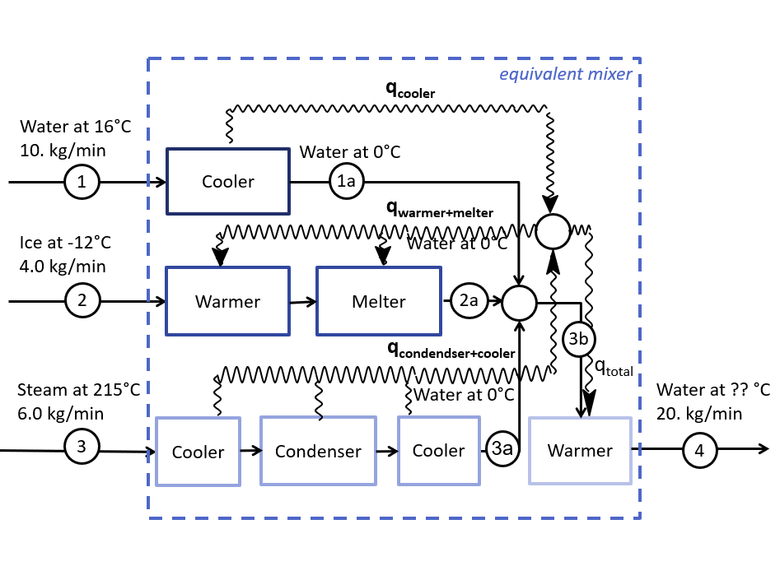
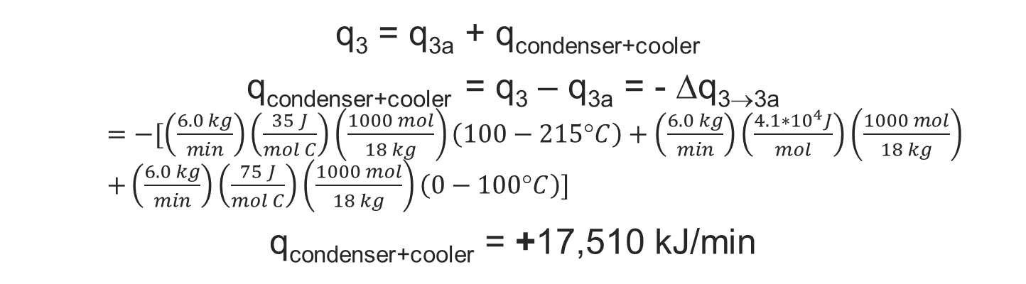
Repeat Analysis for Other Streams
Condenser + Cooler
Cool steam to 100°C
Condense steam to water
Cool water from 100°C to 0°C

Slide 9
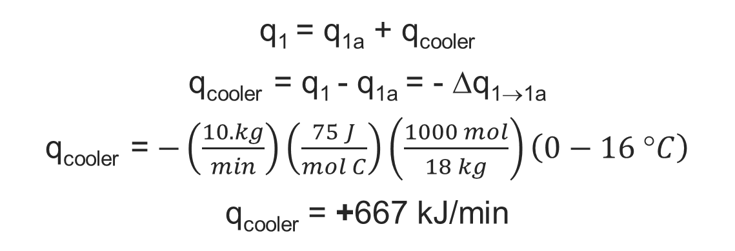
Repeat Analysis for Other Streams
Cooler
1) Cool water from 16°C to 0°C

Slide 10
equivalent mixer
q_{cooler}
Water at 16°C
10. kg/min
Water at 0°C
Cooler
1
1a
q_{warmer+melter}
Ice at -12°C
4.0 kg/min
Water at 0°C
Warmer
Melter
2
2a
q_{condendser+cooler}
3b
q_{total}
Steam at 215°C
6.0 kg/min
Water at 0°C
Water at ?? °C
20. kg/min
Cooler
Condenser
Cooler
Warmer
3
3a
4

Slide 11
Determine Exit Temperature
q_{warmer+melter}
Balance around Combiner
rate of energy in = rate of energy out
q_{cooler} + q_{condenser+cooler} = q_{total} + q_{warmer+melter}
q_{total} = +16,756 kJ/min
Balance around Warmer
rate of energy in = rate of energy out
q_{total} = q₄ – q₃ = F_{T,4}C_{P,water}(T₄ – T_{3a})
T₄ = 201°C
q_{cooler}
q_{total}
q_{condenser+cooler}
q_{total}
Water at ?? °C
20. kg/min
warmer
3a
4
BUT WAIT!
H₂O isn’t liquid at 201°C!
Let’s check our assumptions…

Slide 12
What are possible combinations leaving?
  All ice
  Water + ice
  All water
  Water + steam
  All steam
We started here
Started with the middle condition – all water
If T>100°C, must have some (or all) steam
If T<0°C, must have some (or all) ice

Slide 13
equivalent mixer
q_{cooler}
Water at 16°C
10. kg/min
cooler
1
1a
q_{warmer+melter}
q_{total}
Ice at -12°C
4.0 kg/min
warmer + melter
2
2a
q_{condendser+cooler}
2b
Steam at 215°C
6.0 kg/min
cooler +
condenser + cooler
Water at 0°C
warmer
3
3a
3b
3c
Water
100°C
3d
boiler
3e
4
We predicted water + steam for final product

Slide 14
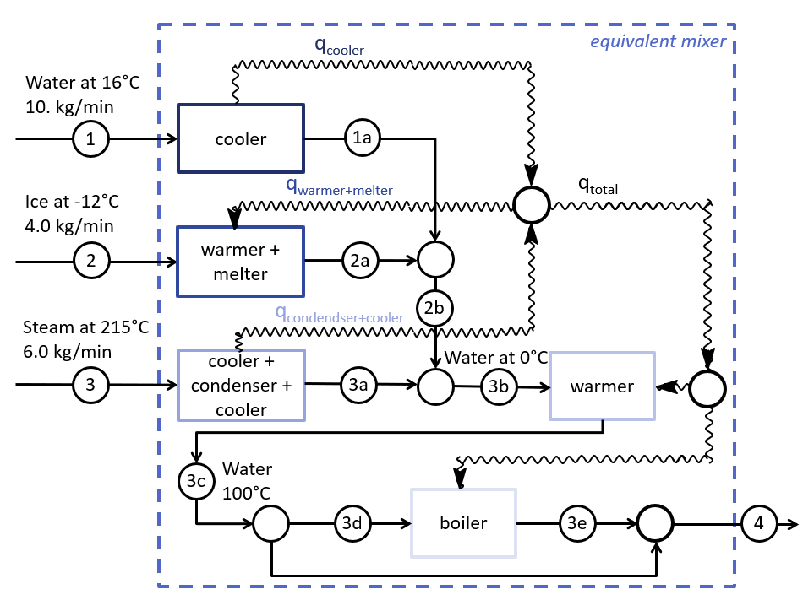
Energy Balances
Energy goes into heating the water to 100C and then vaporizing the water
q_{warmer}
Water
100°C
warmer
3b
3c
Around the Warmer:
q_{3b} + q_{warmer} = q_{3c}
q_{warmer} = q_{3c} – q_{3b}
= F_{T,3b}C_{P,water}(T_{3c}-T_{3b})
q_{warmer} = +8333 kJ/min
q_{total}
Around the Splitter:
q_{boiler} = q_{total} – q_{warmer}
q_{boiler} = +8423 kJ/min
q_{warmer}
q_{boiler}

Slide 15
How much water converted to steam?
q_{boiler}
boiler
3d
3e
Balance around Boiler
q_{3d} + q_{boiler} = q_{3e}
q_{boiler} = q_{3e} – q_{3d} = F_{T,3d}ΔH_{vap}
F_{T,3d} = q_{boiler}/ΔH_{vap} = 3.7 kg/min
F_{T,3d} ≤ F_{T,4} so T₄ = 100°C
X_{steam} = F_{T,3d}/F_{T,4} = 19 wt% steam
X_{water} = 81 wt% water

Slide 16
Takeaways
Break down complicated processes into simple units.
Check your signs/directionality!
  Is heat entering or leaving the stream?
    Coolers/Condensers → Heat is leaving
    Warmers/Melters/Vaporizers → Heat is entering
Units!
  kJ vs. J
  kg vs. moles (heat capacities)
Questions?

