Slide 1



Calculation Session 6!
Exercise 3.67
Created by Ailen Lao (‘23)
Presented by Maggie MacNeel (’24)
Edited by Lauren de Silva (‘25)
Improved by Liam Gillespie (‘26)

Slide 2


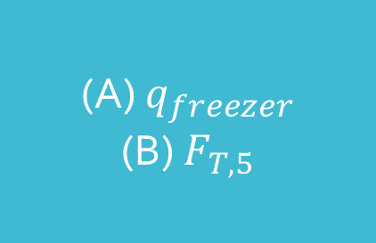
Overview
Let T ≡ total, W ≡ water, and I ≡ ice
slush: 0.0°C
50.% water
50.% ice
water
23°C
6
7
water
23°C
236 kg/min
water
23°C
177 kg/min
5
ice
0.0°C
ice
0.0°C
ice
0.0°C
1
2
freezer
3
4
(A) $q_{freezer}$
(B) $F_{T,5}$
$$q_{freezer}$$

Slide 3

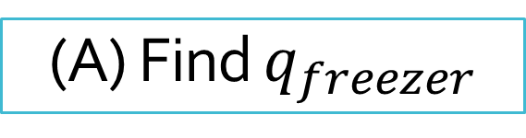
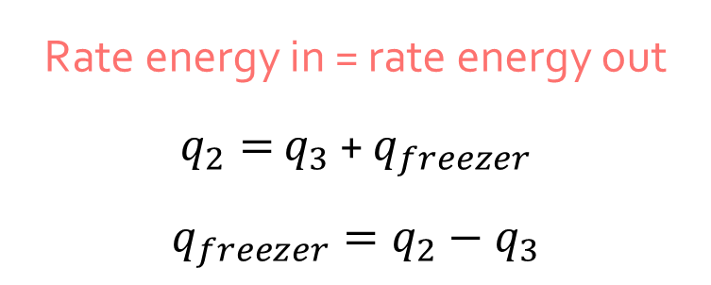
(A) Find $q_{freezer}$
Rate energy in = rate energy out
$q_{2}=$ $q_{3}$ + $q_{freezer}$
$${q_{freezer}=q}_{2}−q_{3}$$
water
23°C
177 kg/min
ice
0.0°C
2
freezer
3
We can only calculate change in energy, not absolute energy!
$$q_{freezer}$$

Slide 4


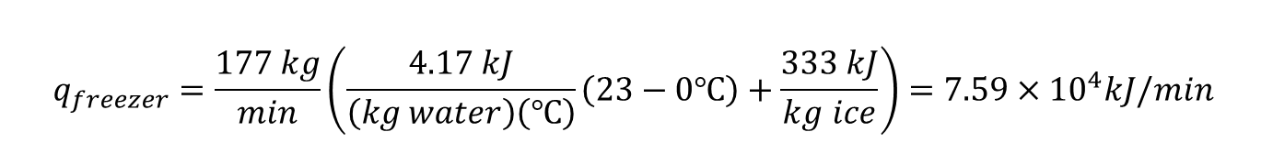



(A) Find $q_{freezer}$
$${q_{freezer}=q}_{2}−q_{3}$$
$${q_{freezer}=F}_{T,2}{\overline{C}}_{P,water}\left(T_{2}−T_{3}\right)+F_{T,2}{∆\overline{H}}_{melt,ice}$$
$${q_{freezer}=F}_{T,2}[{\overline{C}}_{P,water}\left(T_{2}−T_{3}\right)+{∆\overline{H}}_{melt,ice}]$$
$$T_{2}=23℃$$
$${ T}_{3}=0.0℃$$
$${\overline{C}}_{P,water}= \left(\frac{75 J}{(mol water)(℃)}\right)\left(\frac{1000 mol water}{18 kg water}\right)=\frac{4.17 kJ}{(kg water)(℃)}$$
Moles to mass!
$${∆\overline{H}}_{melt,ice}= \left(\frac{6.0×{10}^{3} J}{mol ice}\right)\left(\frac{1000 mol ice}{18 kg ice}\right)=\frac{333 kJ}{kg ice}$$
Moles to mass!
$$q_{freezer}=\frac{177 kg}{min}\left(\frac{4.17 kJ}{\left(kg water\right)\left(℃\right)}\left(23−0℃\right)+\frac{333 kJ}{kg ice}\right)=7.59×{10}^{4}kJ/min$$
Energy is removed from the freezer at a rate of $7.6×{10}^{4}$kJ/min!

Slide 5
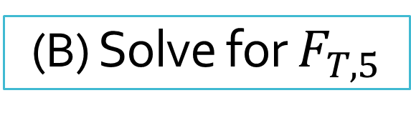

In other words…
Find how much ice we need to cool our water to 0.0°C
Find out how much additional ice we need to satisfy our ratio
(B) Solve for $F_{T,5}$
slush: 0.0°C
50.% water
50.% ice
water
23°C
6
7
water
23°C
236 kg/min
water
23°C
177 kg/min
5
ice
0.0°C
ice
0.0°C
ice
0.0°C
1
2
freezer
3
4
$$q_{freezer}$$
Notes:
Part (b): calculate flow rate of stream 5. balance around combiner and set up equivalent units

Slide 6
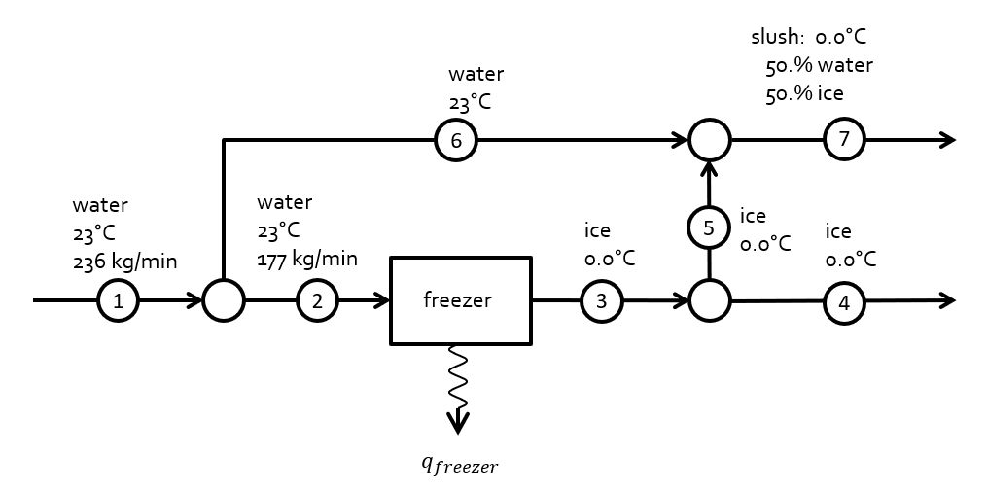
Lets find out how much water we’re dealing with

Slide 7


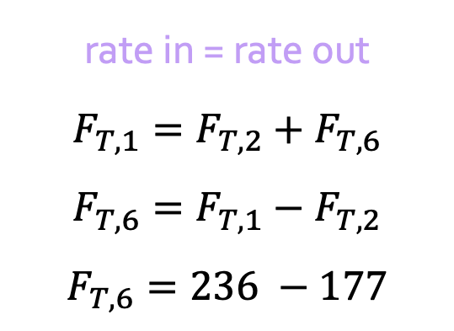
Find $F_{T,6}$ (total mass balance)
rate in = rate out
$$F_{T,1}=F_{T,2}+F_{T,6}$$
$$F_{T,6}=F_{T,1}−F_{T,2}$$
$$F_{T,6}=236 −177$$
water
23°C
6
1
2
water
23°C
236 kg/min
water
23°C
177 kg/min
$F_{T,6}=59$ kg/min

Slide 8
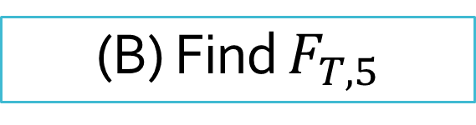

(B) Find $F_{T,5}$
slush: 0.0°C
50.% water
50.% ice
$F_{T,6}=59$ kg/min
water
23°C
6
7
water
23°C
236 kg/min
water
23°C
177 kg/min
5
ice
0.0°C
ice
0.0°C
ice
0.0°C
1
2
freezer
3
4
Set up equivalent unit…
$$q_{freezer}$$
Notes:
Part (b): calculate flow rate of stream 5. balance around combiner and set up equivalent units

Slide 9

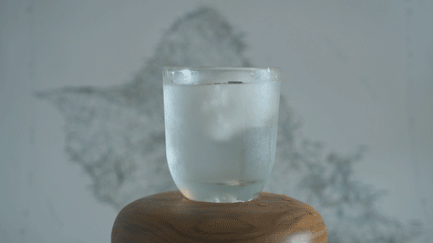

Equivalent Unit
water
23°C
59 kg/min
water
0.0°C
59 kg/min
6
cooler
6a
slush: 0.0°C
50.% water
50.% ice
water
23°C
59 kg/min
slush: 0.0°C
50.% water
50.% ice
$$q_{cooler}$$
6
7
7
5
ice
0.0°C
What do we think?
NO!!!!!!!!!!!!!!!!!!!!!!
Energy must be balanced!
Some of the ice is melted into water
ice
0.0°C
5

Slide 10

Equivalent Unit
water
23°C
water
0.0°C
6
cooler
6a
slush: 0.0°C
50.% water
50.% ice
slush: 0.0°C
50.% water
50.% ice
water
23°C
$$q_{cooler}$$
water
0.0°C
ice
0.0°C
6
7
melter
5c
7
5b
5
ice
0.0°C
5a
ice
0.0°C
ice
0.0°C
5
rate energy in = rate energy out

Slide 11
We know…
So we can…
Flow rates of streams 1, 2, and 3
Composition of stream 7
Temperatures of all streams
Find flow rate of stream 6
Find energy flows of cooler and melter
Combine above information and mass balances to find flow rate of stream 5

Slide 12



Back to our equivalent unit
rate in = rate out
water
23°C
water
0.0°C
6
cooler
6a
$59$ kg/min
$59$ kg/min
$$q_{cooler}$$
slush: 0.0°C
50.% water
50.% ice
water
0.0°C
ice
0.0°C
melter
5c
7
5b
5a
ice
0.0°C
ice
0.0°C
5

Slide 13

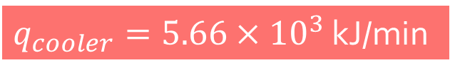
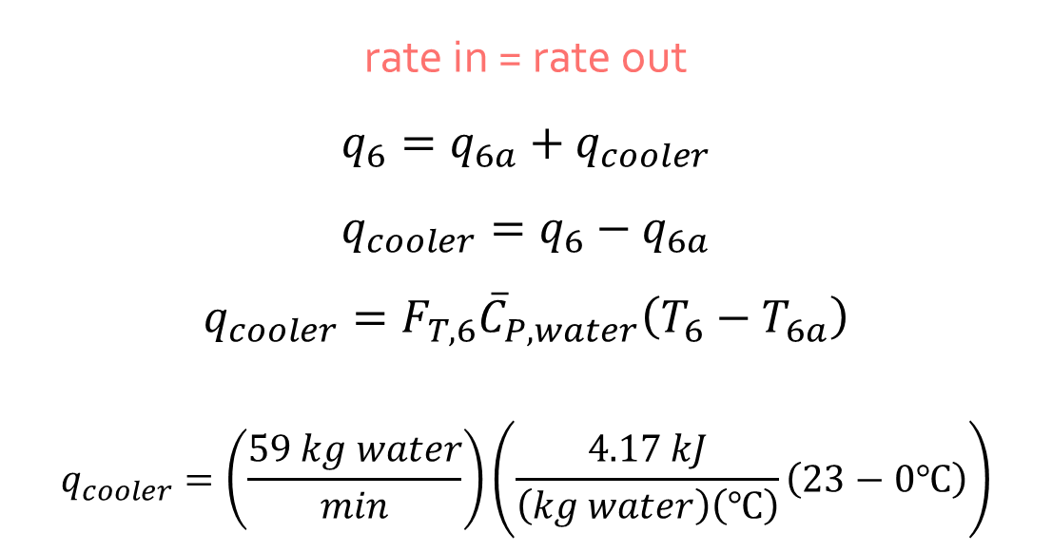

Find $q_{cooler}$ (energy balance)
water
23°C
59 kg/min
water
0.0°C
59 kg/min
rate in = rate out
$$q_{6}=q_{6a}+q_{cooler}$$
$$q_{cooler}=q_{6}−q_{6a}$$
$${q_{cooler}=F}_{T,6}{\overline{C}}_{P,water}\left(T_{6}−T_{6a}\right)$$
$$q_{cooler}=\left(\frac{59 kg water}{min}\right)\left(\frac{4.17 kJ}{\left(kg water\right)\left(℃\right)}\left(23−0℃\right)\right)$$
6
cooler
6a
$$q_{cooler}$$
We can only calculate change in energy, not absolute energy!
$q_{cooler}=5.66×{10}^{3}$ kJ/min

Slide 14


Equivalent Unit
water
23°C
water
0.0°C
6
cooler
6a
$F_{T,6}=59$ kg/min
$59$ kg/min
$$q_{cooler}$$
slush: 0.0°C
50.% water
50.% ice
$q_{cooler}=5.66×{10}^{3}$ kJ/min
water
0.0°C
ice
0.0°C
melter
5c
7
5b
rate in = rate out
5a
ice
0.0°C
ice
0.0°C
5

Slide 15
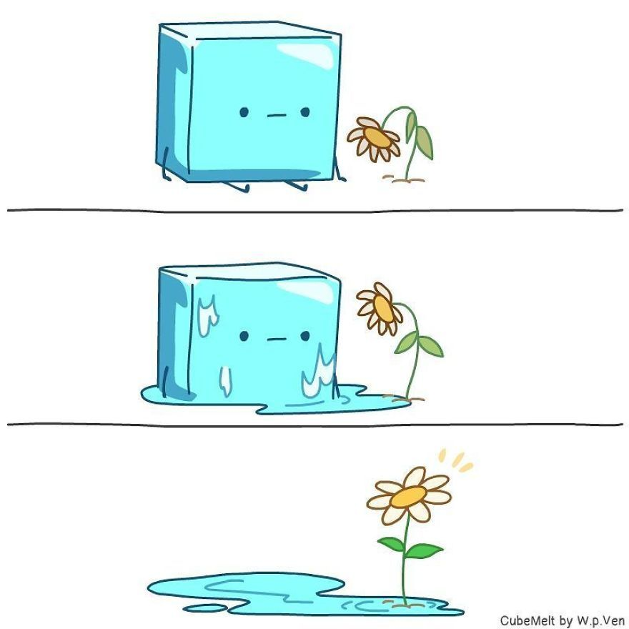
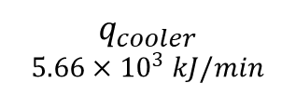
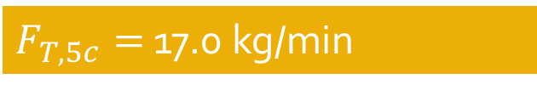
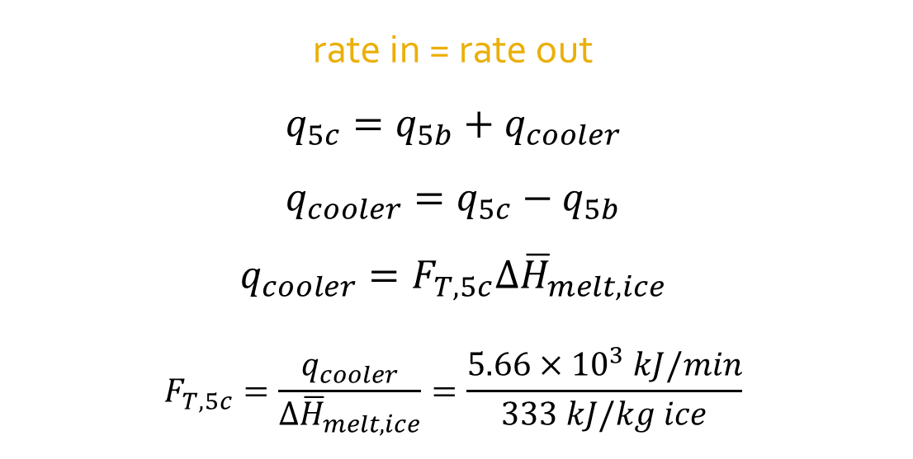
Now we can find how much ice we melted
$$q_{cooler}$$
$$5.66×{10}^{3} kJ/min$$
rate in = rate out
$$q_{5c}=q_{5b}+q_{cooler}$$
$$q_{cooler}=q_{5c}−q_{5b}$$
$${q_{cooler}=F}_{T,5c}{∆\overline{H}}_{melt,ice}$$
$$F_{T,5c}=\frac{q_{cooler}}{{∆\overline{H}}_{melt,ice}}=\frac{5.66×{10}^{3} kJ/min}{333 kJ/kg ice}$$
water
0.0°C
ice
0.0°C
melter
5c
5b
melting…
$F_{T,5c}=$ 17.0 kg/min

Slide 16
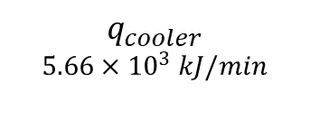
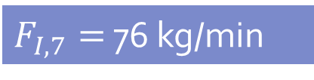
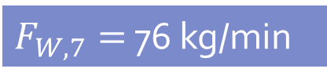
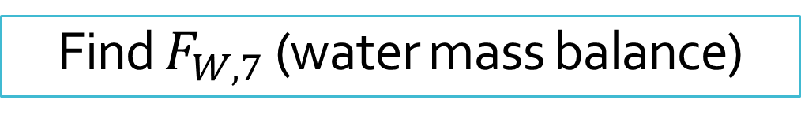
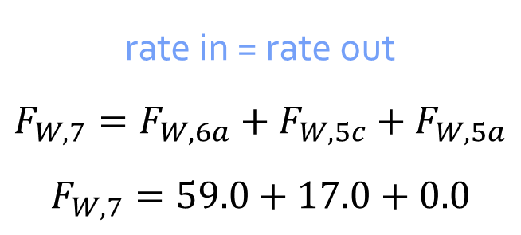
Find $F_{W,7}$ (water mass balance)
water
23°C
59 kg/min
water
0.0°C
59 kg/min
rate in = rate out
$${F_{W,7}=F}_{W,6a}+F_{W,5c}+F_{W,5a}$$
$$F_{W,7}=59.0+17.0+0.0$$
6
cooler
6a
$$q_{cooler}$$
$$5.66×{10}^{3} kJ/min$$
water
0.0°C
17.0 kg/min
slush: 0.0°C
50.% water
50.% ice
ice
0.0°C
17.0 kg/min
melter
5c
7
$F_{W,7}=$ 76 kg/min
5b
Because stream 7 is equal parts water and ice…
5a
ice
0.0°C
ice
0.0°C
76.0 kg/min
$F_{I,7}=$ 76 kg/min
5

Slide 17
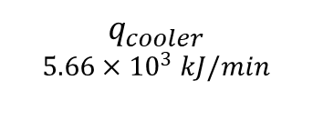
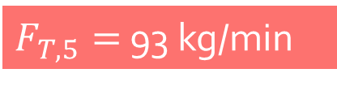

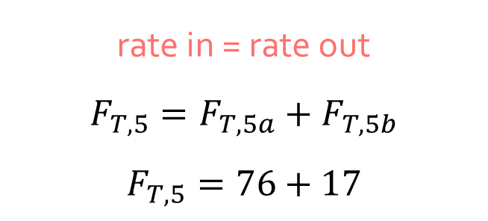
Find $F_{T,5}$ (total mass balance)
water
23°C
59 kg/min
water
0.0°C
59 kg/min
6a
rate in = rate out
$$F_{T,5}=F_{T,5a}+F_{T,5b}$$
$$F_{T,5}=76+17$$
6
cooler
$$q_{cooler}$$
$$5.66×{10}^{3} kJ/min$$
water
0.0°C
17.0 kg/min
slush: 0.0°C
50.% water
50.% ice
ice
0.0°C
17.0 kg/min
5c
melter
7
5b
$F_{T,5}=$ 93 kg/min
5a
ice
0.0°C
ice
0.0°C
76 kg/min
The flow rate of stream 5 is 93 kg/min!
5

Slide 18

Key Takeaways
There are many viable methods! (But some are riskier than others…)
Measure difference in energy, not absolute energy
Use equivalent elementary units
Always check units
Any Questions?!?!

Slide 19
Calculation Session 6
Energy Balance Exercises 3.66 and 3.67.
Consider drawing an equivalent unit that comprises
units with elementary energy changes.
Process Economics Exercises 3.94 and 3.95.
Prelim questions? Ask!

