Slide 1


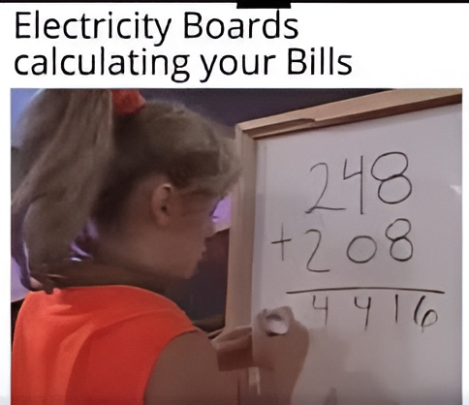

Exercise 3.94
Created by: Gavin Batsimm (‘21)
Edited by: Sanna Vedrine (‘23)
Burke Combs (‘24)
Dennis Wu (‘25)
Amy Wu (‘26)

Slide 2

TASK
Decrease expensive energy bill
SOLUTION
Install batteries
Specification | Metric
Battery Cost | $65,000
Battery Lifetime | 5 years
Annual Maintenance | $4,000 / year
Original Energy Bill | $110,000 / year
New Energy Bill | $ 80,000 / year

Slide 3


Calculating ROI
Revenue:
New Energy Bill – Old Energy Bill
= – ($80,000/year) – (– $110,000/year)
= $30,000/year
Operating Cost:
Annual Maintenance
= $4,000/year
Forgot to consider depreciation!
Profit:
Revenue – Operating Costs
= $30,000/year – $4,000/year
= $26,000/year
Specification | Metric
Battery Cost | $65,000
Battery Lifetime | 5 years
Annual Maintenance | $4,000 / year
Original Energy Bill | $110,000 / year
New Energy Bill | $80,000 / year
ROI:
Profit / Capital Cost
= $26,000/year / $65,000
= 40 % /year

Slide 4

(Re)Calculating ROI
Revenue:
New Energy Bill – Old Energy Bill
= – ($80,000/year) – (– $110,000/year)
= $30,000/year
Operating Cost:
+ Depreciation
Annual Maintenance
= $4,000/year
+ ($65,000 / 5 years)
= $17,000/year
Forgot to consider depreciation!
Profit:
Revenue – Operating Costs
= $30,000/year – $4,000/year
= $26,000/year
– $17,000/year
= $13,000/year
ROI:
Profit / Capital Cost
= $26,000/year / $65,000
= 40 % /year
= $13,000/year /
= 20% /year

Slide 5

Takeaways
Remember depreciation!
Return
Profit
ROI =
=
Investment
Capital Cost

