Slide 1
Calculation Session 6 Exercise 3.95
Created by Ariel Struzyk (‘23)
Revised by Austin Kwan (‘24) and Ashlyn Dumaw (’25)

Slide 2
Goal:
Determine which of seven projects to fund with your $10 million budget
Info:
Capital cost, operating cost, and revenue for each project
Where to start:
Look at economic indicators to determine the best investment

Slide 3
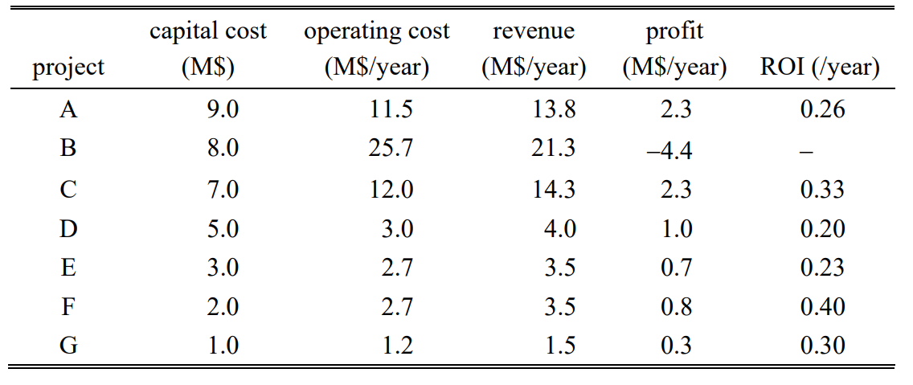
Project Options - $10 M
Profit =
revenue - operating cost

Slide 4
Project Options - $10 M
P = R - OC
ROI =
$$\frac{profit}{capital cost}$$

Slide 5
Project Options - $10 M
P = R - OC
ROI = P / CC
How should we invest $10 million?

Slide 6
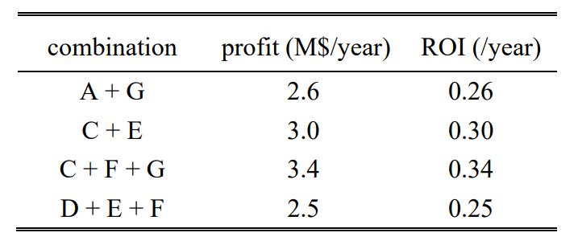
best combination

Slide 7
Key Takeaways
Profit = (revenue) – (operating costs)
ROI =
Use ROI to determine what to invest in
Not revenue!
Not profit!
profit
$$\frac{p ffrofit}{capital cost}$$
capital costs

