Slide 1


Calculation Session 6 Exercise 3.95
Created by Ariel Struzyk (‘23)
Revised by Austin Kwan (‘24), Ashlyn Dumaw (’25), and Kong Chen (‘26)

Slide 2


Slide 3

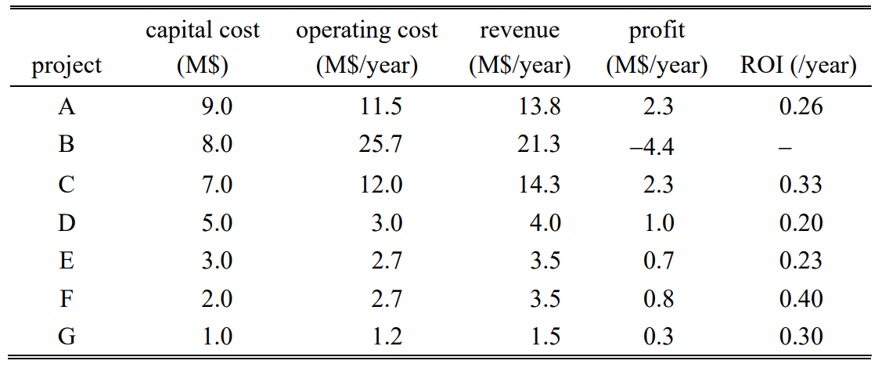
Project Options - $10 M
Profit =
revenue - operating cost

Slide 4

Project Options - $10 M
P = R - OC
ROI =
$$\frac{profit}{capital cost}$$

Slide 5
Project Options - $10 M
P = R - OC
ROI = P / CC
How should we invest $10 million?

Slide 6
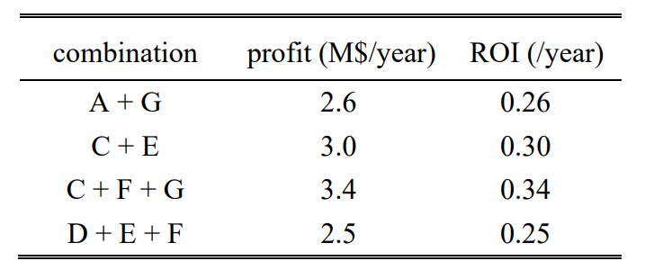
best combination

Slide 7

Key Takeaways
Profit = (revenue) – (operating costs)
ROI =
Use ROI to determine what to invest in
Not revenue!
Not profit!
profit
$$\frac{p ffrofit}{capital cost}$$
capital costs

