Slide 1
Calculation Session 6
Exercise 3.95
Created by Ariel Struzyk (‘23)
Revised by Austin Kwan (‘24), Ashlyn Dumaw (’25), and Sean McInnis (‘26)

Slide 2

Poke Lava Fundraiser.

Slide 3

Goal:
Determine which of seven projects to fund
with your $10 million budget
Info:
Capital cost, operating cost, and revenue for each project
Where to start:
Look at economic indicators to determine the best investment

Slide 4
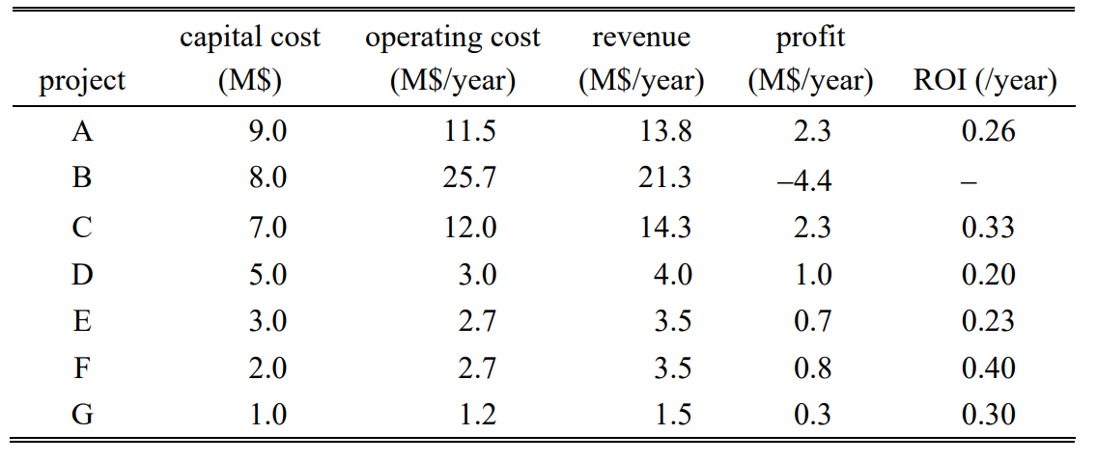
Project Options - $10 M
Profit =
revenue - operating cost

Slide 5

Project Options - $10 M
P = R - OC
ROI =
$$\frac{profit}{capital cost}$$

Slide 6
Project Options - $10 M
P = R - OC
ROI = P / CC
How should we invest $10 million?

Slide 7
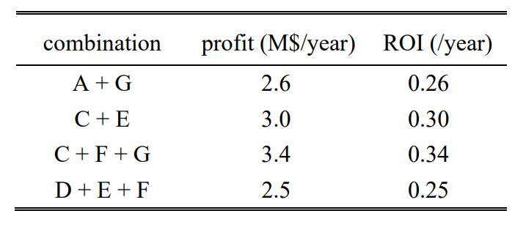
best combination

Slide 8

Key Takeaways
Profit = (revenue) – (operating costs)
ROI =
Use ROI to determine what to invest in
  Not revenue!
  Not profit!
🥗 Poke Lava Fundraiser 🥗
profit
$$\frac{p ffrofit}{capital cost}$$
capital costs

