Slide 1
Exercise 4.15
Created by: Jenny Bushnell ‘17 and Amy Penick ’17
Revised by: Joe Hassler ’18, Olivia Young ’19
Spencer Hong ’20
Andrew Simon ’21
Kelsey Levine ’22
Ailen Lao ‘23, Sanna Vedrine ’23
Austin Kwan ’24
Donovan Cho ‘25
Expectations
Reality
Math
Chemistry
Chemistry
Math
ChemE

Slide 2
Parts A & B: Finding Compositions and Flow Rates
3
4
Composition and Flow Rate of 3?
Composition and Flow Rate of 4?

Slide 3
Part A:
3
Vapor
4
Vapor + Liquid
l
98
Stream 4
Stream 3
x_{ACN,4} = 0.36
y_{ACN,3} = 0.74
v
Liquid
Stream 1
mol% ACN

Slide 4
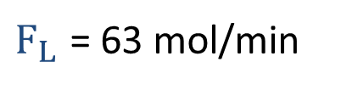
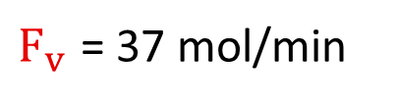
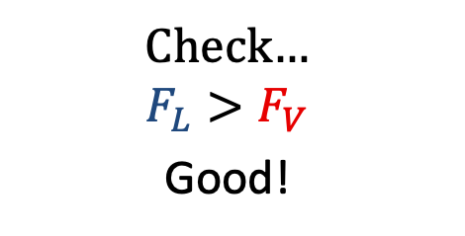
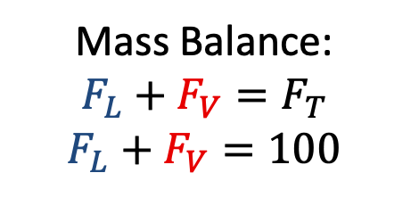
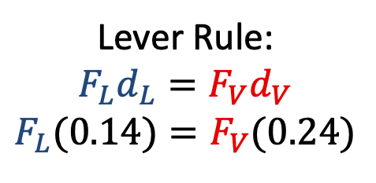
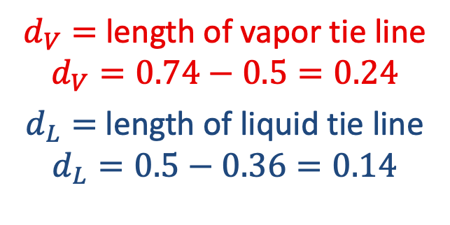
Part B: Using the Lever Rule
F_{L}
$d_{V}=$ length of vapor tie line
$$d_{V}=0.74−0.5=0.24$$
$d_{L}=$ length of liquid tie line
$$d_{L}=0.5−0.36=0.14$$
d_{L}
F_{V}
d_{V}
0.36
0.50
0.74
Lever Rule:
$$F_{L}d_{L}=F_{V}d_{V}$$
$$F_{L}(0.14)=F_{V}(0.24)$$
Solve!
Mass Balance:
$$F_{L}+F_{V}=F_{T}$$
$$F_{L}+F_{V}=100$$
Check…
$$F_{L}>F_{V}$$
Good!

Slide 5
Parts C & D:
a second flash drum is added:
3
4
Temperature and Composition of second flash drum?

Slide 6
Part C:
3
Vapor
4
?
(D) Composition of Stream 8?
Stream 8
Stream 6
T = 111°C
Stream 4
Stream 3
Vapor + Liquid
Liquid
Stream 1
x_{ACN} = .15
mol% ACN

Slide 7
Part E:
F₇?
F₈?
rate out = rate in
F_{T,8} + F_{T,3} = 100 mol/min
…but what are F₈ and F₃?

Slide 8


(E)
Vapor
$x_{3, ACN}=$ 0.15
$y_{8, ACN}=$ 0.74
Stream 8
Stream 6
Stream 3
Stream 4
Vapor + Liquid
Liquid
Stream 1
mol% ACN

Slide 9
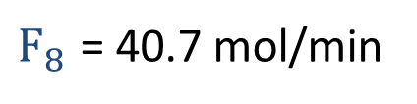
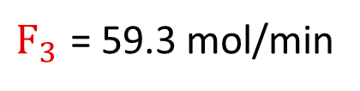
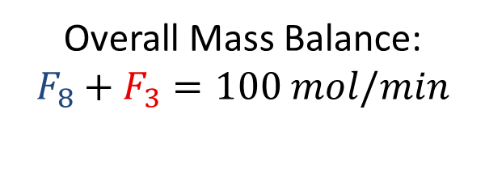
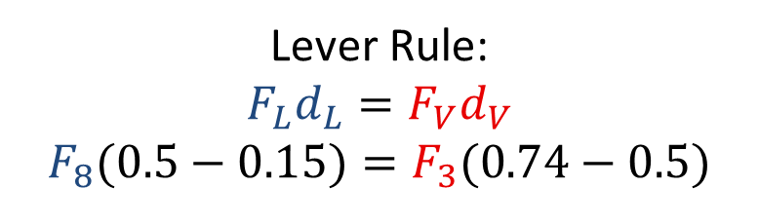
F₈? Use the Lever Rule!
Stream 8
Stream 3
0.50
0.15
0.74
rate out = rate in
Stream 1
Lever Rule:
$$F_{L}d_{L}=F_{V}d_{V}$$
$$F_{8}(0.5−0.15)=F_{3}(0.74−0.5)$$
Overall Mass Balance:
$$F_{8}+F_{3}=100 mol/min$$
Solve!

Slide 10
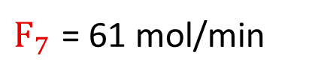
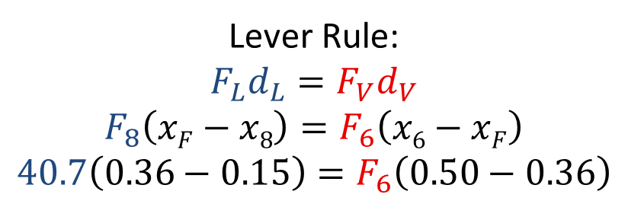
F₇? Use the Lever Rule!
Part E:
We know F₈ = 40.7 mol/min and F₇ = F₆. Solve for F₆!
Stream 8
.36
Stream 6
.15
.50
Stream 5
Lever Rule:
$$F_{L}d_{L}=F_{V}d_{V}$$
$$F_{8}\left(xF−x8\right)=F_{6}\left(x6−xF\right)$$
$$40.7\left(0.36−0.15\right)=F_{6}\left(0.50−0.36\right)$$
Solve!

Slide 11
4.15: Takeaways
The Lever Rule applies for any species balance
  Can use on overall system!
Check if your calculations seem reasonable
Label your streams and the direction of flow on your phase diagrams

