Slide 1
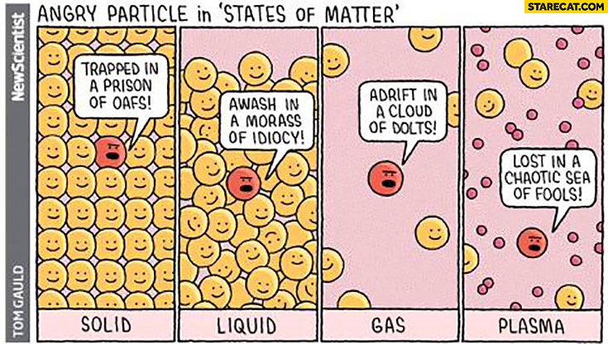

Exercise 4.2
Graphical Energy Balances - Visualizing Phase Properties
Created by Eddie Reynolds ‘12
Revised by McKenzie Huston ’14, Bari Grossman ’15, McKenzie Hubert ‘16, Natalie Goh ’17, Doris Chen ’18, Rose Yin ’19, Spencer Hong ’20, Drew Lazarow ’21, Sarah Huang ’22, Ariel Struzyk ’23, Austin Vollweiler ’24, Lauren de Silva ’25, Kong Chen ‘26

Slide 2
Temperature Scale & Linear Specific-Energy Scale
Temperature (⁰C)
-200
-100
0
100
200
300
400
0
500
1000
1500
2000
2500
3000
3500
4000
4500
5000
Specific Energy (kJ/kg)

Slide 3
Temperature (⁰C)
-200
-100
0
100
200
300
400
0
500
1000
1500
2000
2500
3000
3500
4000
4500
5000
Specific Energy (kJ/kg)
Goals
T_{melt}
ΔH_{vap}
C_{p,liquid}

Slide 4
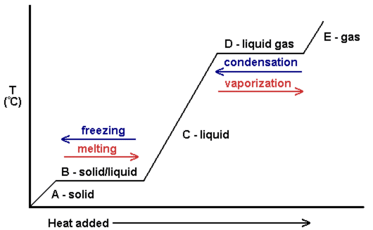
solid
solid + liquid
liquid
liquid + vapor
vapor
Temperature (⁰C)
-200
-100
0
100
200
300
400
0
500
1000
1500
2000
2500
3000
3500
4000
4500
5000
Specific Energy (kJ/kg)

Slide 5
Find T_{melt}
solid
solid + liquid
liquid
liquid + vapor
vapor
Temperature (⁰C)
-200
-100
0
100
200
300
400
0
500
1000
1500
2000
2500
3000
3500
4000
4500
5000
Specific Energy (kJ/kg)

Slide 6
Find T_{melt}
solid
solid + liquid
liquid
Temperature (⁰C)
-200
-100
0
100
200
300
400
0
500
1000
1500
2000
2500
3000
3500
4000
4500
5000
Specific Energy (kJ/kg)
same temperature

Slide 7
Find T_{melt}
solid
solid + liquid
liquid
Temperature (⁰C)
-200
-100
0
100
200
300
400
0
500
1000
1500
2000
2500
3000
3500
4000
4500
5000
Specific Energy (kJ/kg)
same temperature
melting temperature = 60˚C

Slide 8

solid
solid + liquid
liquid
liquid + vapor
vapor
Temperature (⁰C)
-200
-100
0
100
200
300
400
0
500
1000
1500
2000
2500
3000
3500
4000
4500
5000
Specific Energy (kJ/kg)

Slide 9
liquid
liquid + vapor
vapor
Temperature (⁰C)
-200
-100
0
100
200
300
400
0
500
1000
1500
2000
2500
3000
3500
4000
4500
5000
Specific Energy (kJ/kg)
ΔH_{vap} = energy difference between vapor and liquid

Slide 10
liquid
liquid + vapor
vapor
Temperature (⁰C)
-200
-100
0
100
200
300
400
0
500
1000
1500
2000
2500
3000
3500
4000
4500
5000
Specific Energy (kJ/kg)
ΔH_{vap} = 4750 kJ/kg – 2500 kJ/kg
= 2250 kJ/kg

Slide 11

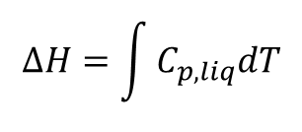


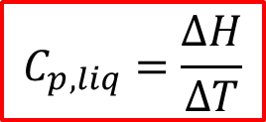
solid
solid + liquid
liquid
liquid + vapor
vapor
Temperature (⁰C)
-200
-100
0
100
200
300
400
0
500
1000
1500
2000
2500
3000
3500
4000
4500
5000
Specific Energy (kJ/kg)
What formula relates ΔH and ΔT?

Slide 12
ΔT
liquid
Temperature (⁰C)
-200
-100
0
100
200
300
400
0
500
1000
1500
2000
2500
3000
3500
4000
4500
5000
Specific Energy (kJ/kg)
ΔH

Slide 13

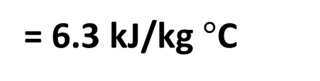
ΔT
liquid
Temperature (⁰C)
-200
-100
0
100
200
300
400
0
500
1000
1500
2000
2500
3000
3500
4000
4500
5000
Specific Energy (kJ/kg)
2500 kJ/kg – 1500 kJ/kg
C_{p,liquid} =
= 6.3 kJ/kg$°$C
ΔH
220$°$C – 60$°$C

Slide 14
Key Takeaways
Use colored diagrams to visualize concepts
Combining scales can simplify the problem
  E.g. temperature and energy
We can simplify equations by stating assumptions
  E.g. heat capacity is independent of temperature
  Any Questions?

