Slide 1
Calculation Session 9
Exercise 4.27
Created by: Katie Reilly ('12)
Edited by: Andrew Robbins (‘13), Tim Abbott (‘15), Jesse Garcia (‘16), Jenny Bushnell (‘17), Angela Tang (‘18), Sydney Brannan (‘19), Gavin Batsimm (‘21), Max Serota (‘22), Ariel Struzyk (‘23), Austin Vollweiler (‘24), Ashlyn Dumaw (‘25), and Sean McInnis (‘26)

Slide 2


Slide 3
Goal:
Use ternary diagrams to do graphical mass balances for mixtures with three components
Info:
A ternary diagram for mixtures of water,
methanol, and ethanol
Where to start:
Label the diagram
Label your given streams

Slide 4
Why are Graphical Techniques Useful?
Helpful for visual learners
Great as an intuitive check
Often times, math is more complicated
Lever:
Math:
A = 10 kg/min
B = 5 kg/min
A
B

Slide 5
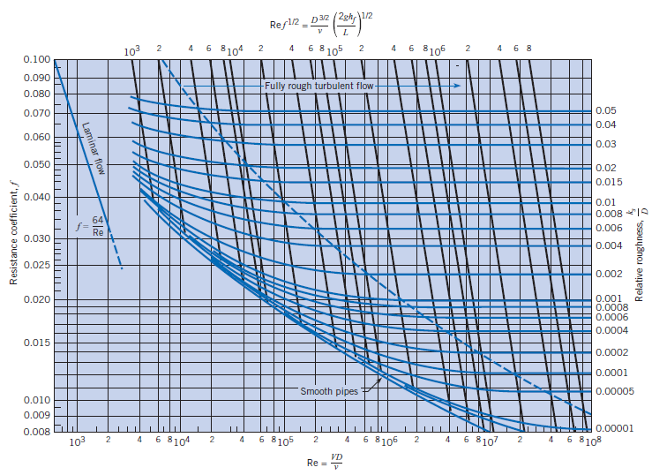
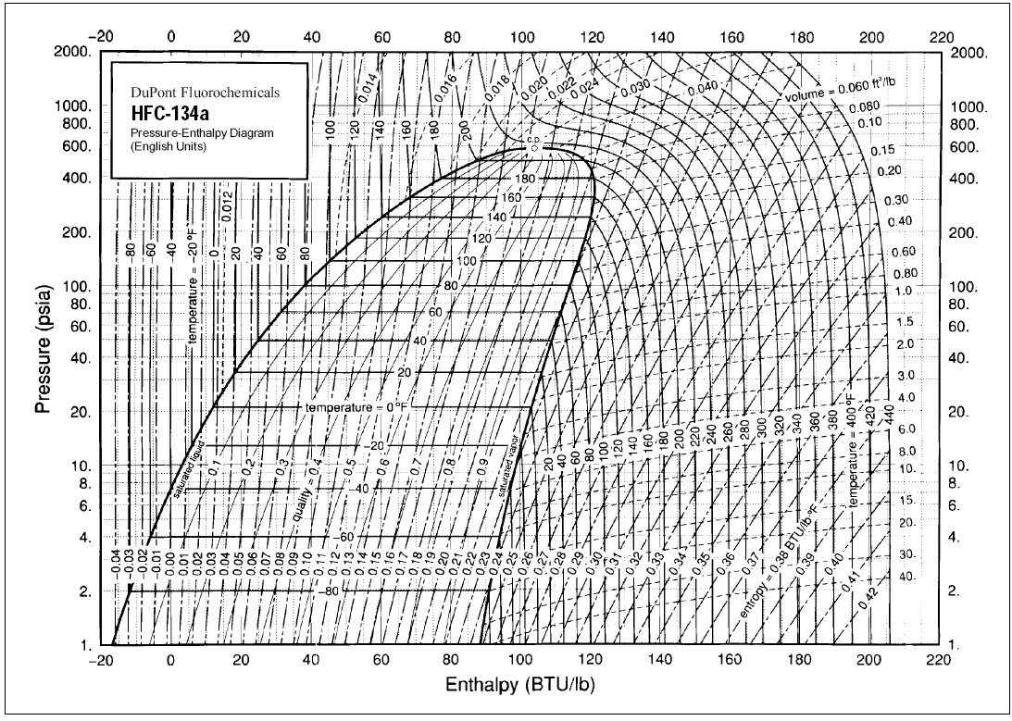
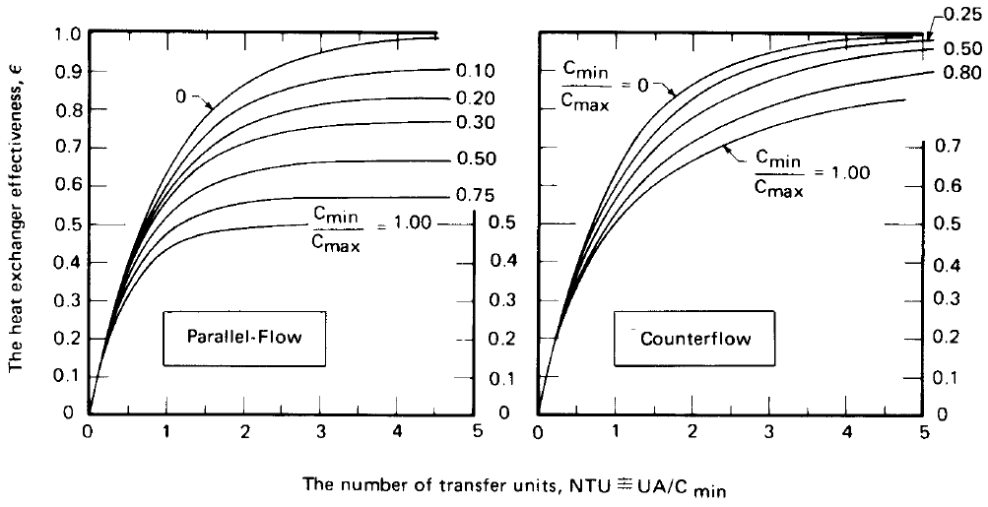
When are Graphical Techniques Used?
ChemE 3230:
Fluid Dynamics
Moody Diagram -- frictional losses, etc. in pipe flow
ChemE 3130:
Thermodynamics
Heat pumps, refrigeration cycles
ChemE 3240:
Heat & Mass Transfer
Effectiveness-NTU method for heat exchanger analysis

Slide 6
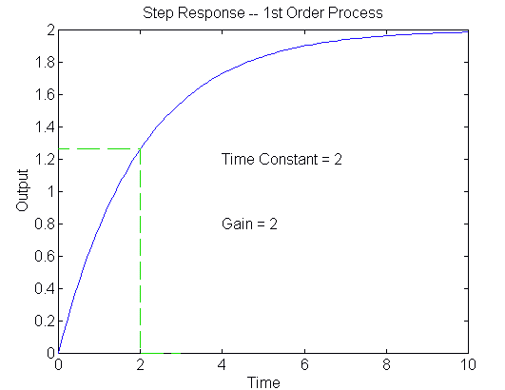
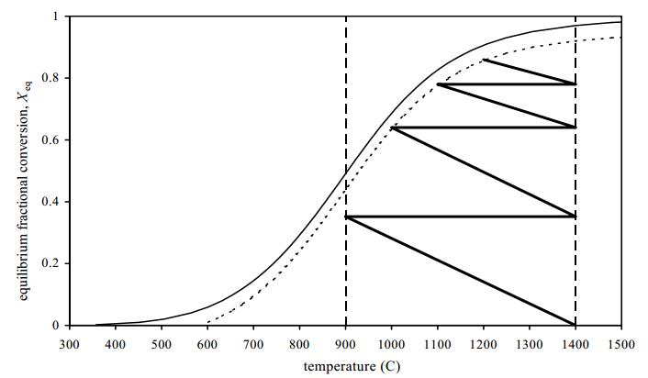
When are Graphical Techniques Used?
ChemE 3720:
Process Dynamics & Controls
Determine gain and time constant
ChemE 3900:
Kinetics & Reactor Design
Adiabatic temperature rise
ChemE 3320:
Separations
Ternary diagrams!

Slide 7
Let’s get familiar with ternary diagrams!
Pure Ethanol
Pure Water
Pure Methanol

Slide 8
A) Composition of Stream 3
40 mol% water
50 mol% methanol
10 mol% ethanol
? mol/min
On the ternary diagram
Locate streams 1 and 2
Draw a mixing line
2
20 mol% water
10 mol% methanol
70 mol% ethanol
1 mol/min
58 mol% ethanol
? mol/min
1
3
Notes:
Use a mixing line to calculate the composition of stream 3.
Locate the coordinates of streams 1 and 2 on the ternary diagram.
Connect the points with a mixing line.
The point corresponding to stream 3 is the intersection of the mixing line and the ethonal composition line at 0.58

Slide 9
A) Composition of Stream 3
Pure Ethanol
Stream 1:
x_{EtOH} = 0.70
x_{MeOH} = 0.10
x_{H2O} = 0.20
Stream 2:
x_{EtOH} = 0.10
x_{MeOH} = 0.50
x_{H2O} = 0.40
x_{H2O} = 0.24
1
x_{EtOH} = 0.58
A quick check:
0.58 + 0.18 + 0.24 = 1.0
✓
2
Pure Water
Pure Methanol
x_{MeOH} = 0.18

Slide 10
B) Flow Rate of Stream 2
Pure Ethanol
Stream 1:
x_{EtOH} = 0.70
x_{MeOH} = 0.10
x_{H2O} = 0.20
Stream 2:
x_{EtOH} = 0.10
x_{MeOH} = 0.50
x_{H2O} = 0.40
x_{H2O} = 0.24
1
x_{EtOH} = 0.58
Along the ethanol axis:
(0.7-0.58) F_{T, 1} = (0.58-0.10) F_{T, 2}
F_{T, 1} = 1 mol/min
(0.12) (1) = (0.48) F_{T, 2}
F_{T, 2} = 0.25 mol/min
2
Pure Water
Pure Methanol
x_{MeOH} = 0.18

Slide 11
Key Takeaways
There are a variety of tools we can use to solve exercises
Graphical tools can make solving exercises easier to visualize and understand
Start by labeling your diagrams and understanding what each dimension means
Graphical solutions can help give intuition on an exercise, beyond simply a numeric solution

Slide 12
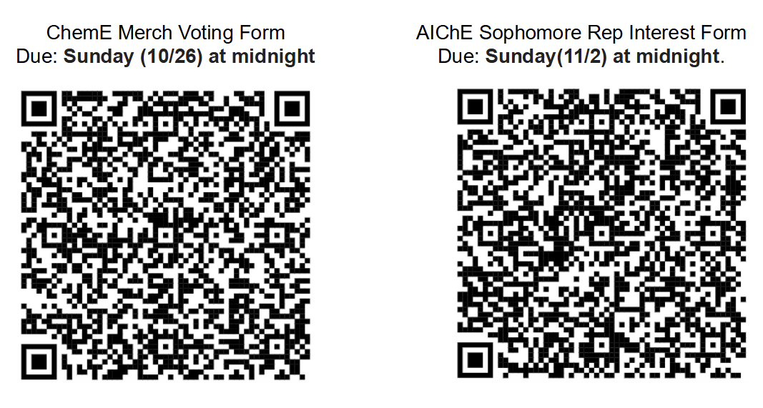

Slide 13


