Slide 1
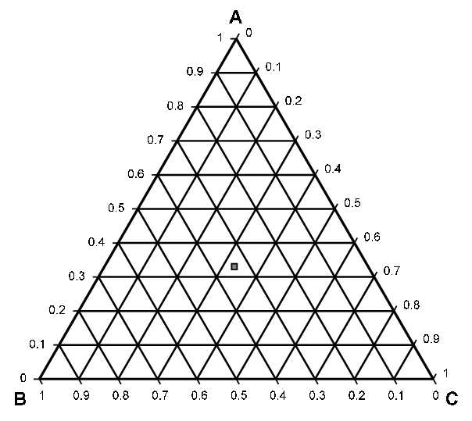

Exercises 4.28 and 4.96
Created by Barbara Wang ’10
Edited by Eddie Reynolds ’12
Andrew Robbins ’13
Tim Abbott ’15
Matt Ferguson ’16
Robert Lee ’17
Joe Hassler ’18
Francis Ledesma ’19
Kasim Khan ’20
Max Serota ‘22
Ailen Lao and Sanna Vedrine ’23
Austin Kwan ‘24
Dennis Wu and Lauren de Silva ’25
Kong Chen and Amy Wu ‘26
all nighters
Money
30% averages
Balance of all

Slide 2


Slide 3
Let’s get familiar with the diagram…
Pure mcp
1 phase region
Mixture splits into 2 phases
2 phase region
Pure hexane
Pure aniline
aniline-poor
aniline-rich

Slide 4
aniline-rich stream
aniline
3 mol/min
mcp
1
4
Map stream 1 from the process onto the ternary diagram
mixer
3
liquid-liquid separator
2
50 mol% hexane
50 mol% mcp
2 mol/min
5
aniline-poor stream
hexane
aniline

Slide 5
aniline-rich stream
aniline
3 mol/min
mcp
1
4
Map stream 2 from the process onto the ternary diagram
mixer
3
liquid-liquid separator
2
50 mol% hexane
50 mol% mcp
2 mol/min
5
aniline-poor stream
hexane
aniline

Slide 6


aniline-rich stream
aniline
3 mol/min
Represent mixer by a mixing line!
1
4
Stream 3 must be on the mixing line…
mixer
3
liquid-liquid separator
… We can use the lever rule to find exactly where Stream 3 lies!
2
50 mol% hexane
50 mol% mcp
2 mol/min
5
aniline-poor stream
2 mol/min
3 mol/min

Slide 7
aniline-rich stream
aniline
3 mol/min
1
4
Find compositions of stream 4 and stream 5
mixer
3
liquid-liquid separator
2
50 mol% hexane
50 mol% mcp
2 mol/min
5
aniline-poor stream
2 phase region

Slide 8
aniline-rich stream
aniline
3 mol/min
1
4
Find compositions of stream 4 and stream 5
mixer
3
liquid-liquid separator
Represent separator by a tie line!
2
50 mol% hexane
50 mol% mcp
2 mol/min
5
aniline-poor stream

Slide 9
aniline-rich stream
aniline
3 mol/min
1
4
Find compositions of stream 4 and stream 5
mixer
3
liquid-liquid separator
Represent separator by a tie line!
2
50 mol% hexane
50 mol% mcp
2 mol/min
5
Read off compositions
aniline-poor stream
Stream 5:
70% Hexane
10% Aniline
20% MCP

Slide 10
aniline-rich stream
aniline
3 mol/min
1
4
Find compositions of stream 4 and stream 5
mixer
3
liquid-liquid separator
Represent separator by a tie line!
2
50 mol% hexane
50 mol% mcp
2 mol/min
5
Read off compositions
aniline-poor stream
Stream 5:
70% Hexane
10% Aniline
20% MCP
Stream 4:
10% Hexane
70% Aniline
20% MCP

Slide 11
aniline-rich stream
aniline
3 mol/min
1
4
Find flow rates of stream 4 and stream 5
mixer
3
liquid-liquid separator
Let’s use the lever rule on our tie line !
50 mol% hexane
50 mol% mcp
2 mol/min
2
5
(F_{stream 5} ) (0.6-0.1) = (F_{stream 4} ) (0.7-0.6)
aniline-poor stream
(F_{stream 5} ) 0.5 = (F_{stream 4} ) 0.1
1 equation, 2 unknowns! We can’t solve this ☹
F_{stream 5}
F_{stream 4}
0.5*
0.1*
* no need for a ruler, let’s use the aniline axis

Slide 12
Let’s do an overall mass balance:
aniline-rich stream
aniline
3 mol/min
1
4
mixer
3
liquid-liquid separator
2
50 mol% hexane
50 mol% mcp
2 mol/min
5
aniline-poor stream
F_{stream 1} + F_{stream 2} = F_{stream 4} + F_{stream 5}
3 mol/min + 2 mol/min = F_{stream 4} + F_{stream 5}
5 mol/min = F_{stream 4} + F_{stream 5}

Slide 13
aniline-rich stream
aniline
3 mol/min
1
4
mixer
3
liquid-liquid separator
2
50 mol% hexane
50 mol% mcp
2 mol/min
5
aniline-poor stream
Overall Mass Balance:
5 mol/min = F_{stream 4} + F_{stream 5}
Lever Rule:
(F_{stream 5} ) 0.5 = (F_{stream 4} ) 0.1
2 equations, 2 unknowns! We can solve the system:
F_{stream 4} = 4.2 mol/min
F_{stream 5} = 0.8 mol/min

Slide 14

aniline-rich stream
aniline
3 mol/min
1
4
Find flow rates of stream 4 and stream 5
mixer
3
liquid-liquid separator
2
50 mol% hexane
50 mol% mcp
2 mol/min
5
aniline-poor stream
F_{stream 5}
F_{stream 4}
0.8 mol/min
4.2 mol/min

Slide 15
Exercise 4.96
Goal: a product stream of at least 35 mol/min with at least 75% hexane
Given: 100 mol/min 50/50 hexane/mcp

Slide 16
Start with 100 mol/min of
50% hexane
50% mcp
0% aniline
And some amount of
100% aniline

Slide 17
Goals:
75% hexane
Final flow rate of 35 mol/min
Mix stream 1 and stream 2
This is the tie line—it represents one separator splitting input into two liquids!
Any point along this line has 75% hexane!

Slide 18

How much aniline is needed?
Lever Rule on mixing line:
250 mol/min
100 $\frac{mol}{min}$(7.5 cm) = F_{stream 1} (3 cm)
F_{stream 1} = 250 mols of aniline
7.5 cm
3 cm

Slide 19
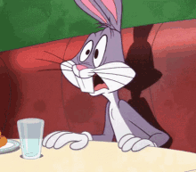
How much product will there be?
Lever Rule on tie line:
250 mol/min
F_{stream 4} (7.5 cm) = F_{stream 3} (0.5 cm)
F_{stream 4} (7.5 cm) =
(350 - F_{stream 4}) (0.5 cm)
22 mol/min
F_{stream 4} =22 mol/min
of product
This is less than 35 mol/min!
0.5 cm
F_{stream 3}
F_{stream 4}
7.5 cm

Slide 20

How do we get at least 35 mol/min?
What if I introduce aniline more than once? That is, I use more than one separator?

Slide 21
How do we get at least 35 mol/min?
hexane-rich product

Slide 22
Goals:
75% hexane
Final flow rate of 35 mol/min
First:
Mix input with 100% aniline at a smaller flow rate to move equilibrium line “up”
Then:
Mix hexane rich stream with
100% aniline again and repeat process!

Slide 23
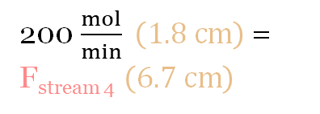
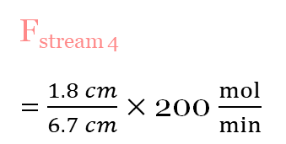
Lever Rule for first separator tie line:
hexane-poor liquid
aniline
146 mol/min
100 mol/min
3
1
liquid-liquid
Total flow rate
2
separator
hexane-poor liquid
50 mol% hexane
52 mol/min
50 mol% mcp
hexane-rich liquid
6
200 $\frac{mol}{min} \left(1.8 cm\right)$ = F_{stream 4} $\left(6.7 cm\right)$
100 mol/min
54 mol/min
4
liquid-liquid
5
separator
aniline
75 mol% hexane
37 mol/min
39 mol/min
Total length
7
F_{stream 4}
= $\frac{1.8 cm}{6.7 cm}×$ 200 $\frac{mol}{min}$
1.8 cm
F_{stream 4} = 54 mol/min of hexane-rich liquid
F_{stream 4}
F_{stream 3}
6.7 cm

Slide 24

Goals:
75% hexane
Flowrate: 35 mol/min
hexane-poor liquid
aniline
146 mol/min
100 mol/min
3
100 mol/min
1
liquid-liquid
How much aniline into second separator?
2
separator
hexane-poor liquid
50 mol% hexane
52 mol/min
50 mol% mcp
hexane-rich liquid
6
100 mol/min
54 mol/min
4
liquid-liquid
5
separator
aniline
hexane rich
product
Lever Rule on mixing line:
F_{stream 5} (5.9 cm) =
54 $\frac{mol}{min}$ (4.0 cm)
37 mol/min
75 mol% hexane
39 mol/min
7
F_{stream 5}
= 37 mol/min of aniline to
2nd separator
F_{stream 4}
4.0 cm
5.9 cm
F_{stream 5}

Slide 25

Goals:
75% hexane
Flowrate: 35 mol/min
hexane-poor liquid
aniline
146 mol/min
100 mol/min
3
100 mol/min
1
liquid-liquid
2
separator
hexane-poor liquid
50 mol% hexane
52 mol/min
How much final product?
Lever Rule in second separator on tie line:
50 mol% mcp
hexane-rich liquid
6
100 mol/min
54 mol/min
4
liquid-liquid
5
separator
aniline
hexane rich
product
37 mol/min
75 mol% hexane
39 mol/min
7
(90 $\frac{mol}{min}$) (3.5 cm) =
F_{stream 7} (8.2 cm)
3.5 cm
F_{stream 7} = 39 mols/min hexane rich product
F_{stream 7}
F_{stream 6}
8.2cm

Slide 26
Did we meet our goals?
hexane-poor liquid
146 mol/min
aniline
3
100 mol/min
1
liquid-liquid
2
separator
hexane-poor liquid
50 mol% hexane
52 mol/min
50 mol% mcp
hexane-rich liquid
6
100 mol/min
54 mol/min
Yes!
4
liquid-liquid
separator
5
aniline
75 mol% hexane
37 mol/min
39 mol/min
7
Product stream of at least 35 mol/min
Product stream is at least 75% hexane
There is more than one solution…

Slide 27
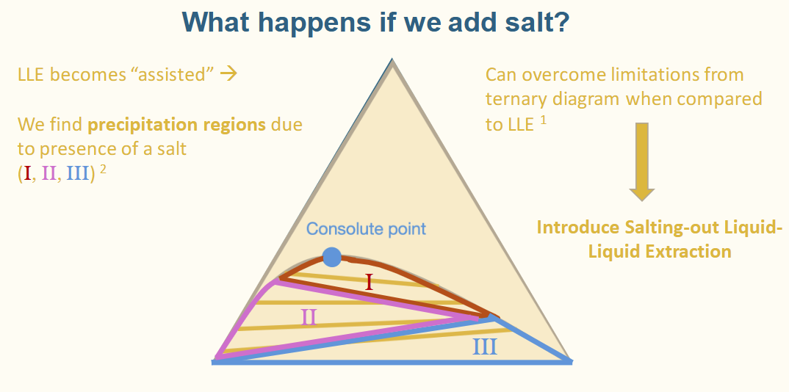
Fun fact
Kong, Amy, Sean, and Lara used ternary diagrams for our final separation presentation (SALLE)

Slide 28

Takeaways
Lever rule is very important!
  Applies to both mixing lines and tie lines
A series of separators can be more effective than a single separator
There may be more than one good design
Questions?

Slide 29


ChemE Merch Voting Form
Due: Sunday (10/26) at midnight
AIChE Sophomore Rep Interest Form
Due: Sunday(11/2) at midnight.

Slide 30


TA Evaluations

