Slide 1
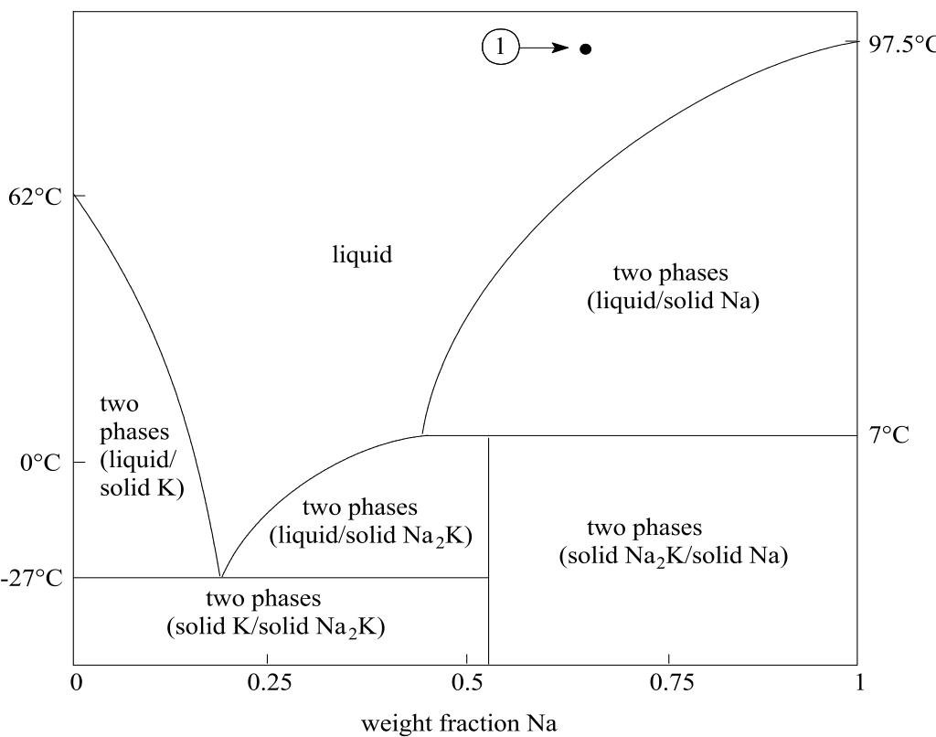
Exercise 4.92
Created by Dan Brown (‘10)
Revised by Colin Buss (‘11)
David Sroczynski (‘14) Alana Szkodny (‘14)
Katrina Curtiss (‘15)
McKenzie Hubert (‘16)
Robert Lee (‘17)
Ameer Basrai (‘18)
Rose Yin (‘19)
Michelle Quien (‘20)
Ann Metzloff (‘21)
Sarah Huang (‘22)
Leon Lee (‘23)
Austin Kwan (‘24)
Donovan Cho (’25)

Slide 2
Objectives
Maximize production of Na
Minimize number of units needed

Slide 3
Understand the Diagram
What are the units?
What do the regions mean?
Which regions are we interested in?

Slide 4
Phase Diagram for Na-K Mixtures
Axes ?
Which regions should we avoid?
Temperature (˚C)
Single Phase Regions?
Goal ?
weight fraction Na
Eutectic Point!
Pure Na

Slide 5
Phase Diagram for Na-K Mixtures
Which temperature in the liquid/solid Na region gives the highest flow rate of pure Na:
A, B, or C?
A ~ 62 ˚C
B ~ 50 ˚C
C ~ 7 ˚C
C!
Choose a temperature such that the tie line has the longest possible arm extending to the liquid border.

Slide 6
Phase Diagram for Na-K Mixtures
Check the compositions
3
~ 7°C
2
~44 wt% Na
Pure Na

Slide 7
Our Design
3
Na (44%)
K (56%)
Liq (no solid)
Can we get any more Na from this stream?
Na (65%)
K (35%)
Liq/solid
Separator
7 ˚C
1
Pure Na Product
2
Solid (no liq)
Success! We’ve produced pure Na!
But…
We also want to maximize our production of pure Na

Slide 8
Phase Diagram for Na-K Mixtures
Separate 3:
Again choose the temperature that maximizes the length of the tie line arm to the liquid border.
Product
3
2
5
4
What temperature?
Just above -27 ˚C
Liquid Na₂K,
~20 wt% Na
Solid Na₂K

Slide 9
The design so far:
5
Na (20%)
K (80%)
Liq (no solid)
3
Na (44%)
K (56%)
Separator -27 ˚C
Na (65%)
K (35%)
Liq/solid
Liq (no solid)
Separator
7 ˚C
Solid (no liq)
1
4
Na₂K
Pure Na Product
2
Solid (no liq)
What can we do with stream 4?
What can we do with stream 5?

Slide 10
Phase Diagram for Na-K Mixtures
Single phase region!
3
2
What about for stream 4?
5
4
If we lower the temperature of stream 5, can we separate it?
What if we raise the temperature?

Slide 11
Phase Diagram for Na-K Mixtures
Pure Na Product
3
2
5
4
Do we need to use a 3rd separator to treat stream 4?
No! Can reuse existing separators

Slide 12
The New Design
5
Na (20%)
K (80%)
Liq (no solid)
3
Na (44%)
K (56%)
Separator -27 ˚C
1
Na (65%)
K (35%)
Liq/solid
Liq (no solid)
Separator
7 ˚C
Solid (no liq)
4
Na₂K
purge
2
Pure Na Product
Solid (no liq)

Slide 13
Takeaway
The graphical skills we have learned can be applied to many different types of diagrams!
Eutectic points are difficult to deal with.

