Slide 1
Exercise 3.122 Prelim Review
Created by Liam Gillespie (‘26)

Slide 2
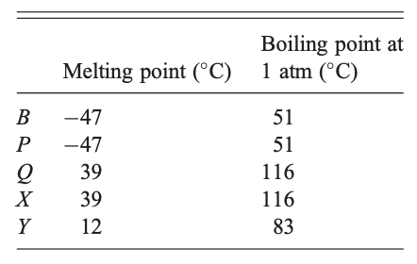
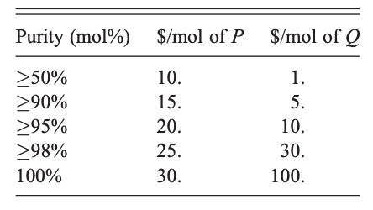

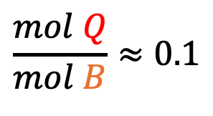

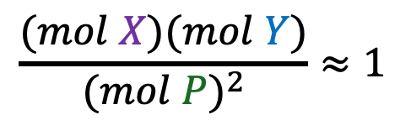

What are we given
Reactions
Reaction Kinetics
Example
$$\frac{mol Q}{mol B}≈0.1$$
$$B↔Q$$
$$11 mol B→10 mol B+1 mol Q$$
$$\frac{(mol X)(mol Y)}{{(mol P)}^{2}}≈1$$
$$2P↔X+Y$$
$$3 mol P→1 mol Y+1 mol X+1 mol P$$

Slide 3
Design Goals – In order of importance
Maximize revenue from selling P and Q at maximum quantity and purity
Minimize number of units
Minimize size of each unit
Design Constraints
No process unit may have a capacity larger than ~2000 mol/hr
Use 200. mol/hr of a 1:1 molar mixture of P and B
Hint: Production of pure Q is possible

Slide 4
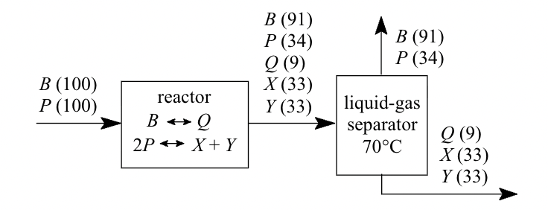
Starting Out
B and P are inseparable so…
B (91)
P (34)
Q (9)
X (33)
Y (33)
B (91)
P (34)
B (100)
P (100)
Q (9)
X (33)
Y (33)
The streams in this process are worthless
Key Idea: Let’s convert all the B and P to their products and separate from there
Add a Recycle
Notes:
For Complex problems like this it is beneficial to start with the first step of running the reactor once and seeing what the output is

Slide 5
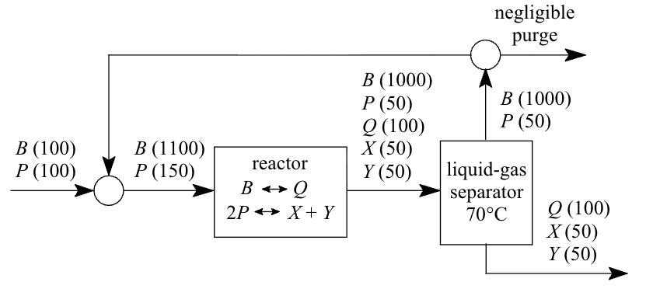
Next Step – Add a recycle
B (1000)
P (50)
B (1000)
P (50)
Q (100)
X (50)
Y (50)
B (1000)
P (50)
B (100)
P (100)
B (1100)
P (150)
Q (100)
X (50)
Y (50)
This design produces 100 mols Q at a 50% purity
This is $100 per hour of production
But we can do better…

Slide 6
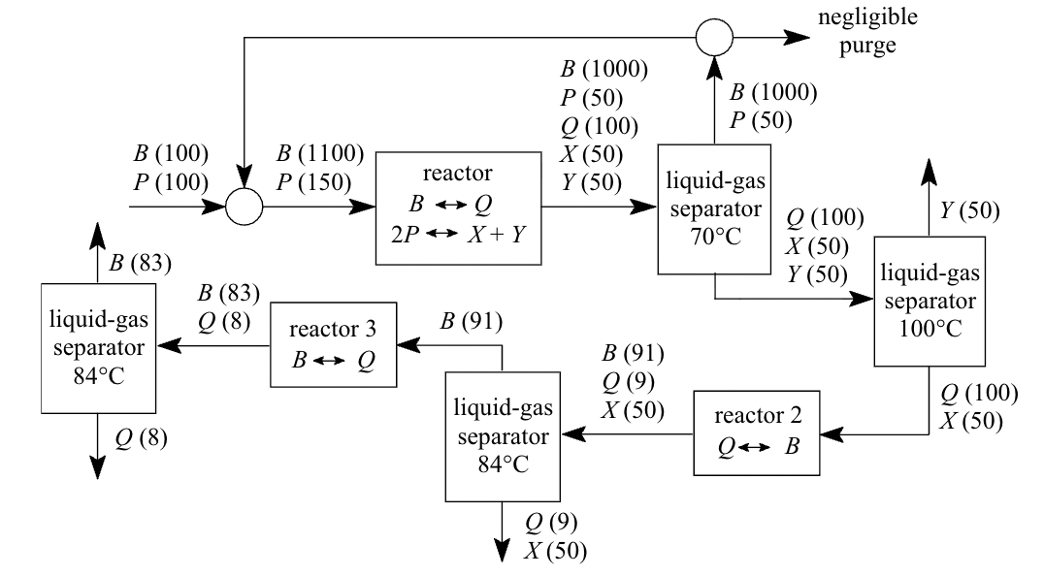
Let’s Make some pure Q
B (1000)
P (50)
B (1000)
P (50)
Q (100)
X (50)
Y (50)
B (1000)
P (50)
B (100)
P (100)
B (1100)
P (150)
Y (50)
Q (100)
X (50)
Y (50)
B (83)
B (83)
Q (8)
B (91)
B (91)
Q (9)
X (50)
Q (100)
X (50)
Q (8)
Q (9)
X (50)
Better… But, let’s increase Q Production with recycle loops

Slide 7
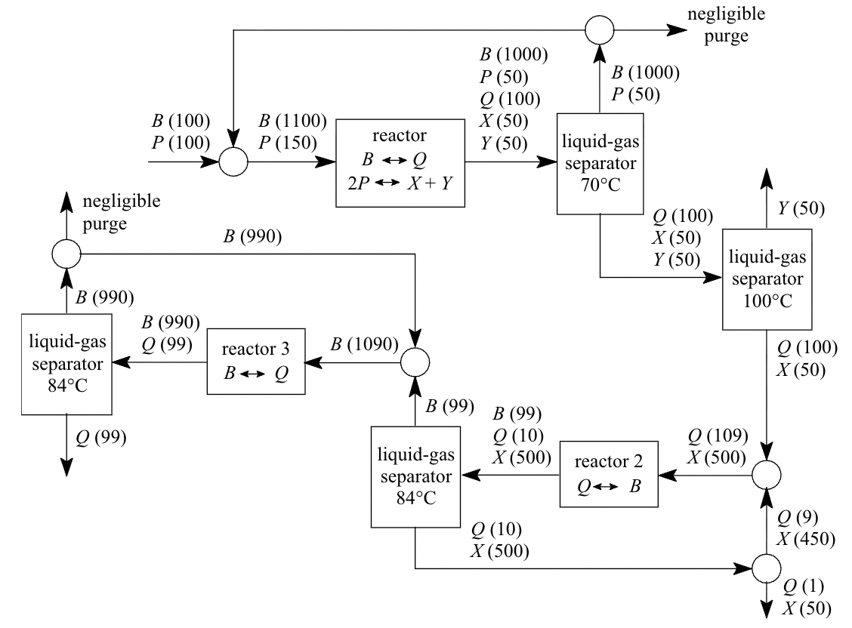
B (1000)
P (50)
B (1000)
P (50)
Q (100)
X (50)
Y (50)
B (1000)
P (50)
B (100)
P (100)
B (1100)
P (150)
Y (50)
Q (100)
X (50)
Y (50)
B (990)
B (990)
B (990)
Q (99)
B (1089)
Q (100)
X (50)
B (99)
B (99)
Q (10)
X (500)
Q (99)
Q (109)
X (500)
This Produces 99 mols of Q per hour which is $9900/hr.
Q (9)
X (450)
Now let’s do something with our X and Y
Q (10)
X (500)
Q (1)
X (50)

Slide 8
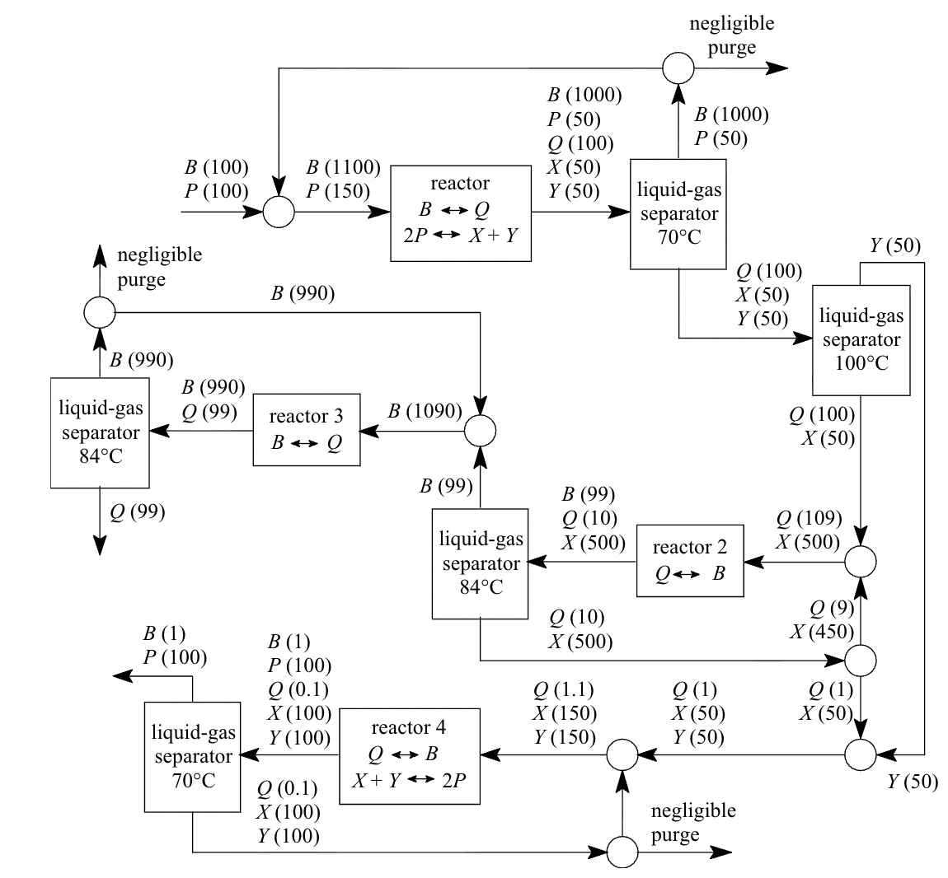
B (1000)
P (50)
B (1000)
P (50)
Q (100)
X (50)
Y (50)
B (1000)
P (50)
B (100)
P (100)
B (1100)
P (150)
Y (50)
Q (100)
X (50)
Y (50)
B (990)
B (990)
B (990)
Q (99)
B (1089)
Q (100)
X (50)
B (99)
B (99)
Q (10)
X (500)
Q (99)
Q (109)
X (500)
Amazing we did it!
Q (9)
X (450)
B (1)
P (100)
Q (10)
X (500)
B (1)
P (100)
Q (0.1)
X (100)
Y (100)
Q (1.1)
X (150)
Y (150)
Q (1)
X (50)
Y (50)
Q (1)
X (50)
Questions??
Q (0.1)
X (100)
Y (100)

Slide 9
Key Takeaways
Take your time to optimize your process but don’t worry about it being perfect
Try to plan out how you will separate one species from another
In reversable reactions, both products and reactants can be understood as different forms of each other; utilize this to separate inseparable species: P = X + Y and B = Q
Can anyone explain why we can’t make pure P?

