Slide 1
EngrD 2190 – Lecture 29
Concept: Dimensional Analysis and Dynamic Scaling
Context: Universal Scaling of Walking and Running
Defining Question: What is a core variable?
Read Chapter 5 pp. 436-447
The terminal velocity of a sphere.
Lecture 30 will follow the textbook.

Slide 2
Calculation Session Today
TA Panel on Pre-enrollment for Spring 2025
Prepare questions about the 4th semester
and the ChemE curriculum.

Slide 3
Dimensional Analysis and Dynamic Scaling
A Universal Correlation
for the Dynamics of Walking

Slide 4
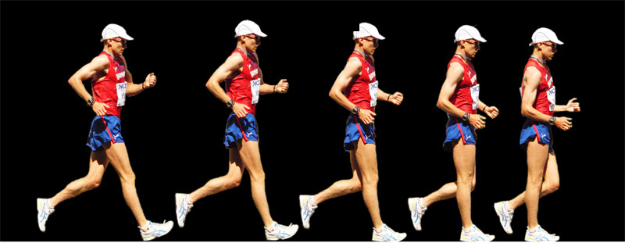
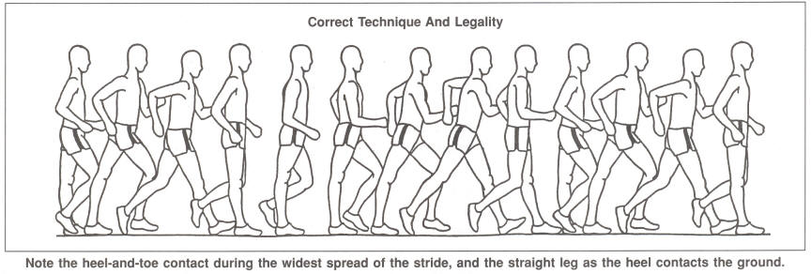
Race Walking

Slide 5
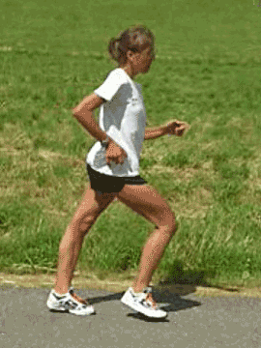
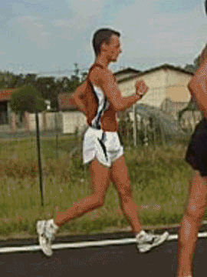
Race Walking

Slide 6
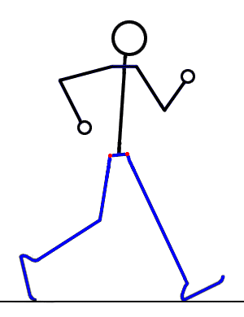
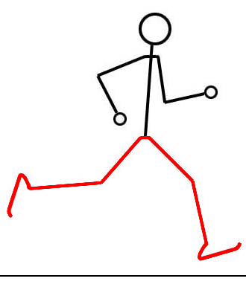
Race Walking vs. Running

Slide 7


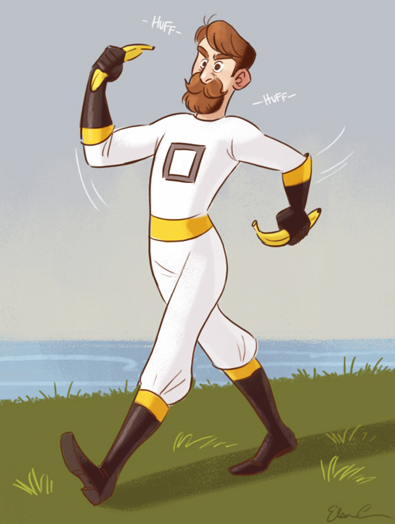
Power Walking

Slide 8
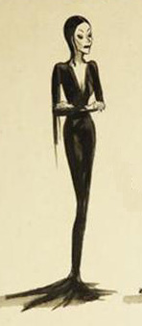
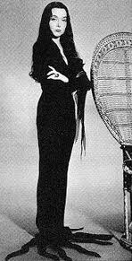
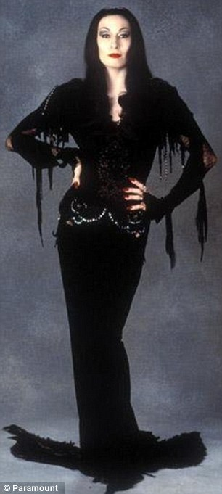
Short Strides

Slide 9

Long Strides

Slide 10
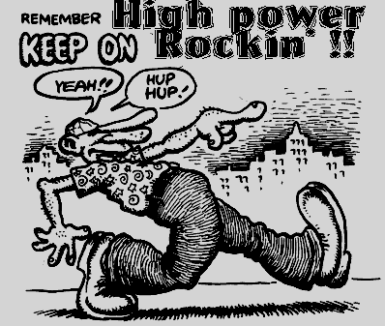
Long Strides

Slide 11
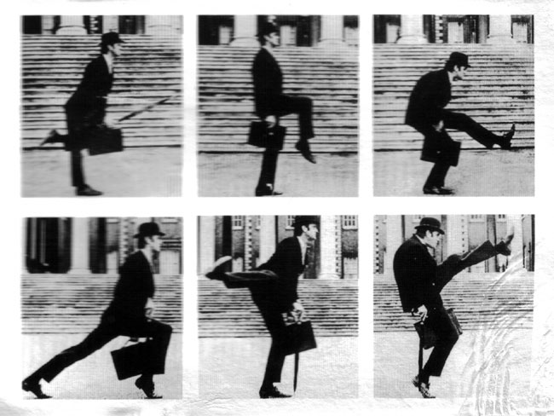
Silly Walking

Slide 12

Silly Walking
John Cleese, Andrew White Visiting Professor at Cornell, 1999-2006

Slide 13
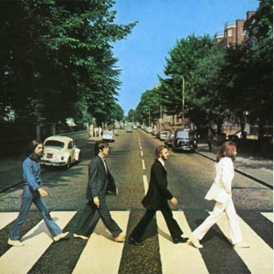
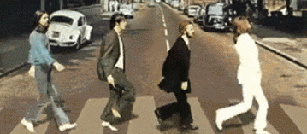
More Brits Walking

Slide 14
The Dynamics of Walking
Table 5.6 p. 432.
Parameter Symbol
Dimensions
velocity v
L/T
leg length 
L
mass m
M
gravity g
L/T²
stride s
L
stride
Goal: a function of the form: v = ƒ(, m, g, s)
[v] = L/T
Better Goal: a function of the form: constant = ƒ(v, , m, g, s)
[constant] = (none)
We seek a dimensionless relation.

Slide 15
The Dynamics of Walking
Better Goal: a function of the form: constant = ƒ(v, , m, g, s) [constant] = (none)
Every term in this function will be dimensionless
Every term will have the general form:
Every term to be dimensionless, each dimension’s exponent must be zero.
Walking is independent of mass, like a pendulum.
2 equations, 4 unknowns ⇒ ∞ solutions.
Must set the values of two exponents.
The parameters that correspond to these two exponents will be our core variables.

Slide 16
The Dynamics of Walking
Choosing core variables.
person B
We seek a correlation like …
person A
person C
but there will be a different
line for each person.
Better: a universal correlation …
every person
and not velocity
and not stride
We choose velocity and stride for the core variables of walking.

Slide 17
The Dynamics of Walking
Deriving Dimensionless Groups (of Parameters)
First dimensionless group (of parameters): Π₁
aka ‘a pi group.’
Π₁ contains velocity ⇒ a = any non-zero number
Choose a = 1 for convenience.
Π₁ does not contain stride ⇒ e = 0
Substitute a = 1 into Time exponent:
Substitute a = 1, d = −½ , e = 0 into Length exponent:
Fractional exponents are inconvenient.
We could have chosen a = 2, which would yield −

Slide 18
The Dynamics of Walking
Deriving Dimensionless Groups (of Parameters), continued.
Second dimensionless group (of parameters): Π₂
Π₂ contains stride ⇒ e = any non-zero number
Choose e = 1 for convenience.
Π₂ does not contain velocity ⇒ a = 0
Substitute a = 0 into the Time exponent:
Substitute a = 0, d = 0, e = 1 into the Length exponent:

Slide 19
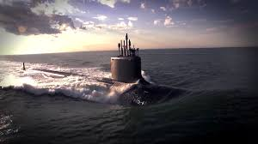
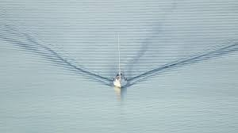
The Dynamics of Walking
Π₁ appears in dimensionless descriptions of other physical systems,
whenever forward motion causes something to be lifted in a gravitational field.
A body rises between strides.
A ship creates a bow wave.
William Froude first used this dimensionless
group to characterize ship efficiencies.
Π₁ = v²/(g) is called the “Froude Number”
“Froude” rhymes with food, not cloud.

Slide 20
The Dynamics of Walking - Summary
constant = ƒ(v, , m, g, s)
dimensional analysis
v²/(g) = Fr is called the “Froude Number.”
s/ is not named for anyone. s/ is called ‘reduced stride.’
To obtain the specific function, we must conduct experiments.

Slide 21
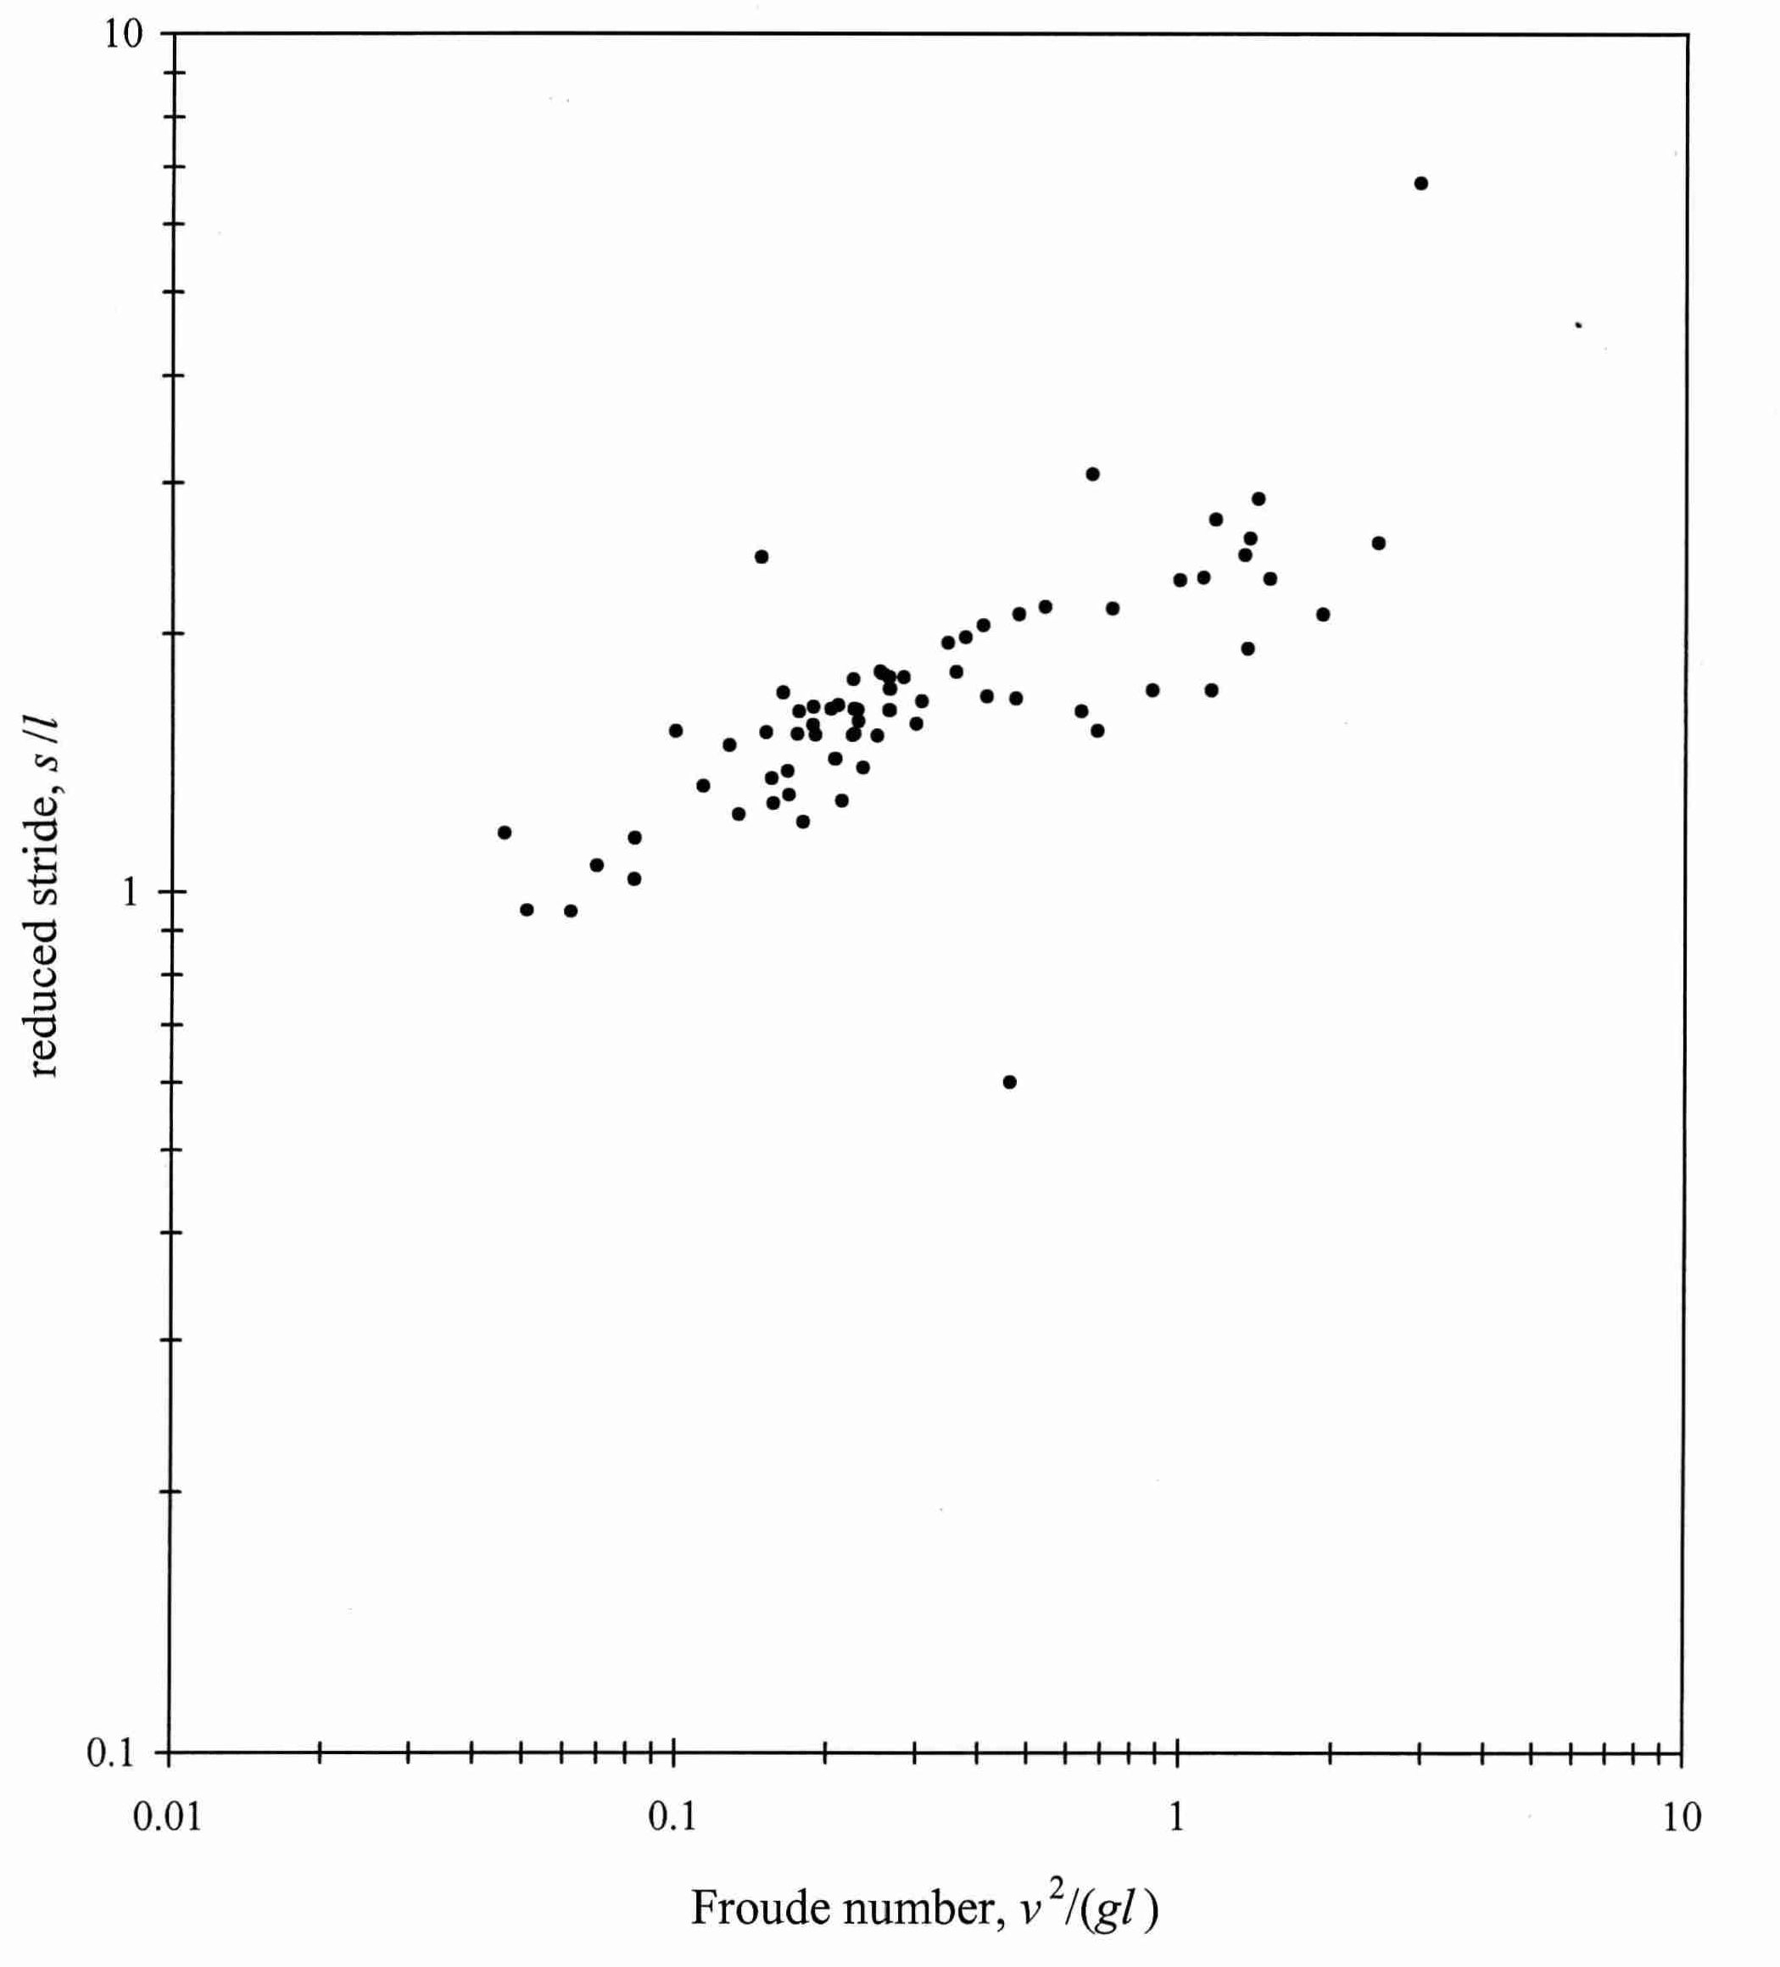
Experiments in Walking – EngrI 112, Fall 1994

Slide 22
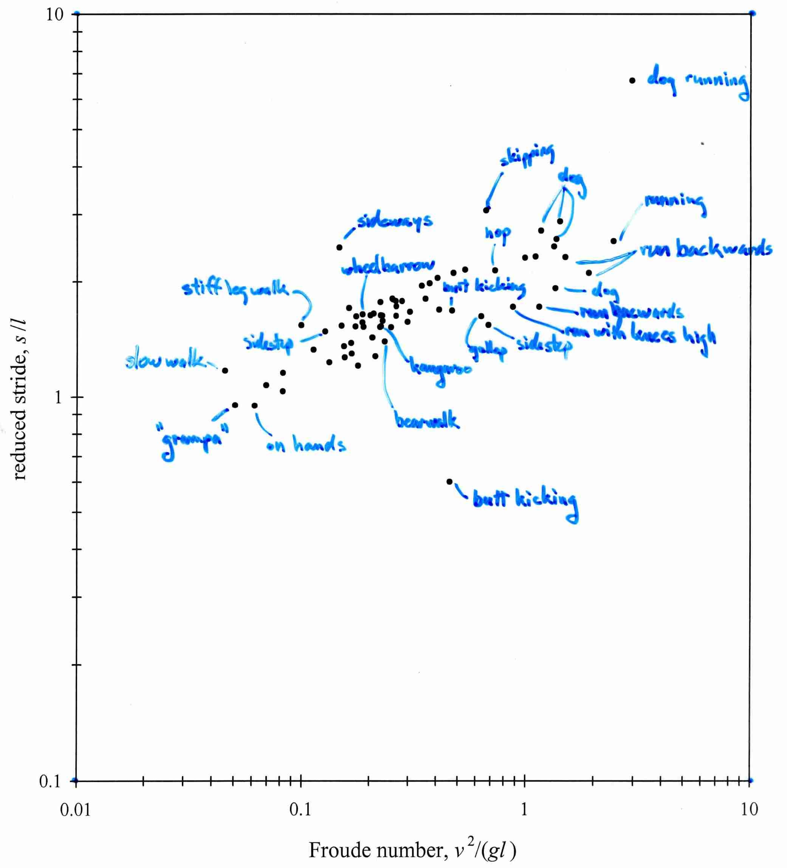
Experiments in Walking – EngrI 112, Fall 1994
Includes freshmen that are now
professors of chemical engineering:
Deborah Kaufman (Purdue)
Margot Vigeant (Bucknell)
Anand Asthagiri (Northeastern)

Slide 23
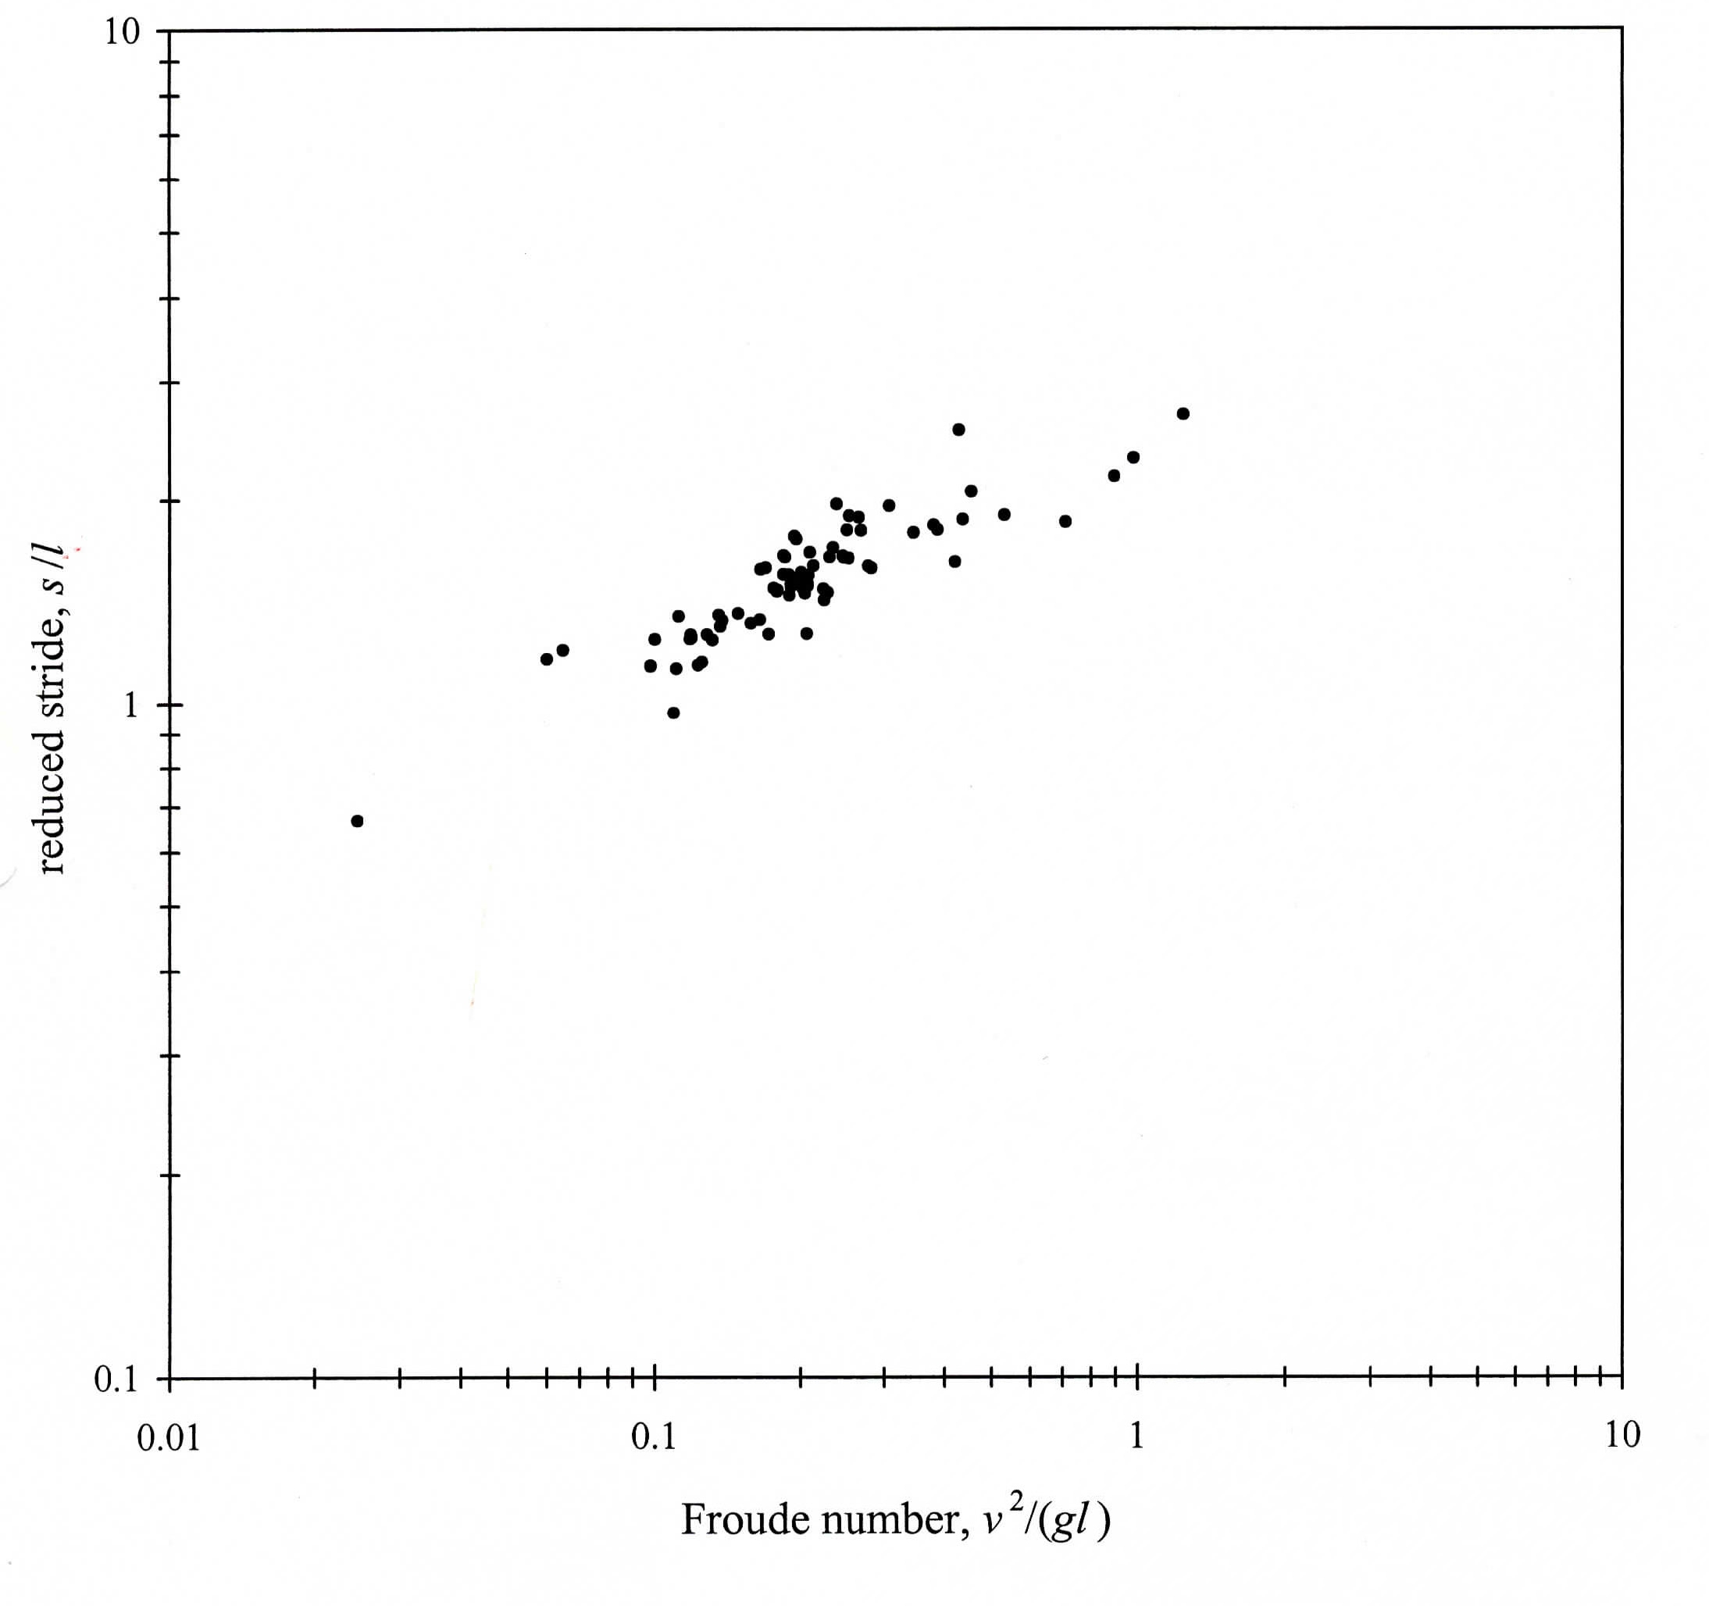
Experiments in Walking – EngrI 112, Fall 1995

Slide 24
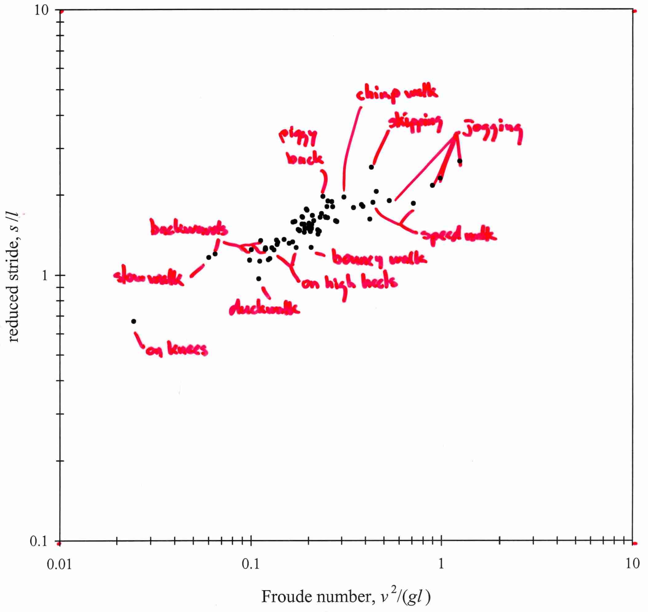
Experiments in Walking – EngrI 112, Fall 1995
Includes freshmen that are now professors:
Julie Goddard (Food Science - Cornell)
Peter Woolf (ChemE - Michigan)
Sean Holleran (ChemE - Penn)
Peter Adams (CEE - Carnegie Mellon)

Slide 25
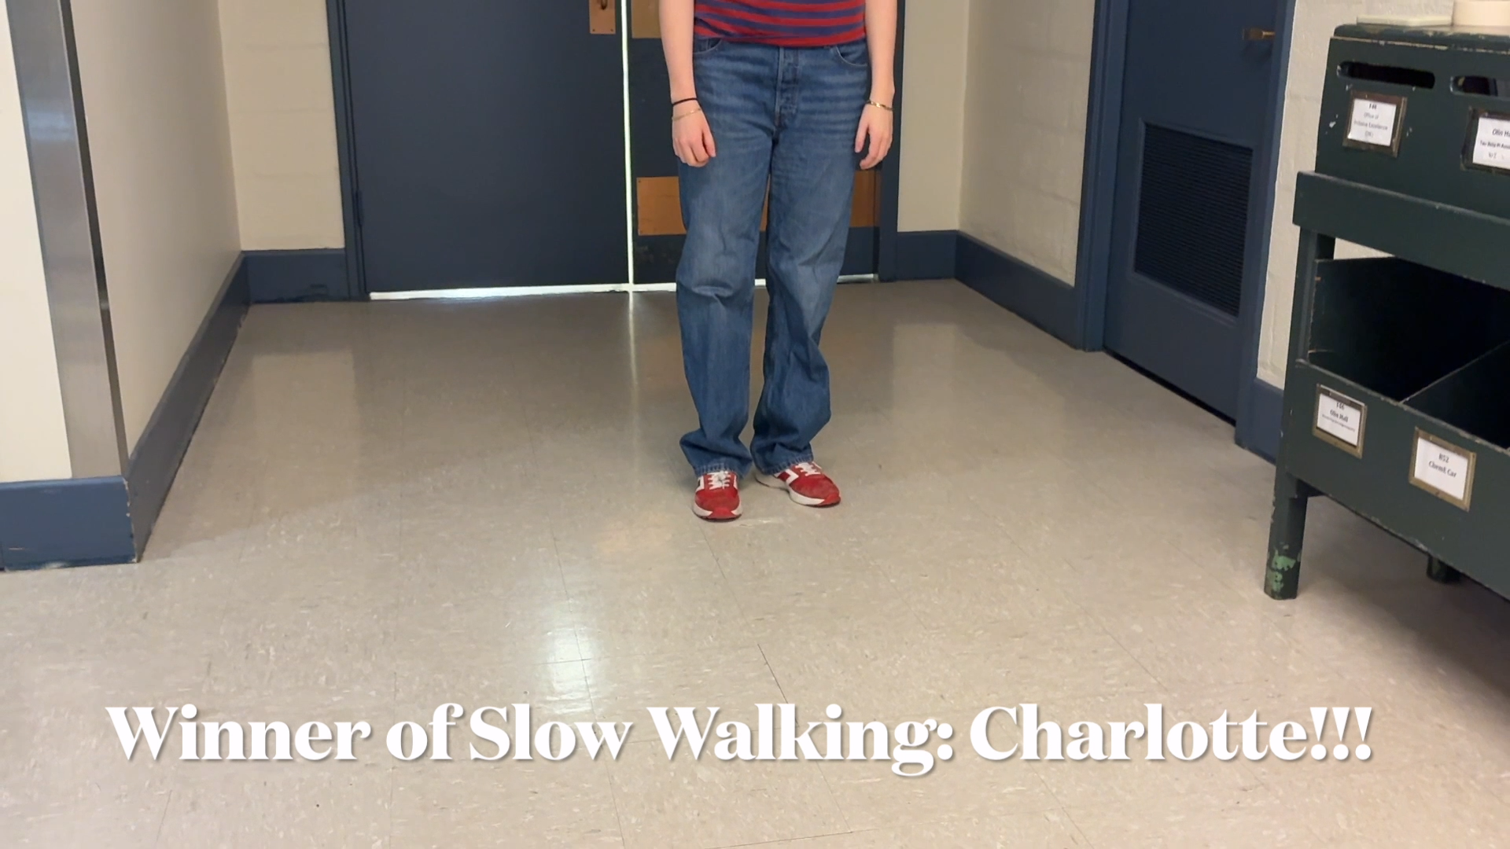
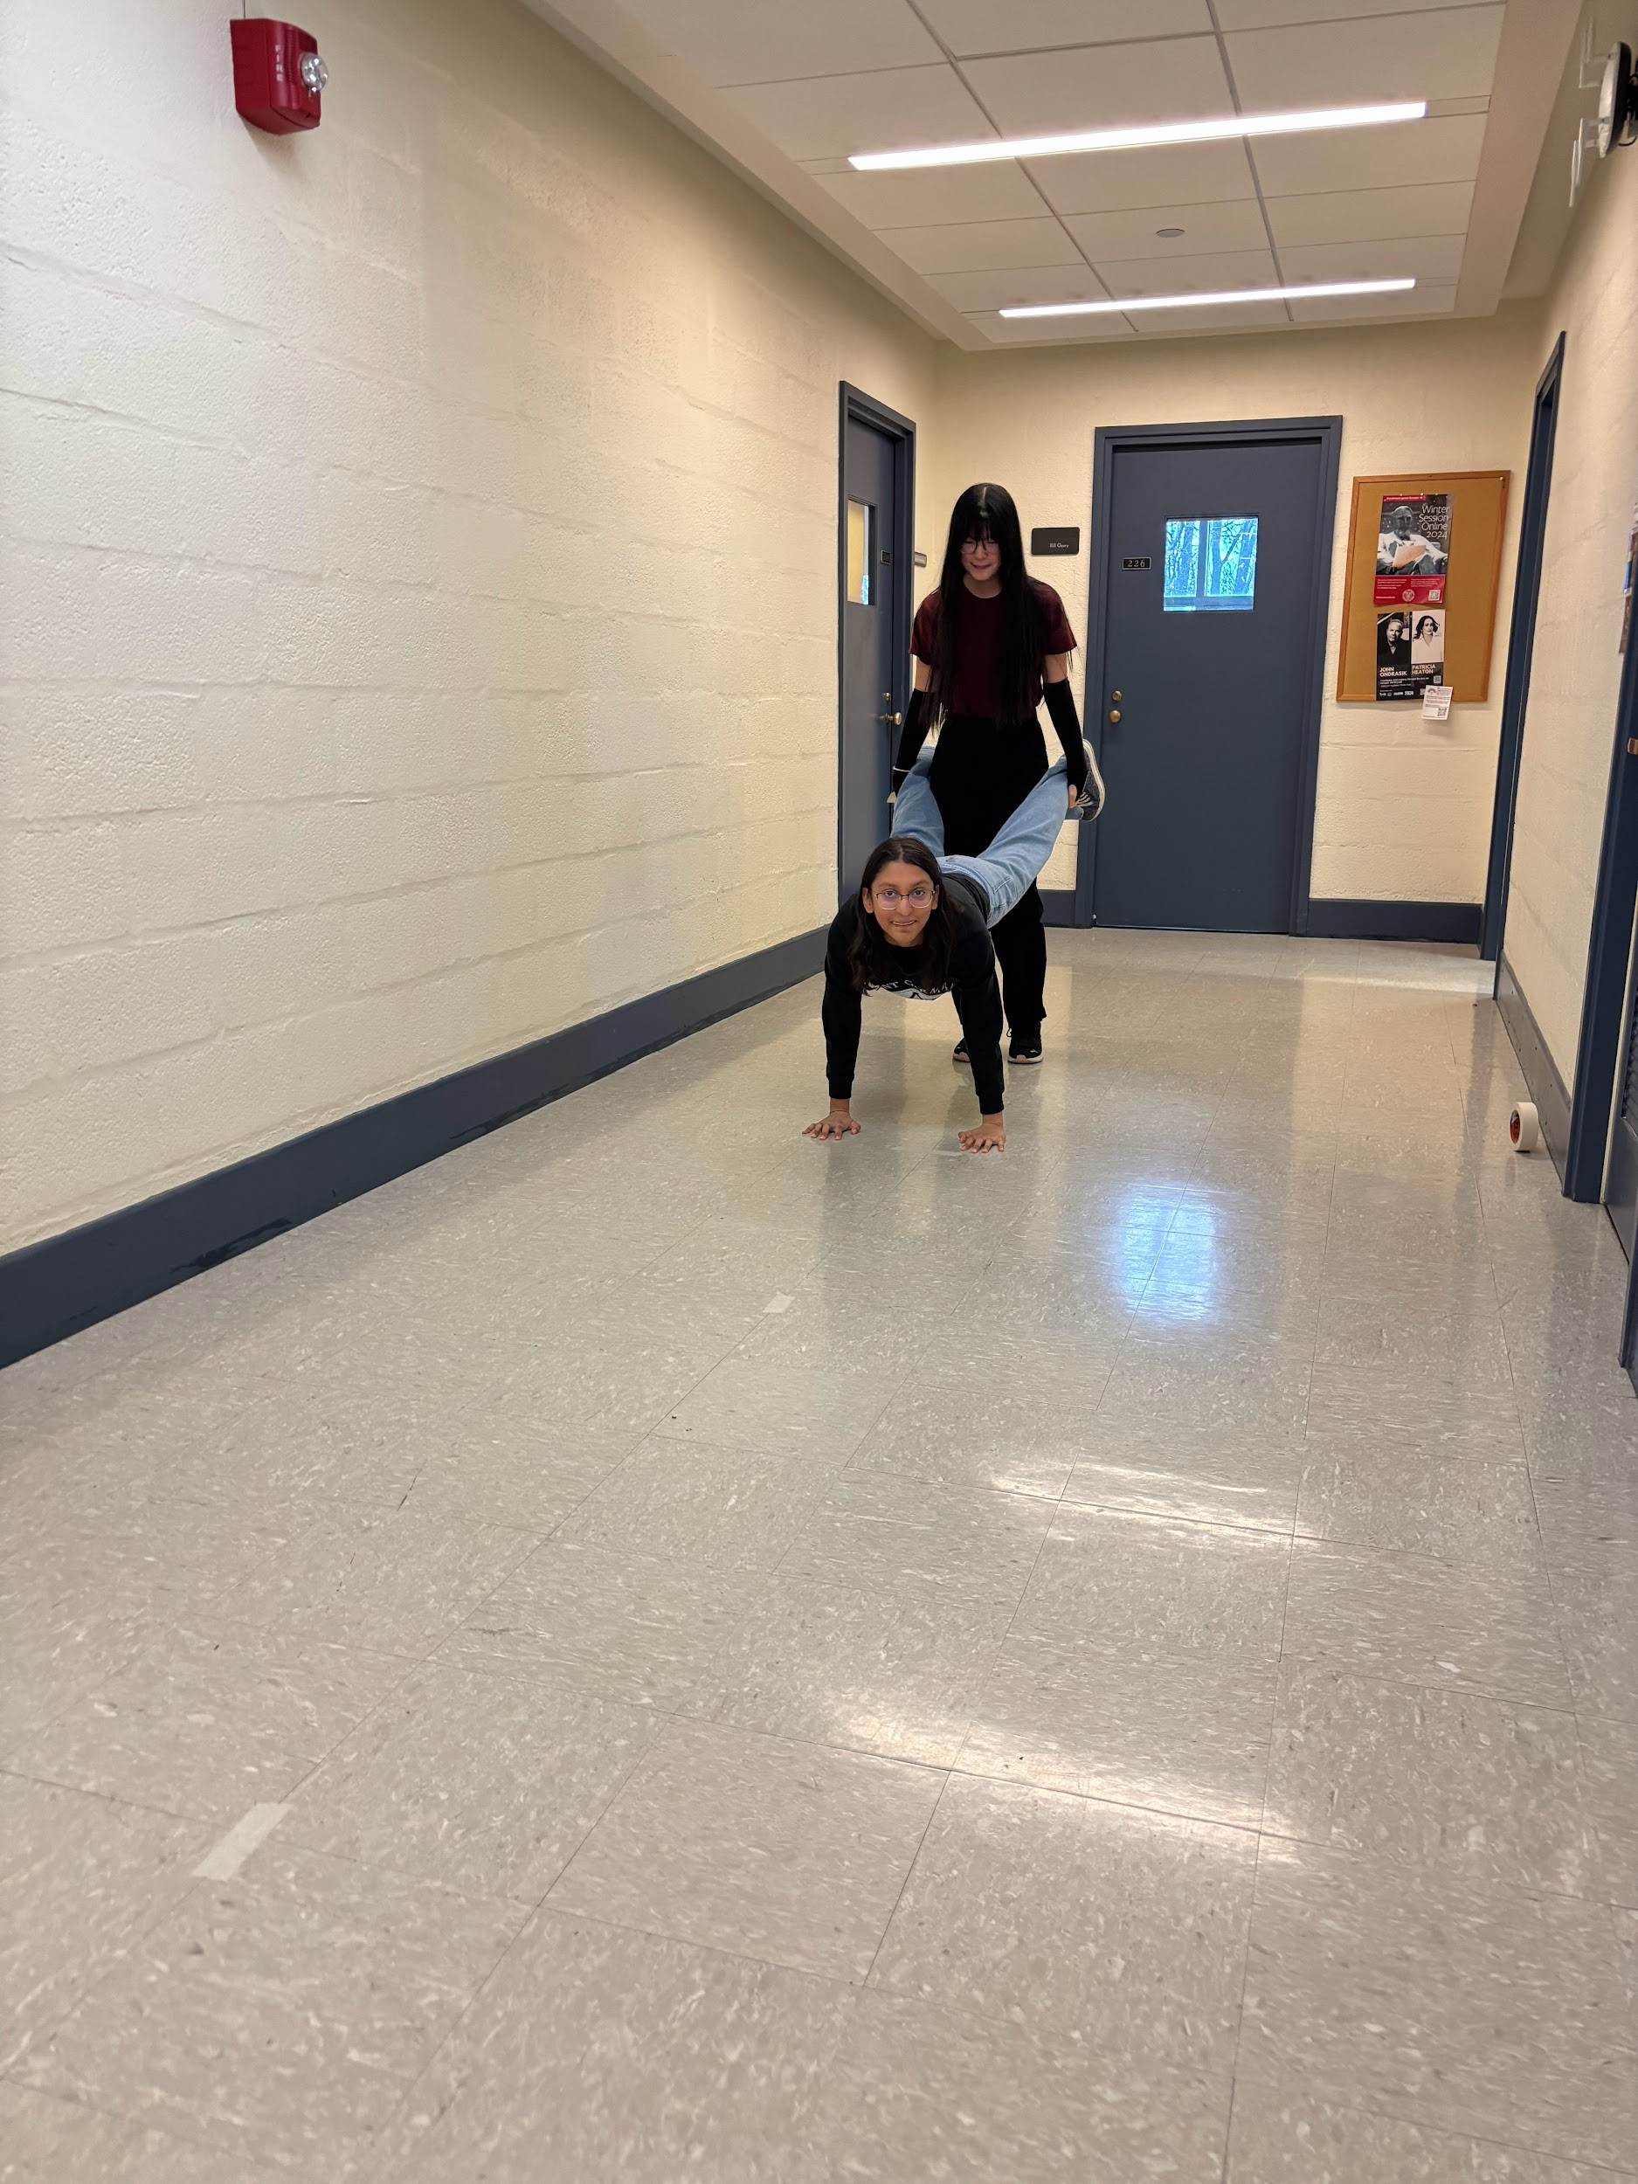
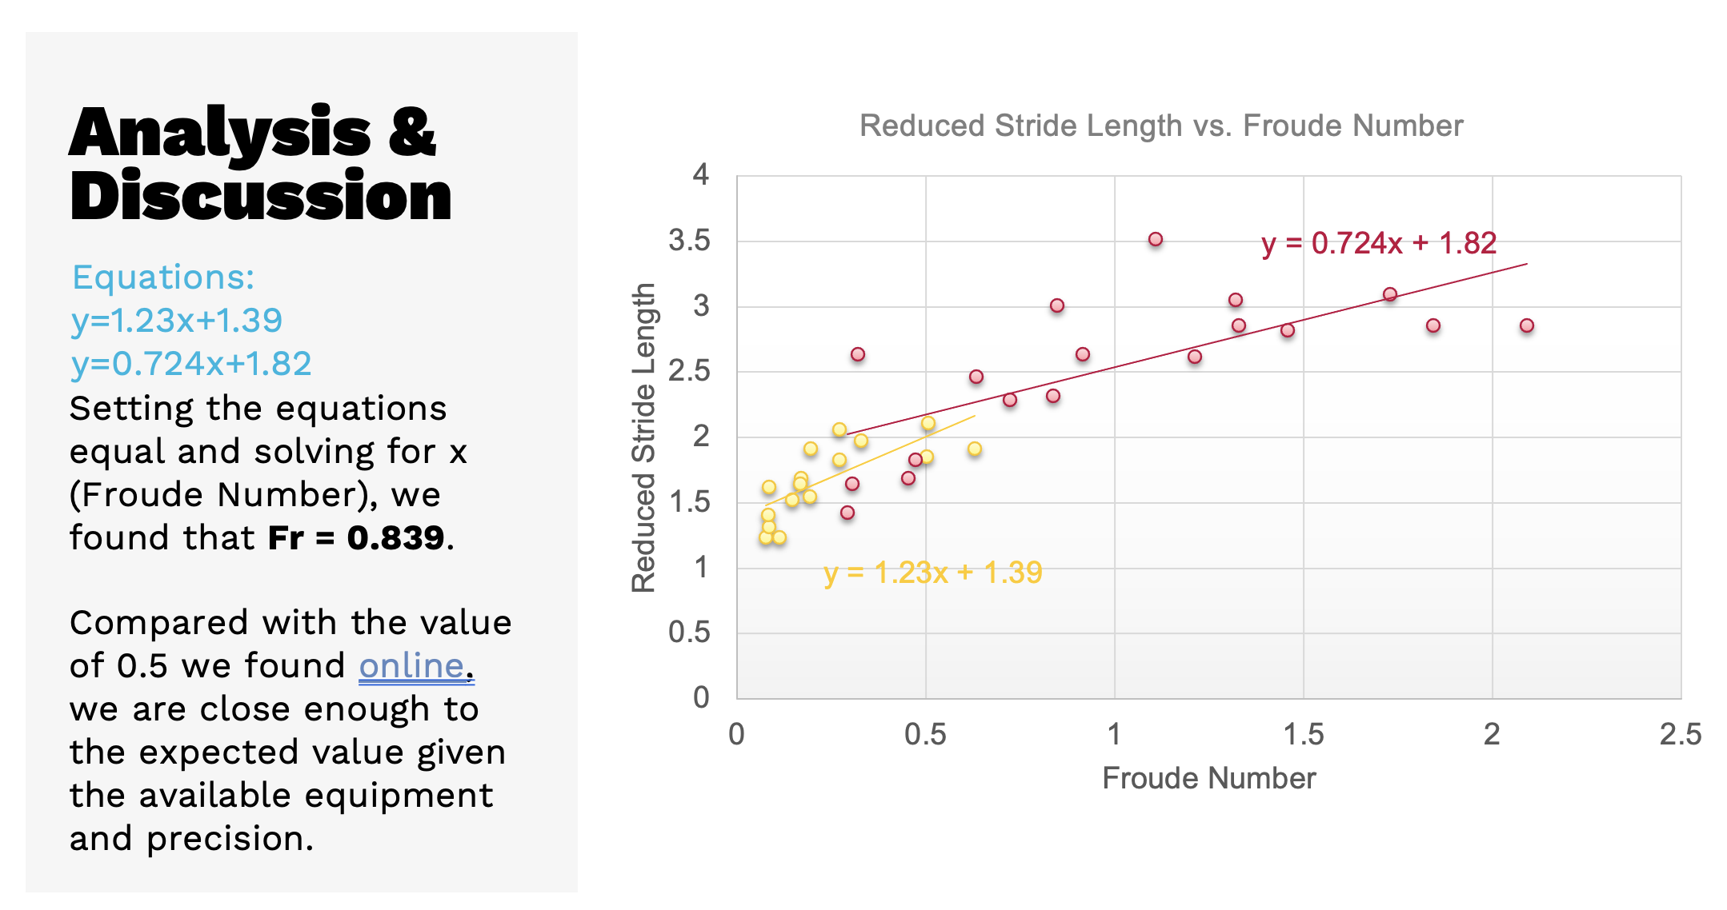
Dynamic Scaling Experiential Module - 2024

Slide 26
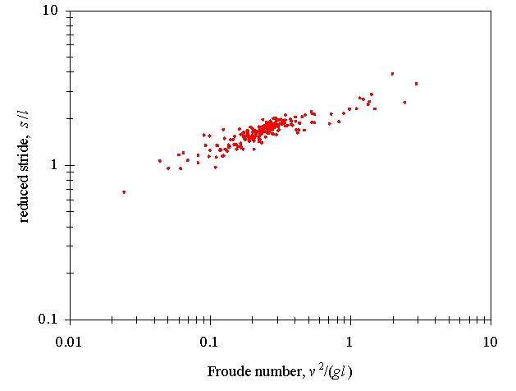
Experiments in Walking – Freshmen in EngrI 112, 1994 - 95

Slide 27
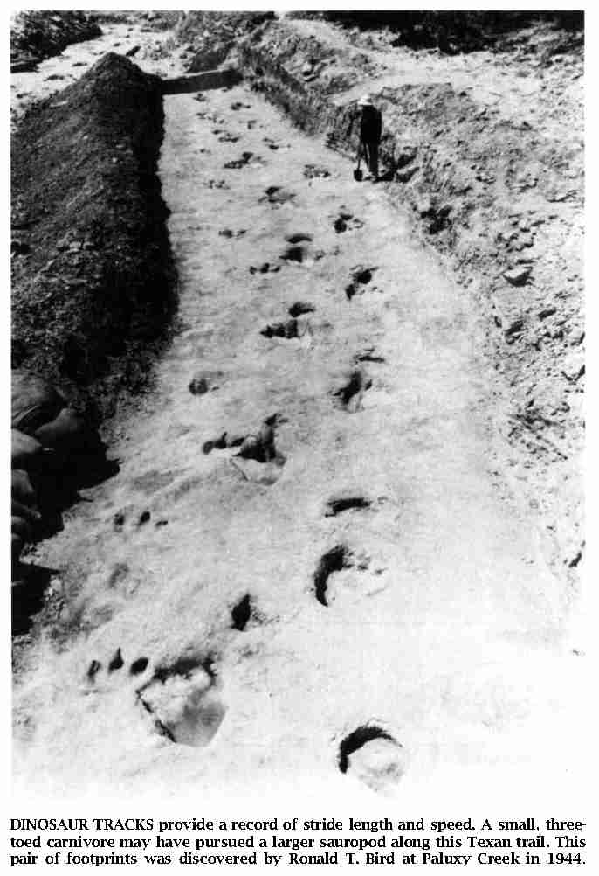
“How Dinosaurs Ran”
R. N. Alexander, Scientific American, April 1991.

Slide 28
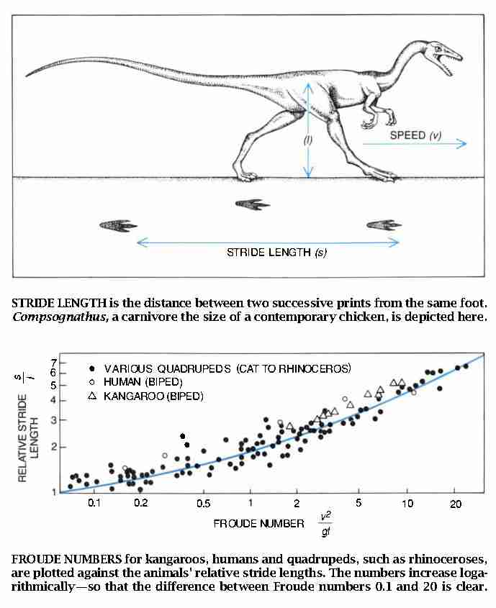
“How Dinosaurs Ran”
R. N. Alexander, Scientific American, April 1991.

Slide 29
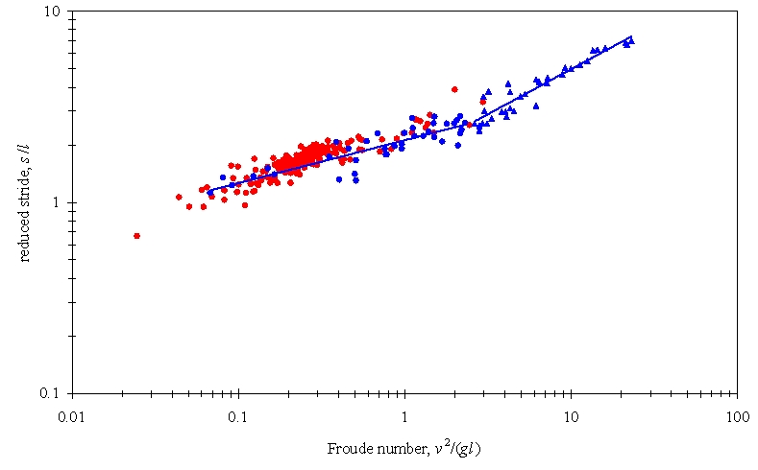
Experiments in Walking
Freshmen in EngrI 112 – Fall 1994-95 (bipeds)
Alexander’s data (quadrupeds)

Slide 30
Experiments in Walking
Freshmen in EngrI 112 – Fall 1994-95 (bipeds)
Alexander’s data (quadrupeds)
bipeds running
quadrupeds galloping
bipeds walking
quadrupeds trotting
2.5

Slide 31
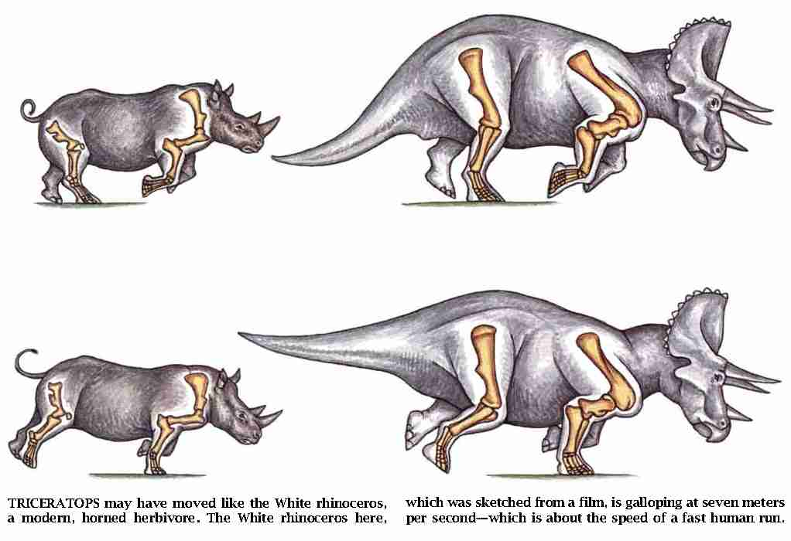
“How Dinosaurs Ran”
R. N. Alexander, Scientific American, April 1991.

Slide 32
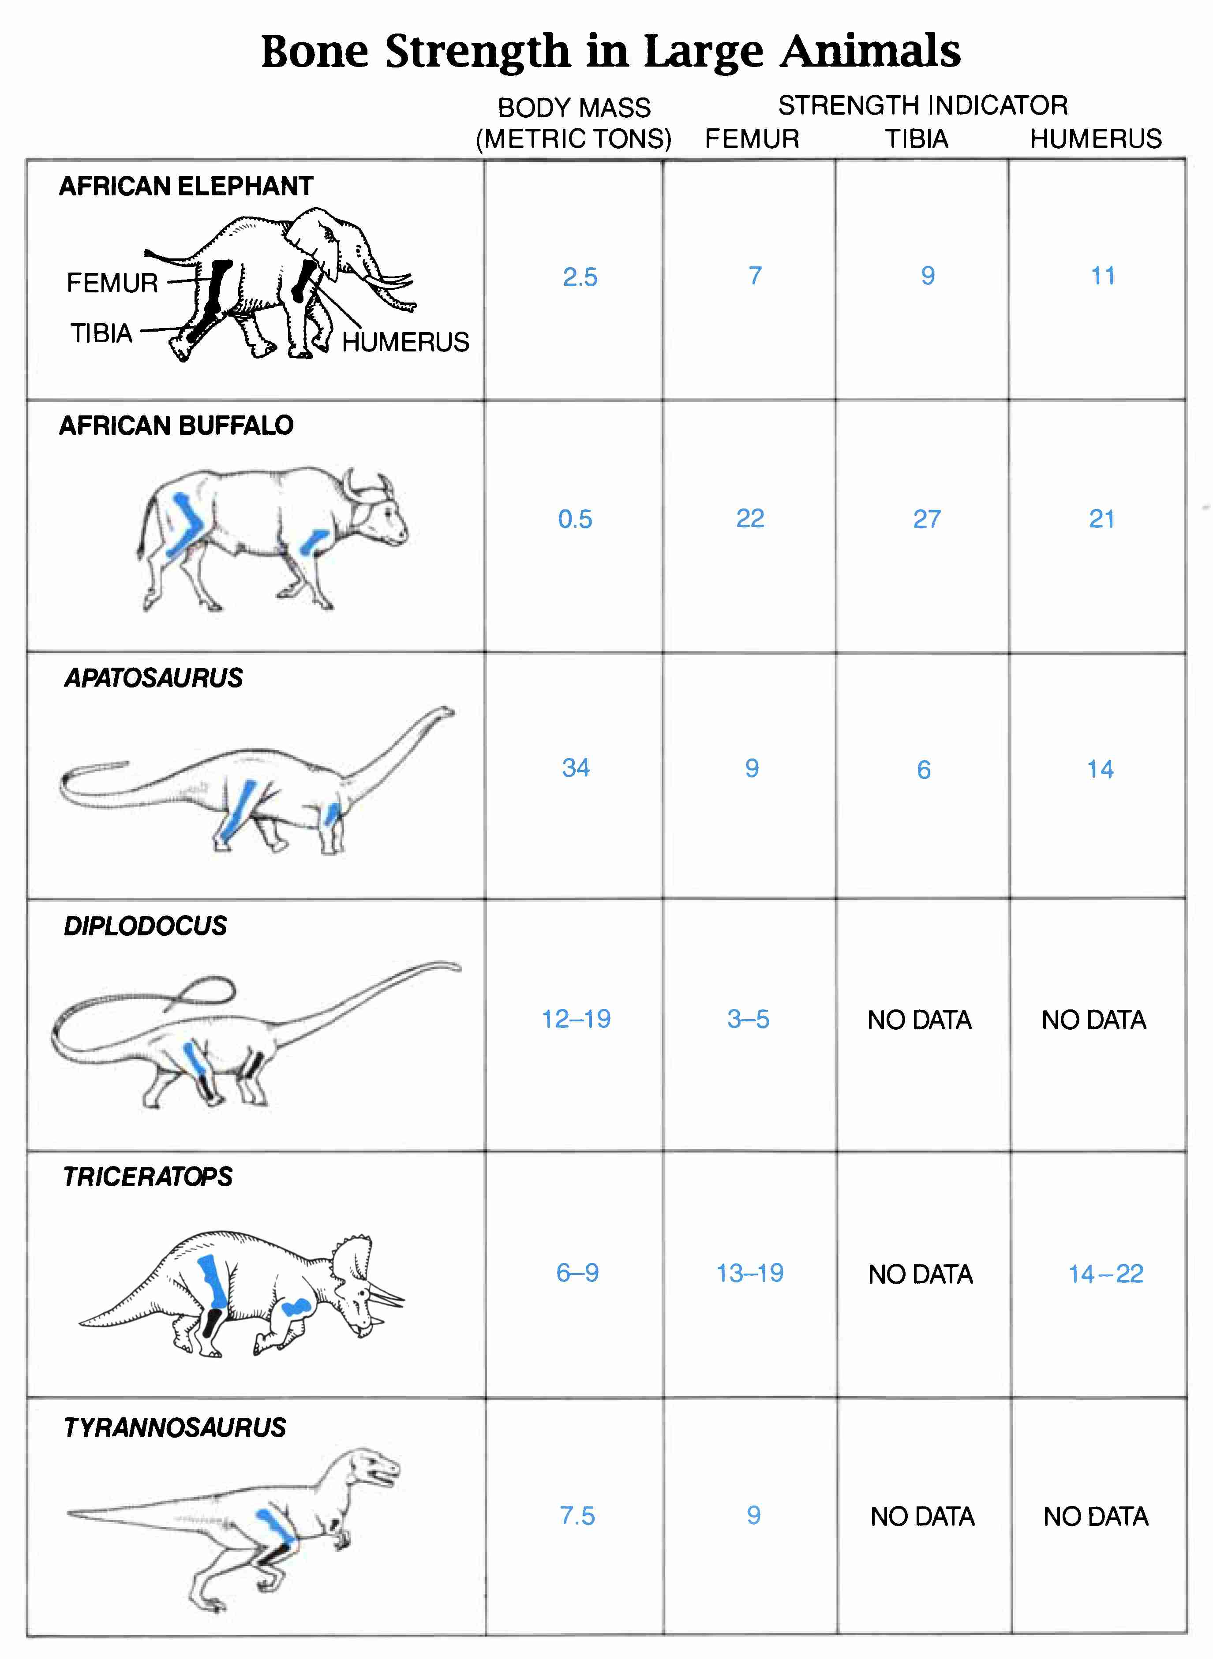
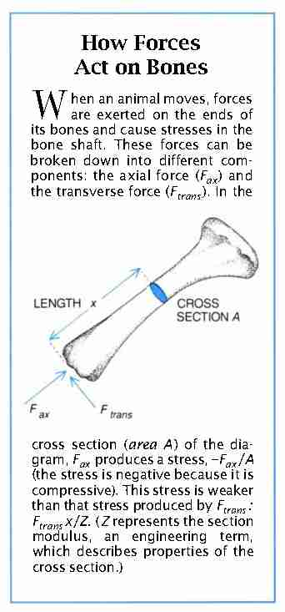
“How Dinosaurs Ran”
R. N. Alexander, Scientific American, April 1991.

Slide 33
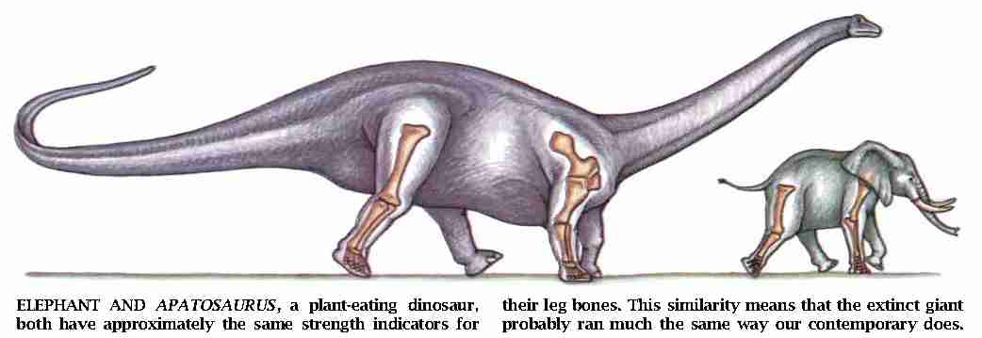
“How Dinosaurs Ran”
R. N. Alexander, Scientific American, April 1991.

Slide 34


Recommended reading in dynamic scaling.

