Slide 1
EngrD 2190 – Lecture 30
Concept: Dimensional Analysis and Dynamic Scaling
Context: Universal Scaling of the Terminal Velocity of a Sphere
Defining Question: What is the most famous dimensionless Group?
Read Chapter 5 pp. 447-454
Dynamic Similarity – How to Design a Model

Slide 2
Homework
• Homework 8 due today at noon.
Write team code and names of all contributing team members on all solutions.
Indicate this week’s Team Coordinator.
Submit after lecture or deliver to the EngrD 2190 mailbox in a cabinet in the
hallway outside 116 Olin Hall (ChemE Business Office). Not to my mailbox.
• Homework 9 (the last homework) due Friday 11/21.
5.12 deriving Pi groups
5.26 & 5.31 analysis with dimensionless correlations.
Homework is your chief means of assessing your command of the material.

Slide 3
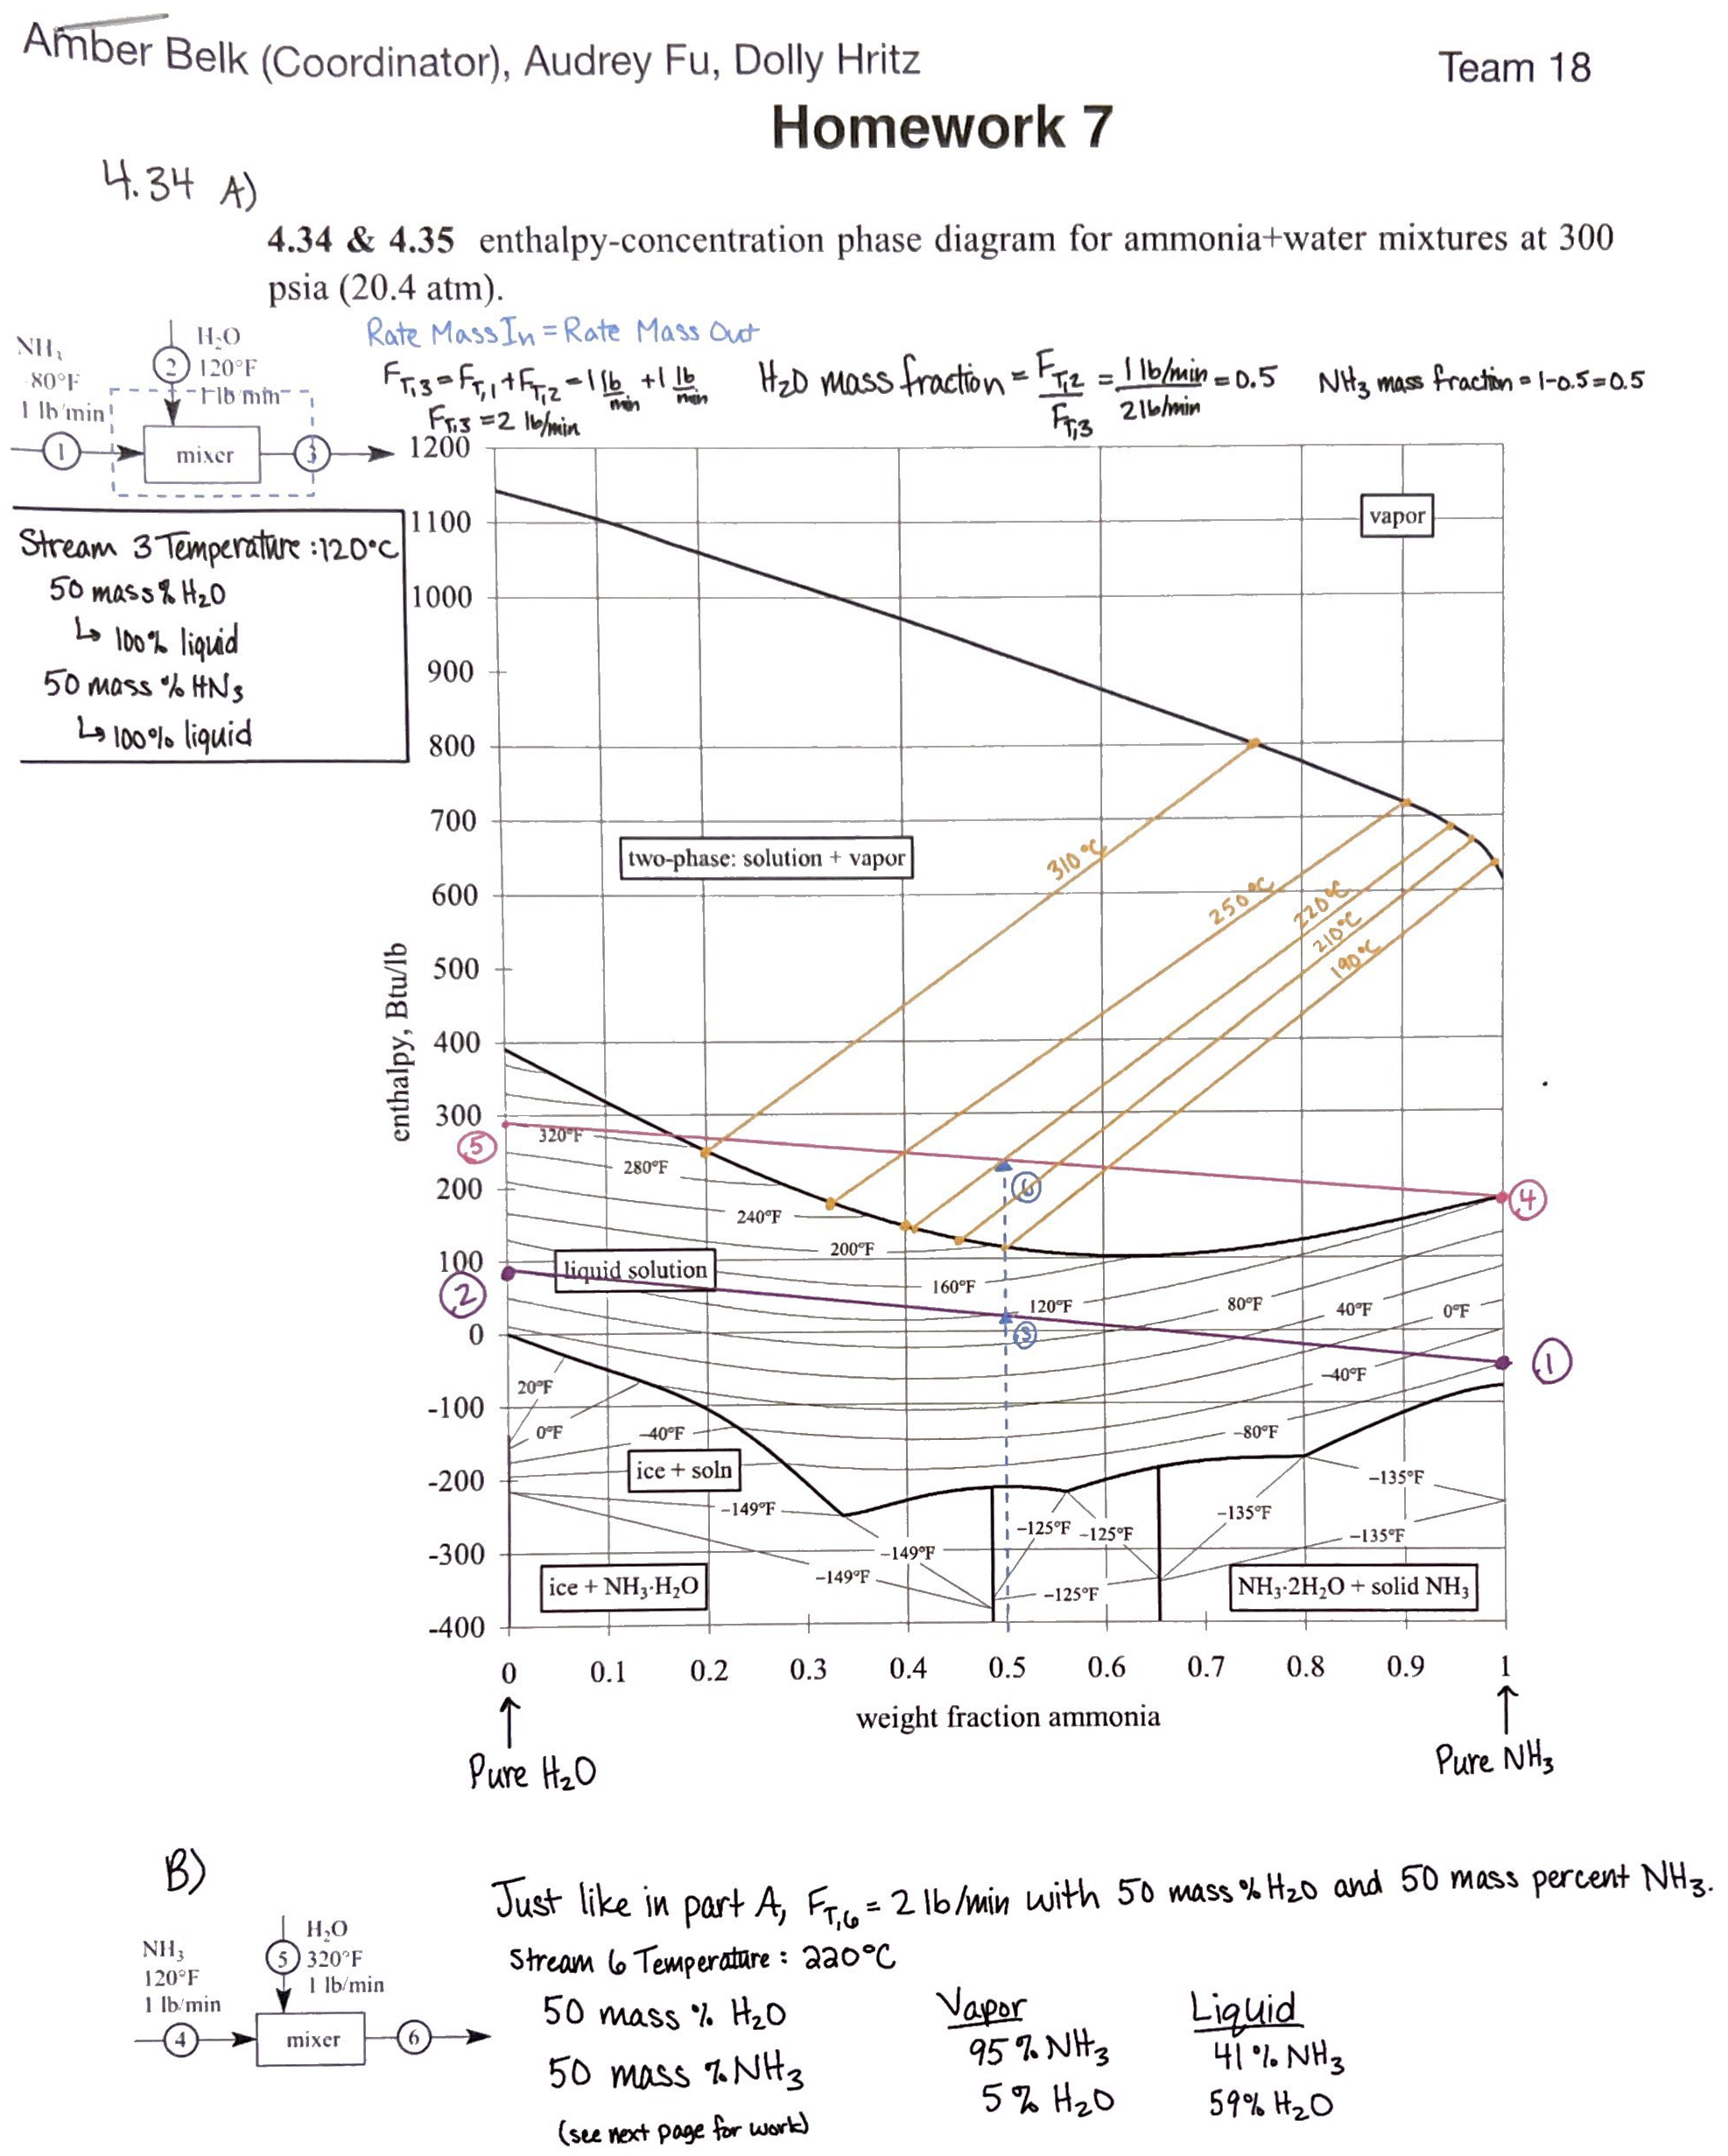
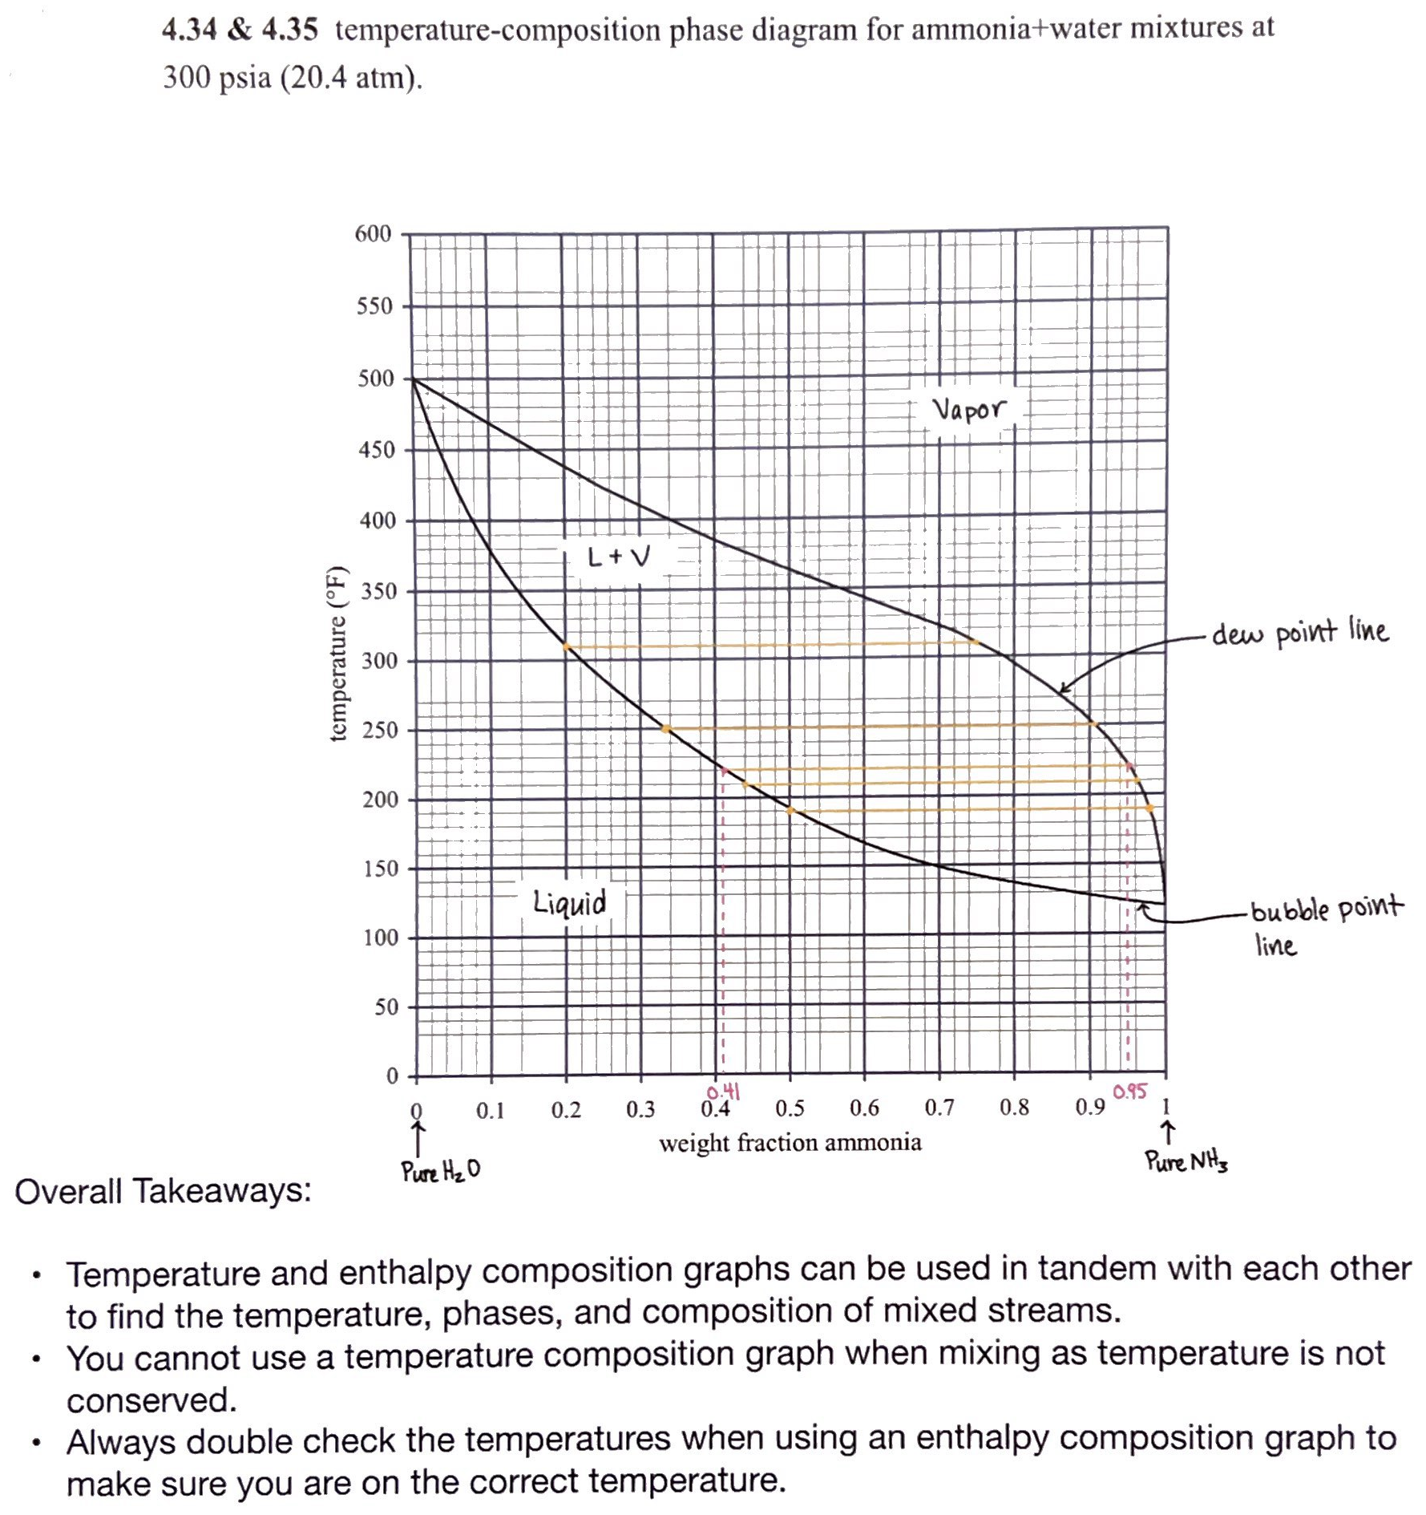
Homework 7 Excellence – Exercise 4.34 – Team 18
Honorable
Mention to Teams
3, 4, 6, 10, 19, and 23

Slide 4
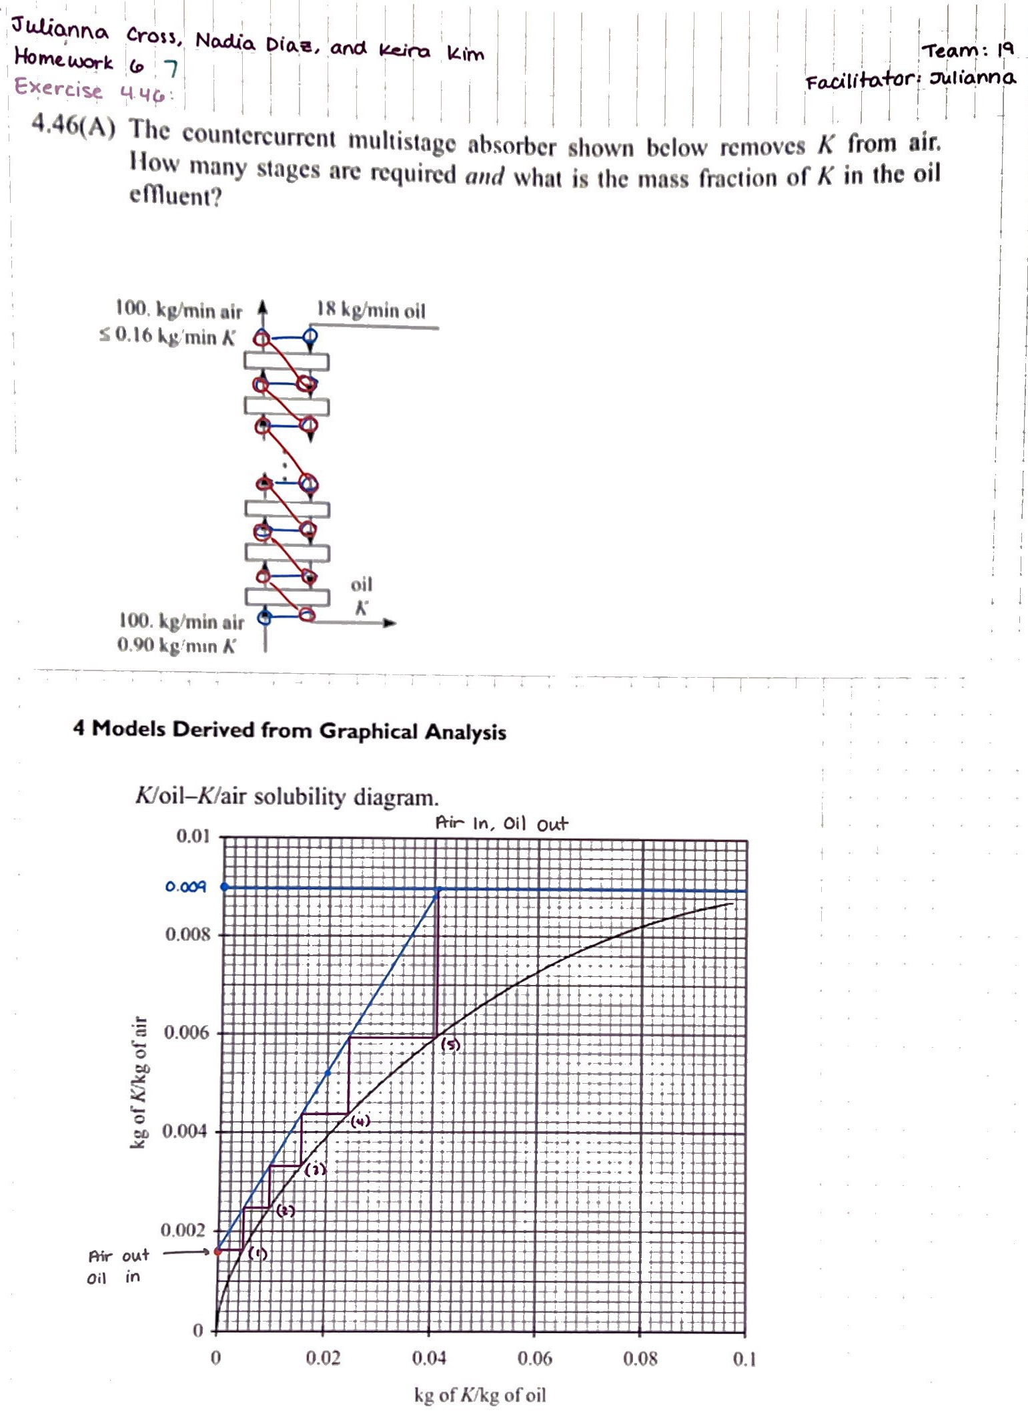
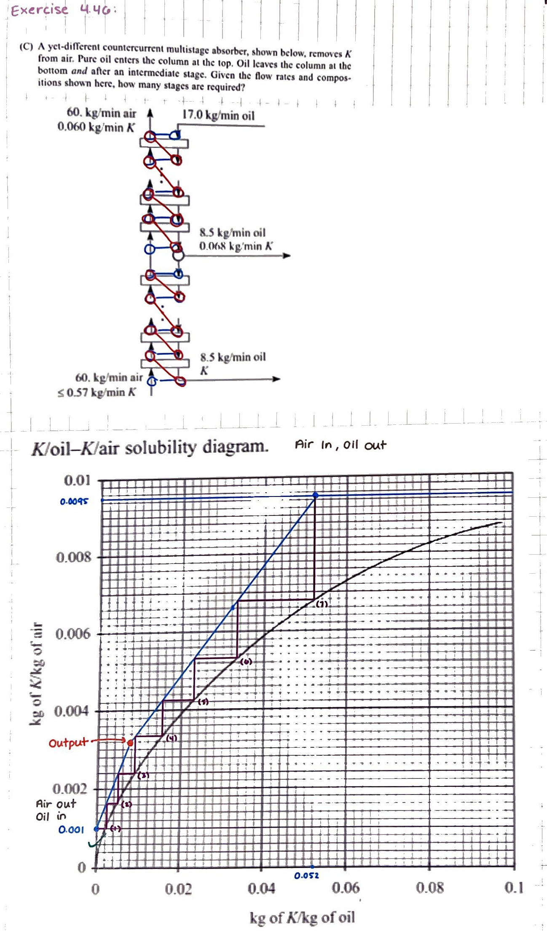
Homework 7 Excellence – Exercise 4.46 – Team 19
Honorable
Mention to 18(!) Teams
with perfect scores!

Slide 5
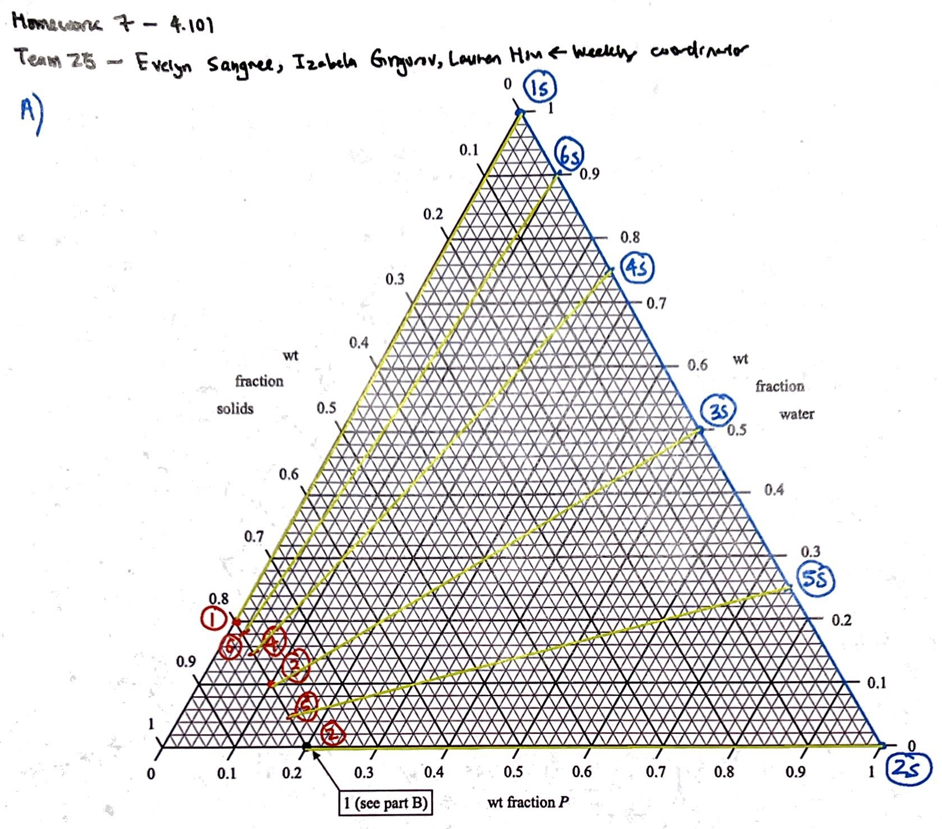
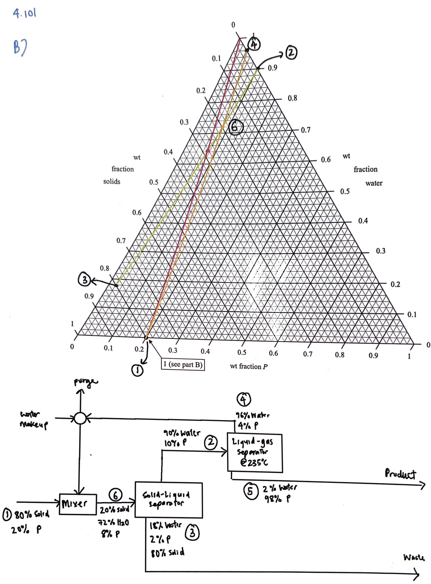
Homework 7 Excellence – Exercise 4.101 – Team 25
Honorable
Mention to Teams
11, 15, 16, 18, 19, 23, and 26.

Slide 6
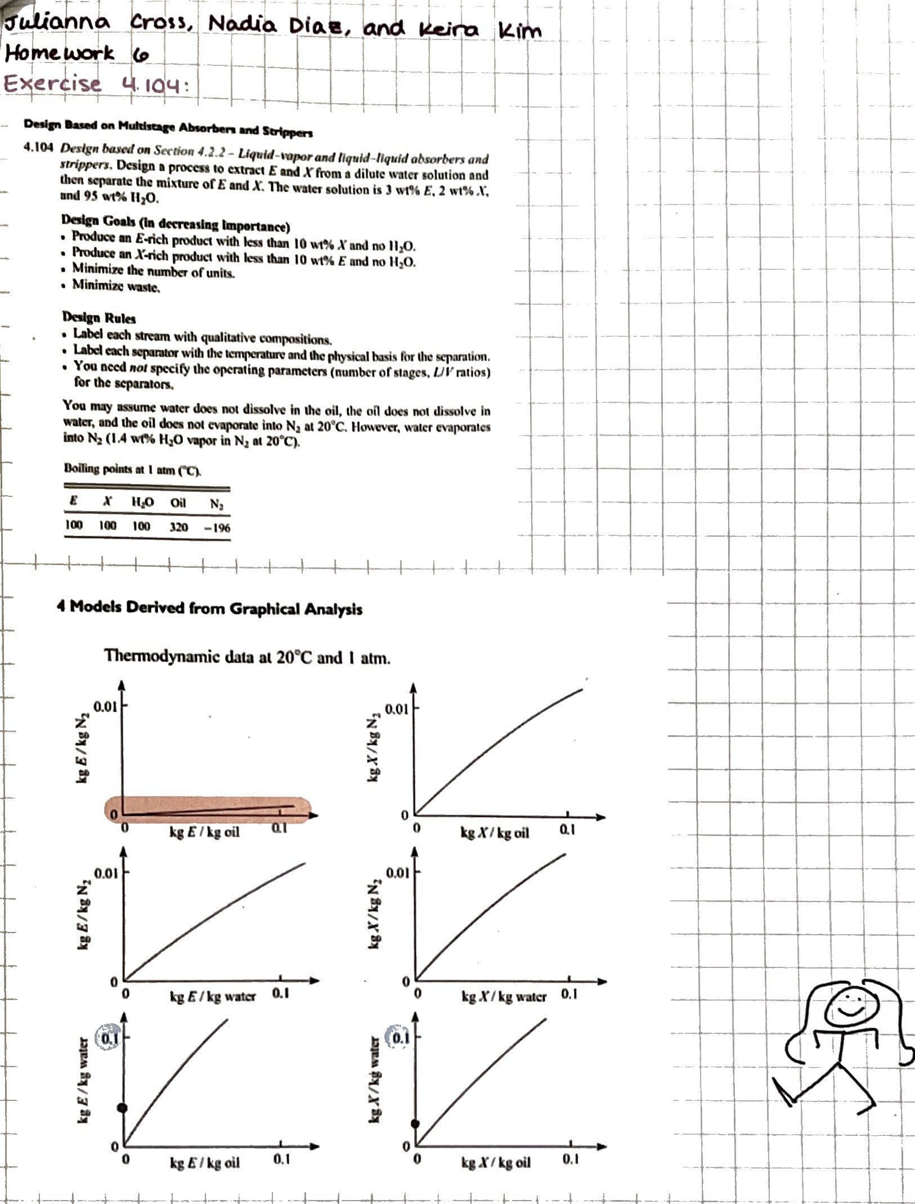
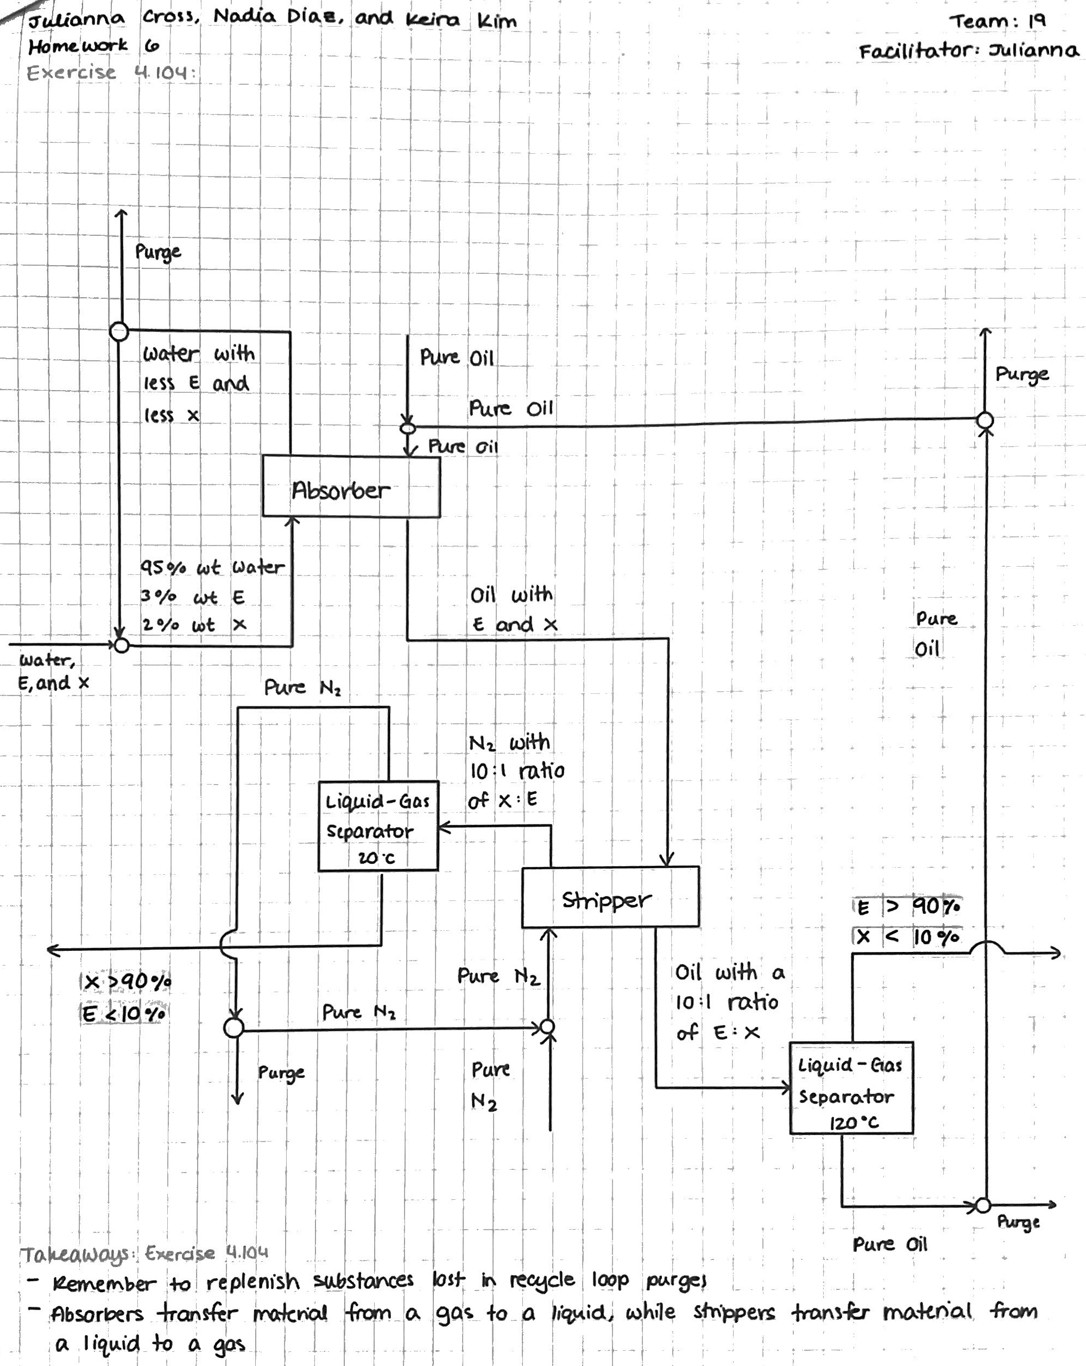
Homework 7 Excellence – Exercise 4.104 – Team 19
Honorable
Mention to Teams
8, 10, 11, 13, 15, 16, 23, 24, and 25.

Slide 7
Recap
Motivation: to predict the behavior/performance of an inconvenient system.
Inconvenient system is too large or too small.
Inconvenient system is too fast or too slow.
Inconvenient system is too hot or too cold.
Plan: study a convenient model of the inconvenient system.
How to design a dynamically similar convenient model?
Dimensional Analysis and Dynamic Scaling!

Slide 8
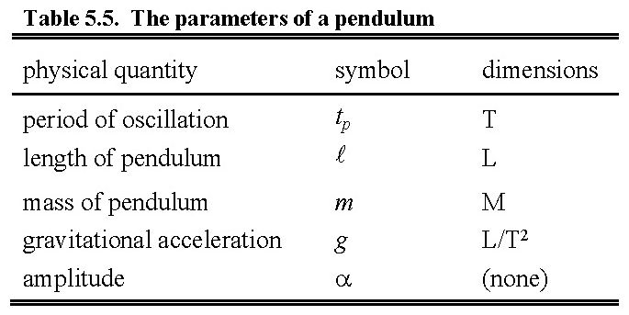
Recap of Dimensional Analysis of Pendulums and Walking
One dimensionless group (of parameters):
The dimensionless group reveals how parameters scale:
If  is increased ×100, t_{period} increases by ×100^{½} = ×10.
Must conduct experiments to obtain universal relation:

Slide 9
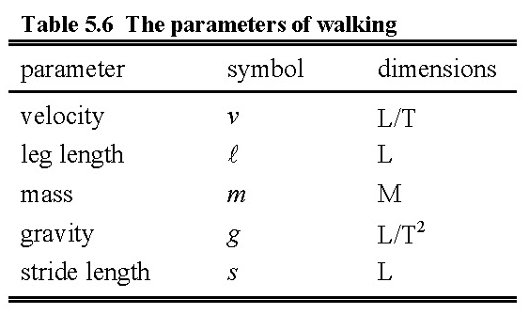
Recap of Dimensional Analysis of Pendulums and Walking, cont’d
Two dimensionless groups:
is called a Dimensionless Group (of Parameters)
aka a Dimensionless Number (The Froude Number)
aka a Π Group
‘Number’ is a misnomer
upper case
The magnitude of a dimensionless group describes the phenomenon.
Froude Number < 2.5 ⇒ bipeds walking or quadrupeds trotting
Froude Number > 2.5 ⇒ bipeds running or quadrupeds galloping

Slide 10
Dimensional Analysis and Dynamic Scaling
A Universal Correlation
for the Terminal Velocity of a Sphere

Slide 11
The Terminal Velocity of a Sphere - Applications
Solid-liquid separations
Muddy water - why does sand settle quickly but silt settles slowly? How slowly?
Solid-vapor separations
Dust settling in air - how long does volcanic ash remain in the atmosphere?
Vapor-liquid systems
How fast do air bubbles rise in a fermenter?
How fast do vapor bubbles rise through the liquid on an equilibrium stage
in a distillation column?
Liquid droplets in air: mist and fog? Spray painting? Virus spreading?
Liquid-liquid systems
Oil-water absorbers and strippers - bouyancy effects?

Slide 12
The Method of Dimensional Analysis
recap from previous lecture:
1. List parameters
will always be given in this course.
2. Find dimensions of each parameter
3. Write equation for generic Π group
4. Choose core variables
5. Derive Π groups
6. Measure Data
7. Plot universal correlation

Slide 13
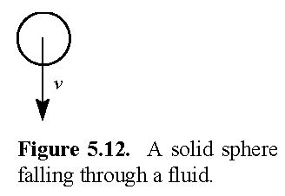
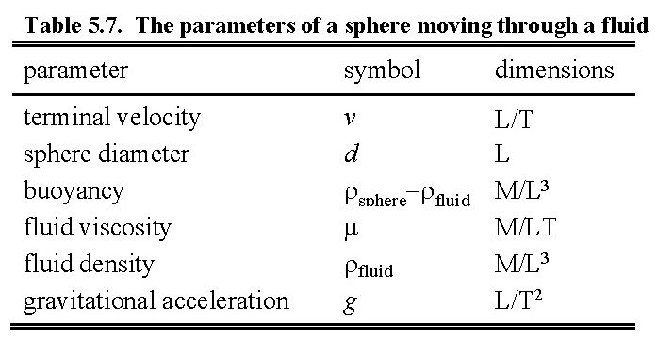
Dimensional Analysis of a Falling Sphere
1. List parameters
2. Find dimensions of each parameter
dynamics
the sphere
the fluid
physical constant
will be given
will usually
be given
must derive

Slide 14
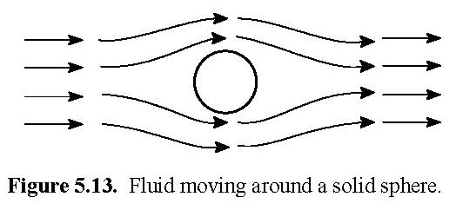
Why the density of the fluid is relevant
Consider running
in a straight line
through a crowded room
people
‘density’ = people/area
you
people
balloons
you

Slide 15
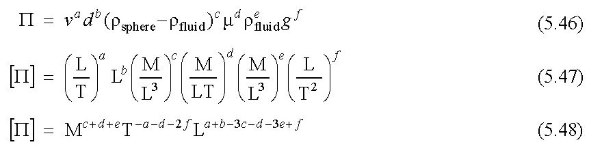
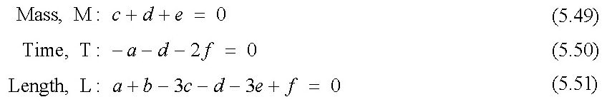
Dimensional Analysis of a Falling Sphere
3. Write an equation
for generic Π group
For Π to be dimensionless, each dimension’s exponent must be zero.
(6 parameters) − (3 dimensions) = 3 core variables

Slide 16
Dimensional Analysis of a Falling Sphere
4. Choose core variables
Two Rules for Core Variables
1. The set of core variables must represent all dimensions.
Easy to check.
Not velocity, sphere diameter, and gravity (dimension M is omitted).
2. The core variables must not form a dimensionless group.
Not easy to check.
Not fluid density and buoyancy.
It is often easier
to derive the Π groups.
If a problem arises,
this rule was likely
violated.
Not velocity, sphere diameter, and gravity:
v²/(dg) is a Froude Number; [v²/(dg)] = (none)

Slide 17
Dimensional Analysis of a Falling Sphere
4. Choose core variables, cont’d
Logical choices for the core variables:
What do we want to predict?
velocity
What do we want to vary in our experiments?
sphere diameter and fluid viscosity
But we are not the first to study spheres falling through fluids.
Use traditional core variables to relate our results to previous results.
Traditional core variables: buoyancy, gravity, and fluid viscosity.

Slide 18
Dimensional Analysis of a Falling Sphere
5. Derive Π groups
Π = vªd^{b}(ρ_{sphere} − ρ_{fluid})^{c}μ^{d}(ρ_{fluid})^{e}g^{f}
Use the core variables - buoyancy, gravity, and fluid viscosity - to set the exponents.
buoyancy
c = 1
gravity
f = 0
fluid viscosity
d = 0
Π₁
Π₂
c = 0
f = 1
−1
d = 0
Π₃
c = 0
f = 0
d = 1
−1
Core variables buoyancy, gravity, and fluid viscosity yield key dimensionless groups!

Slide 19
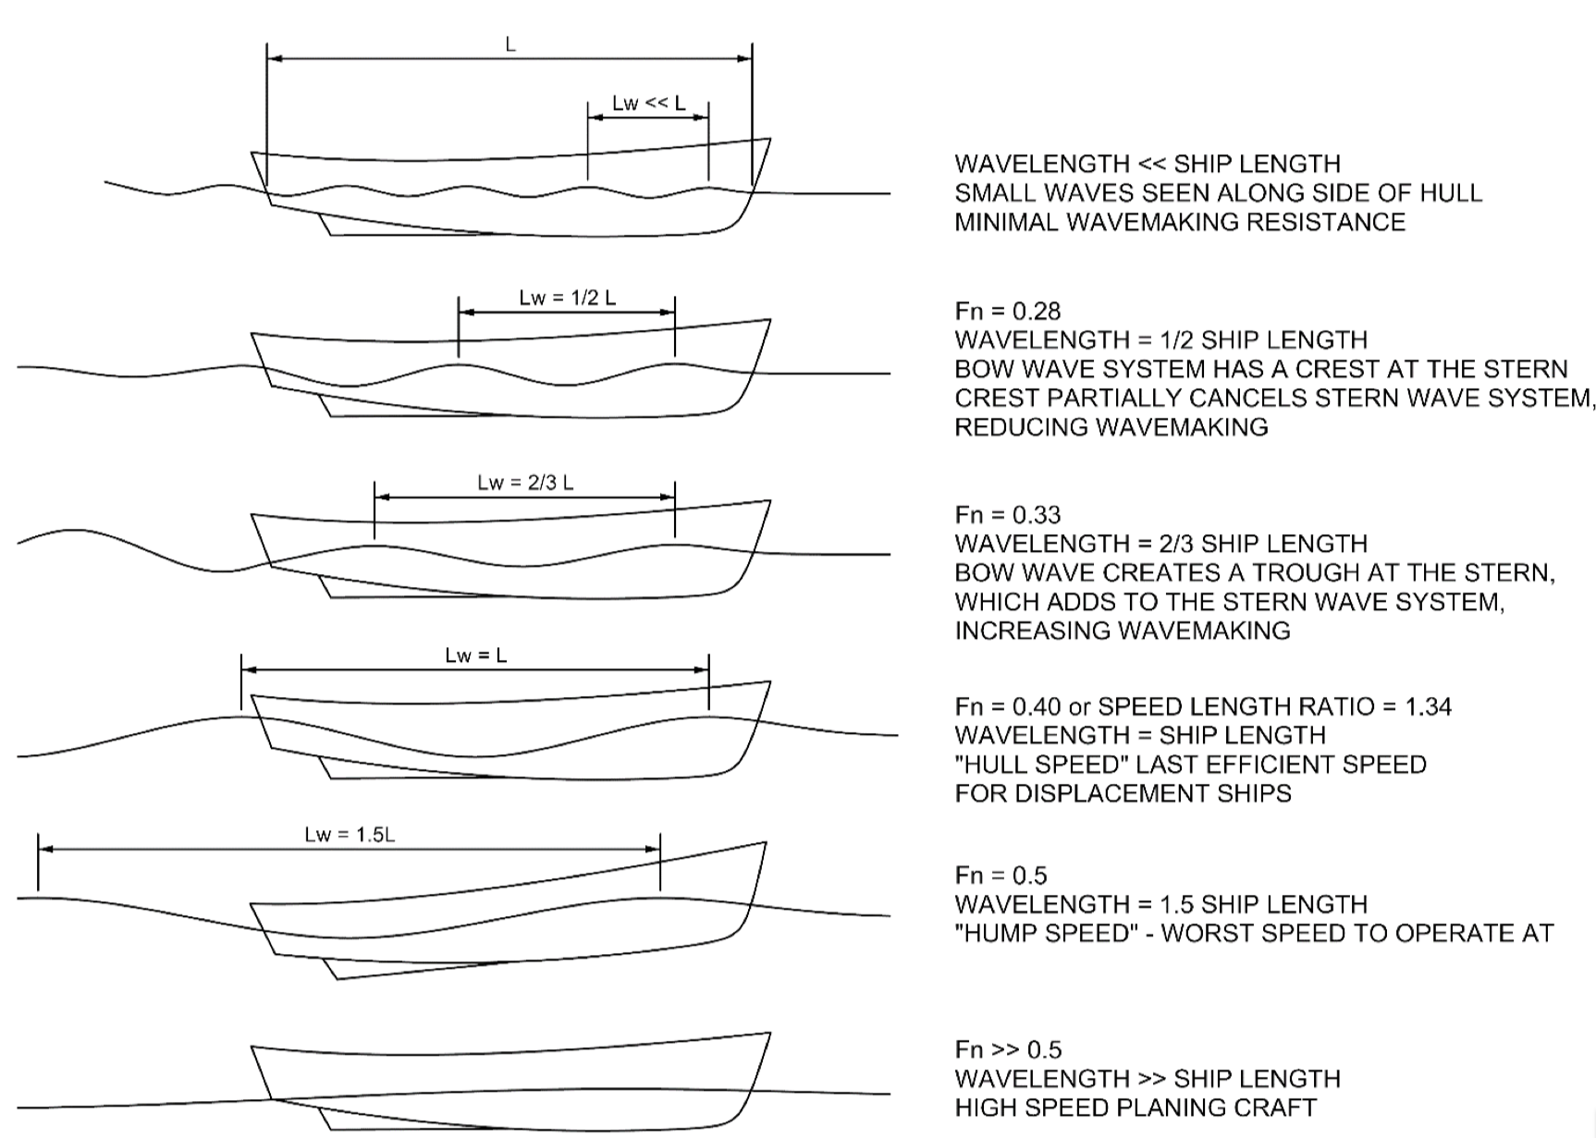
Core variables buoyancy, gravity, and fluid viscosity yield key dimensionless groups!

Slide 20
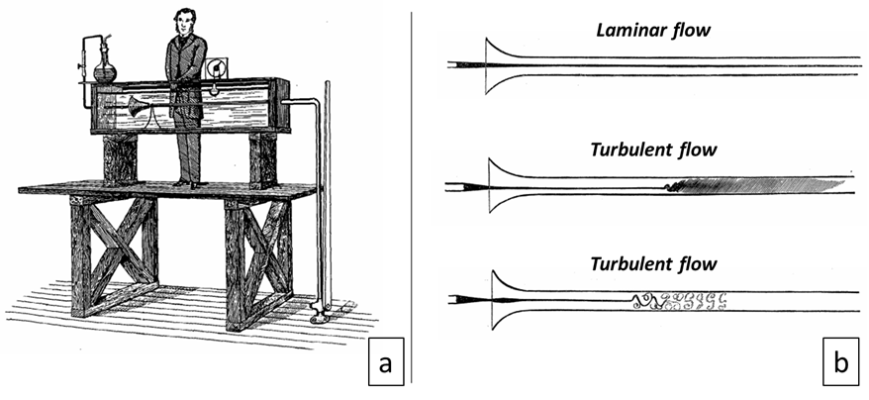
The Reynolds Number
density × volume = mass
∝ Shear stress (Newton’s Law of Viscosity)
∝ surface area of sphere
Re < 1
1 < Re < 1000
Re > 1000
Osborne Reynolds 1883

Slide 21
The Reynolds Number

Slide 22
Dimensional Analysis of a Falling Sphere
6. Measure Data
Measure v, d, ρ_{sphere}, μ, and ρ_{fluid}.

Slide 23
Dimensional Analysis of a Falling Sphere
7. Plot universal correlation
How to plot? A 3-D plot of a level surface?
Difficult to read
quantitative values.
Better to plot as a
family of curves
for values of Fr.

Slide 24
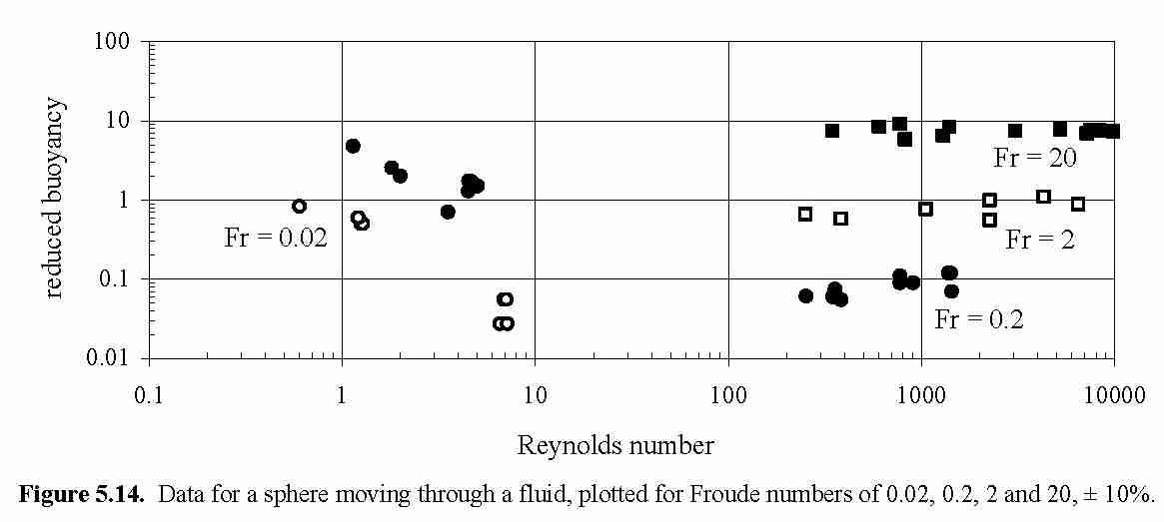
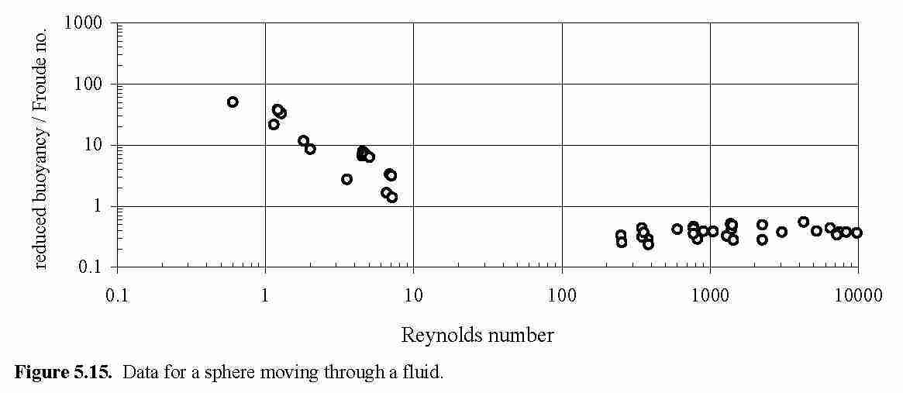
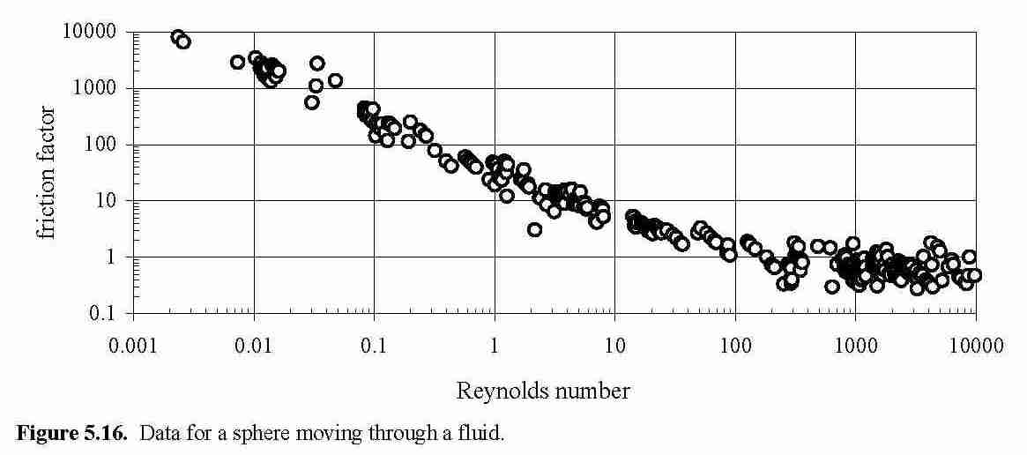
Dimensional Analysis of a Falling Sphere
7. Plot universal correlation, cont’d
Divide reduced buoyancy
by Froude number

Slide 25
Fluid Flow around a Sphere
Re < 1
Laminar Flow
Stokes’s Law
slope = −1
Re > 100
Turbulent Flow

Slide 26
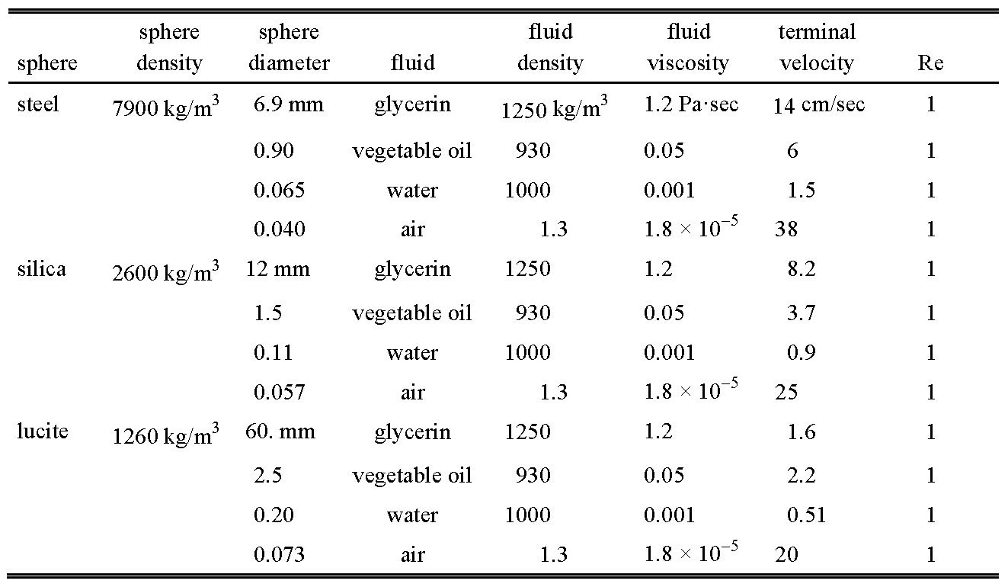
Dynamically Similar Spheres Falling at their Terminal Velocity
inconvenient
Use convenient models to predict results for inconvenient systems.
Extrapolation?
No! All systems are dynamically similar.

Slide 27

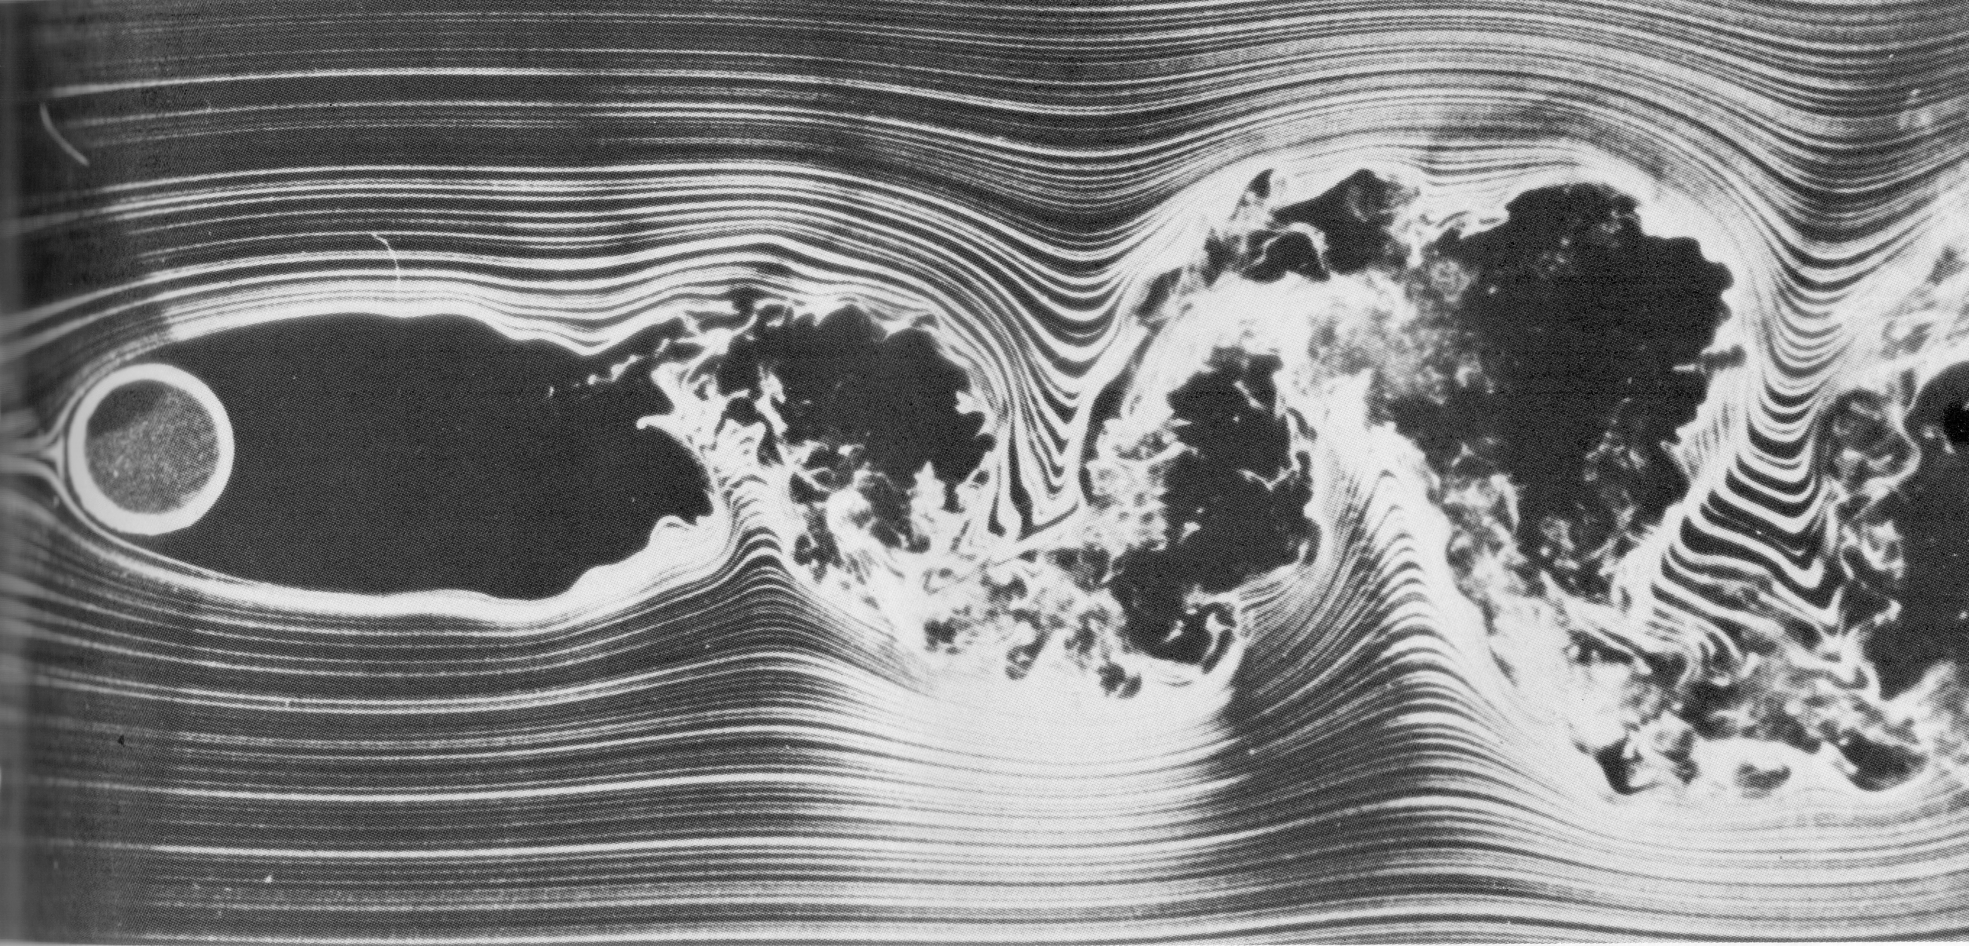
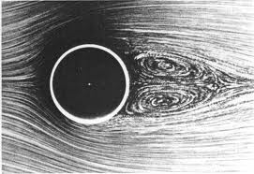
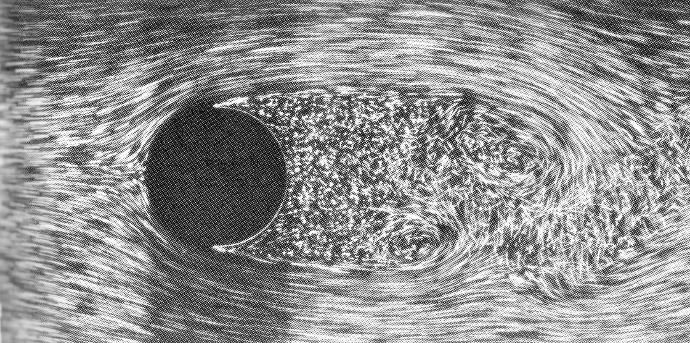
Flow Around a Cylinder
Re « 1
Re = 1000
Re = 10,000
Re = 100

Slide 28
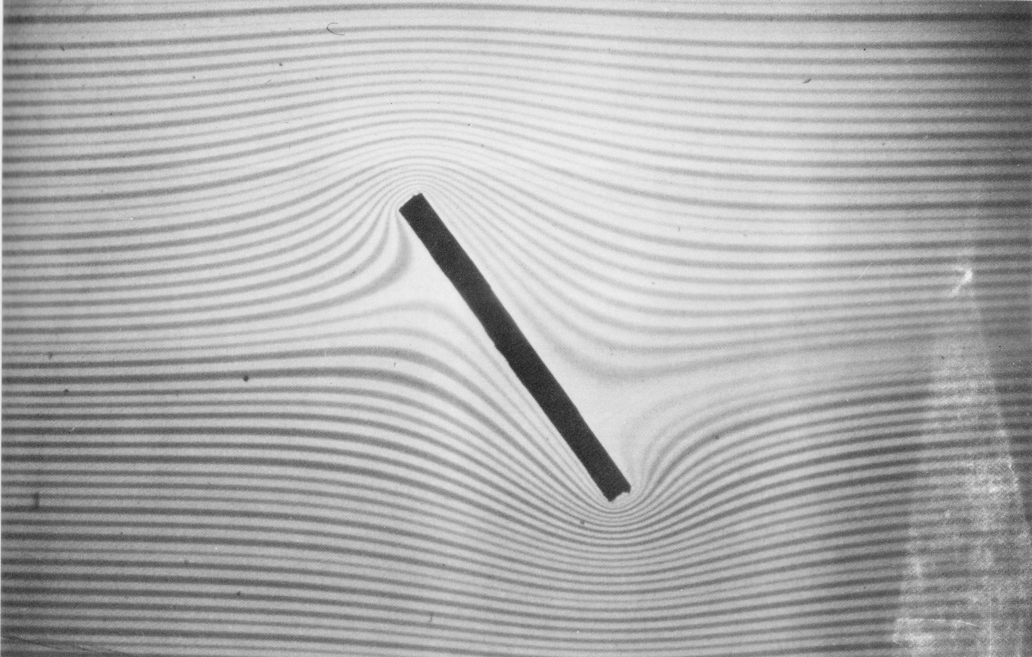
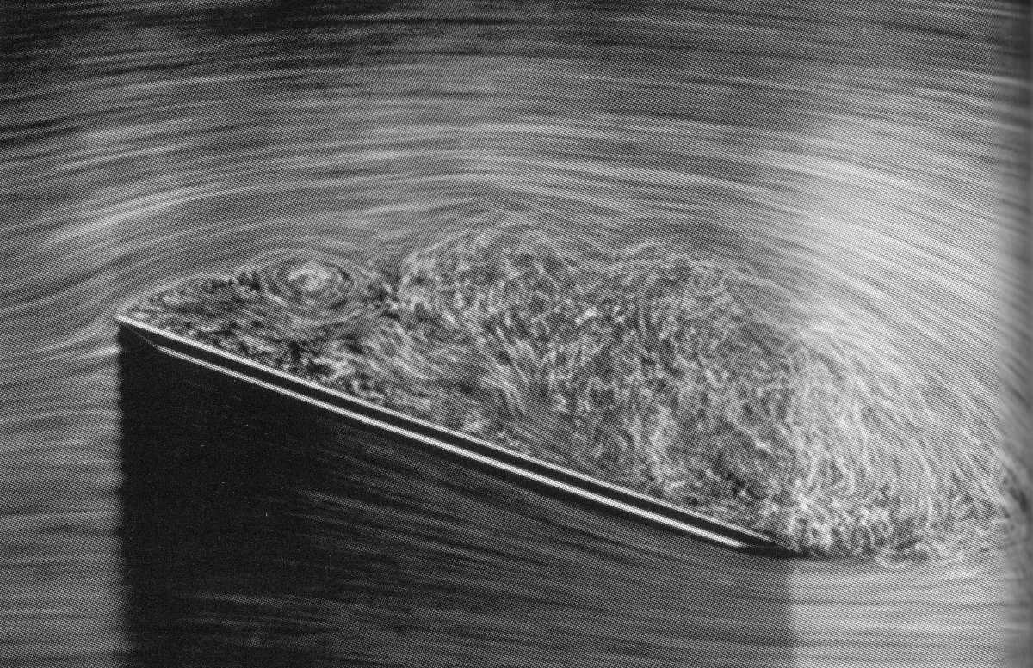
Flow Past a Plate
Re = 0.1
Re = 10,000

Slide 29
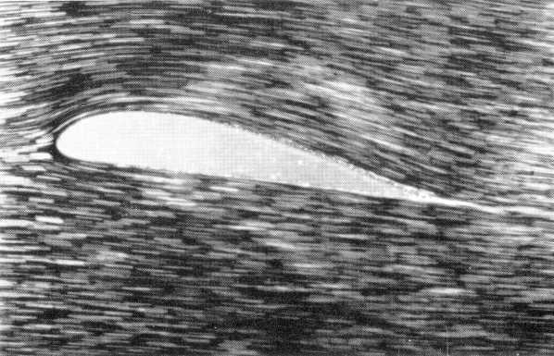
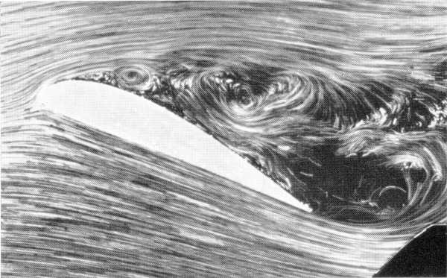
Flow Past an Airfoil
Re = 100
Re = 1000

Slide 30
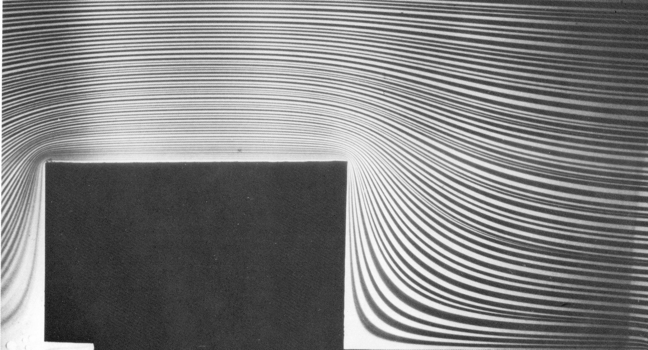
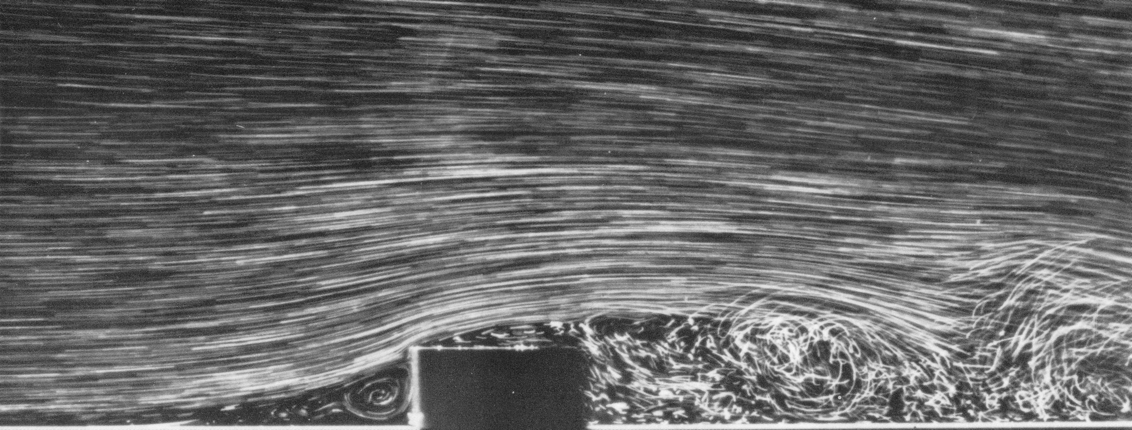
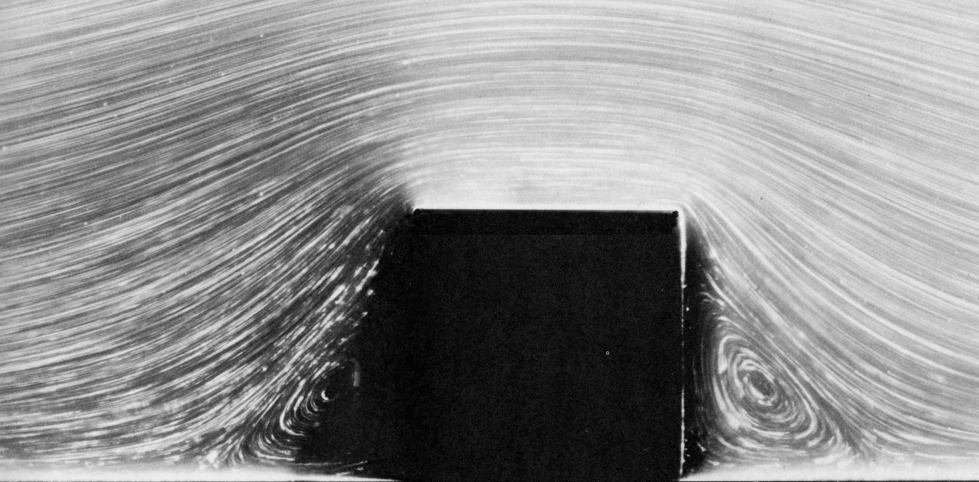
Flow Past a Block
Re = 0.01
Re = 10,000
Re = 10

Slide 31
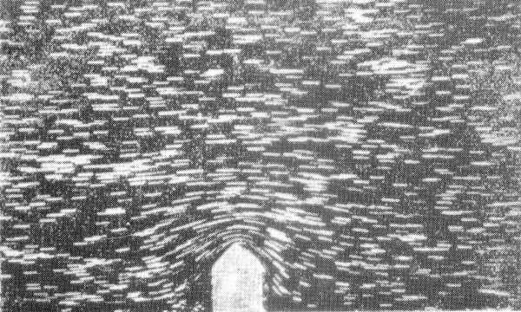
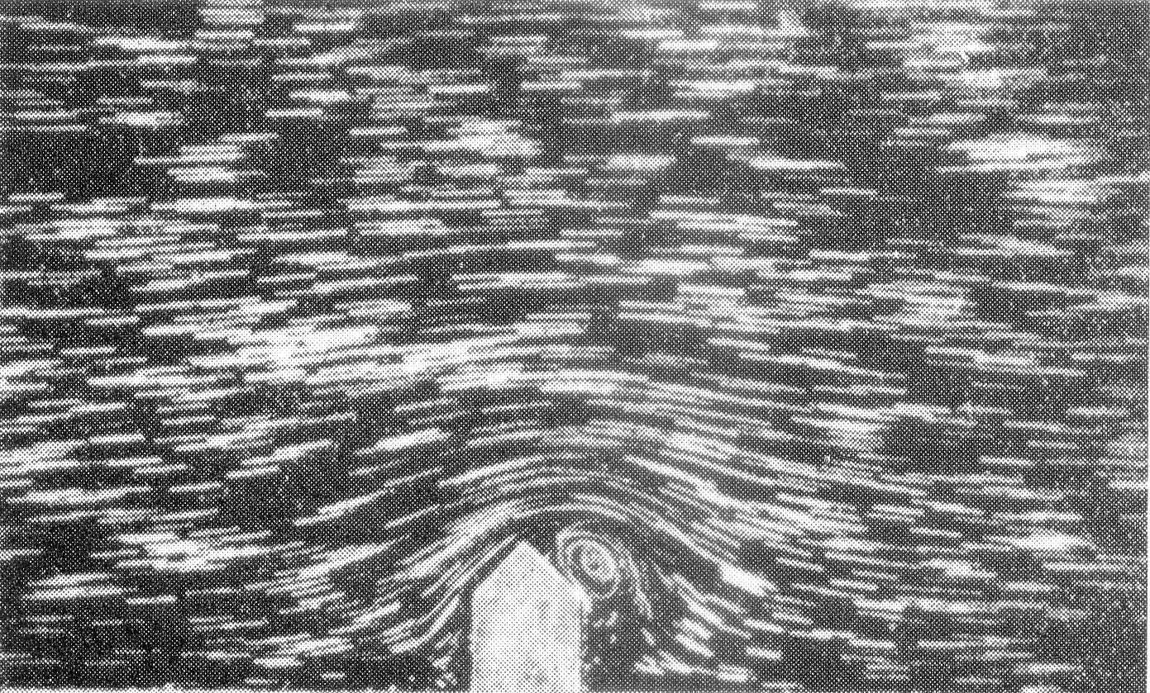
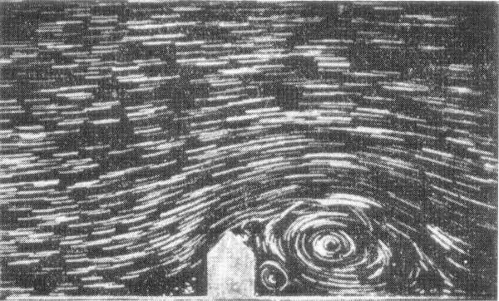
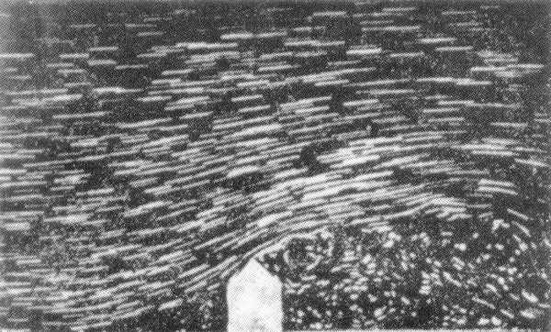
Flow Past a House
Re = 0.1
Re = 10
Re = 100
Re = 10,000

Slide 32


