Slide 1
EngrD 2190 – Lecture 40
Course Summary and Review – Part 2
Graphical Modeling
and Dimensional Analysis/Dynamic Scaling
Final Exam
Friday, December 12, 7:00 - 9:30 p.m., 128 and 245 Olin Hall.
Comprehensive - covers chapters 2 through 5, with emphasis on
chapter 5: dimensional analysis and dynamic scaling.
Open notes and open exercise solutions.
Bring a calculator and a ruler/straightedge.
Graphing calculators are okay.

Slide 2
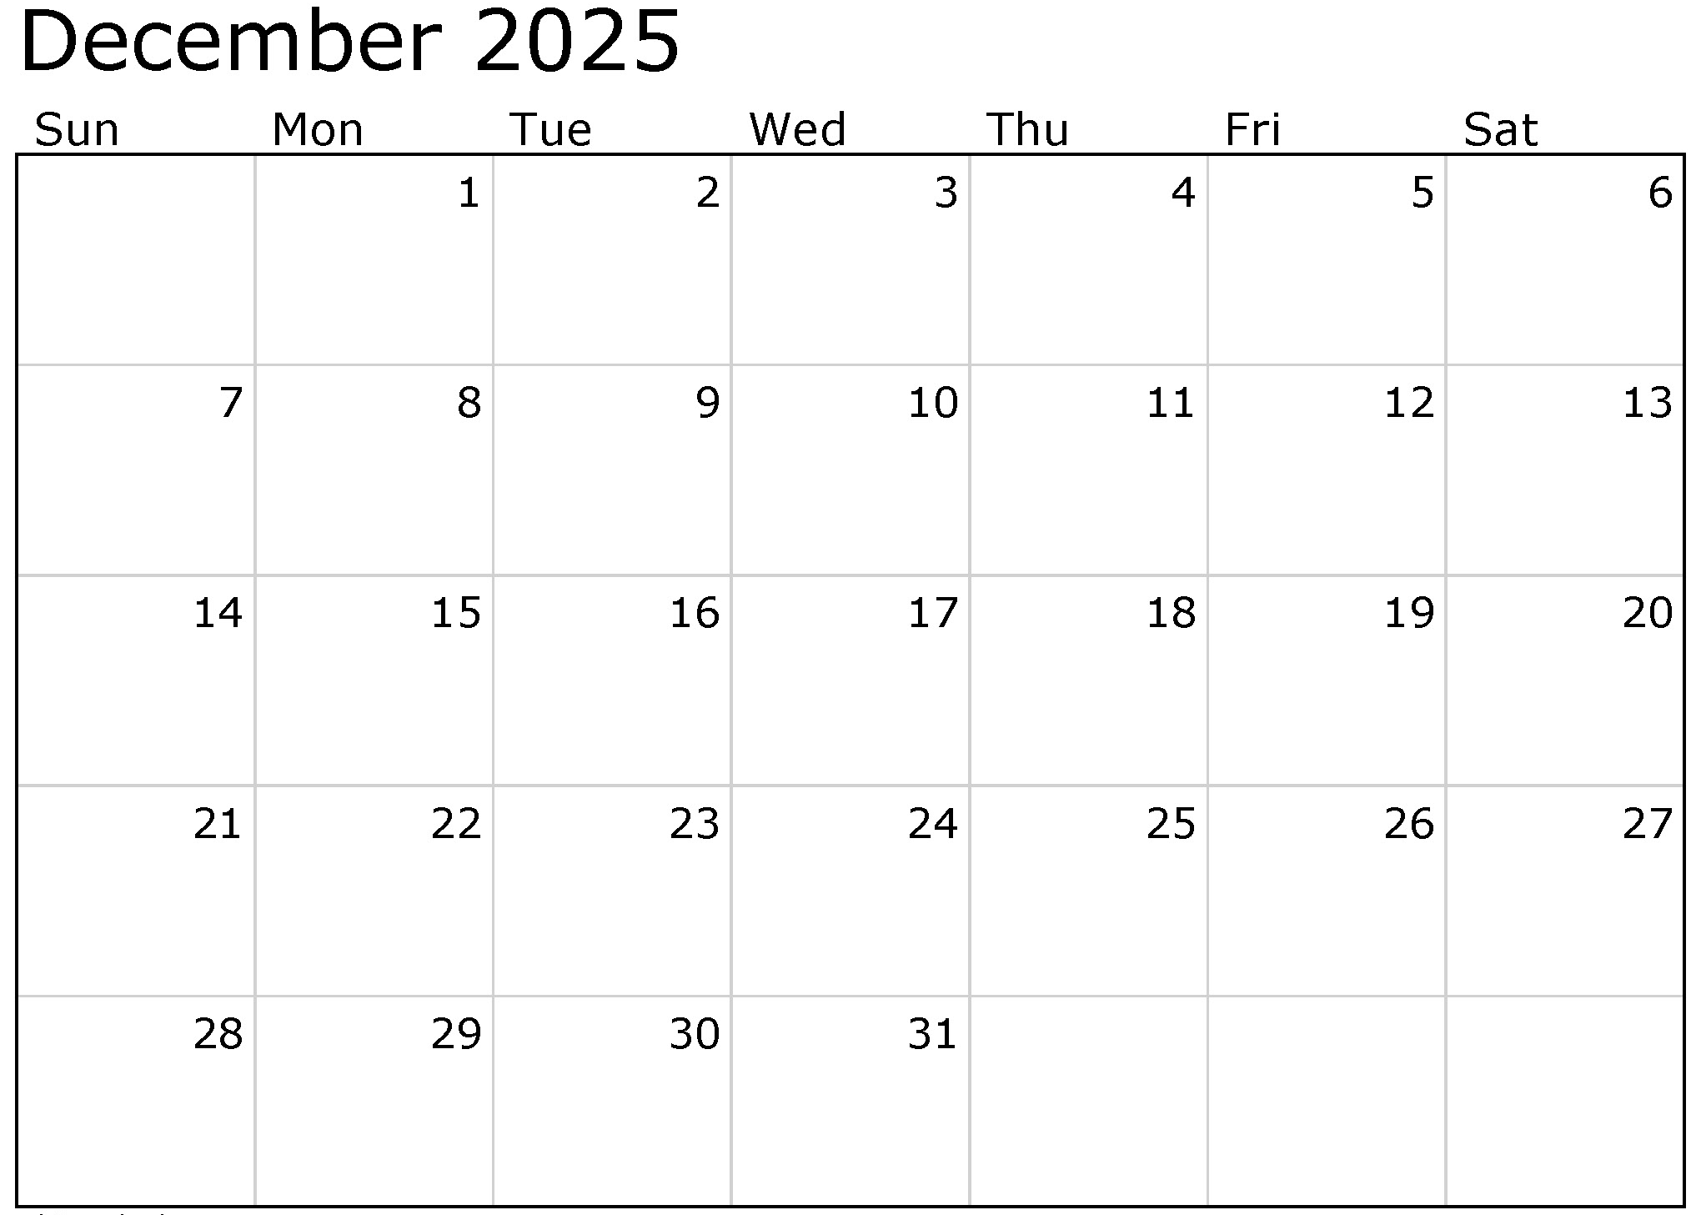
We are
here
Lecture Monday
December 8 is
CANCELLED
Last
Day of
Classes
EngrD
2190
7 p.m.
TMD
Office Hours
Noon – 2 p.m.
TA
Office Hours
2-4 p.m.
TA
Office Hours
2-4 p.m.
Chem
3890
7 p.m.
Math 2930
2 p.m.
Phys 2213
9 a.m.
Math 2940
9 a.m.

Slide 3


Slide 4
Lecture Monday 12/8 is cancelled

Slide 5

Applications
for Affiliation
are due
Saturday
December 20

Slide 6
Affiliation
Typically ~65% of freshmen in EngrI 1120
choose to affiliate with ChemE.
~65% of those who earn an A in EngrI 1120
choose to affiliate with ChemE.
~65% of those who earn a B in EngrI 1120
choose to affiliate with ChemE.
~65% of those who earn a C in EngrI 1120
choose to affiliate with ChemE.
Choose your major.
Don’t let a major choose you.

Slide 7
From the advice to sophomores in Fall 2026:
It will be tempting to just do the homework to completion, just
“getting it done.” I PROMISE you will forever grateful to yourself
If you do each problem with the goal of understanding, not completion.
This class is about the journey, not the destination.
Do as many practice problems as possible when preparing for an exam.
Even though this class may have open-note exams, you don’t have
much time to go through your notes during the exam.
Sufficient practice is much more helpful for finishing the exam on time.
Make a short study guide to use on the open-note exams
and practice the problems WITH YOUR NOTES. It helps a lot.

Slide 8
EngrD 2190 – Chemical Process Design & Analysis
Course Summary and Review – Part 2
Graphical Modeling
Dimensional Analysis & Dynamic Scaling
Two graphical methods:
Tie lines and the lever rule
Operating lines

Slide 9
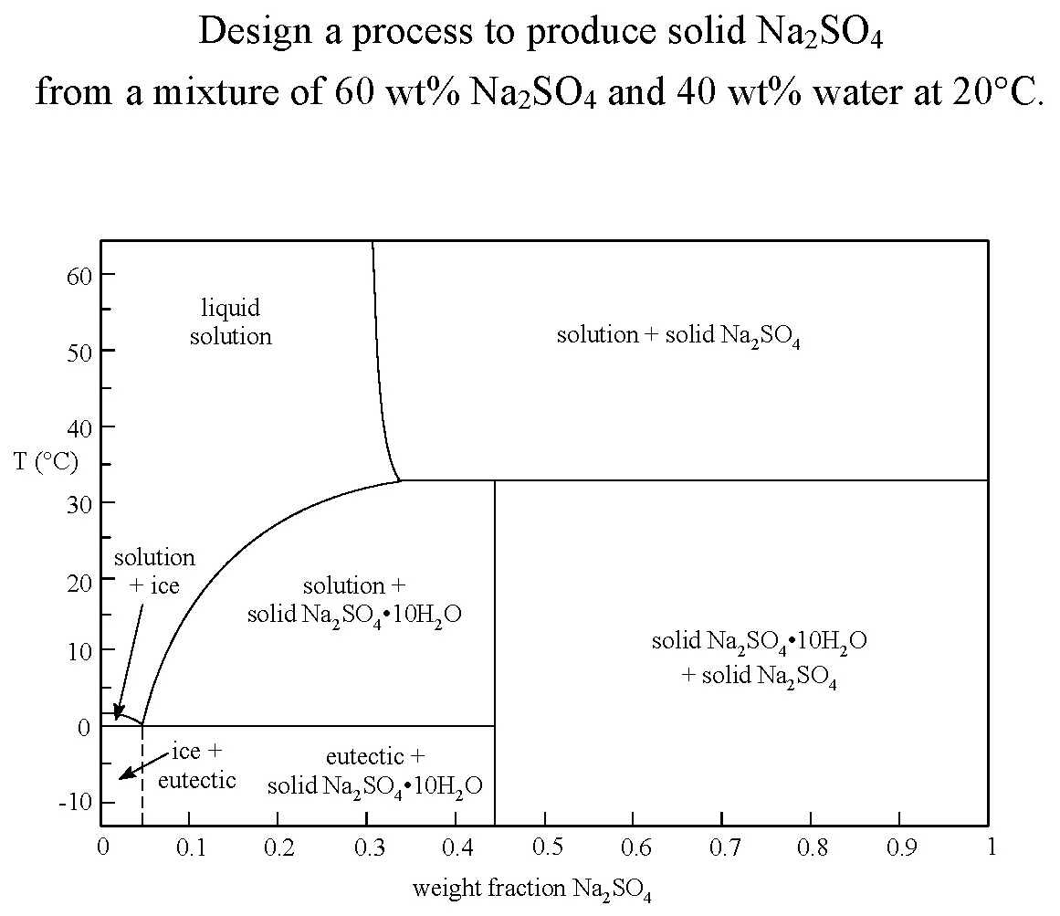
Exercise 4.94
secondary goal
limit
goal
H₂O
Na₂SO₄

Slide 10
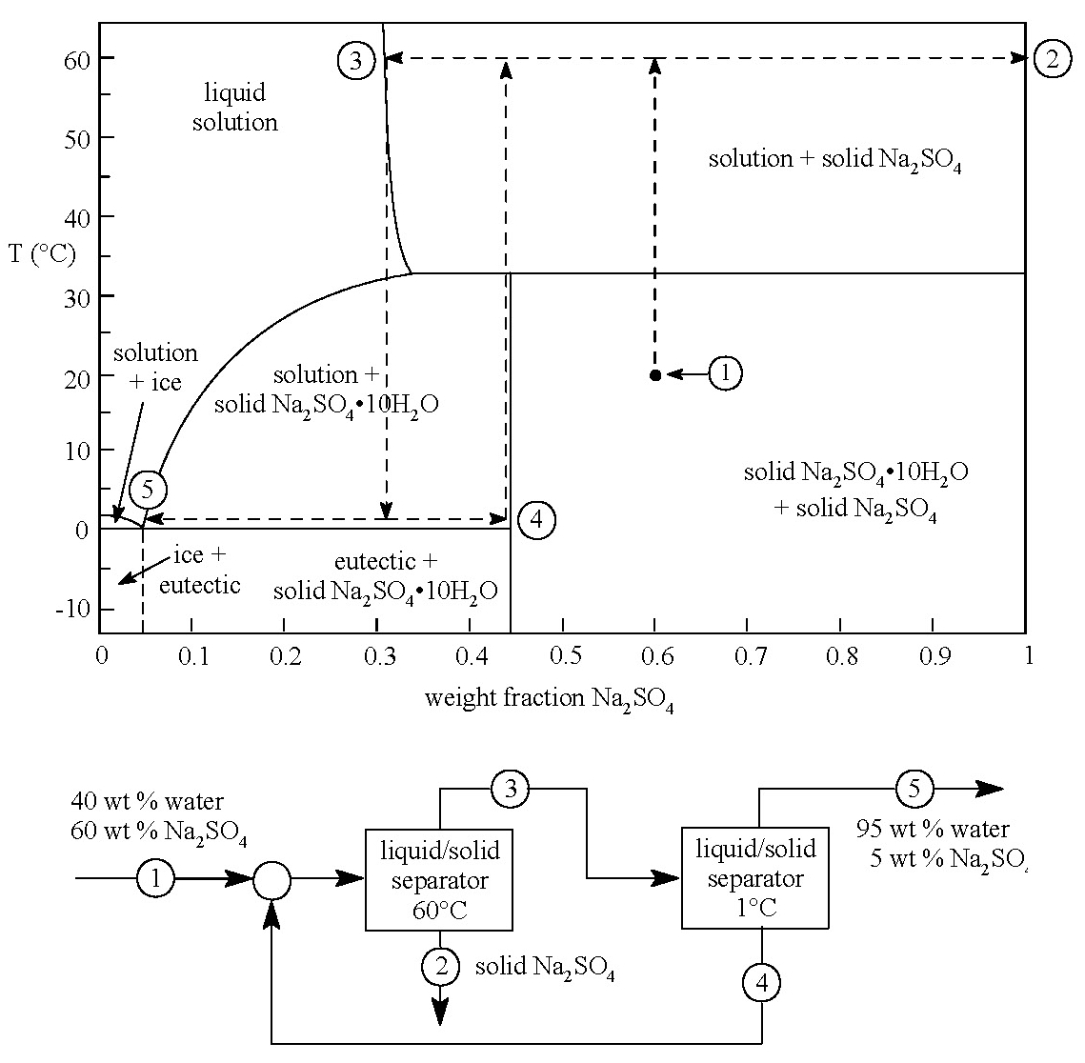
Exercise 4.94
Solution
3
2
5
4
Product purity?
No change
Product purity?
No change
Product flowrate?
No change
Product flowrate?
Capital costs?
Equipment sizes?
Decreases.
35°C
20°C
Operating costs?
Heating?
ROI?
ROI?

Slide 11
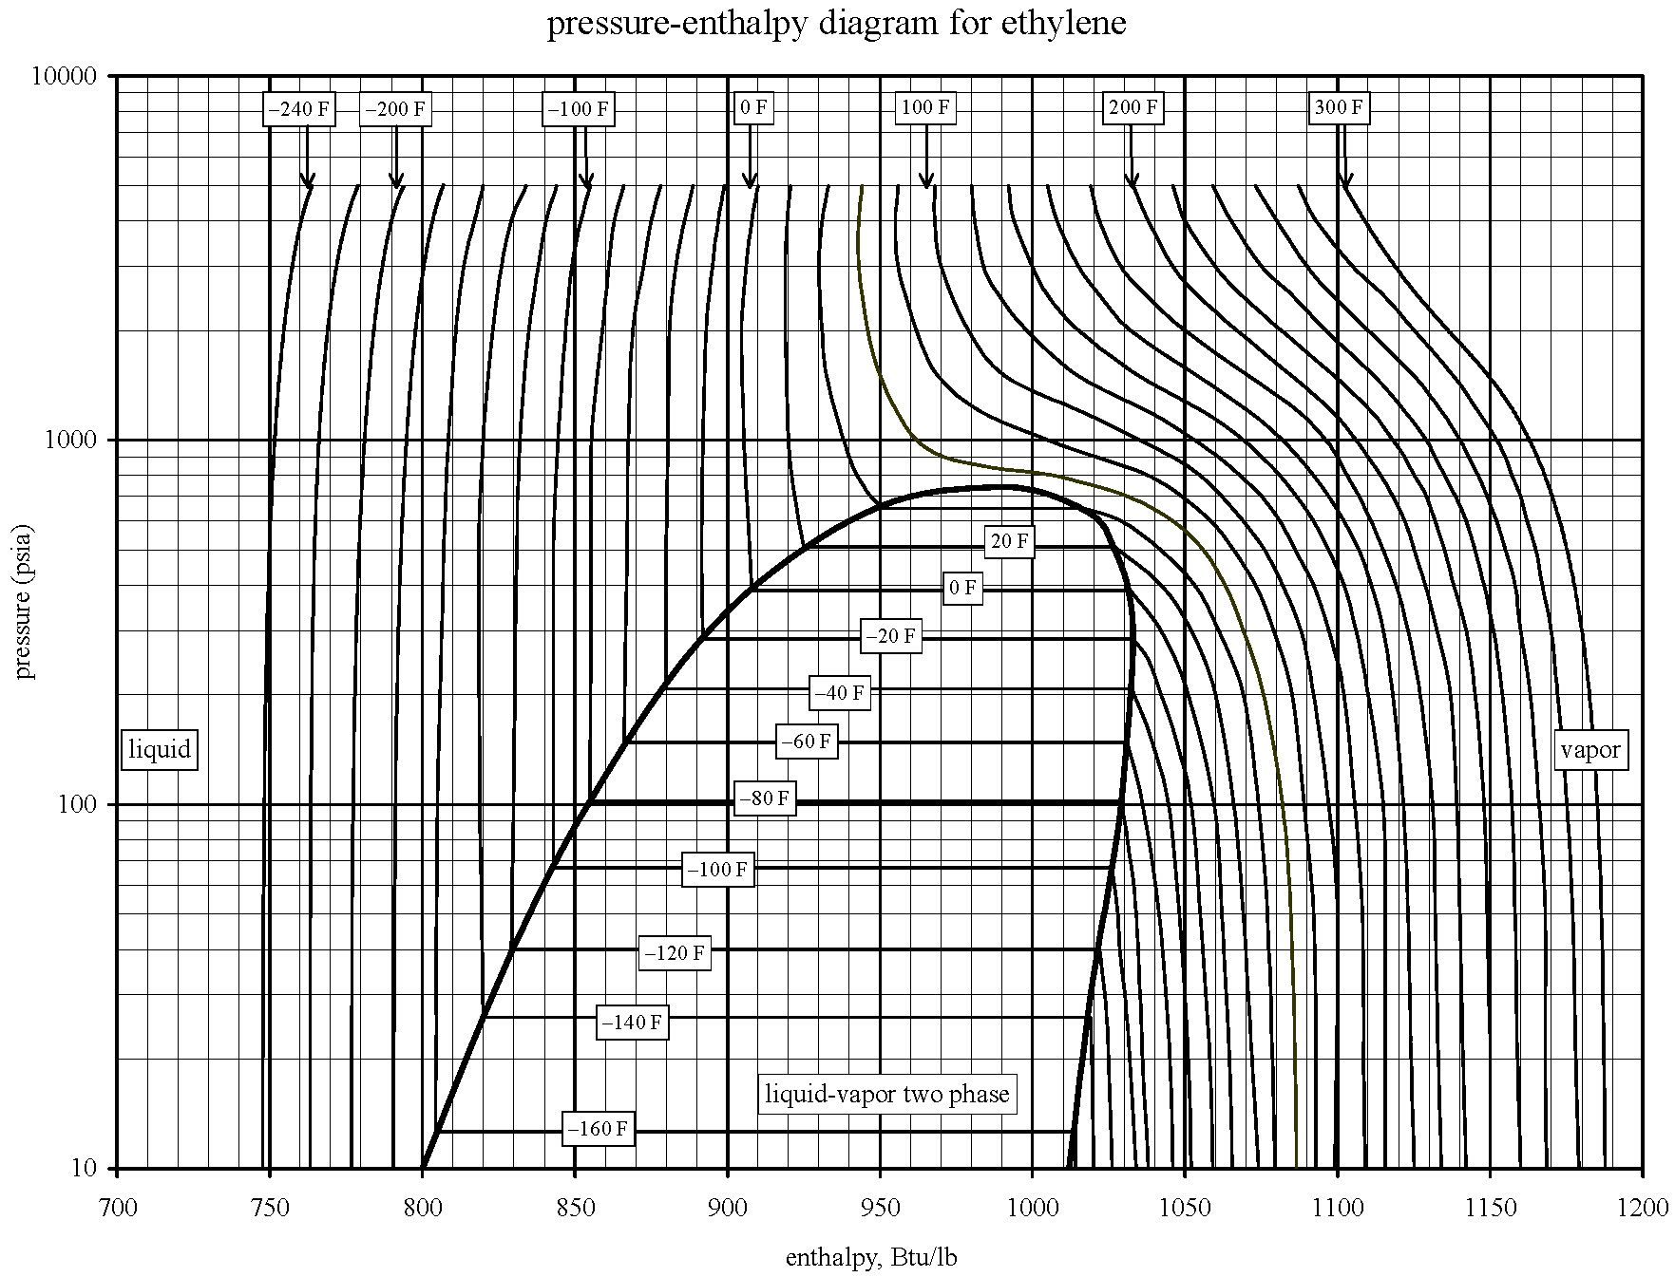
Linear scale for energy.
Use tie lines and mixing lines
with the lever rule.

Slide 12
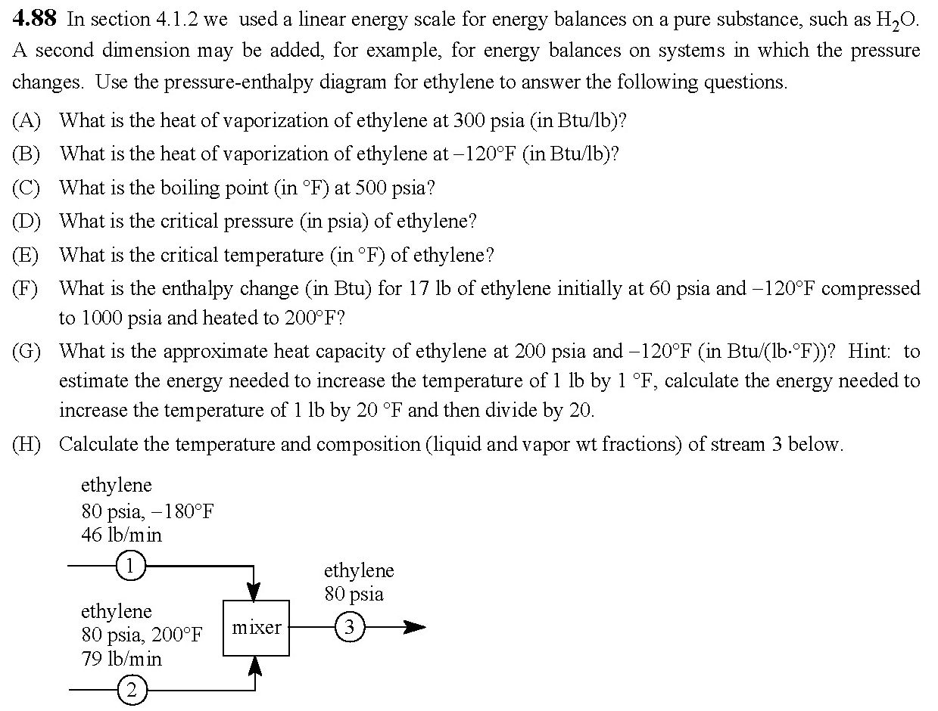

Slide 13
−120°F
(F) (1105 − 830) × 17 = 4700 Btu
500
300
200
114
79
46
11
80
60
(A) 1033 − 893 = 140 Btu/lb
830
893
1033
1105
(B) 1020 − 830 = 190 Btu/lb
830
1020

Slide 14

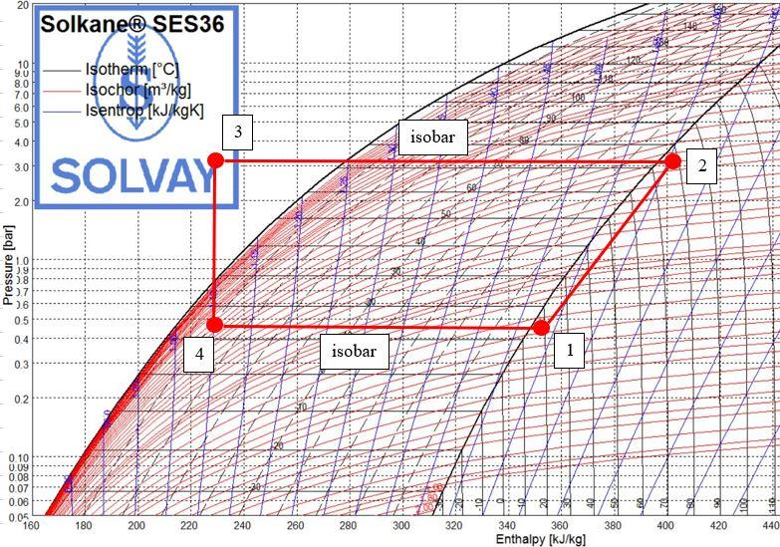
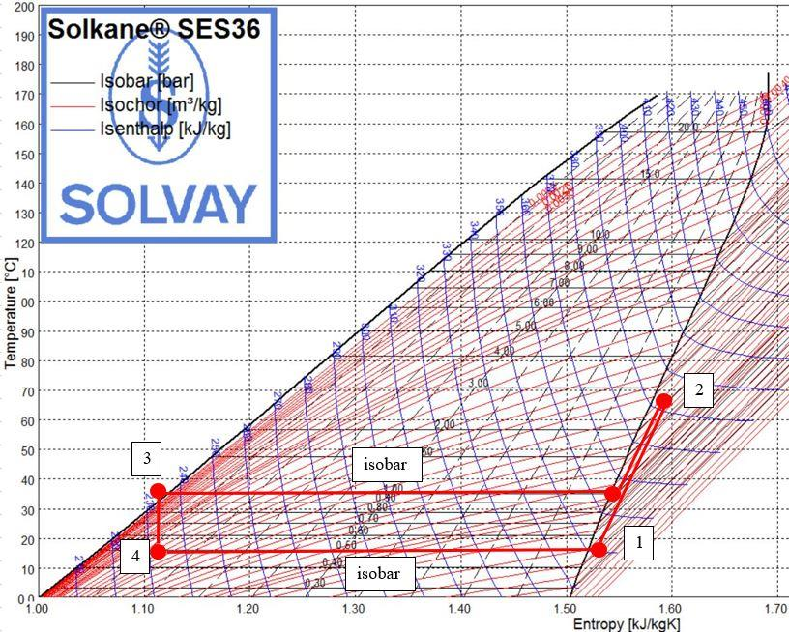

Slide 15
Multistage Countercurrent Absorbers

Slide 16
Multistage Countercurrent Distillation

Slide 17
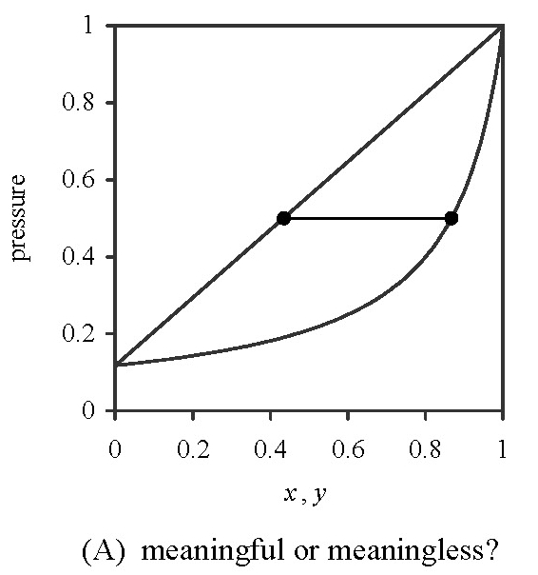
Is this a meaningful graphical model of a binary mixture in either a single-stage separator or a multi-stage, counter-current separator?
liquid
liquid+vapor
vapor

Slide 18
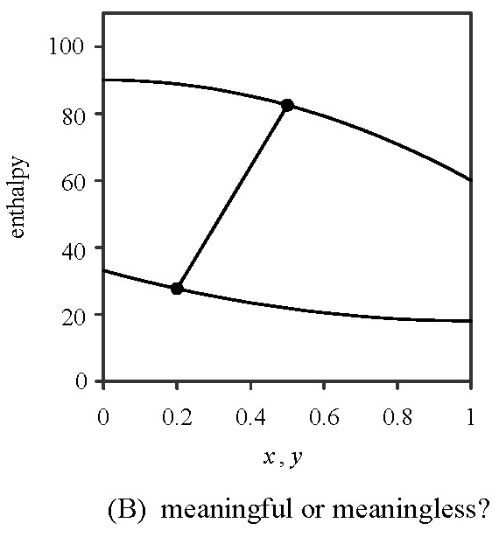
Is this a meaningful graphical model of a binary mixture in either a single-stage separator or a multi-stage, counter-current separator?
vapor
liquid+vapor
liquid

Slide 19
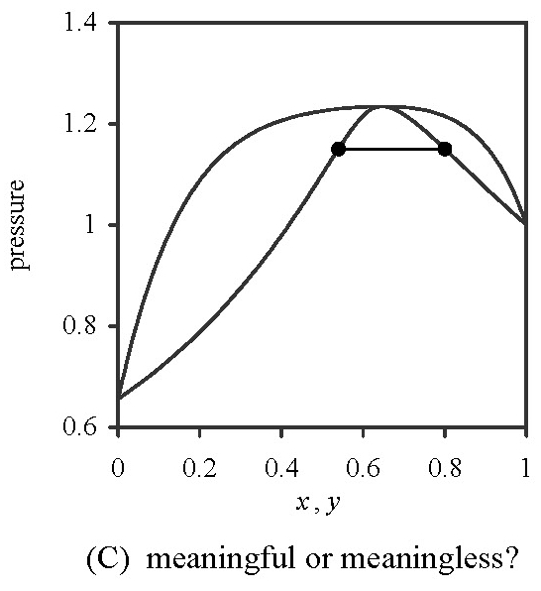
Is this a meaningful graphical model of a binary mixture in either a single-stage separator or a multi-stage, counter-current separator?
liquid
liquid+vapor
liquid+
vapor
vapor

Slide 20
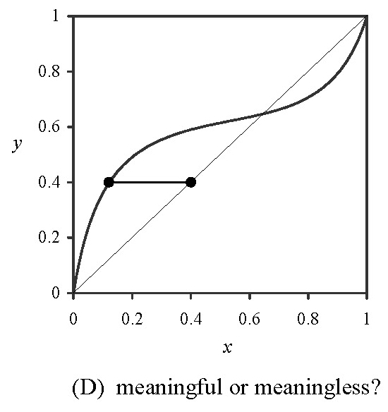
Is this a meaningful graphical model of a binary mixture in either a single-stage separator or a multi-stage, counter-current separator?

Slide 21
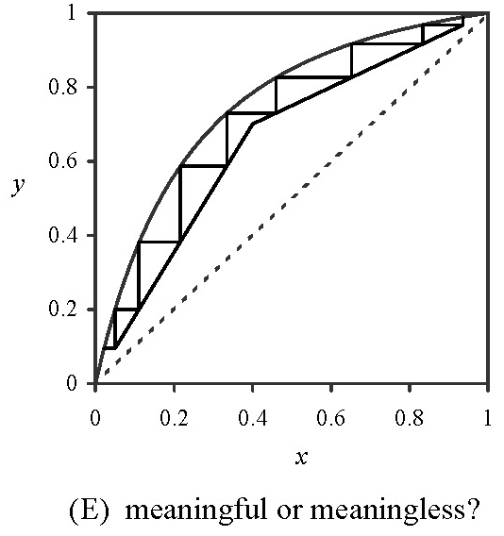
Is this a meaningful graphical model of a binary mixture in either a single-stage separator or a multi-stage, counter-current separator?

Slide 22
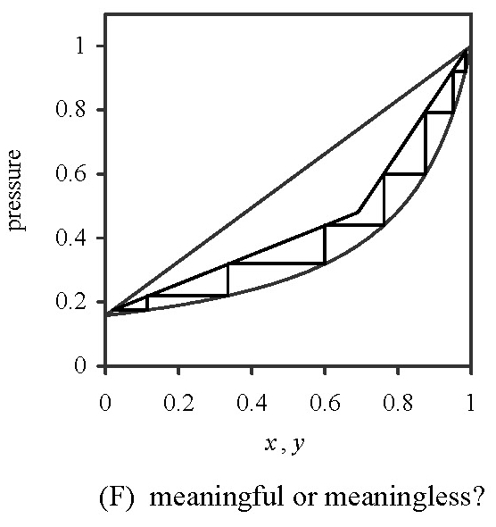
Is this a meaningful graphical model of a binary mixture in either a single-stage separator or a multi-stage, counter-current separator?

Slide 23
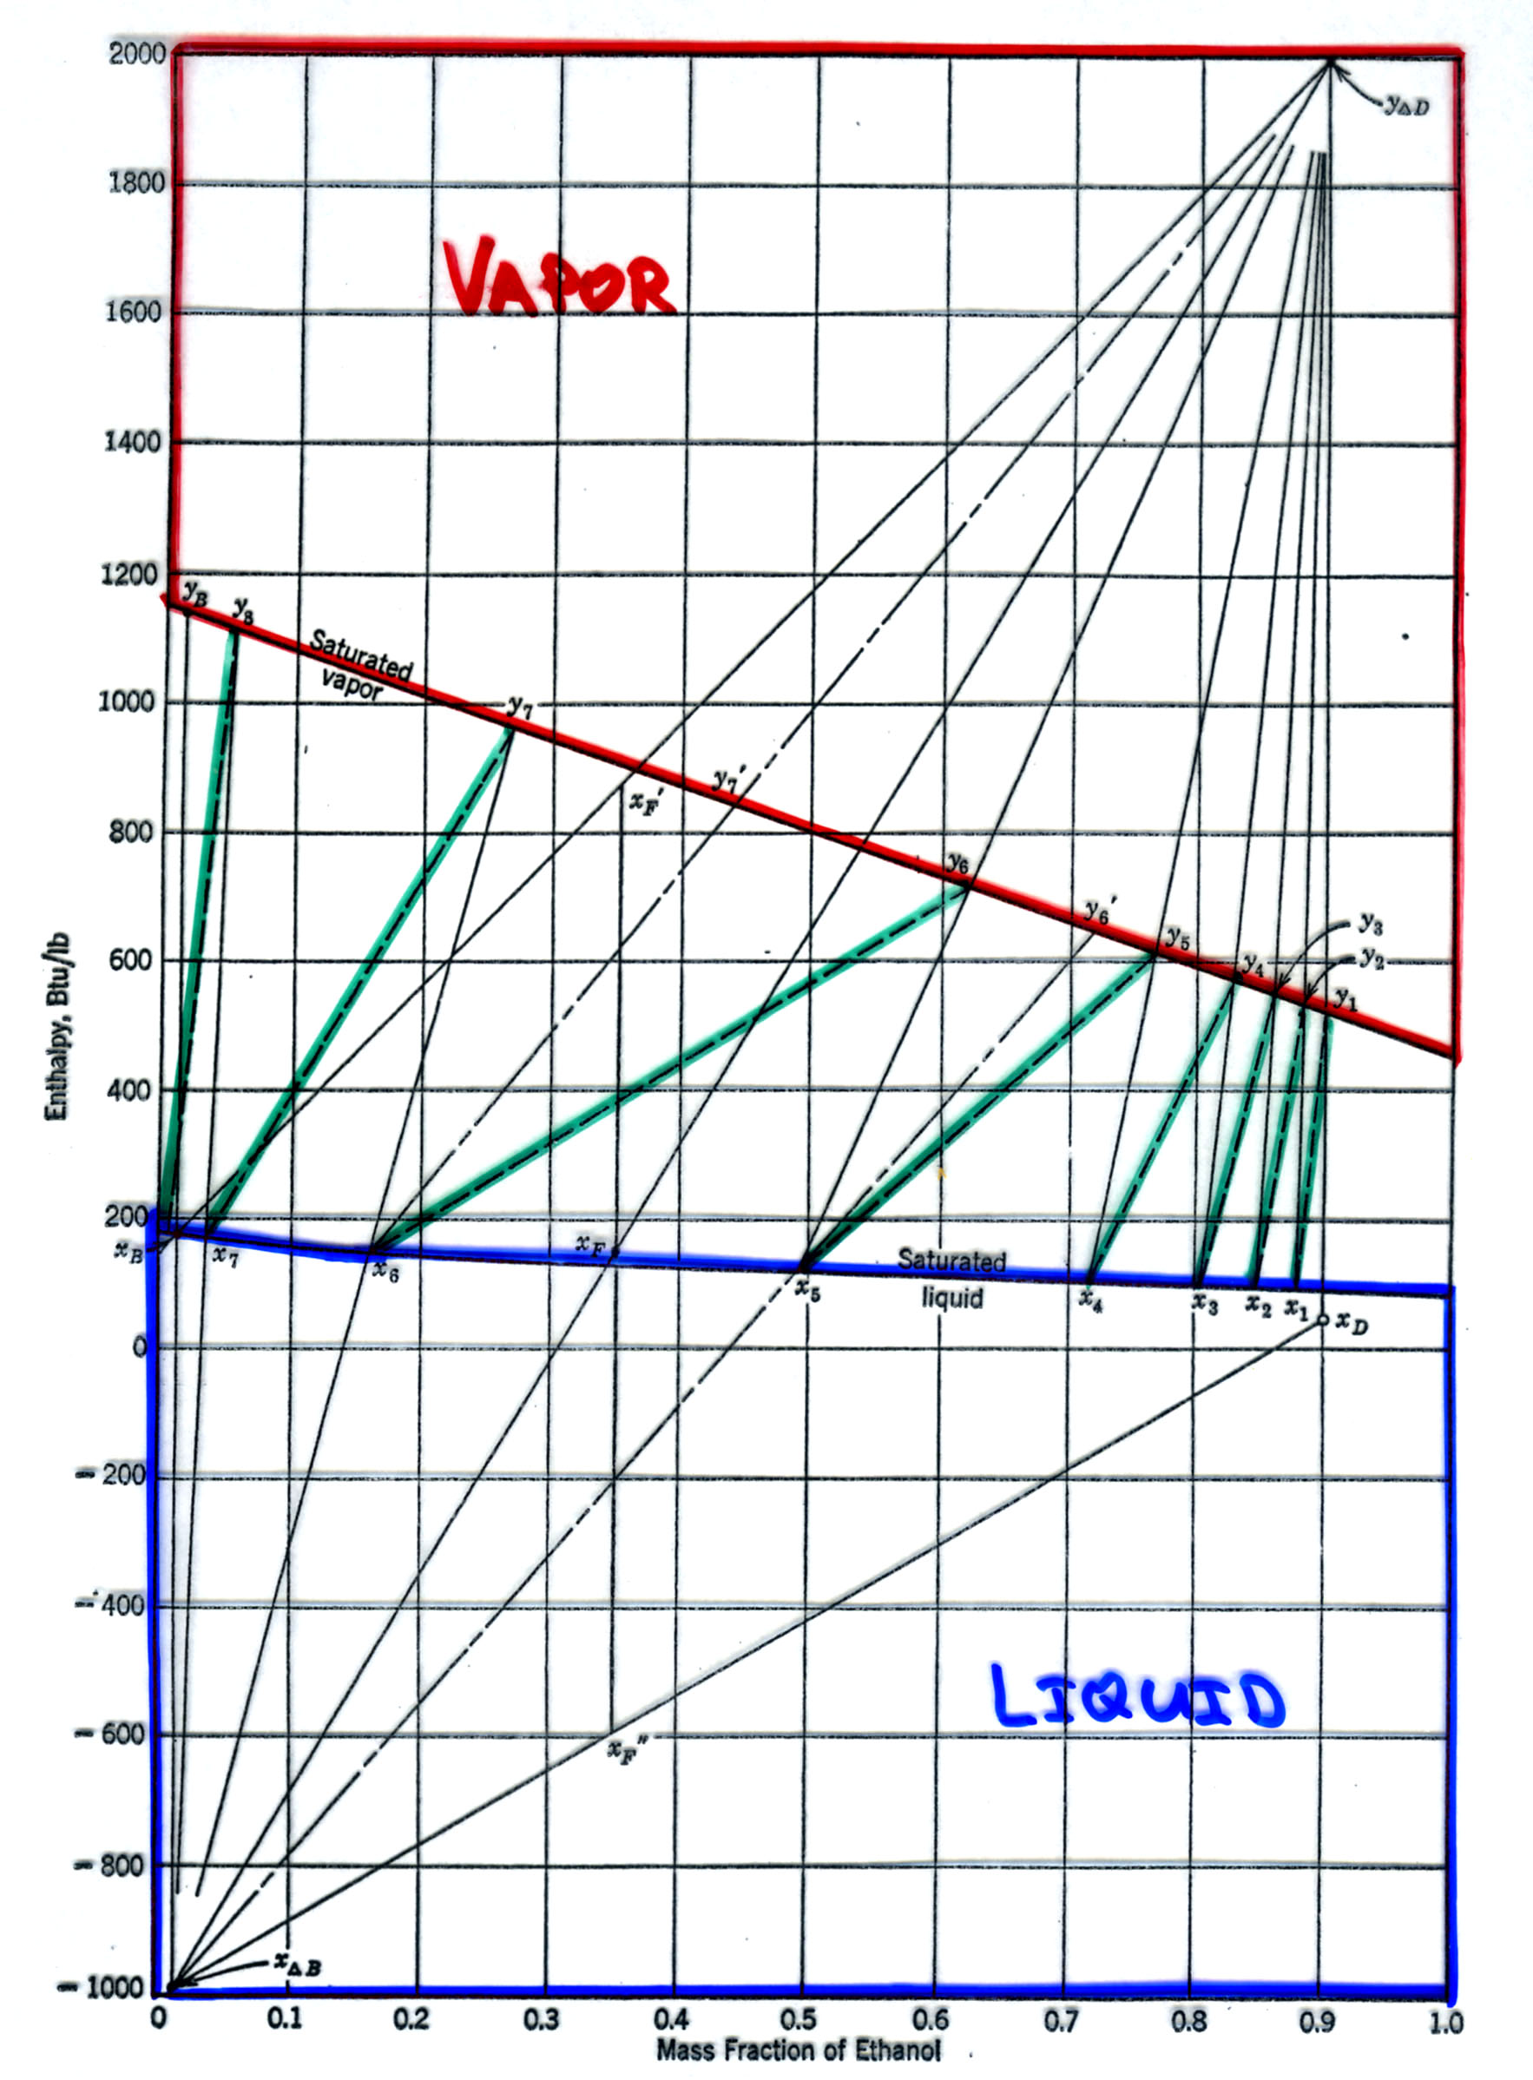
Multistage Countercurrent Distillation

Slide 24
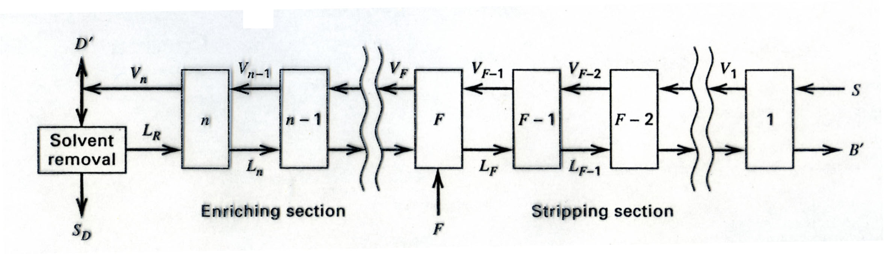
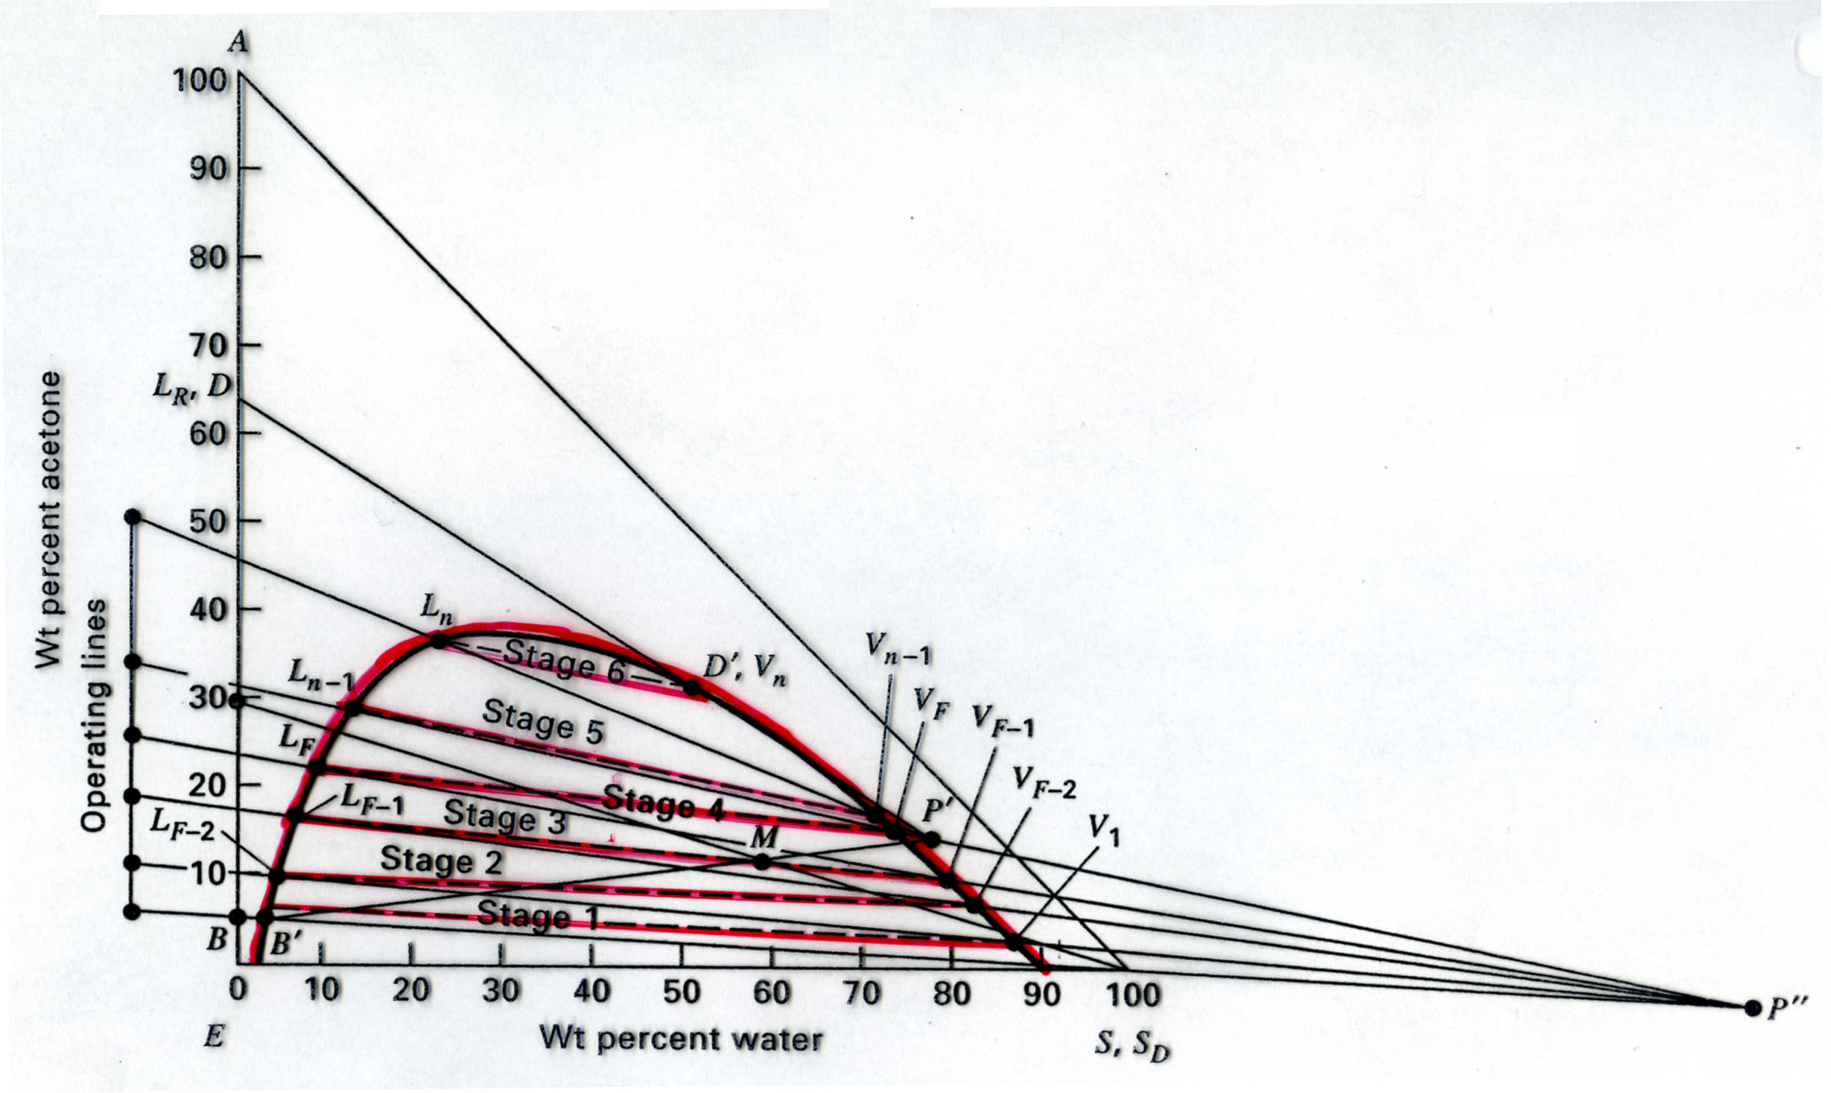
Multistage Countercurrent Liquid-Liquid Absorber

Slide 25
The Stages of Separations Development
Invent a new separation technique.
Devise a graphical analysis.
Write a song or poem.
Professor Harriott’s Ode to McCabe-Thiele:
“… Then one cried out - It’s simple, don’t you see?
The key to this problem is L over V.”

Slide 26
Three Skills in Dimensional Analysis / Dynamic Scaling
1. Derive a set of dimensionless groups given a list of parameters.
Lectures 28, 29, and 30:
Pendulums Swinging, People Walking, and Spheres Falling.
Practice Exercises: 5.8, 5.13, 5.15, 5.20, and 5.22.
2. Use a Universal Correlation of Dimensionless Groups.
Lecture 31.
Practice Exercises: 5.28, 5.29, and 5.30.
3. Design a Dynamically Similar Model by Scaling.
Lectures 32 and 33.
Practice Exercises: 5.33, 5.34, and 5.39.
Solutions to practice exercises are posted at the EngrD 2190 homepage.

Slide 27
Method of Dimensional Analysis
1. List parameters
will always be given in this course.
2. Find dimensions of each parameter
3. Write equation for generic Π group
4. Choose core variables
5. Derive Π groups
6. Measure Data
7. Plot universal correlation
Two Rules for Core Variables
1. The set of core variables must represent all dimensions.
Easy to check.
2. The core variables must not form a dimensionless group.
Not easy to check.
It is often easier to derive the Π groups.
If a problem arises, this rule was likely violated.

Slide 28
Methods of Using Dimensionless Correlations
If unknown variable uniquely appears in abscissca or ordinate – simple.
If unknown variable appears in both abscissca or ordinate – four methods.
1. Guess ‘n’ Check.
2. Eliminate the unknown parameter from the two dimensionless groups.
3. Convert the dimensionless correlation to an equation.
Recast the dimensionless correlation with the unknown variable
as a core variable.

Slide 29
Designing a Dynamically Similar Model
Assume the system is described by n Π groups: Π₁, Π₂, …, Π_{n}
1. Set (Π_{i})_{model} = (Π_{i})_{actual} for i = 1 to n−1.
2. Use the model to measure Π_{n}.
3. Use Π_{n} to calculate parameters for the actual system.
If your model has a different length and/or mass dimension -
your model is smaller or less massive - your model must also
change something so there is a different time dimension.
Usually, use a different fluid for the model.
Fluid parameters: viscosity:
surface tension:
heat capacity:
thermal conductivity:

Slide 30
Dimensional Analysis and Dynamic Scaling
Dynamics of Aerosols
Transmitted by Speech

Slide 31
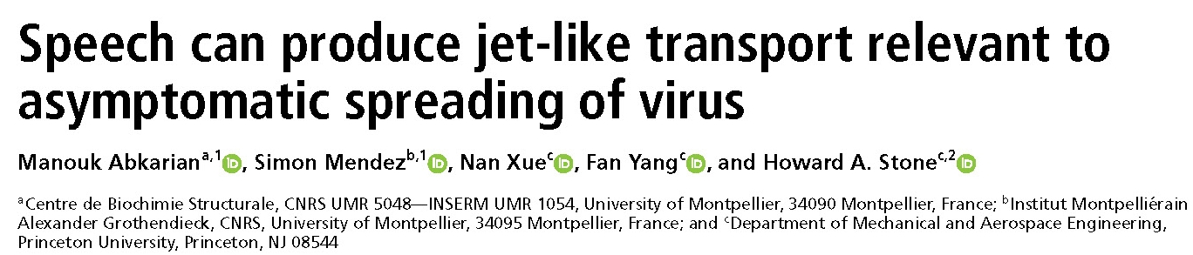
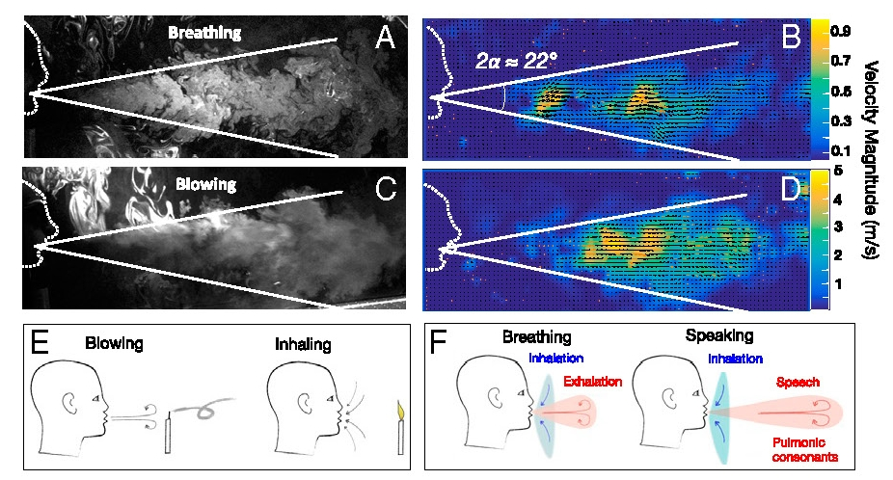
Dimensional Analysis: Viral Transmission by Speech-Driven Aerosol Transport

Slide 32
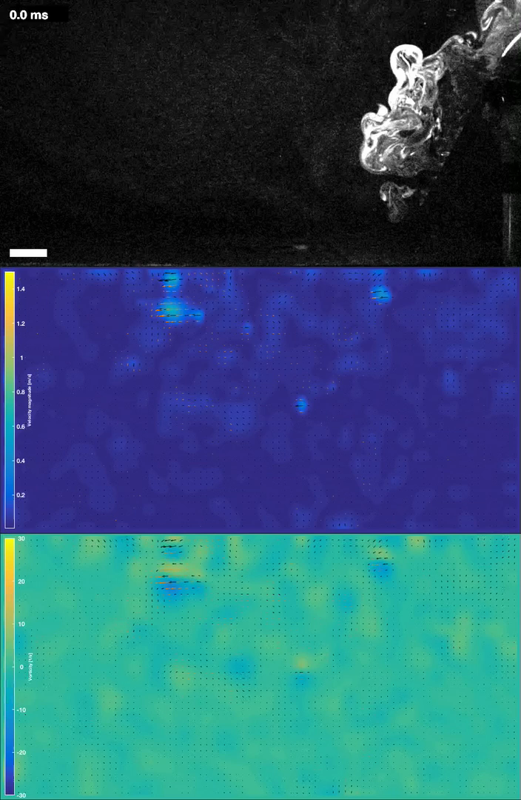

Slide 33
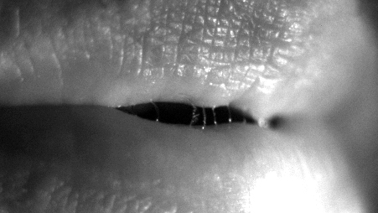
Aerosol Droplets Form from Filaments on Lips
Howard Stone et al.:
engineering.princeton.edu/news/2020/10/06/speaking-creates-droplets-linked-disease-transmission

Slide 34
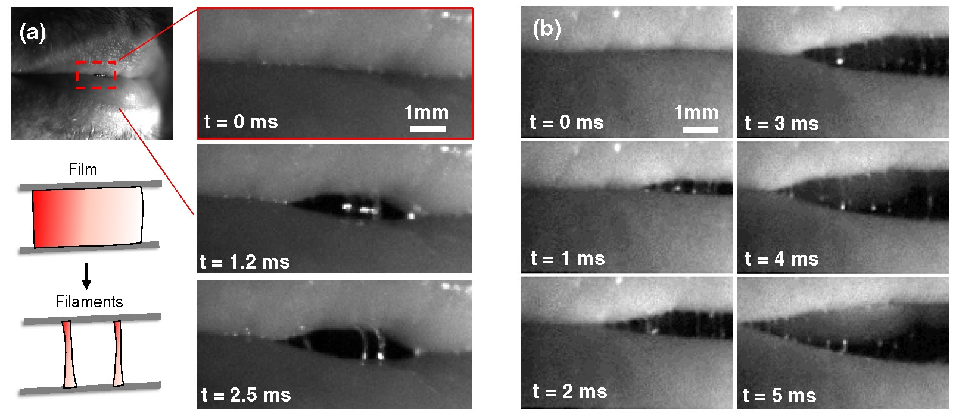
Aerosol Droplets Form from Saliva Filaments on Lips
Manouk Abkarian and Howard Stone, “Stretching and break-up of saliva filaments during speech: A route for pathogen aerosolization and its potential mitigation,” Physical Review Fluids 5, 102301(R) (2020)

Slide 35
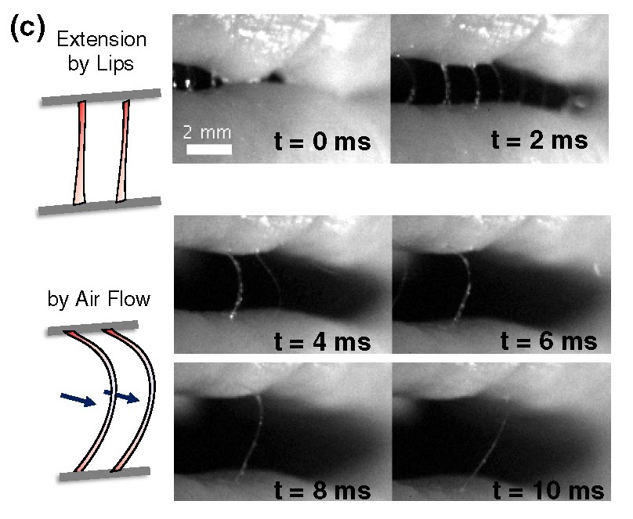
Aerosol Droplets Form from Saliva Filaments on Lips
Manouk Abkarian and Howard Stone, Physical Review Fluids 5, 102301(R) (2020)

Slide 36
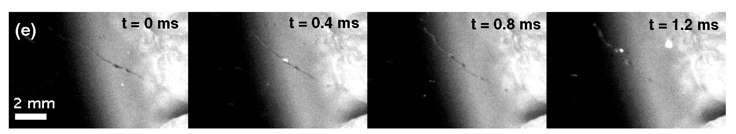
Aerosol Droplets Form from Saliva Filaments on Lips
System described by -
Reynolds Number – inertia/viscosity ratio in fluid flow
Stokes’s Number – behavior of droplets suspended in fluid flow
Weber Number – inertia/surface tension of droplets suspended in air
Ohnesorge Number – surface tension/viscosity of droplets suspended in air
OON-neh-sah-geh (German)
see exercise 5.23

Slide 37
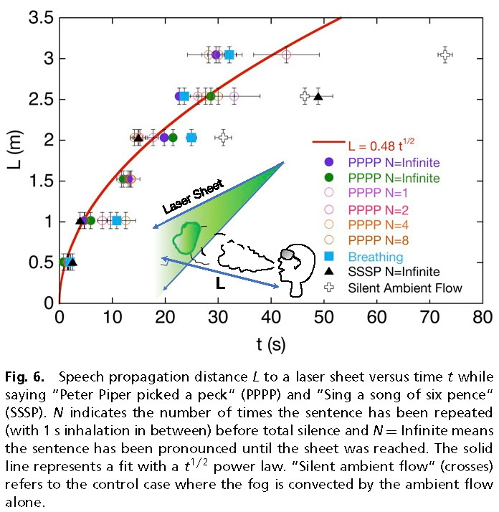
Time Scaling of Speech-Driven Aerosol Plume
Manouk Abkarian, Simon Mendez, Nan Xue, Fan Yang , and Howard A. Stone, “Speech can produce jet-like transport relevant to asymptomatic spreading of virus,” Proceedings of the National Academy of Science 117, 25237 (2020)

Slide 38
EngrD 2190 Course Objectives
Learning Skills
To know your natural learning style, to recognize the
learning style of a presentation or document, and to
translate into your preferred learning style.
To gain teamwork skills for design, analysis, and learning.

Slide 39
Stages and Styles of Learning
Stage | Style
Perception | Sensory Intuitive
Assimilation | Visual Verbal
Organization | Inductive Deductive
Processing | Active Reflective
Understanding | Sequential Global

Slide 40
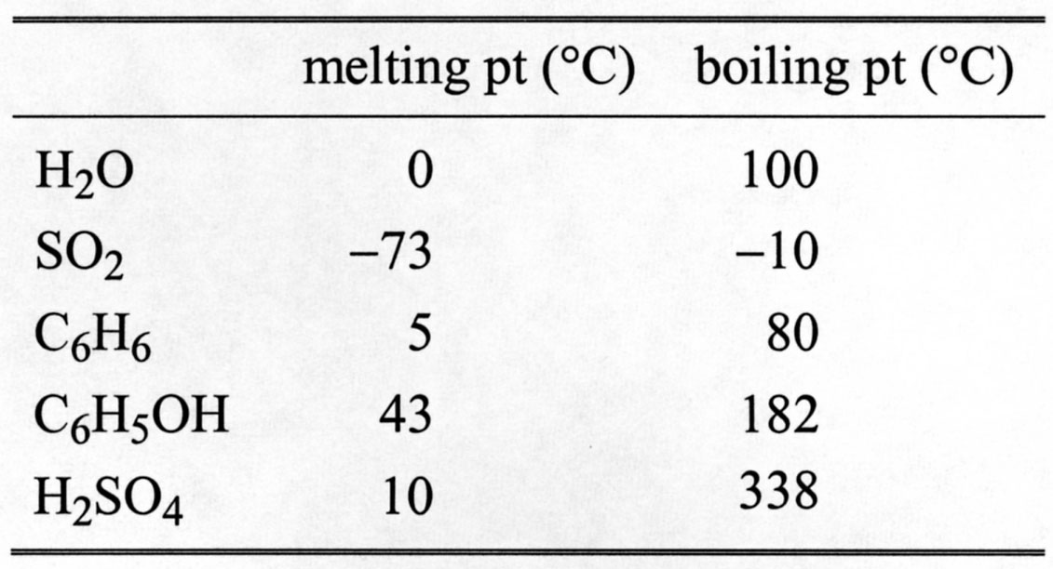
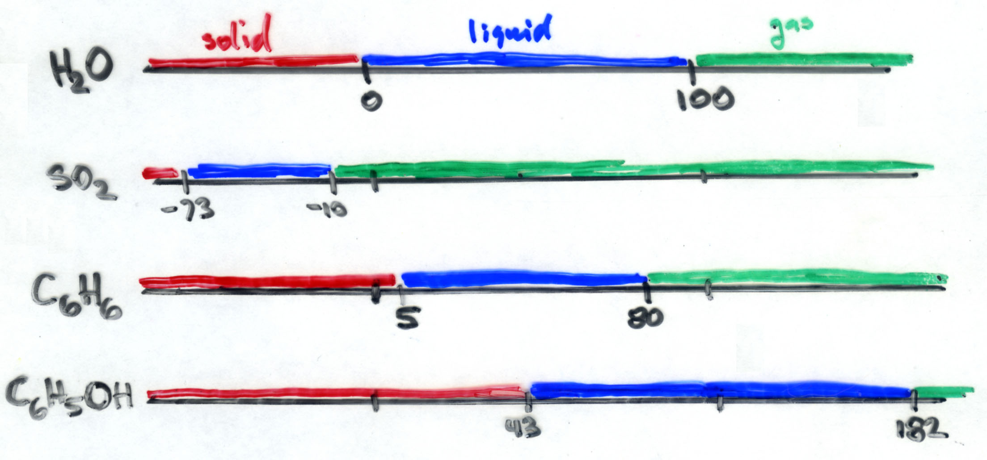
Visual vs. Verbal Assimilation
Verbal
Visual

Slide 41
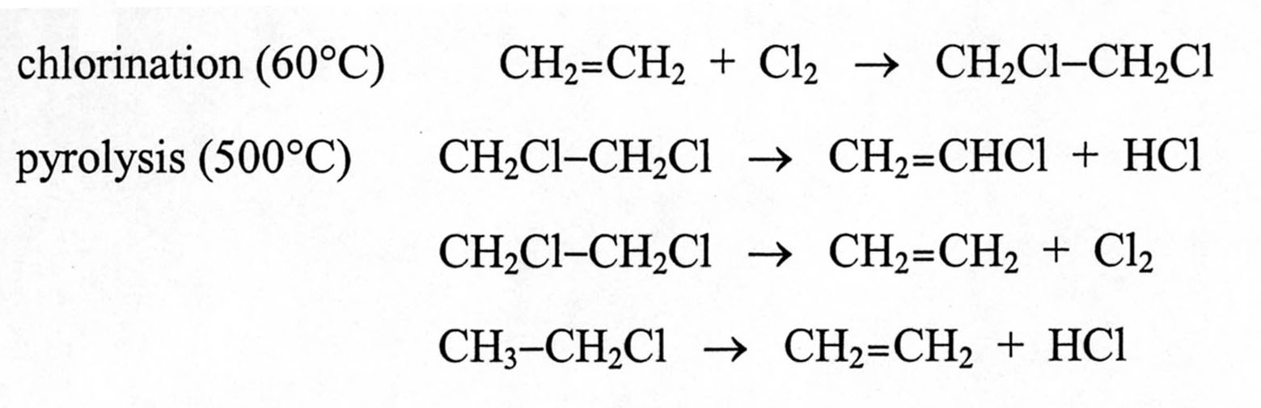
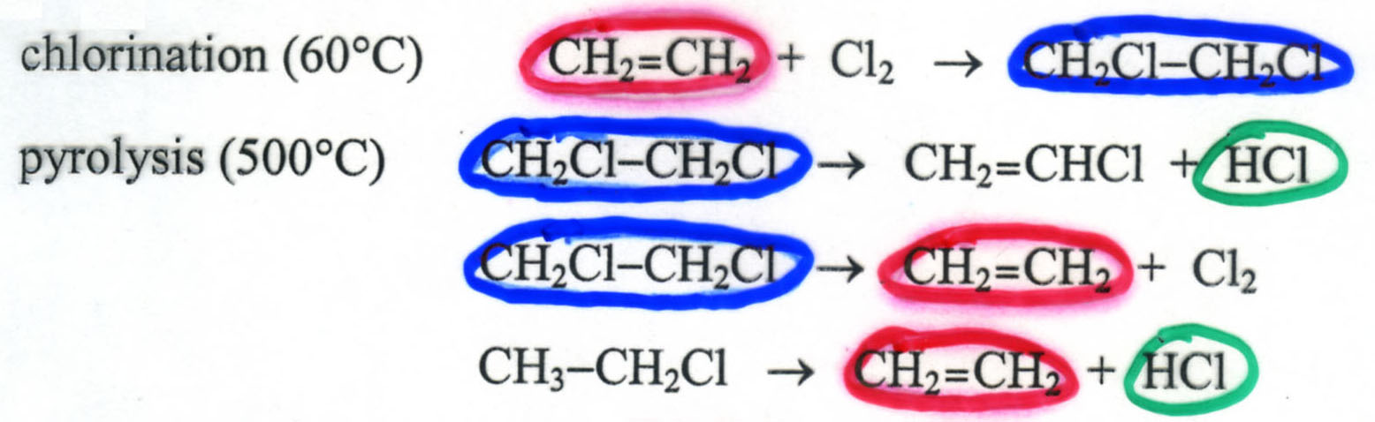
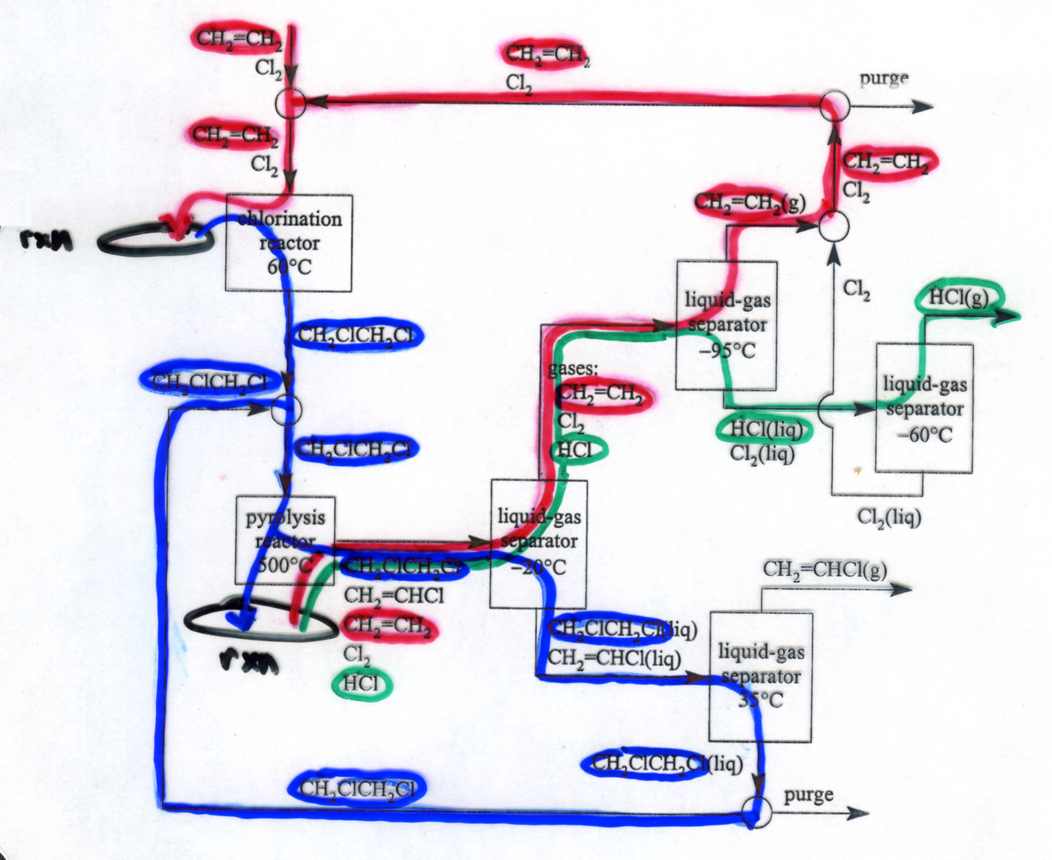
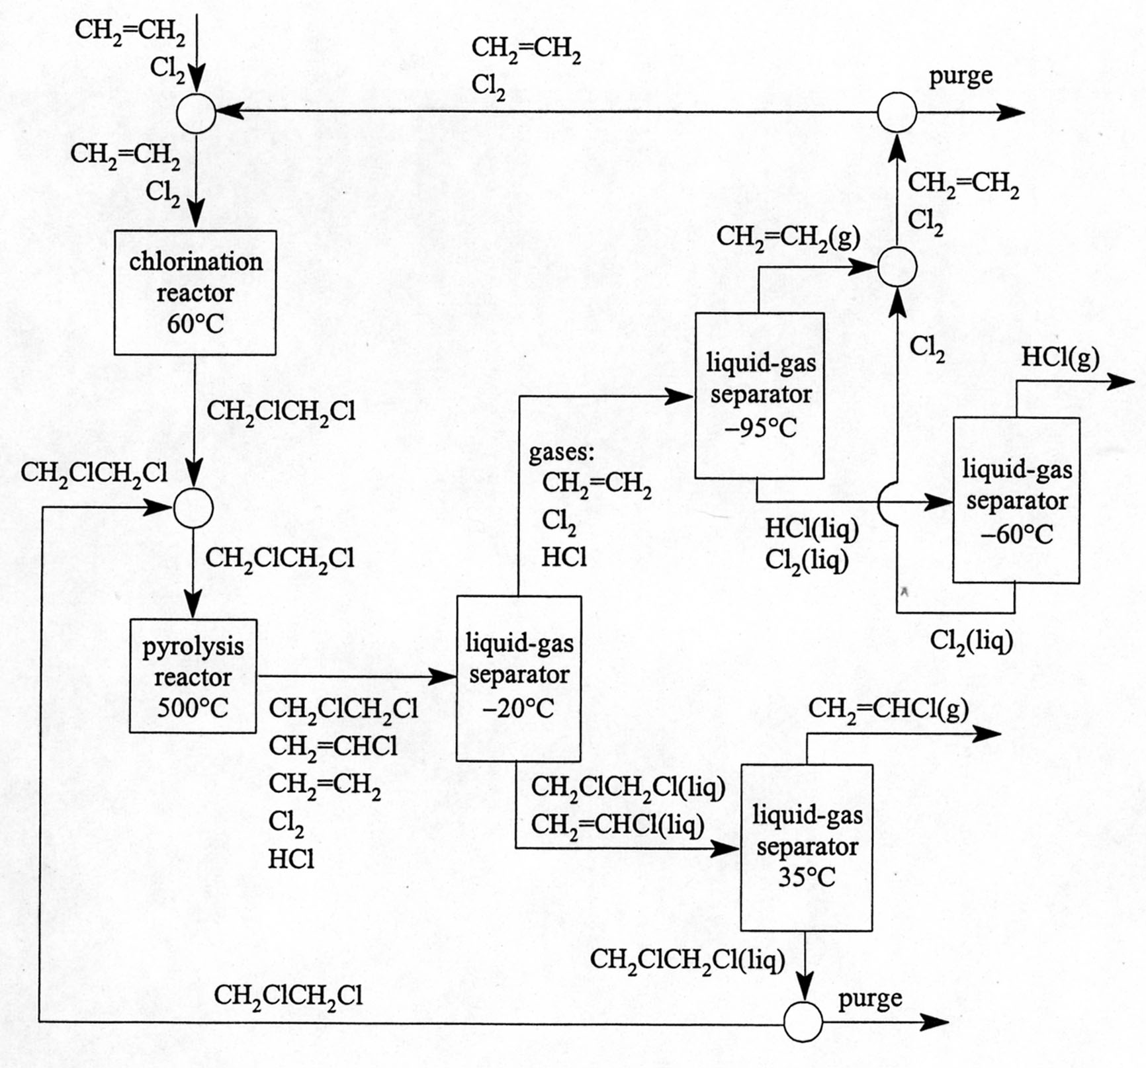
Active Processing and Visual Assimilation

Slide 42
Deductive vs. Inductive Organization
If you prefer to organize inductively
and your textbook has a deductive style,
annotate your textbook with inductive translations.
Deductive: “Solid-solid separators produce
solid-free liquids and wet solids.”
Inductive: “Dirty water separates into clean water and mud,
not clean water and dust.”
Deductive: “If a solid is soluble in a liquid,
the liquid and solid cannot be separated
into pure liquid and pure solids.”
Inductive: “Salt water fed to a solid-liquid separator
will not separate into pure water and dry salt,
even though NaCl is a solid at 20°C.”

Slide 43
Dimensionless Groups
Euler
“Oiler”
Froude
“Frood”
Not “Froud”
Thiele
“TEE-leh”
Not “THEE-lee”
Péclet
“pay-CLAY”
Poiseuille
“pwah-zø-YAH”
see p. 469.

