Slide 1



Calculation Session 10
Exercise 2
Created by: Professor Duncan
Edited by: Vivian Liu (‘26)

Slide 2

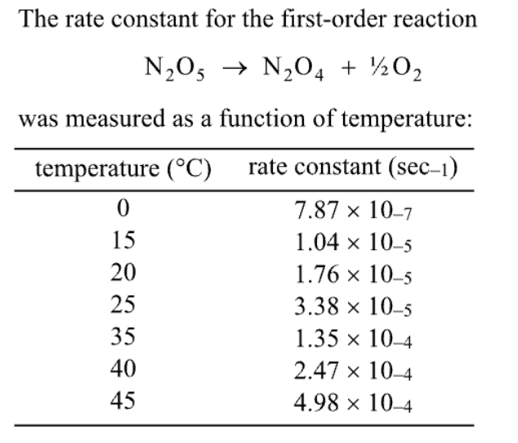
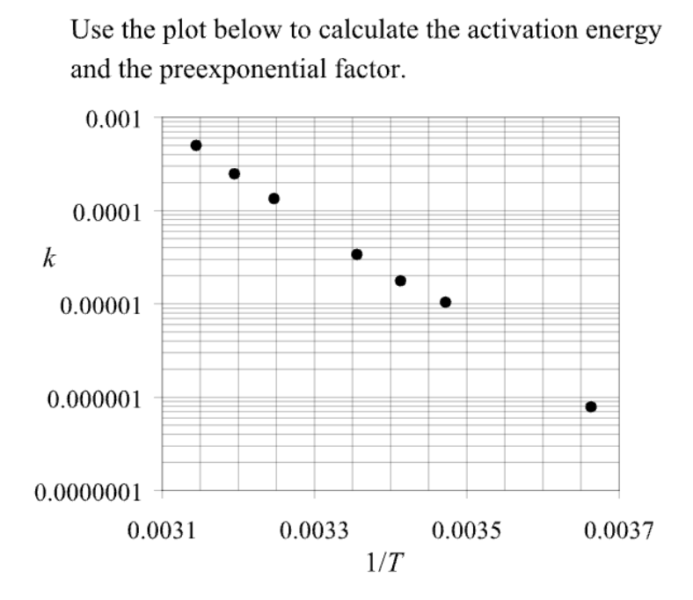

Givens

Slide 3
Arrhenius Parameters A and E_{a} from Experimental Data
Example: A + B → products
r_{rxn} = k [A]^{n}[B]^{m}
Measure r_{rxn} at different temperatures and concentrations. Calculate k at each temperature.
Assume Arrhenius Theory:
Goal: A straight line to verify the assumption.
Plot ln k vs. 1/T
y
10,000
slope
x
or use semi-log paper.
1,000
k
100
Straight line
validates
Arrhenius Theory.
10
y
slope
x
hot
cold
1
0
Lecture K4, Slide 10
(T → ∞)

Slide 4

(0.0031, 0.0008)
Good job!
(0.0037, 0.00000055)

Slide 5

Calculate the Activation Energy, E_{A}
Is magnitude of E_{a} reasonable?
Yes!

Slide 6

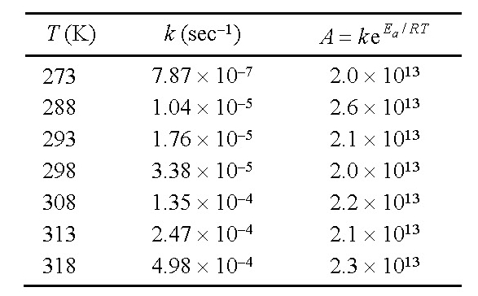

Calculate the Pre-exponential, A
average value is A ≈ 2 × 10¹³
A is extremely sensitive to the activation energy
and the activation energy is somewhat uncertain.
Typically only one significant figure can be justified for A.

Slide 7
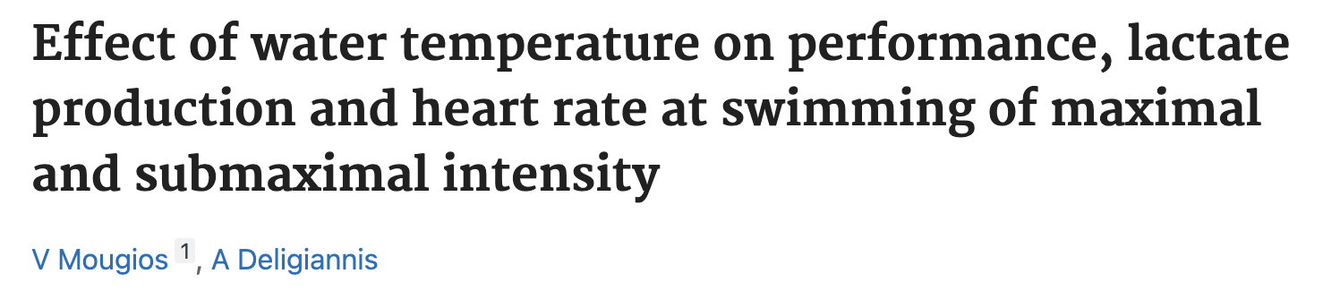

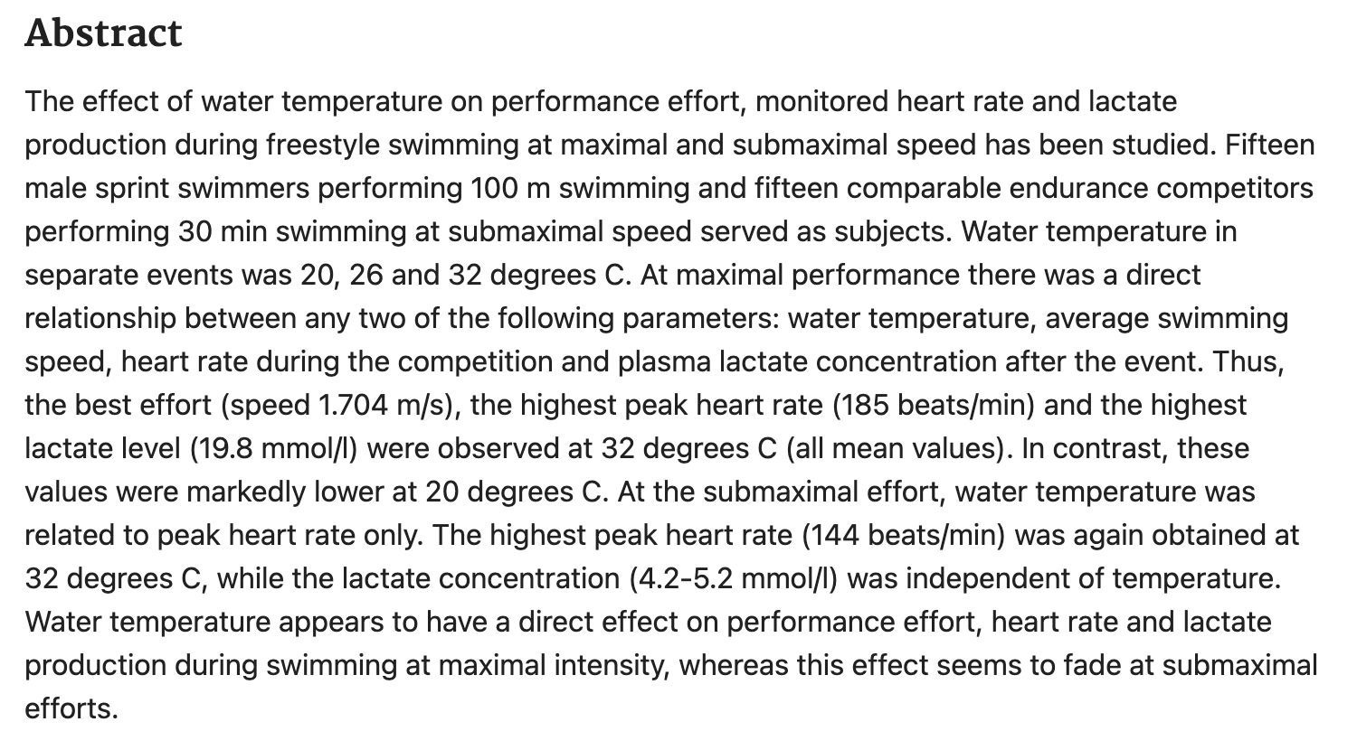
Unconventional Applications of Arrhenius Law

Slide 8
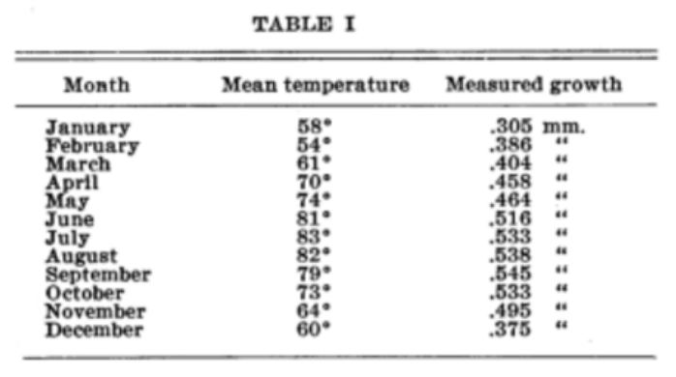

Unconventional Applications of Arrhenius Law
Seasonal Changes in Hair Growth
Eaton, P.; Eaton, M. W. Science 1937, 86 (2233), 354–354.

Slide 9
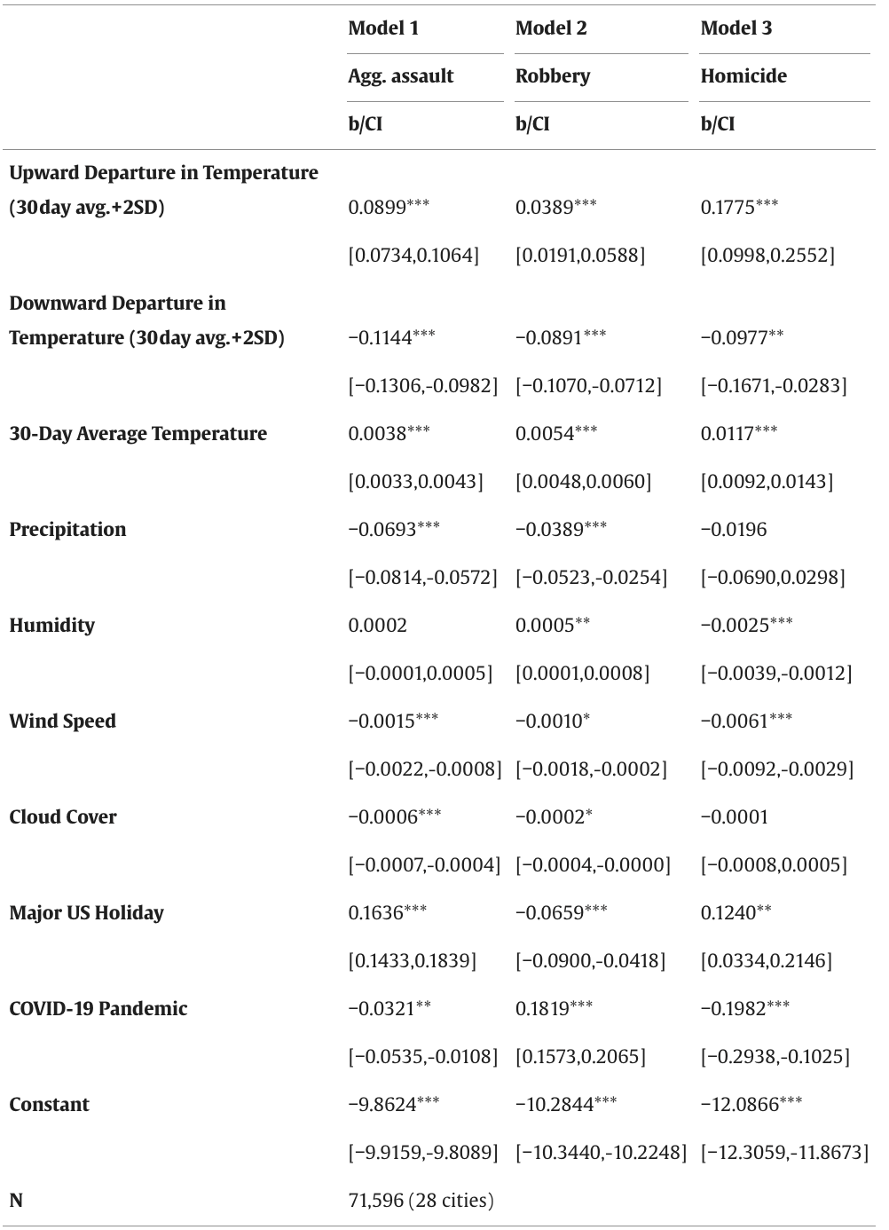

Unconventional Applications of Arrhenius Law
Temperature and Violent Crime Rate
Thomas, C.; Wolff, K. T. Journal of Criminal Justice 2023, 87, 102090–102090

Slide 10
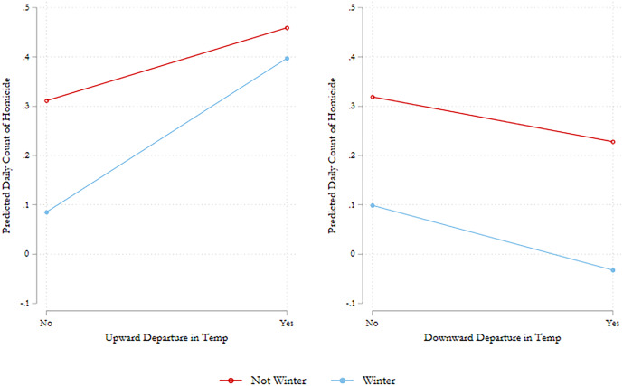
Unconventional Applications of Arrhenius Law
Temperature and Violent Crime Rate
Thomas, C.; Wolff, K. T. Journal of Criminal Justice 2023, 87, 102090–102090

Slide 11


Key Takeaways
Pay attention to graph axes
  semi-log, log-log, normal
Pay attention to significant figures
Reasonable activation energies are on the order of 10-10² kJ/mol
In warmer weather, remember to choose peace

