Slide 1
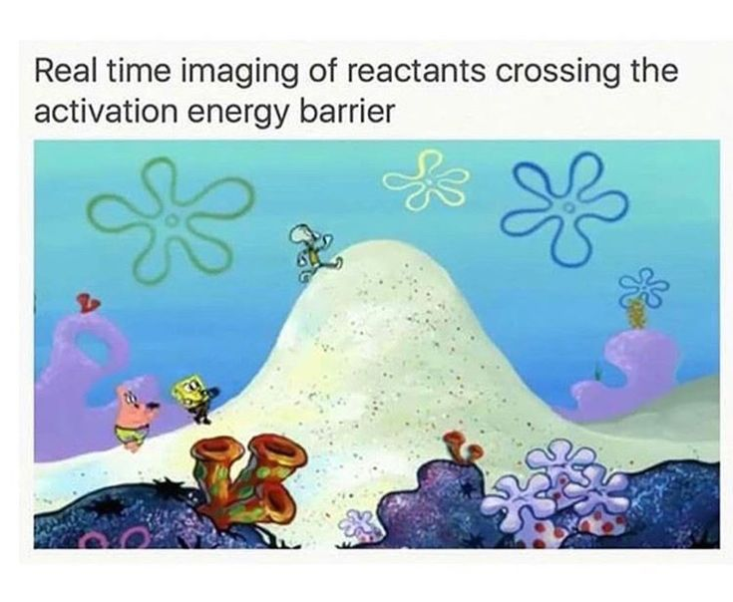

Calculation Session 10
Exercise 3
By Alana Szkodny ’14
Revised by Heather Barton and Katherine Fein ’15
Revised by Will Gregg ’16 and Eric McShane ’16
Revised by Alyssa Restauro ‘17 and Emily Mendelsohn ‘17
Revised by Vinnie Rigoglioso ’18 and Michaela Jones ’18
Revised by Praveen Bagavandoss ‘19 and Jordan Fuller ’19
Revised by Drew Lazarow ’21
Revised by Kaleigh Soucy ’23
Revised by Lauren de Silva ’25
Revised by Kong Chen ‘26

Slide 2


Slide 3

GOAL
Match reactions to their corresponding Arrhenius plot considering only the forward reaction
Arrhenius???

Slide 4
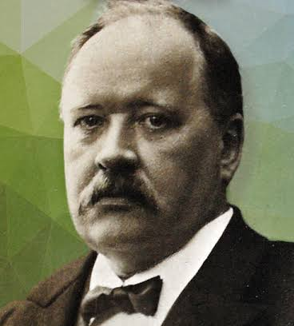
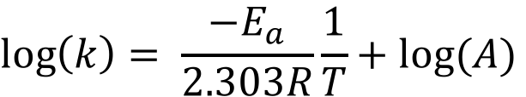
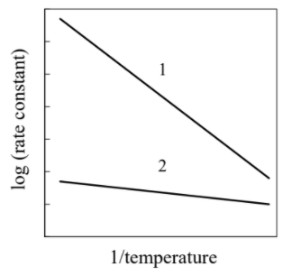

Arrhenius Plot
$$k=Ae^{−\frac{Ea}{RT}}$$
When plotting
$$lnK=\frac{−E_{a}}{R}\left(\frac{1}{T}\right)+lnA$$
y
m
x
b
HOT
COLD

Slide 5
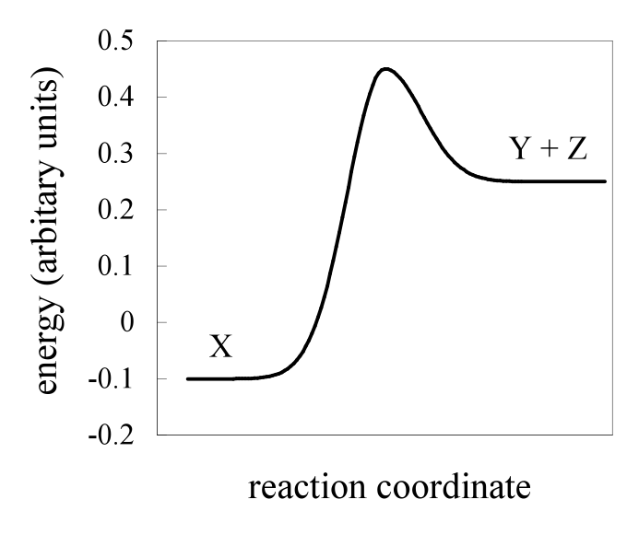
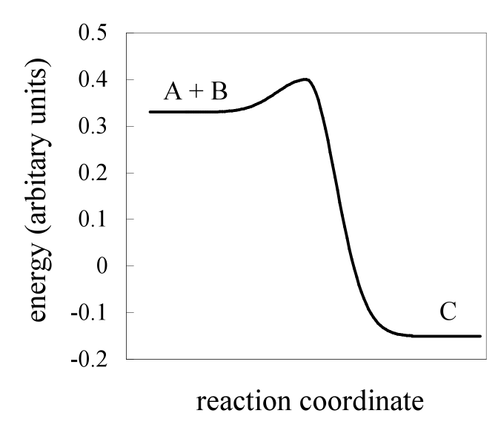
Lets look at the rate of the reaction…
REACTION 1
REACTION 2
A + B → C
X → Y + Z
Small E_{a}
Large E_{a}
Which reaction is faster?
Hint:
Compare Activation Energies
Reaction 1 is faster!

Slide 6


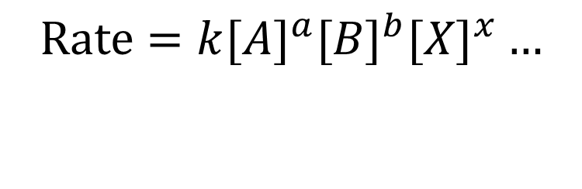
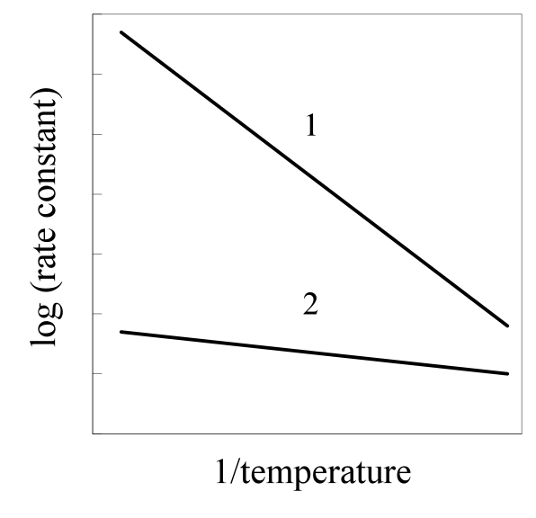
Small E_{A}
Large E_{A}
REACTION 1
REACTION 2
WRONG!!
Larger rate constant = Faster reaction!!!
$$Rate=k[A]^{a}[B]^{b}[X]^{x}…$$

Slide 7
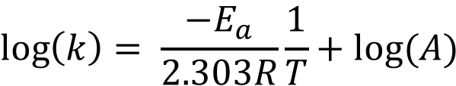
Slope is proportional to activation energy
Intercept is the log of the pre- exponential factor

Slide 8
Smaller E_{a}, so shallower slope
Larger E_{a}, so steeper slope
REACTION 1
REACTION 2
Higher E_{A} reaction is more sensitive to temperature
Notes:
This should make sense, A is your efficiency of collisions. In bimolecular reactions, you have chances to bump into the wrong molecules, so your A is usually lower. In decomp, you always have a chance to form products, so your A is usually higher.

Slide 9
Now for a sanity check…
Bimolecular Collisions
Unimolecular Decomposition
The A tends to be much larger for Unimolecular Decomposition (sometimes as extreme as 10¹⁷ versus 10¹⁰)
Notes:
This should make sense, A is your efficiency of collisions. In bimolecular reactions, you have chances to bump into the wrong molecules, so your A is usually lower. In decomp, you always have a chance to form products, so your A is usually higher.

Slide 10
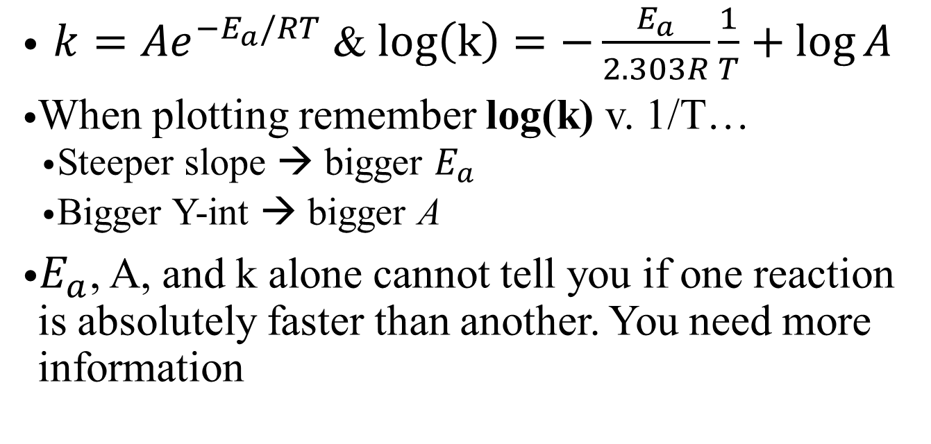
Key Takeaways
${k=Ae}^{−E_{a}/RT}$ & $log\left(k\right)=−\frac{E_{a}}{2.303R}\frac{1}{T}+\log{A}$
When plotting remember log(k) v. 1/T…
  Steeper slope → bigger $E_{a}$
  Bigger Y-int → bigger A
  $E_{a}$, A, and k alone cannot tell you if one reaction is absolutely faster than another. You need more information
Notes:
Celebratory high-five!

