Slide 1
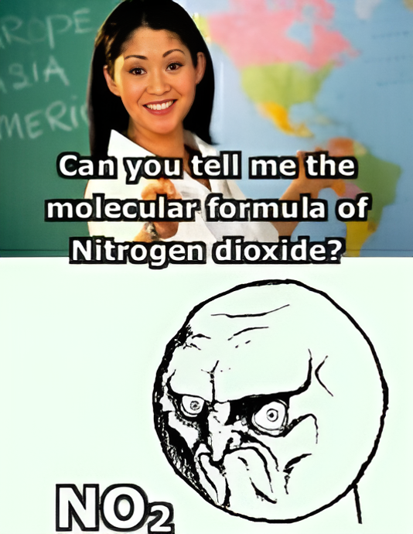
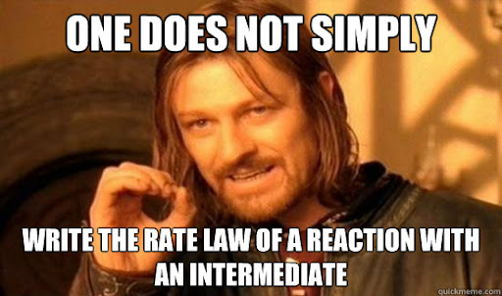
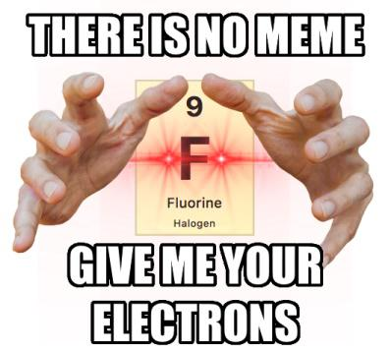
Calculation Session 11
Exercise 2
Created by Carl Schultz (‘15)
Revised by Michael Statt (‘16), Alyssa Restauro (’17), Adam Berry (‘18), Connie Li (‘19), Max Graham (‘21), Jonathan Su (‘23), Ashlyn Dumaw (‘25), and Amy Wu (‘26)

Slide 2
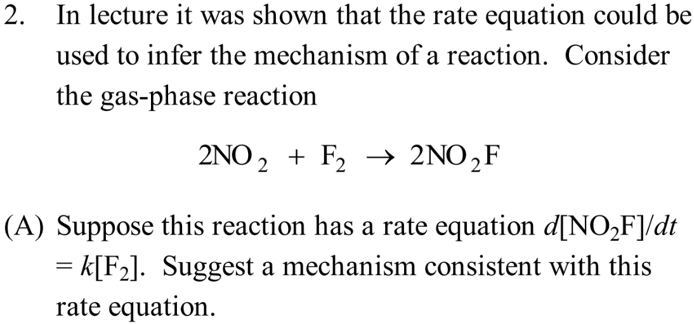

Slide 3
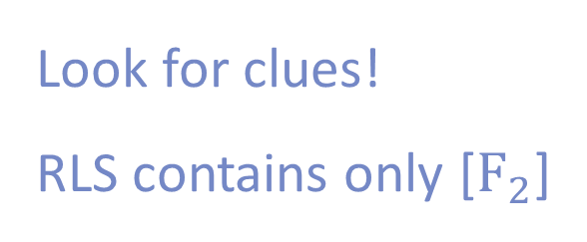
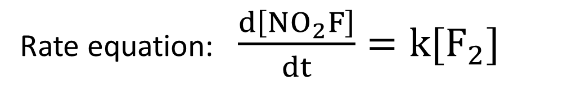
Part A
Rate equation: $\frac{d\left[NO_{2}F\right]}{dt}=k[F_{2}]$
Look for clues!
RLS contains only [$F_{2}$]
slow (RLS)
fast

Slide 4
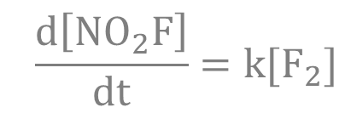
Part A
$$\frac{d\left[NO_{2}F\right]}{dt}=k[F_{2}]$$
slow (RLS)
fast
F· is an intermediate
What approximation can we use?
Steady-state approximation!

Slide 5
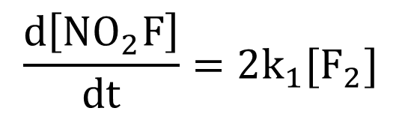


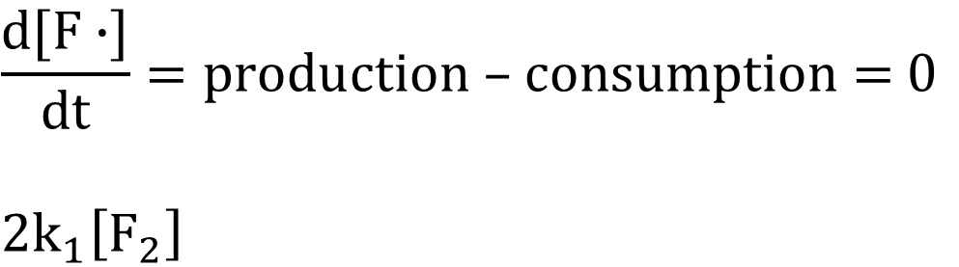
Part A
$$\frac{d\left[NO_{2}F\right]}{dt}=k[F_{2}]$$
Steady-state approximation:
concentration does not change with time
$$\frac{d[F∙]}{dt}=\text{production}\text{ – }\text{consumption}\text{ = 0}$$
$$2k_{1}\left[F_{2}\right]$$
$$−k_{2}\left[NO_{2}\right]\left[F∙\right]=0$$
$$2k_{1}\left[F_{2}\right]=k_{2}\left[NO_{2}\right]\left[F∙\right]$$
$$\frac{d\left[NO_{2}F\right]}{dt}=2k_{1}[F_{2}]$$

Slide 6
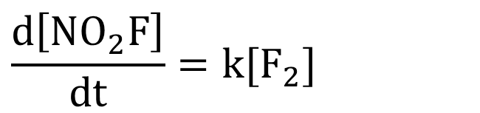
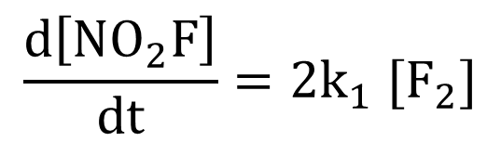
Part A
$$\frac{d\left[NO_{2}F\right]}{dt}=k[F_{2}]$$
$$\frac{d\left[NO_{2}F\right]}{dt}=2k_{1} [F_{2}]$$
$$\frac{d\left[NO_{2}F\right]}{dt}=k[F_{2}]$$

Slide 7
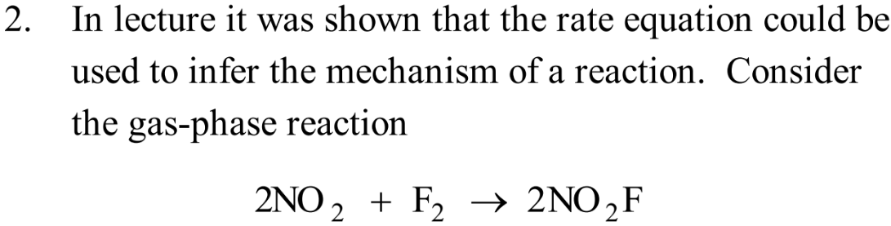
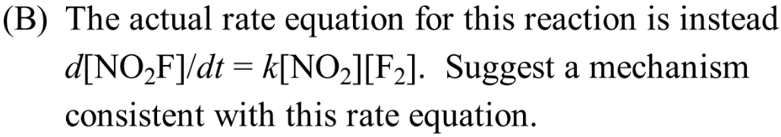

Slide 8
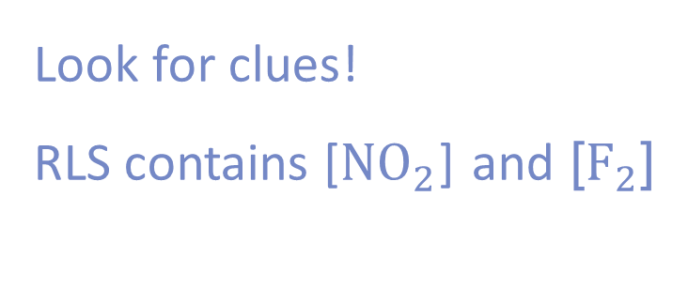
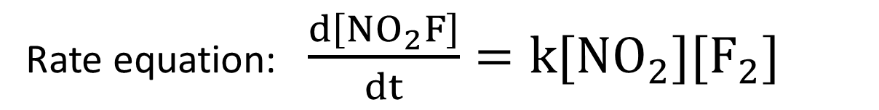
Part B
Rate equation: $\frac{d\left[NO_{2}F\right]}{dt}=k[{NO}_{2}][F_{2}]$
Look for clues!
RLS contains [${NO}_{2}$] and [$F_{2}$]
slow (RLS)
fast

Slide 9
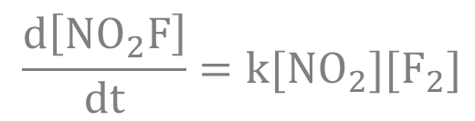
Part B
$$\frac{d\left[NO_{2}F\right]}{dt}=k[{NO}_{2}][F_{2}]$$
slow (RLS)
fast
F· is an intermediate
Steady-state approximation!

Slide 10
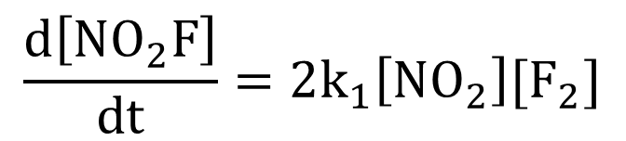

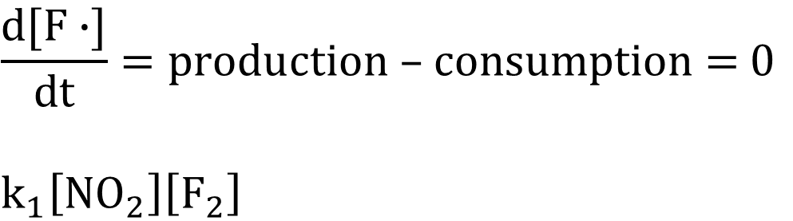
Part B
$$\frac{d\left[NO_{2}F\right]}{dt}=k[{NO}_{2}][F_{2}]$$
Steady-state approximation:
concentration does not change with time
$$\frac{d[F∙]}{dt}=\text{production}\text{ – }\text{consumption}\text{ = 0}$$
$$k_{1}\left[{NO}_{2}\right]\left[F_{2}\right]$$
$$−k_{2}\left[NO_{2}\right]\left[F∙\right]=0$$
$$k_{1}\left[{NO}_{2}\right]\left[F_{2}\right]=k_{2}\left[NO_{2}\right]\left[F∙\right]$$
$$\frac{d\left[NO_{2}F\right]}{dt}=2k_{1}\left[NO_{2}\right][F_{2}]$$

Slide 11
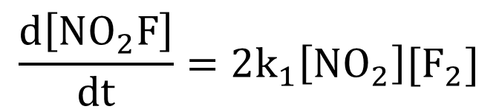
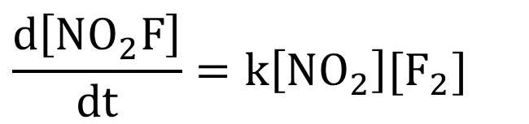
Part B
$$\frac{d\left[NO_{2}F\right]}{dt}=k[{NO}_{2}][F_{2}]$$
$$\frac{d\left[NO_{2}F\right]}{dt}=2k_{1}\left[NO_{2}\right][F_{2}]$$
$$\frac{d\left[NO_{2}F\right]}{dt}=k\left[NO_{2}\right][F_{2}]$$

Slide 12
Key Takeaways
Use the provided rate equation to look for clues
Use your chemical intuition to devise a mechanism
The overall rate equation indicates what species are likely in the rate limiting step
Use the steady-state approximation on intermediates (especially radicals)!

