Slide 1
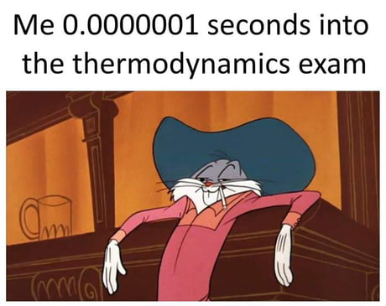


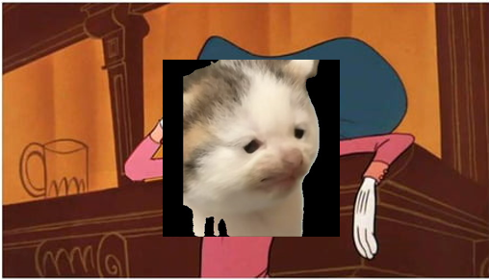
CALCULATION SESSION 12
EXERCISE 2
By Emily Mendelsohn (‘17)
Revised by Kathryn Haldeman (‘18)
Jordan Fuller (‘19) and Praveen Bagavandoss (‘19)
Max Graham (‘21)
Leon Lee (‘23)
Lauren de Silva (’25) and Dennis Wu (‘25)
Amy Wu (‘26)

Slide 2
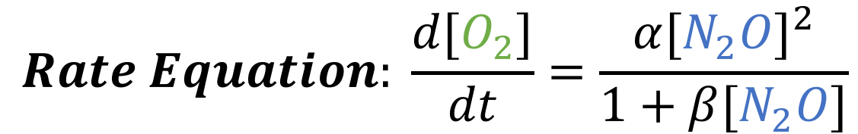
Let’s look at the decomposition of N₂O
$$Overall Reaction: 2N_{2}O→2N_{2}+O_{2}$$
$$Rate Equation: \frac{d[O_{2}]}{dt}=\frac{α{[N_{2}O]}^{2}}{1+β[N_{2}O]}$$
Note: N₂O₂, N₄O₂, and excited nitrous oxide (N₂O*) are extremely unstable

Slide 3



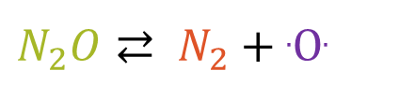

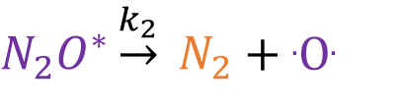


Given these reaction mechanisms….
$$Overall Reaction: 2N_{2}O→2N_{2}+O_{2}$$
Mechanism A
Mechanism B
k₁
k₁
$N_{2}O⇄ N_{2}+$.O.
$$N_{2}O+N_{2}O⇄ N_{2}O^{∗}+N_{2}O$$
k ₋₁
k ₋₁
$$\text{.}\text{O}\text{.}+ N_{2}O\underset{→}{k_{2}} N_{2}+O_{2}$$
$N_{2}O^{∗}\underset{→}{k_{2}} N_{2}+$.O.
$${\text{.}\text{O}\text{.}+N}_{2}O \underset{→}{k_{3}} N_{2}+ O_{2}$$
Mechanism C
k₁
$$N_{2}O+N_{2}O⇄ N_{4}O_{2}$$
k ₋₁
$$N_{4}O_{2}\underset{→}{k_{2}} N_{2}+{N_{2}O}_{2}$$
$$N_{2}O_{2}\underset{→}{k_{3}} N_{2}+O_{2}$$

Slide 4
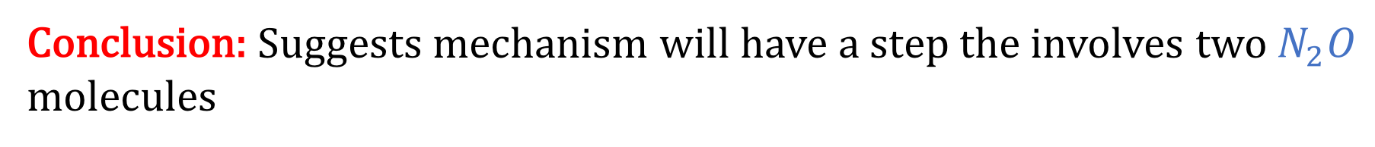
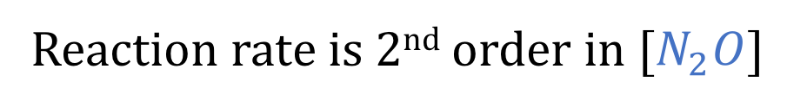
Can we eliminate any choices?
What is the order of the reaction at low concentrations of $N_{2}O$?
$$Rate Equation: \frac{d[O_{2}]}{dt}=\frac{α{[N_{2}O]}^{2}}{1+β[N_{2}O]}=\frac{α{[N_{2}O]}^{2}}{1}=α{[N_{2}O]}^{2}$$
Reaction rate is 2nd order in [$N_{2}O$]
Conclusion: Suggests mechanism will have a step the involves two $N_{2}O$ molecules

Slide 5



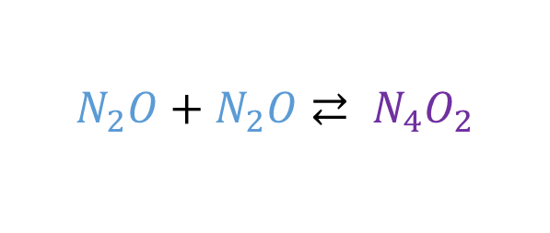
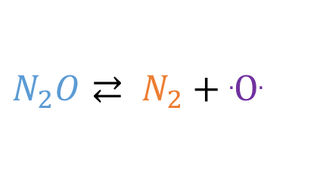

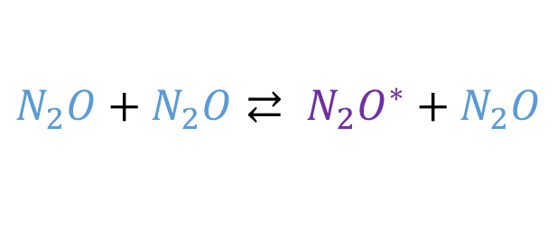
Proposed Mechanisms
$$Overall Reaction: 2N_{2}O→2N_{2}+O_{2}$$
Mechanism B
Mechanism A
k₁
k₁
$$N_{2}O+N_{2}O⇄ N_{2}O^{∗}+N_{2}O$$
$N_{2}O⇄ N_{2}+$.O.
k ₋₁
k ₋₁
$N_{2}O^{∗}\underset{→}{k_{2}} N_{2}+$.O.
$$\text{.}\text{O}\text{.}+ N_{2}O\underset{→}{k_{2}} N_{2}+O_{2}$$
$${\text{.}\text{O}\text{.}+N}_{2}O \underset{→}{k_{3}} N_{2}+ O_{2}$$
Mechanism C
k₁
$$N_{2}O+N_{2}O⇄ N_{4}O_{2}$$
k ₋₁
$$N_{4}O_{2}\underset{→}{k_{2}} N_{2}+{N_{2}O}_{2}$$
$$N_{2}O_{2}\underset{→}{k_{3}} N_{2}+O_{2}$$

Slide 6
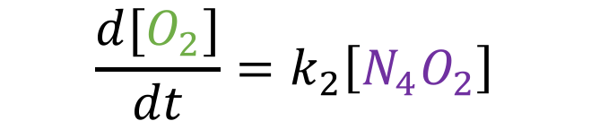

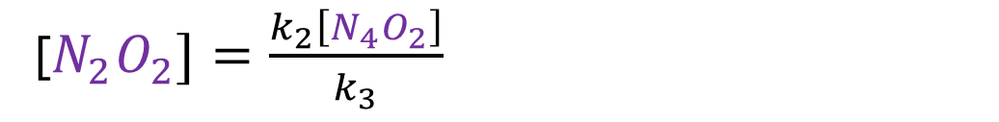

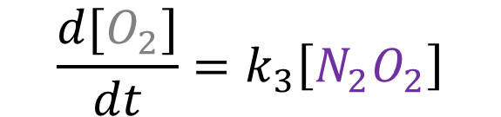

Mechanism C
Mechanism C
Step 1: Derive rate equation
k₁
$$\frac{d[O_{2}]}{dt}=k_{3}\left[N_{2}O_{2}\right]$$
$$N_{2}O+N_{2}O⇄ N_{4}O_{2}$$
k ₋₁
$$N_{4}O_{2}\underset{→}{k_{2}} N_{2}+{N_{2}O}_{2}$$
Step 2: Check if any intermediates
If yes, apply an approximation method
$$N_{2}O_{2}\underset{→}{k_{3}} N_{2}+O_{2}$$
We don’t have k information, so let’s try a steady state approximation on N₂O₂
$$\frac{d[N_{2}O_{2}]}{dt}=0=k_{2}\left[N_{4}O_{2}\right]−k_{3}[N_{2}O_{2}]$$
$$\frac{d[O_{2}]}{dt}=k_{2}\left[N_{4}O_{2}\right]$$
[$N_{2}O_{2}]=\frac{k_{2}\left[N_{4}O_{2}\right]}{k_{3}}$

Slide 7
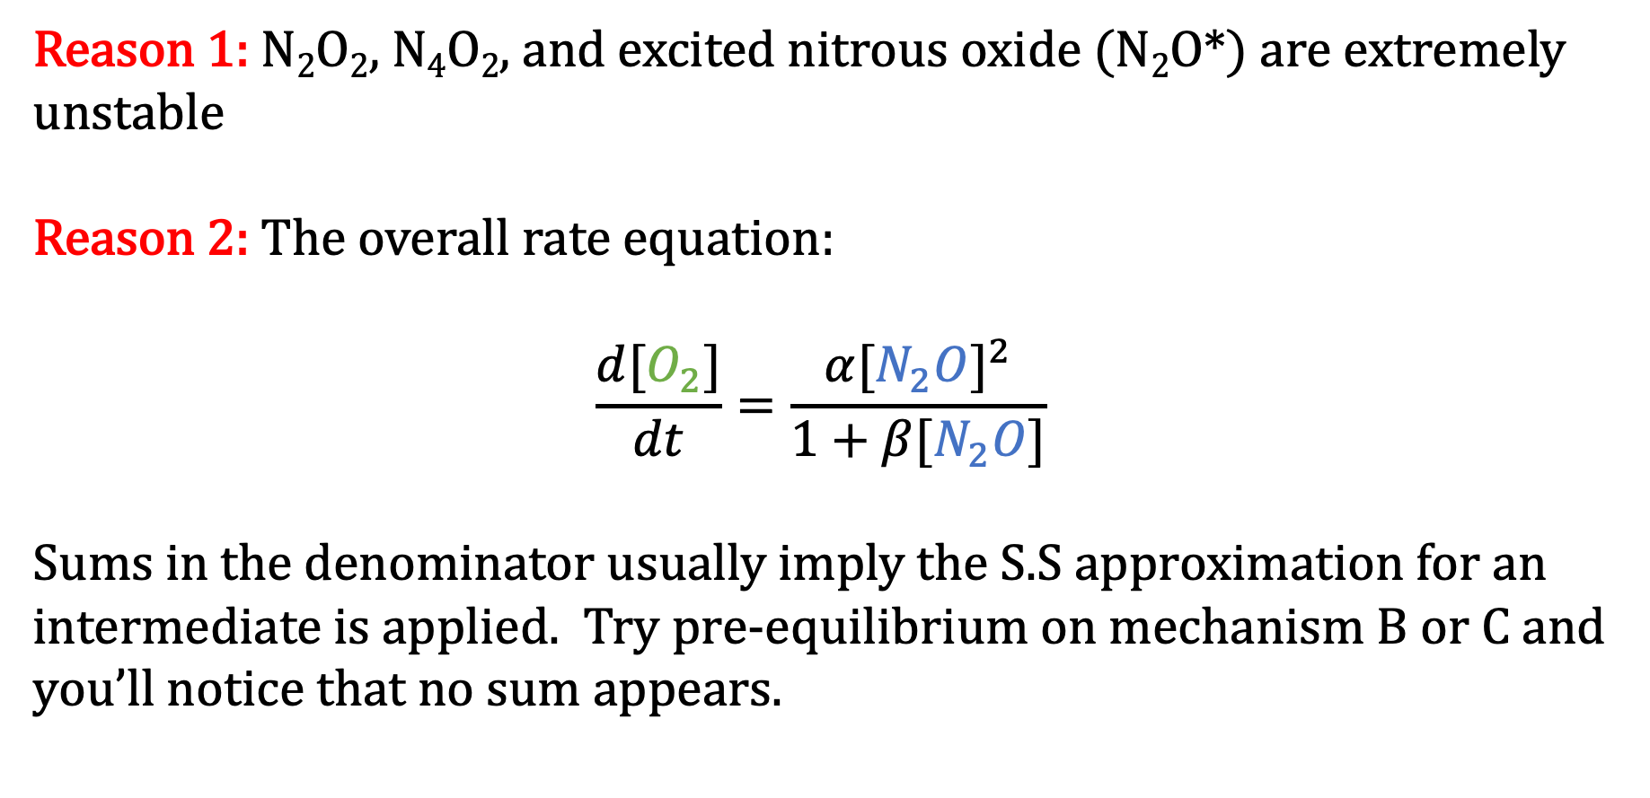
Why the S.S. Approximation?
Reason 1: N₂O₂, N₄O₂, and excited nitrous oxide (N₂O*) are extremely unstable
Reason 2: The overall rate equation:
$$\frac{d[O_{2}]}{dt}=\frac{α{[N_{2}O]}^{2}}{1+β[N_{2}O]}$$
Sums in the denominator usually imply the S.S approximation for an intermediate is applied. Try pre-equilibrium on mechanism B or C and you’ll notice that no sum appears.

Slide 8
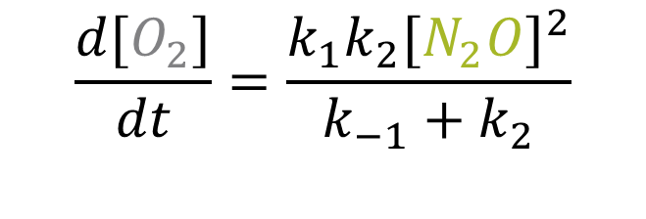
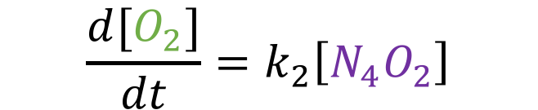
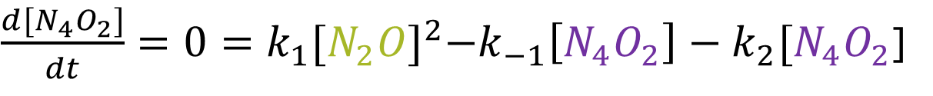
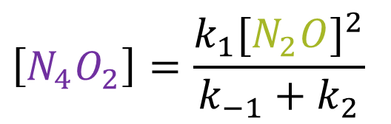
Mechanism C
Mechanism C
Step 3: Check if any intermediates
If yes, apply an approximation method
k₁
$$N_{2}O+N_{2}O⇄ N_{4}O_{2}$$
k ₋₁
$$\frac{d[O_{2}]}{dt}=k_{2}\left[N_{4}O_{2}\right]$$
$$N_{4}O_{2}\underset{→}{k_{2}} N_{2}+{N_{2}O}_{2}$$
$$N_{2}O_{2}\underset{→}{k_{3}} N_{2}+O_{2}$$
Apply steady state on N₄O₂
${\frac{d[N_{4}O_{2}]}{dt}=0=k}_{1}{[N_{2}O]}^{2}−k_{−1}\left[N_{4}O_{2}\right]−k_{2}[N_{4}O_{2}$]
$$\left[N_{4}O_{2}\right]=\frac{k_{1}{[N_{2}O]}^{2}}{k_{−1}+k_{2}}$$
$$\frac{d[O_{2}]}{dt}=\frac{k_{1}k_{2}{[N_{2}O]}^{2}}{k_{−1}+k_{2}}$$
Step 4: Check if any intermediates

Slide 9
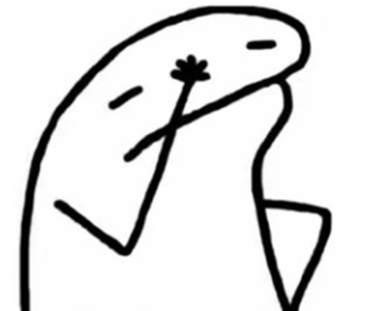
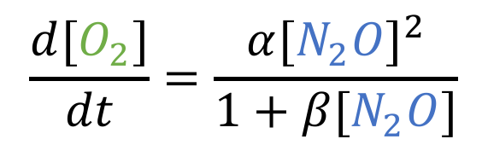

Mechanism C
Mechanism C
Step 5: Compare
k₁
$$N_{2}O+N_{2}O⇄ N_{4}O_{2}$$
Mechanism C rate equation
k ₋₁
$$N_{4}O_{2}\underset{→}{k_{2}} N_{2}+{N_{2}O}_{2}$$
$$\frac{d[O_{2}]}{dt}=\frac{k_{1}k_{2}{[N_{2}O]}^{2}}{k_{−1}+k_{2}}$$
$$N_{2}O_{2}\underset{→}{k_{3}} N_{2}+O_{2}$$
Given rate equation
$$\frac{d[O_{2}]}{dt}=\frac{α{[N_{2}O]}^{2}}{1+β[N_{2}O]}$$

Slide 10

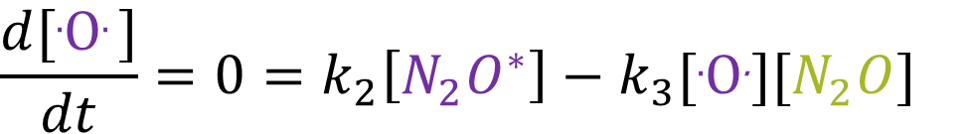
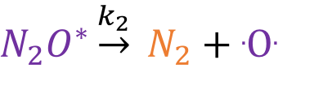
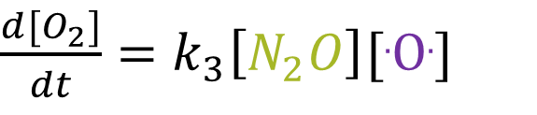

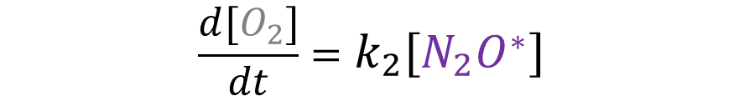
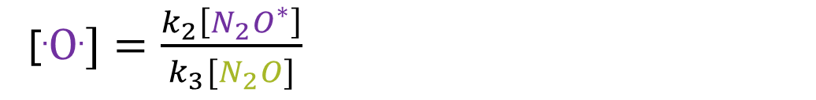
Mechanism B
Mechanism B
Step 1: Derive rate equation
k₁
$$N_{2}O+N_{2}O⇄ N_{2}O^{∗}+N_{2}O$$
k ₋₁
$\frac{d[O_{2}]}{dt}=k_{3}\left[N_{2}O\right][\text{.}\text{O}\text{.}$]
$N_{2}O^{∗}\underset{→}{k_{2}} N_{2}+$.O.
$${\text{.}\text{O}\text{.}+N}_{2}O \underset{→}{k_{3}} N_{2}+ O_{2}$$
Step 2: Check if any intermediates
If yes, apply an approximation method
Apply steady state on .O.
$$\frac{d[\text{.}\text{O}\text{. }]}{dt}=0=k_{2}\left[N_{2}O^{∗}\right]−k_{3}[\text{.}\text{O}\text{.}][N_{2}O]$$
[$\text{.}\text{O}\text{.}]=\frac{k_{2}\left[N_{2}O^{∗}\right]}{k_{3}[N_{2}O]}$
$$\frac{d[O_{2}]}{dt}=k_{2}\left[N_{2}O^{∗}\right]$$

Slide 11
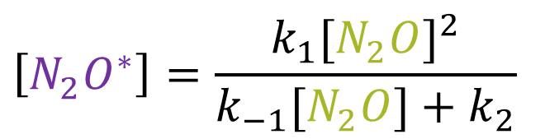

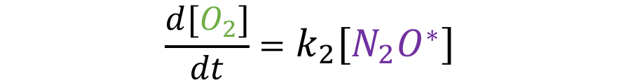
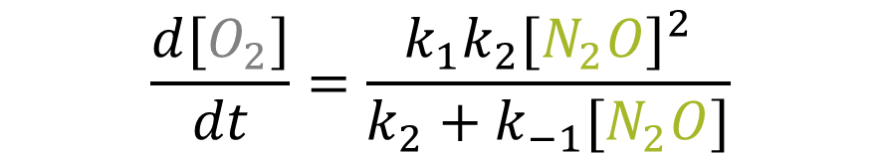
Mechanism B
Mechanism B
Step 3: Check if any intermediates
If yes, apply an approximation method
k₁
$$N_{2}O+N_{2}O⇄ N_{2}O^{∗}+N_{2}O$$
k ₋₁
$N_{2}O^{∗}\underset{→}{k_{2}} N_{2}+$.O.
$$\frac{d[O_{2}]}{dt}=k_{2}\left[N_{2}O^{∗}\right]$$
$${\text{.}\text{O}\text{.}+N}_{2}O \underset{→}{k_{3}} N_{2}+ O_{2}$$
Apply Steady State on $N_{2}O^{∗}$
$$\frac{d[N_{2}O^{∗}]}{dt}=0={k_{1}[N_{2}O]}^{2}−k_{−1}\left[N_{2}O^{∗}\right][N_{2}O]−k_{2}[N_{2}O^{∗}\text{]}$$
$$\left[N_{2}O^{∗}\right]=\frac{k_{1}{[N_{2}O]}^{2}}{k_{−1}[N_{2}O]+k_{2}}$$
$$\frac{d[O_{2}]}{dt}=\frac{k_{1}k_{2}{[N_{2}O]}^{2}}{k_{2}+k_{−1}[N_{2}O]}$$
Step 4: Check if any intermediates

Slide 12

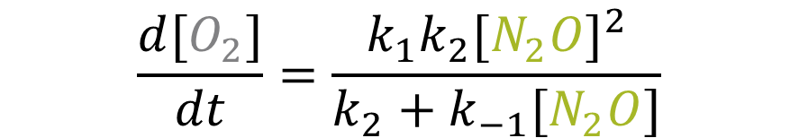

Mechanism B
Mechanism B
Step 5: Compare
k₁
$$N_{2}O+N_{2}O⇄ N_{2}O^{∗}+N_{2}O$$
Mechanism B rate equation
k ₋₁
$N_{2}O^{∗}\underset{→}{k_{2}} N_{2}+$.O.
$$\frac{d[O_{2}]}{dt}=\frac{k_{1}k_{2}{[N_{2}O]}^{2}}{{k_{2}+k}_{−1}[N_{2}O]}$$
$${\text{.}\text{O}\text{.}+N}_{2}O \underset{→}{k_{3}} N_{2}+ O_{2}$$
Given rate equation
$$\frac{d[O_{2}]}{dt}=\frac{α{[N_{2}O]}^{2}}{1+β[N_{2}O]}$$

Slide 13

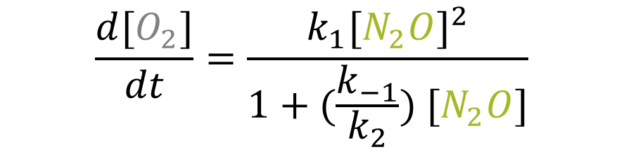
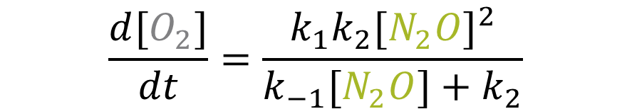

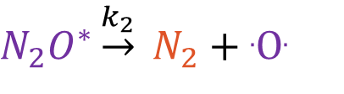
Think about it…
Mechanism B
Step 5: Compare
k₁
$$N_{2}O+N_{2}O⇄ N_{2}O^{∗}+N_{2}O$$
Mechanism B rate equation
k ₋₁
$N_{2}O^{∗}\underset{→}{k_{2}} N_{2}+$.O.
$$\frac{d[O_{2}]}{dt}=\frac{k_{1}k_{2}{[N_{2}O]}^{2}}{k_{−1}[N_{2}O]+k_{2}}$$
$${\text{.}\text{O}\text{.}+N}_{2}O\underset{→}{k_{3}} N_{2}+ O_{2}$$
$$\frac{d[O_{2}]}{dt}=\frac{k_{1}{[N_{2}O]}^{2}}{1+(\frac{k_{−1}}{k_{2}}) [N_{2}O]}$$
Given rate equation
$$\frac{d[O_{2}]}{dt}=\frac{α{[N_{2}O]}^{2}}{1+β[N_{2}O]}$$

Slide 14
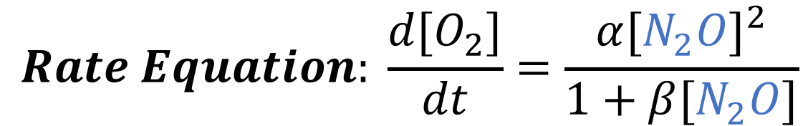
Could we have eliminated MORE choices?
$What does it mean that N_{2}O appears in the denominator$ of the rate equation?
$$Rate Equation: \frac{d[O_{2}]}{dt}=\frac{α{[N_{2}O]}^{2}}{1+β[N_{2}O]}$$
Conclusion: $N_{2}O$ opposes the overall reaction

Slide 15






Proposed Mechanisms
$$Overall Reaction: 2N_{2}O→2N_{2}+O_{2}$$
Mechanism B
Mechanism A
k₁
k₁
$$N_{2}O+N_{2}O⇄ N_{2}O^{∗}+N_{2}O$$
$N_{2}O⇄ N_{2}+$.O.
k ₋₁
k ₋₁
$N_{2}O^{∗}\underset{→}{k_{2}} N_{2}+$.O.
$$\text{.}\text{O}\text{.}+ N_{2}O\underset{→}{k_{2}} N_{2}+O_{2}$$
$${\text{.}\text{O}\text{.}+N}_{2}O\underset{→}{k_{3}} N_{2}+ O_{2}$$
Mechanism C
k₁
$$N_{2}O+N_{2}O⇄ N_{4}O_{2}$$
k ₋₁
$$N_{4}O_{2}\underset{→}{k_{2}} N_{2}+{N_{2}O}_{2}$$
$$N_{2}O_{2}\underset{→}{k_{3}} N_{2}+O_{2}$$

Slide 16
KEY TAKEAWAYS
General rules:
Intermediates cannot appear in the rate equation
Proposed reaction mechanism MUST be consistent with the overall reaction
How to approach these exercises:
Find Clues from the given rate equation
  Denominators → reversible
  Sum in the denominator → reversible and SS approximation
  Order of reactants in final rate law gives hints for the number of reactants needed
Write the rate law according to the mechanism given
Keep applying approximations to eliminate intermediates

